Slide 1
Surface plots

Slide 2
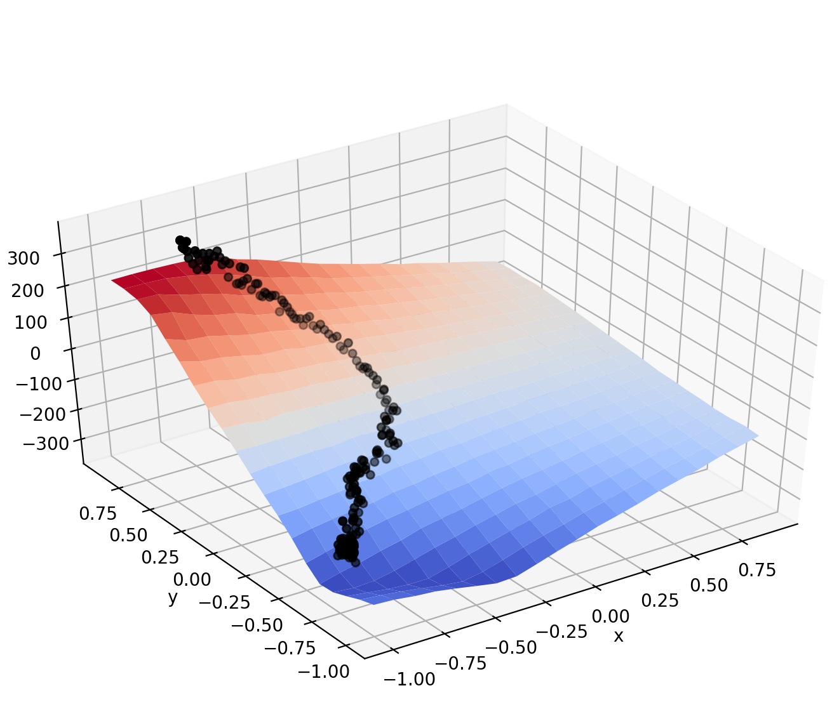
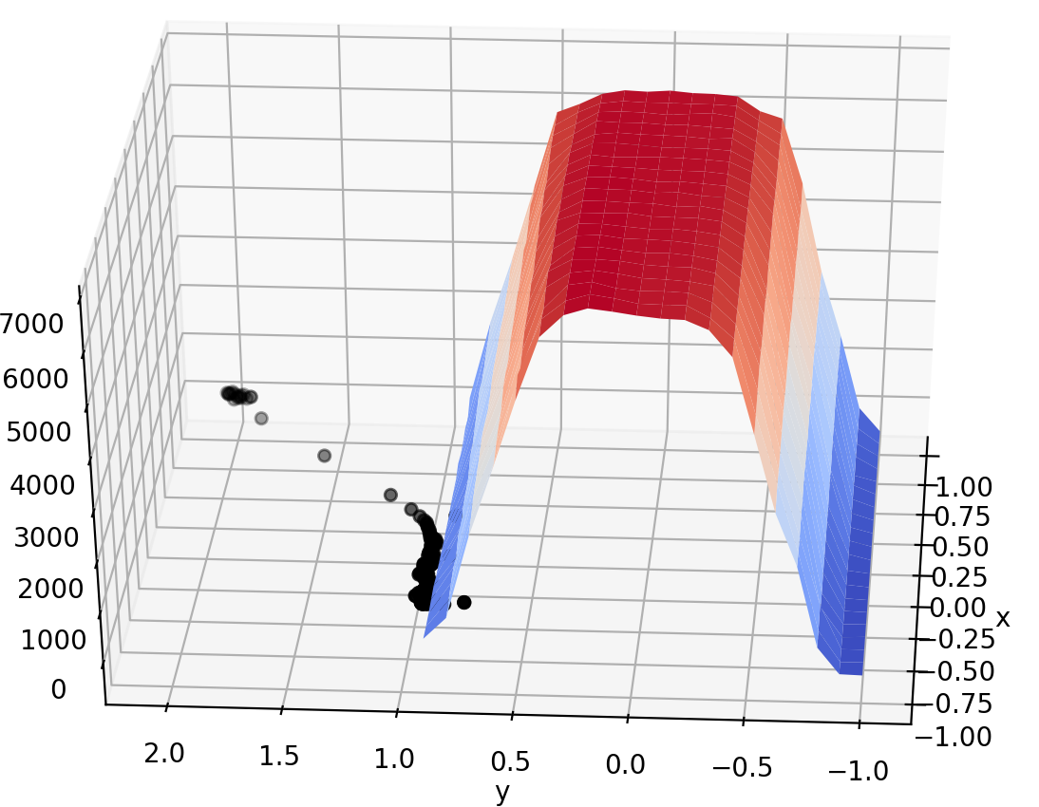

Slide 3




No barrier
With barrier
$$θ_{2}$$
$$θ_{2}$$
$$θ_{1}$$
$$θ_{1}$$

Slide 4



No barrier
With barrier
$$θ_{2}$$
$$θ_{2}$$
$$θ_{1}$$
$$θ_{1}$$

Slide 5
No barrier
With barrier
minimizer of task R
minimizer of task L
$$θ_{2}$$
$$θ_{2}$$
$$θ_{1}$$
$$θ_{1}$$

Slide 6



200
100
0
-100
-200
-300
0.75
0.50
0.25
-1.00
0.00
-0.75
-0.25
-0.50
$$θ_{2}$$
-0.25
-0.50
$$θ_{2}$$
0.00
-0.75
$$θ_{1}$$
0.25
$$θ_{1}$$
0.50
-1.00
0.75
-300
-200
-100
0
100
200

Slide 7


6000
5000
4000
3000
2000
1000
0
0.75
0.50
0.25
-1.00
0.00
-0.75
-0.50
-0.25
$$θ_{2}$$
-0.25
0.00
-0.50
$$θ_{1}$$
0.25
-0.75
0.50
0.75
-1.00
0
1000
2000
3000
4000
5000
6000

Slide 8






Without barrier
With barrier
200
6000
100
5000
0
4000
-100
3000
2000
-200
1000
-300
0
0.50
0.75
0.75
0.25
0.50
-1.00
0.00
0.25
-0.75
-0.25
-1.00
0.00
-0.50
$$θ_{2}$$
-0.75
-0.25
-0.25
-0.50
$$θ_{2}$$
-0.50
-0.50
$$θ_{2}$$
0.00
-0.75
-0.25
$$θ_{1}$$
0.25
0.00
-0.75
$$θ_{1}$$
0.50
0.75
-1.00
$$θ_{1}$$
0.25
0.50
0.75
-1.00
-300
-200
-100
0
100
200
0
1000
2000
3000
4000
5000
6000

Slide 9
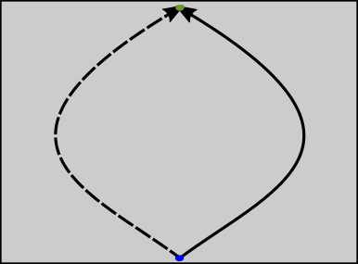
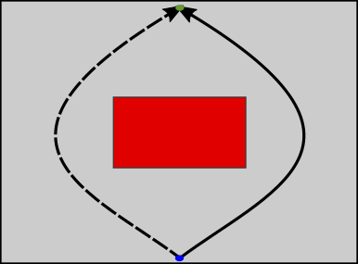


200
6000
100
5000
4000
0
3000
-100
2000
-200
1000
-300
0
0.75
0.50
0.75
0.50
0.25
0.25
0.00
-1.00
-0.75
0.00
-1.00
-0.75
-0.25
-0.25
$$θ_{2}$$
-0.50
$$θ_{2}$$
-0.50
-0.25
-0.50
$$θ_{2}$$
-0.25
-0.50
0.00
-0.75
0.00
-0.75
$$θ_{1}$$
0.25
$$θ_{1}$$
0.25
$$θ_{1}$$
0.50
0.75
-1.00
0.50
0.75
-1.00

Slide 10
Theory figs

Slide 11
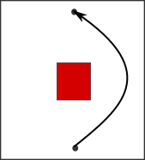
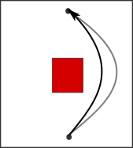
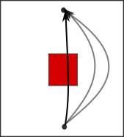










$$θ_{1}←θ_{s}^{∗}$$
$$θ_{2}$$
$$θ_{k}$$
$$θ$$
$$∇_{θ_{1}}η_{π}:$$
$$∇_{θ_{2}}η_{π}:$$
$$⋯$$
$$∇_{θ_{k−1}}η_{π}:$$
$$τ$$
$$⋯$$

Slide 12









$$θ$$
$$θ_{1}←θ_{s}^{∗}$$
$$θ_{2}$$
$$⋯$$
$$θ_{k}$$
$$τ$$
$$⋯$$
$$∇_{θ}η_{π}$$
$$⋯$$

Slide 13




Lemma 1
Lemma 2
$$θ$$
$$θ_{1}←θ_{s}^{∗}$$
$$θ_{2}$$
$$⋯$$
$$θ_{k}$$
$$τ$$
$$⋯$$
$${−∇}_{θ}η_{π}$$
$$⋯$$

