Slide 1
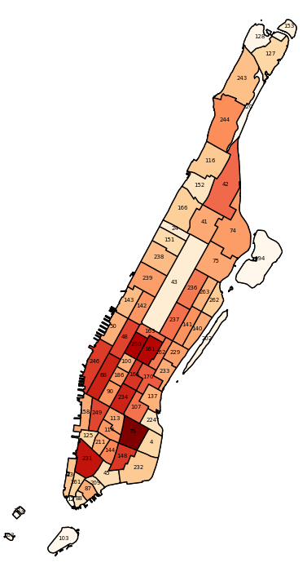
1 | 2
3
4 | 5
6 | 7
8 | 9 | 10 | 11
12 | 13 | 14
15 |  | 16
17 | 18 | 19
20 | 21 | 22
23 | 24 | 25
 | 26 | 27
 | 28
29

