Slide 1
Apache Airflow and Workflow Management in Predicting Stocks
MET CS777 – Term Paper
Chuong Nguyen – Zhen Cao

Slide 2
Presentation Outline
Introduction to Airflow
What is Airflow
Airflow Directed Acyclic Graphs (DAG)
Airflow UI
Demo: Stock prediction with Airflow
Strategy
DAG
Set up the environment
Run the demo

Slide 3
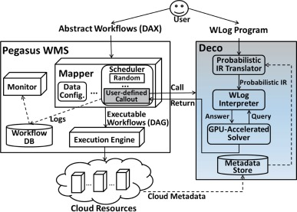
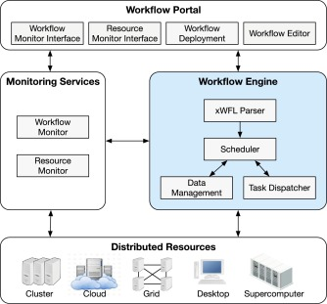
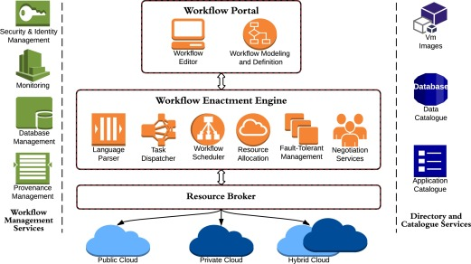
Workflow Management Systems
(Buyya & Rodriguez, 2017)
(Poola, Salehi, Ramamohanarao, & Buyya, 2017)
(Ibrahim, He, & Zhou, 2016)
Notes:
Large and Complex data analysis project involve large and complex workflow. Imagine all the assignments in this course that we have to collect the data ourselves. We have to make request from API, repeat the actions multiple times. Transform, clean, reformat before save into local storage or load onto the cloud, Amazon S3 bucket. Any mistake in between, even if it’s one parameter, one type, or even just a connection error could ruin the whole 3-4 hours of work. Thus, we need a workflow management system.

Slide 4
What is Apache Airflow?
Airflow is open-source
2014-2016: Airbnb
2016-present: Apache Software Foundation
Airflow is a batch workflow orchestration platform
Finite batch workflow
Python framework allows building workflow and connecting any technology

Slide 5
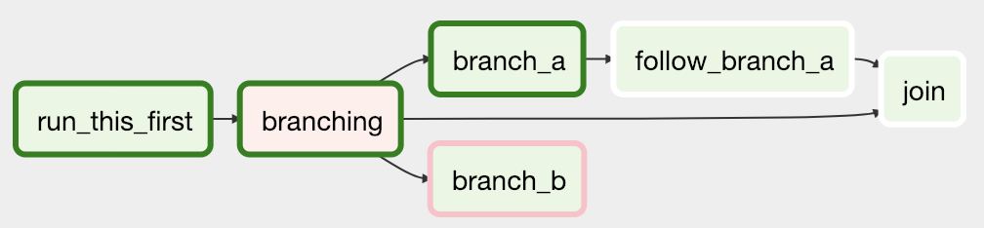
Airflow Directed Acyclic Graphs (DAG)
Image source: (Airflow, 2024)
Notes:
DAG is the core concept – collecting Tasks together, organized with dependencies and relationships to define the order how they run

Slide 6
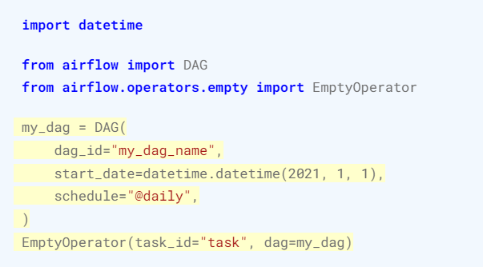
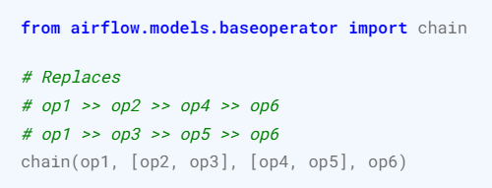
Airflow Directed Acyclic Graphs (DAG)
Image source: (Airflow, 2024)
Notes:
This is how to implement a Task in DAG. There are 3 ways to define one, this is using a standard constructor
This is how to declare the dependencies and the order of how tasks are run in the DAG. You can do either way

Slide 7
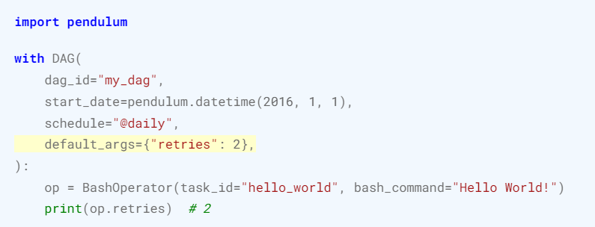
Airflow Directed Acyclic Graphs (DAG)
Image source: (Airflow, 2024)
Notes:
To run DAG: either trigger manually in the UI or schedule it to run -> recurrence
There should be an end_date here as DAG is not design for infinite run -> not a streamline platform, need troubleshoot.

Slide 8
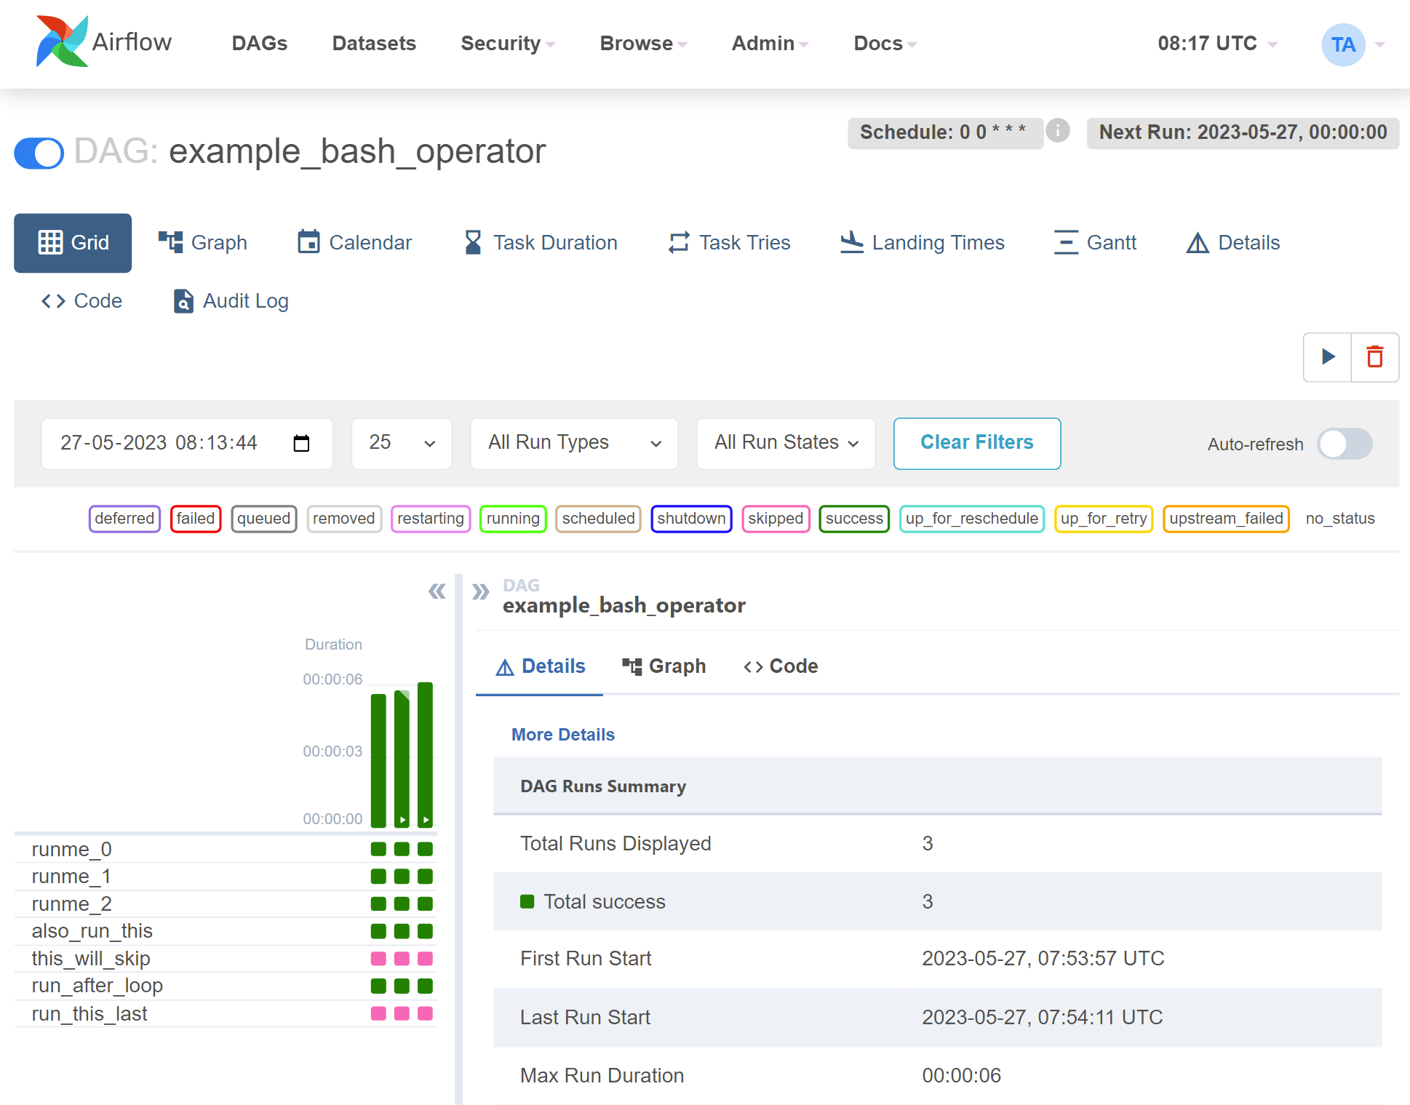
Airflow User Interface
Notes:
Grid view

Slide 9
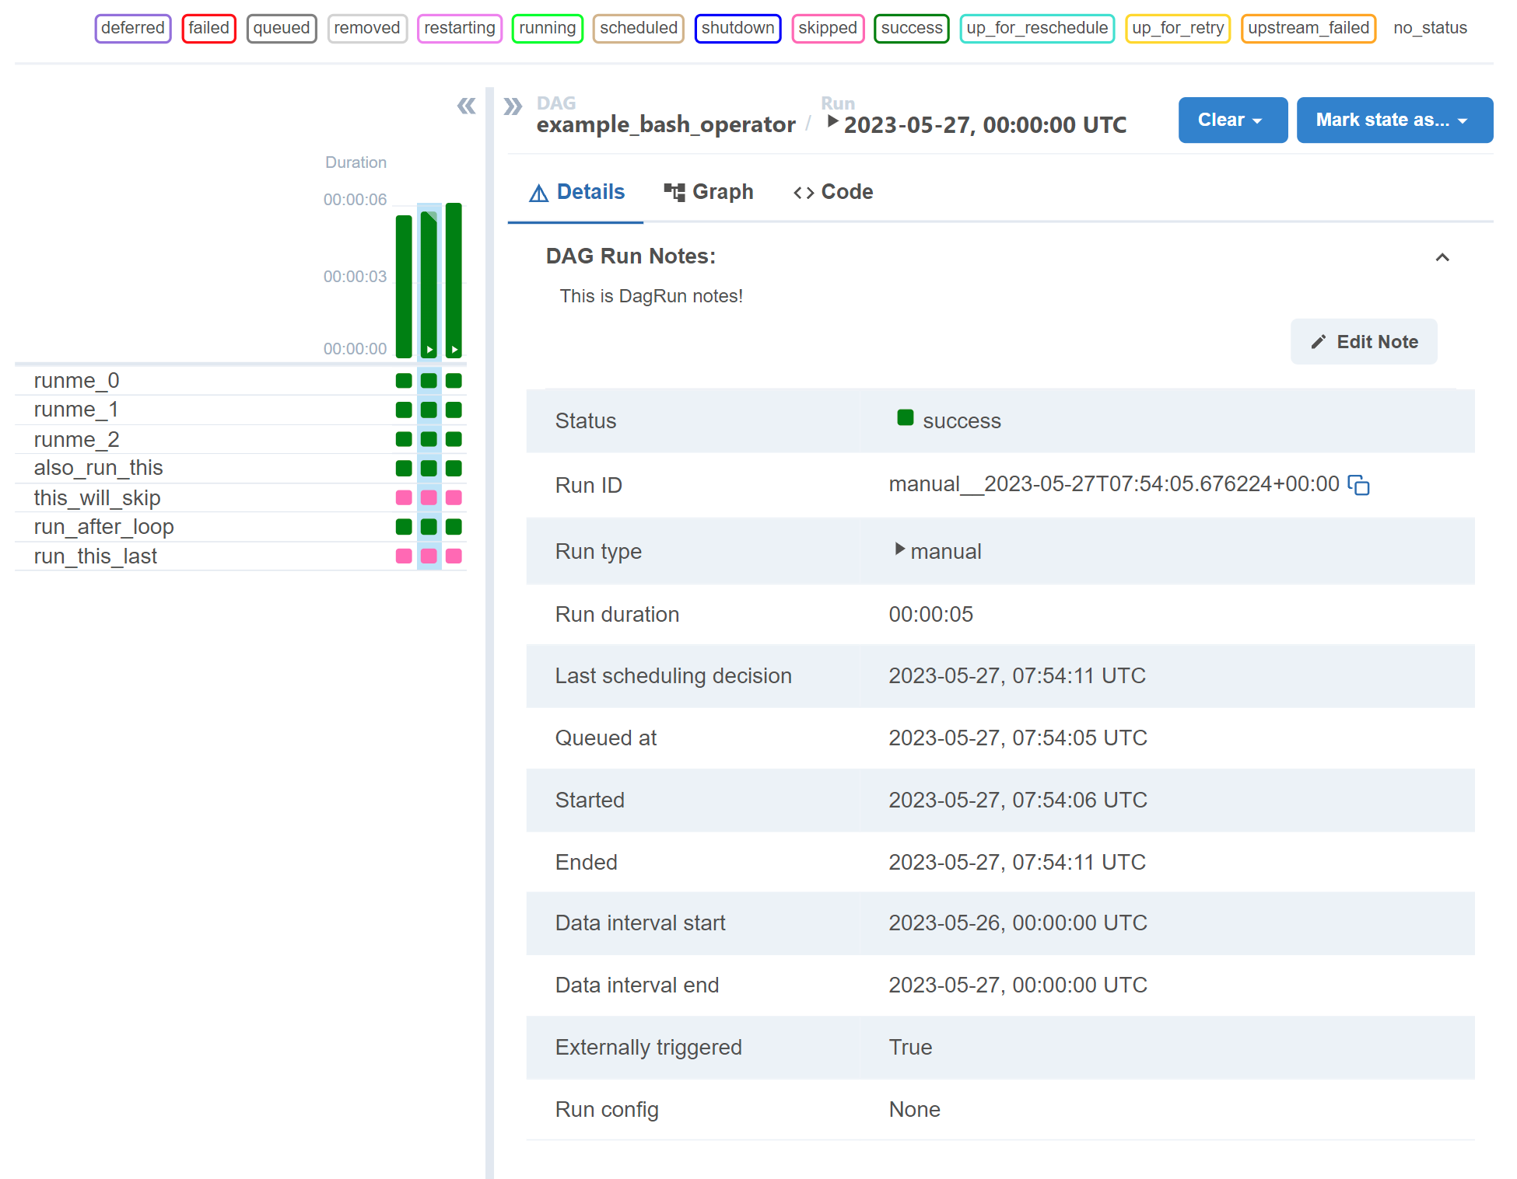
Airflow User Interface
Image source: (Airflow, 2024)
Notes:
Each column represents one DAG run. The top bar chart shows how long in total it takes to run the whole set of tasks
Multiple statuses indicate the stage of the task

Slide 10
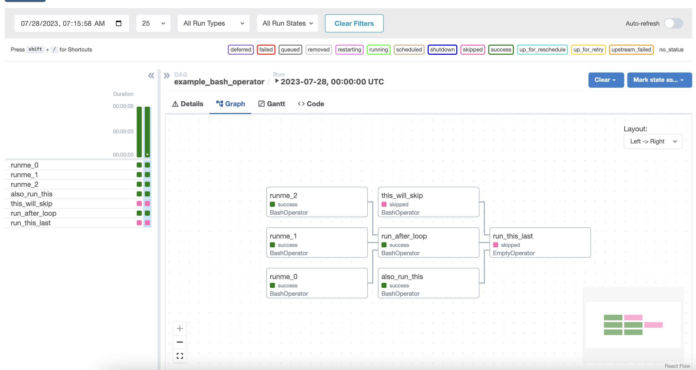
Airflow User Interface
Image source: (Airflow, 2024)
Notes:
A more comprehensive view is Graph view. This visualize all the dependencies in your DAG and the current statuses for the selected run

Slide 11


Demo: Stock prediction with Airflow
Strategy: Day Trading
Model
March
Open Price
Close Price

Slide 12

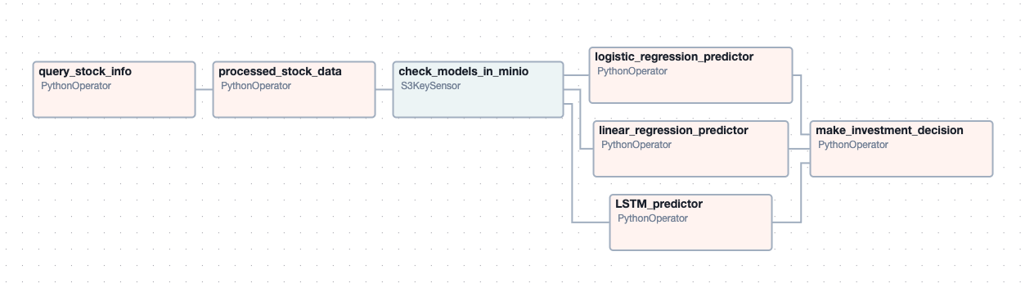

DAG for Demo
Minio
Linear Regression
Logistic Regression
LSTM
Pretrained models:
Postgres

Slide 13
Set up the environment
Python
Airflow
PostgreSQL
Minio

Slide 14


