Slide 1
CGRA Virtualization
Kalhan Koul

Slide 2
Outline
SoC Review
Quick Overview
Spatial Virtualization
Temporal Virtualization

Slide 3
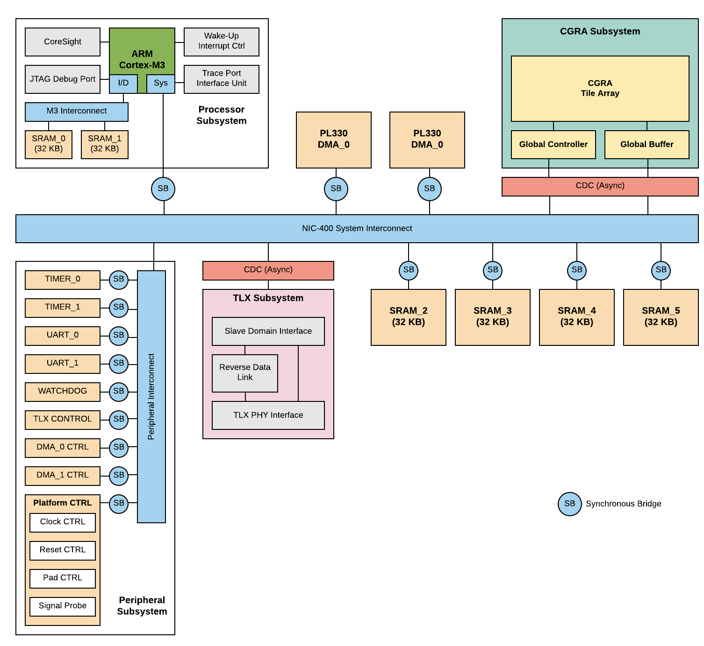
Amber architecture
Processor Subsystem
- ARM Cortex-M3
- Runs software to control CGRA
CGRA Subsystem
- Global Buffer
- Global Controller
- Tile Array (PE, MEM)
- Hardware acceleration occurs
DMA Subsystem
- Two DMAs
Peripheral Subsystem
TLX Subsystem

Slide 4
SoC architecture
Processor Subsystem
- ARM Cortex-M3
- Runs software to control CGRA
CGRA Subsystem
- Global Buffer
- Global Controller
- Tile Array (PE, MEM)
- Hardware acceleration occurs
DMA Subsystem
- Two DMAs
Peripheral Subsystem
TLX Subsystem

Slide 5
SoC architecture
Processor Subsystem
- ARM Cortex-M3
- Runs software to control CGRA
CGRA Subsystem
- Global Buffer
- Global Controller
- Tile Array (PE, MEM)
- Hardware acceleration occurs
DMA Subsystem
- Two DMAs
Peripheral Subsystem
TLX Subsystem

Slide 6
CGRA Architecture

Slide 7
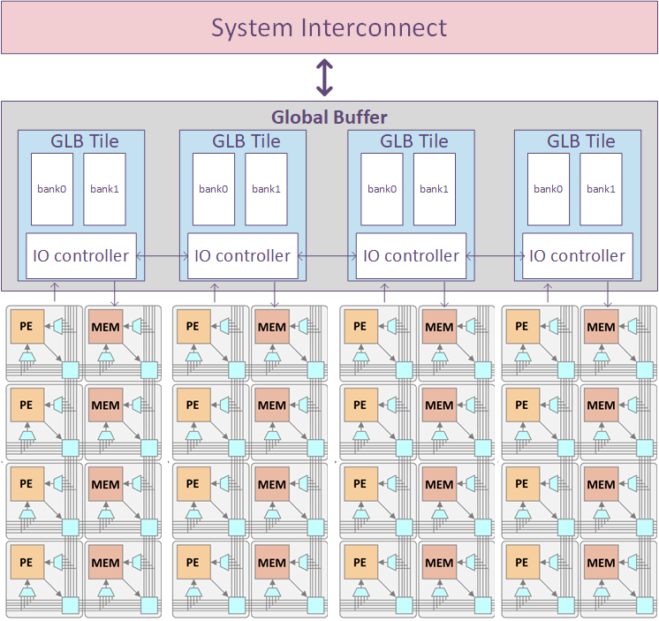
CGRA architecture
Global Buffer
- Communicate with the SoC system with AXI4 and AXI4-Lite interface
- 1D array of GLB Tiles with two banks
- I/O controller streams data into/out of CGRA
- It streams the bitstream into CGRA
CGRA
- Island-style mesh network with PE nodes and MEM nodes
- Divided into groups of columns

Slide 8
The basic control flow to run an application on CGRA
1. DMA streams bitstream to GLB
2. DMA streams to input data GLB
3. M3 configures I/O controller
4. M3 sends config_start signal I/O controller
5. M3 sends kernel_start signal to I/O controller
6. CGRA array runs a kernel
7. I/O controller sends an interrupt signal to M3
8. DMA streams output data out of GLB
data
control
comp.
data

Slide 9
The basic control flow to run an application on CGRA
1. DMA streams input data to GLB
2. DMA streams bitstream to GLB
3. M3 configures I/O controller
4. M3 sends config_start signal I/O controller
5. M3 sends kernel_start signal to I/O controller
6. CGRA array runs a kernel
7. I/O controller sends an interrupt signal to M3
8. DMA streams output data out of GLB
data
control
comp.
data

Slide 10
The basic control flow to run an application on CGRA
1. DMA streams input data to GLB
2. DMA streams bitstream to GLB
3. M3 configures I/O controller
4. M3 sends config_start signal I/O controller
5. M3 sends kernel_start signal to I/O controller
6. CGRA array runs a kernel
7. I/O controller sends an interrupt signal to M3
8. DMA streams output data out of GLB
data
control
comp.
data

Slide 11
The basic control flow to run an application on CGRA
1. DMA streams input data to GLB
2. DMA streams bitstream to GLB
3. M3 configures I/O controller
4. M3 sends config_start signal I/O controller
5. M3 sends kernel_start signal to I/O controller
6. CGRA array runs a kernel
7. I/O controller sends an interrupt signal to M3
8. DMA streams output data out of GLB
data
control
comp.
data

Slide 12
The basic control flow to run an application on CGRA
1. DMA streams input data to GLB
2. DMA streams bitstream to GLB
3. M3 configures I/O controller
4. M3 sends config_start signal I/O controller
5. M3 sends kernel_start signal to I/O controller
6. CGRA array runs a kernel
7. I/O controller sends an interrupt signal to M3
8. DMA streams output data out of GLB
data
control
comp.
data

Slide 13
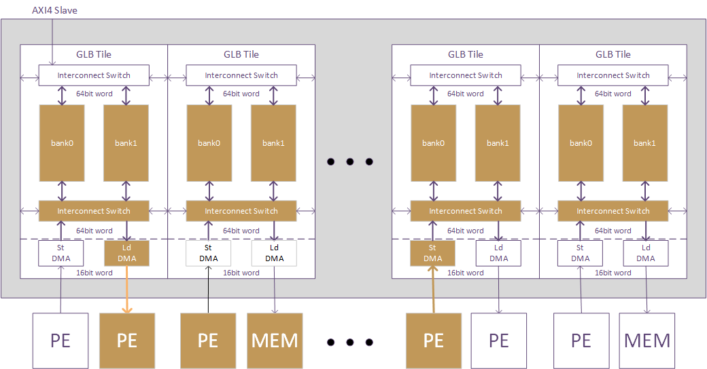
Flexible buffer allocation
input
output
Case1 (Flexible GLB Allocation)
- One kernel
- Input buffer (4 banks)
- Output buffer (4 banks)

Slide 14
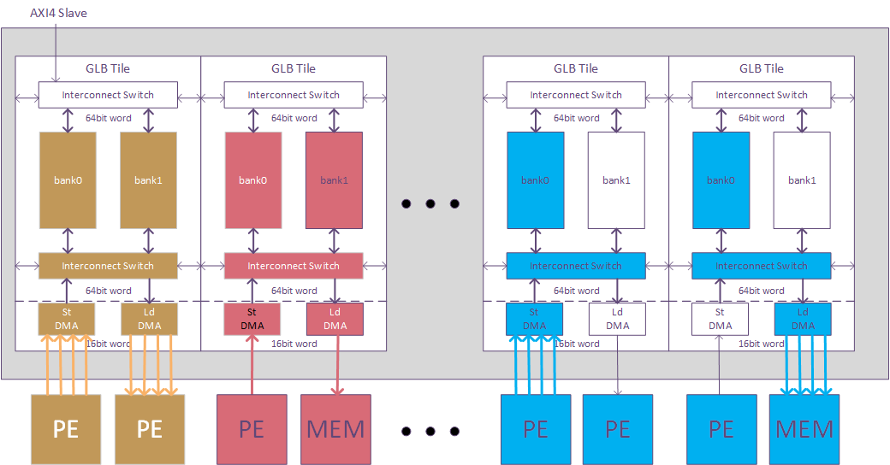
Multiple kernels in parallel
kernel1
kernel2
kernel3
Case2 (Multiple Kernels in Parallel)
- Three kernels
- Different kernels run in different regions of the CGRA
- Independent control of each kernel (start, interrupt)

Slide 15
End-to-End Applications

Slide 16
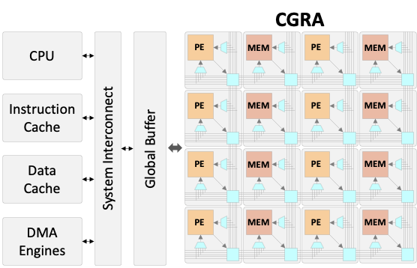
Conducting an Application with the M3 Core
Initialize System
Enable UART, DMA engines, etc.
Select Clocks, Interrupts, etc.
Bring in Configuration and Input Data
Use DMA engines to move data (bitstream, images, etc.)
From DRAM/SRAMs to Global Buffer
Configure Global Buffer and Run Kernel
Use Parallel Configuration to send the bitstream to the CGRA
Stream in input data and stream out output data
Repeat Step 2 and 3 per Application
Finish Application
DMA Output Data to DRAM
Send done information to Host Processor

Slide 17
Conducting an Application with the M3 Core
Initialize System
Enable UART, DMA engines, etc.
Select Clocks, Interrupts, etc.
Bring in Configuration and Input Data
Use DMA engines to move data (bitstream, images, etc.)
From DRAM/SRAMs to Global Buffer
Configure Global Buffer and Run Kernel
Use Parallel Configuration to send the bitstream to the CGRA
Stream in input data and stream out output data
Repeat Step 2 and 3 per Application
Finish Application
DMA Output Data to DRAM
Send done information to Host Processor
​Off Chip: Bitstream, Input Data

Slide 18
Conducting an Application with the M3 Core
Initialize System
Enable UART, DMA engines, etc.
Select Clocks, Interrupts, etc.
Bring in Configuration and Input Data
Use DMA engines to move data (bitstream, images, etc.)
From DRAM/SRAMs to Global Buffer
Configure Global Buffer and Run Kernel
Use Parallel Configuration to send the bitstream to the CGRA
Stream in input data and stream out output data
Repeat Step 2 and 3 per Application
Finish Application
DMA Output Data to DRAM
Send done information to Host Processor
​Bitstream, Input Data

Slide 19
Conducting an Application with the M3 Core
Initialize System
Enable UART, DMA engines, etc.
Select Clocks, Interrupts, etc.
Bring in Configuration and Input Data
Use DMA engines to move data (bitstream, images, etc.)
From DRAM/SRAMs to Global Buffer
Configure Global Buffer and Run Kernel
Use Parallel Configuration to send the bitstream to the CGRA
Stream in input data and stream out output data
Repeat Step 2 and 3 per Application
Finish Application
DMA Output Data to DRAM
Send done information to Host Processor
Configure CGRA to Layer 1
Stream Input/Output
Configure CGRA to Layer 2
Stream Input/Output
…
Configure CGRA to FC Layer
Stream Input/Output

Slide 20
Conducting an Application with the M3 Core
Initialize System
Enable UART, DMA engines, etc.
Select Clocks, Interrupts, etc.
Bring in Configuration and Input Data
Use DMA engines to move data (bitstream, images, etc.)
From DRAM/SRAMs to Global Buffer
Configure Global Buffer and Run Kernel
Use Parallel Configuration to send the bitstream to the CGRA
Stream in input data and stream out output data
Repeat Step 2 and 3 per Application
Finish Application
DMA Output Data to DRAM
Send done information to Host Processor
​Output Data

Slide 21





Motivation for Virtualization
Two users access server for application acceleration
Most domain specific accelerators will schedule one after the other with high PE utilization
CGRA gives us opportunity to do both in parallel, to achieve high PE utilization
Two sensors need immediate processing
CGRA gives us opportunity to do both in parallel on the same accelerator, simplifying SoC architecture and scheduling management

Slide 22
Partitioning Algorithm

Slide 23
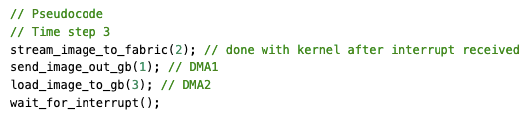
Temporal Scheduling
The M3 and Global Buffer pairing allow us to efficiently schedule applications
For example: a batch of images with the same kernel
Cycles to put an image in GB ≈ cycles to stream an image to the fabric
Can Send Output 1 and Load Image 3 at same time with 2 DMAs
Load Image 1
Stream Image 1
Send Output 1
Load Image 2
Stream Image 2
Send Output 2
Load Image 3
Stream Image 3
Send Output 3

Slide 24
Place PE Utilization stream slide from DARPA

Slide 25

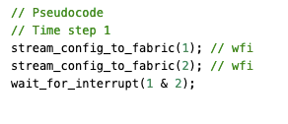
Spatial Scheduling
With the M3 we can place more than one kernel onto the fabric at once
For example: a conv3x3 and harris configured to two halves of the CGRA
With 2 DMAs we can run both applications independently
Conv 3x3
Harris
Load Image 1
Stream Image 1
Send Output 1
Stream Bitstream 1
Load Image 2
Stream Image 2
Send Output 2
Stream Bitstream 2

Slide 26
Place Demosaic + Conv3x3 Slides from DARPA

Slide 27
Dynamic Scheduling Slide

Slide 28
Autoscheduling Slide

Slide 29
Virtualization Summary
Variety of scheduling decisions due to the complexity of our system (DMA, GLB, CGRA, etc.)
Tiling at DRAM level
Tiling at Global Buffer level
Overlapping of Data Movement, Kernels, Configuration etc.
Currently most of our applications are scheduled statically, but ...
Autoscheduling is the next step

