Slide 1
Physical Design Flow for Garnet SoC
Alex Carsello

Slide 2
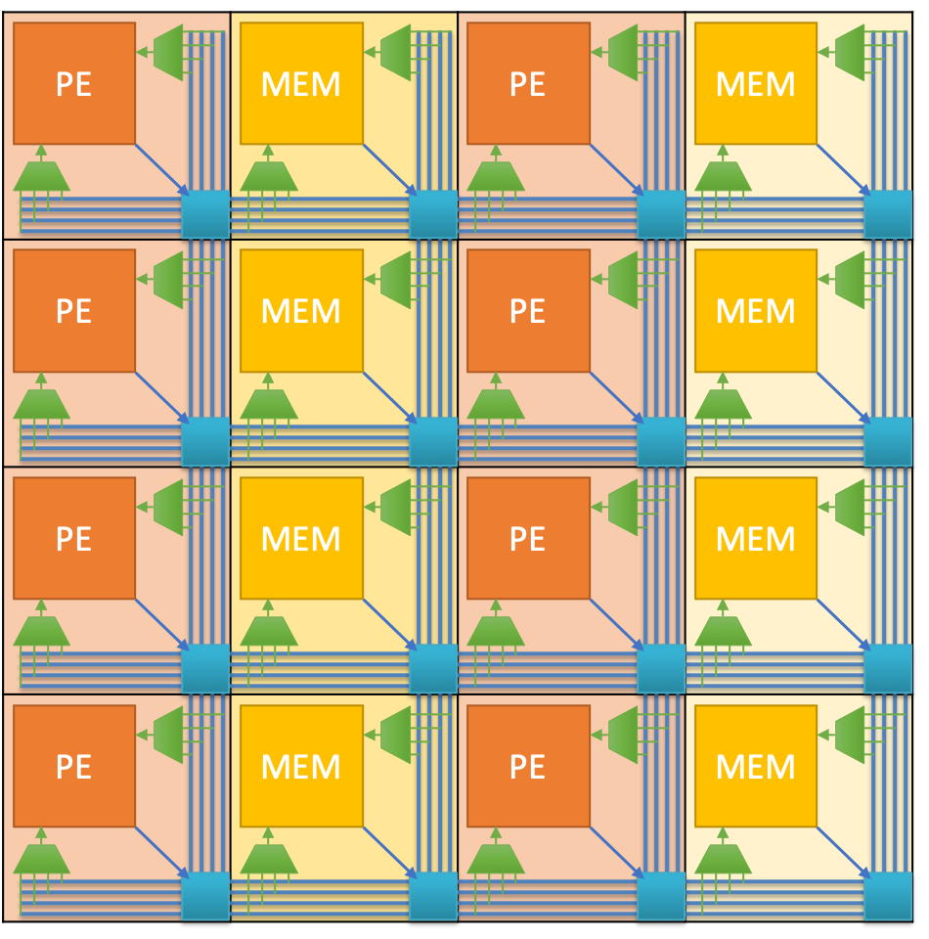
What we’re taping out
Global Buffer SRAM Array
32x16 array of CGRA tiles (possibly larger)
4 MB of SRAMs (256 individual macros)
Analog block
Processor subsystem
Cortex M3
A few SRAMs
Not large (1-2% of total chip area)
Analog block
SoC processor subsystem

Slide 3
Current Physical Flow
Hierarchical physical design flow
Full P&R flow for each tile type (PE and Memory)
Then essentially do everything else at the top-level
Manually place all SRAM macro arrays using flexible/parameterized procedures
Manually abut the tiles
No interconnect routing required because adjacent tiles are connected by abutment
Create soft regions for Global buffer, CGRA, and processor subsystem logic
Tool places and routes all cells for global buffer control, processor subsystem,

Slide 4
Complexities
Creating abutted CGRA tiles
Need to ensure that connecting pins on adjacent tiles align exactly
All kinds of grids
Routing grids for tile pin layers (M3-M6)
FinFET grid
Standard cell row grid
Need to place macros such that all pins end up on the preferred routing tracks for their layers
Ensure power stripes inside tiles line up with top-level power stripes, so that power grid at top-level is uniform across the chip

Slide 5
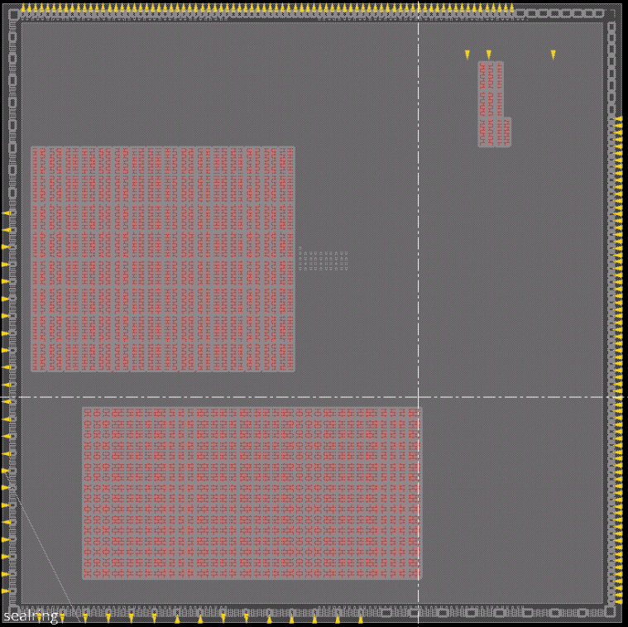
Preliminary floorplan with pads, CGRA tiles, and memory macros placed
Analog block will be placed in top center
Pad placement still needs to be optimized with package in mind to make RDL routing easier/possible
We may be able to make the tile array and global buffer SRAM array larger
Changes I’ve already made to this (sorry I couldn’t update the screenshot on the plane):
Moved ARM processor subsystem to bottom right corner Global buffer SRAMs straddle alignment cells
Alignment cells
ARM processor subsystem
Global Buffer SRAMs
CGRA

Slide 6
Improvements made to the flow
QoR improvements:
Targeting much higher clk frequency and area efficiency
Trying to make it such that design changes only need to be made in one place using the following techniques:
Introspecting the design rather than using hard-coded values for different physical design parameters
Everything technology-dependent is a parameter (and all of these parameters are in one place in the physical design flow scripts)
(Almost) everything design-dependent is calculated by introspecting the design and taking into account a small set of parameters/constraints: tile sizes, power stripe pitches, tile grid dimensions

Slide 7
Problems that still need to be addressed
DRCs
Around 20K DRCs at top-level right now (not as scary as it sounds! But still needs to be addressed. Many of them appear to have the same root cause).
Timing Closure
Individual tiles are meeting timing at just above 400 MHz, but top level P&R is running with extremely lax constraints to reduce P&R runtime as I debug/finish the PD flow
Global signal buffer insertion
Need to calculate proper buffer sizes for all global signals and insert at tile-level. Can’t do this at the top because of the abutted tile floorplan.

Slide 8
Tapeout Checklist
https://github.com/StanfordAHA/garnet/blob/master/docs/tapeout_checklist.md

Slide 9
Physical Design Checklist
Timing (source: Primetime, Innovus)
Primetime hold margin across all scenarios >= xx ns
Max clock frequency (TC 0.8 V) > xx MHz, (TC 1.2 V) > xx MHz
JTAG clock always > xx MHz
Report all static timing analysis overrides (false paths, async boundaries, multicycle paths), make sure they are okay
Static timing overrides in gate level simulation verified
Primetime infers clock gating checks
Clock tree report - reasonable tree depth, insertion delay, skew

Slide 10
Physical Design Checklist
Physical verification (source: Calibre)
DRC (primary, antenna, wirebond) - no errors
ERC - no errors
LVS - correct
All of the above pass after dummy fill

Slide 11
Physical Design Checklist
Power domain related checks (source: Innovus)
PG nets verified
Clock tree multi-voltage safety
check_mv_design (equivalent Innovus command) clean
Decoupling
Worst power + group IR drop in Primerail report (static) < xx mV
Other sanity checks
Bond pad labels match pinout
All memory stubs replaced by SRAM macros

Slide 12
Functional Verification Checklist
RTL functional verification (source: pytest log)
CGRA + GB unit test suite - RTL vs functional model passes
CGRA + GB integration tests using apps (with SoC stub)
SoC unit test suite
SoC integration tests (with CGRA + GB stub)
CGRA + GB + SoC integration tests (with FPGA stub)
Gate level functional verification
All of the above pass at gate level with no timing violations
Power domain aware RTL/gate level simulation/formal checking
Formal verification
RTL vs gates
Configured CGRA vs CoreIR DAG?
Have to make sure we have enough unit and integration test coverage
-- use testing dashboard

