Slide 1
Next-Gen CGRA Architecture

Slide 2
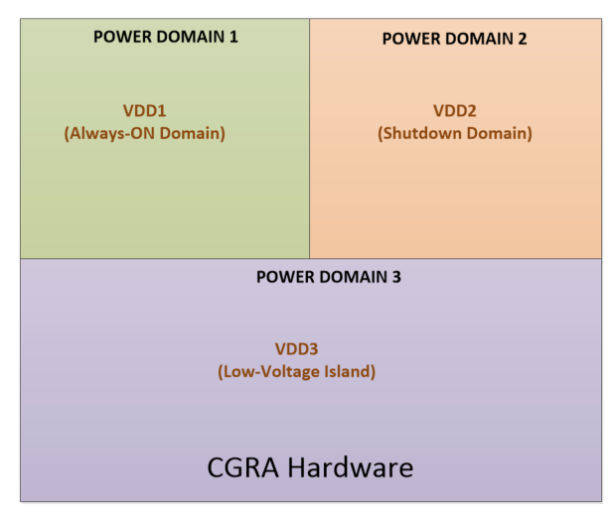
System Architecture (1/2)
Clock domain based CGRA
Allow different part of the chips to operate at different frequencies
Power domain based CGRA
Multiple power domains on the chip – Low-voltage, Always-on, Shut-down
DVFS (Dynamic voltage frequency scaling) support
Variable operating voltage & frequency. DVFS can be used for non-timing critical applications
Power Domain based CGRA

Slide 3
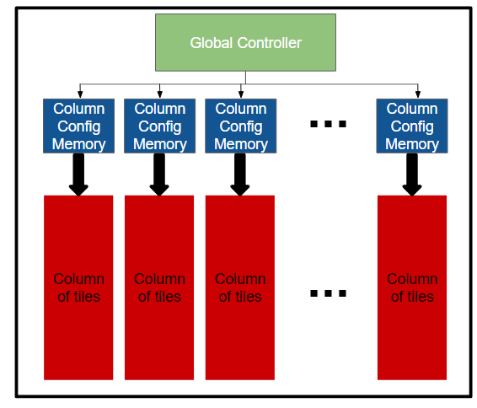
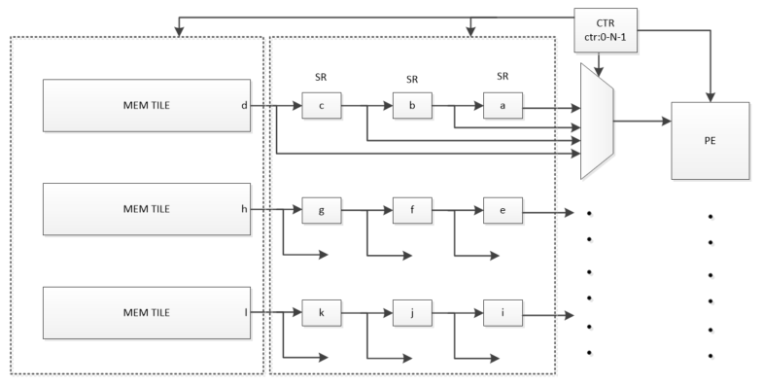
System Architecture (2/2)
Fast reconfiguration/Run-time reconfigurability
Configuration currently takes ~100 JTAG clock cycles per configuration register
Ability to swap out applications quickly
E.g. mapping different convolution layers in CNN
CGRA Hardware Virtualization
Resource re-use when application size is bigger than available hardware resources
Multi-rate support for different applications
State machine based design
Representative fast-reconfiguration architecture
Resource sharing in CGRA

Slide 4
PE Architecture
Analyze the target applications to find frequently occurring common patterns/compute kernels
Improve compute density for PEs
Current version uses 2 input-PE
3-input based PE design
Absolute difference addition, FMA
Support new operations – division, modulo, saturation etc.
Super-PE architecture
Multi-precision handling
Virtualization
Homogeneous vs Heterogeneous PE tiles
All PEs do not need to support all the functionalities – Improve compute density E.g. LUTs, register files
PE Clustering

Slide 5
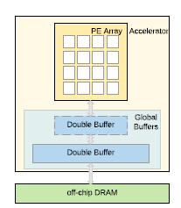
Memory Architecture
Dual ported memory
Flexible and simpler design compared to single-ported SRAM and additional logic
Enable irregular access patterns
Double buffering
Supply operands out of one buffer while performing LD/ST operations on the other
Allow hardware to overlap computation and memory loads
Memory hierarchies
Optimize data locality
DMA Engine
Mem-tile to Mem-tile copying or moving of data within memory
Architecture template with double buffer
& memory hierarchy

Slide 6
CGRA Connectivity/Routing
Explore dataflows/customized connectivity patterns for a class of applications
Interconnect architecture exploration
Trade-offs between flexibility, fanouts and different topologies
Routing Profile Extraction
List of key switchbox parameters needed for P&R to better evaluate metrics like IO utilization, wirelength length stats, routing density etc.

