Slide 1
CGRA Architecture
PTILE
MTILE
PTILE
J
T
A
G
Global Control
Host
CGRA
PTILE
MTILE
PTILE
16 bit bus
1 bit bus
Switch box
16 bit CB
1 bit CB

Slide 2
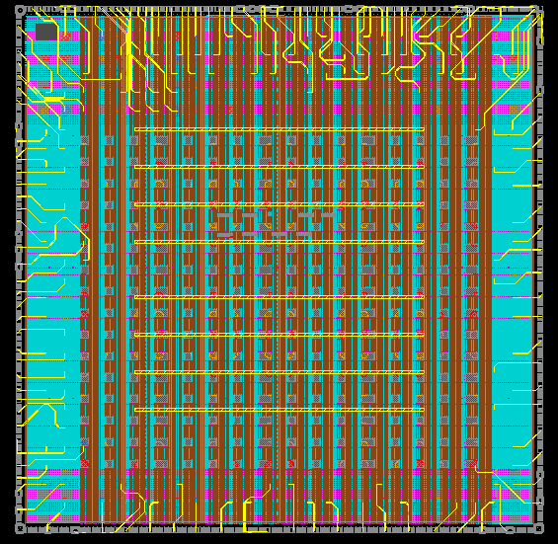
CGRA Specifications
TSMC 16nm FFC PODE 10 ML
5mm x 5mm ; Flip Chip ; PIO
16x16 CGRA grid (192 PE : 64 Mem)
64 programmable IOs
Tile addressable JTAG configuration
2KB per tile, 128KB total on-chip memory
Single, always-on, power domain
Uni-clock architecture
Four 1-bit programmable global signals
CGRA Final Layout

Slide 3
Automating Physical Design
Eight weeks from RTL to Tapeout
Significant effort spent in getting a DRC clean PAD ring and core area
PnR challenges when routing global signals across a die with non-boundary tile macros and long narrow channels
Regular grid structure can be exploited to simplify PnR
CGRA Verilog generator can also generate collateral for directing the PnR tool (UPF/CTS/etc.)

Slide 5
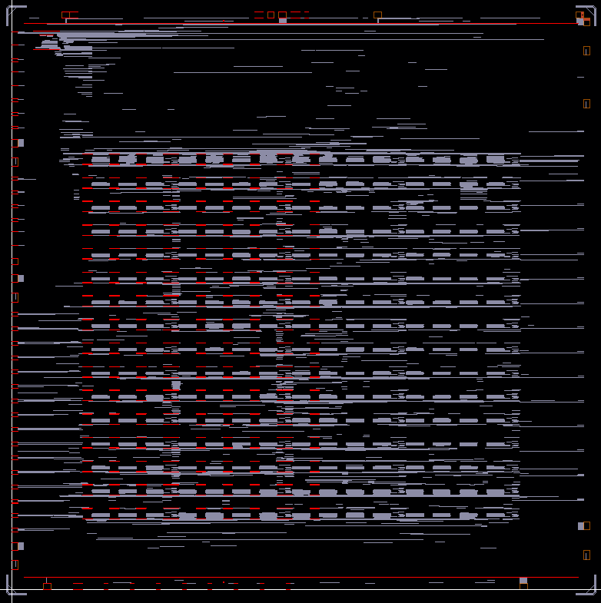
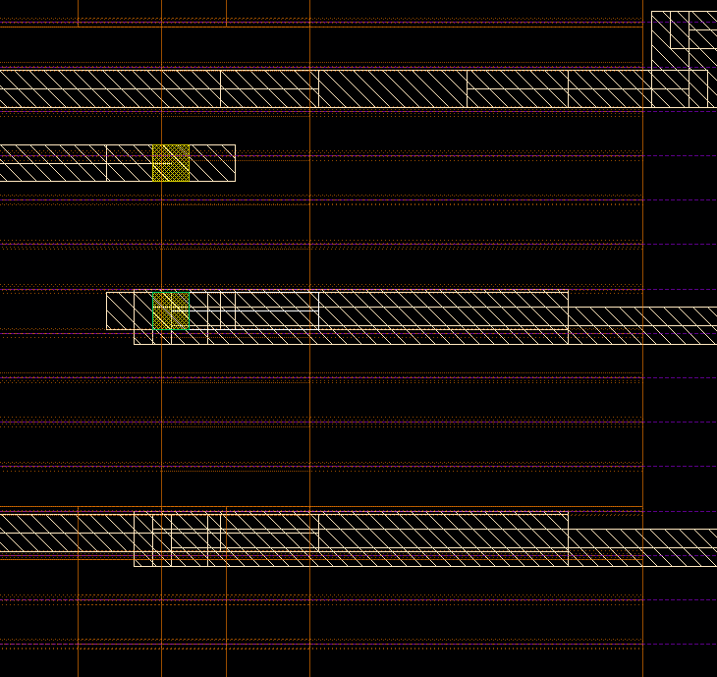
Innovus - Calibre Mismatch
There were many issues in recent Tape-out(16nm FinFET) when running Full-Chip DRC
All these errors couldn’t be detected in Innovus
Examples
1) FIN / OD off-grid error ( > # 1M)
2) Pin off-grid error ( ~ #100)

Slide 6
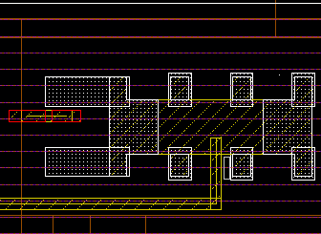
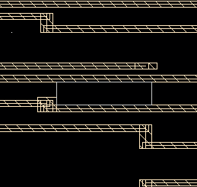
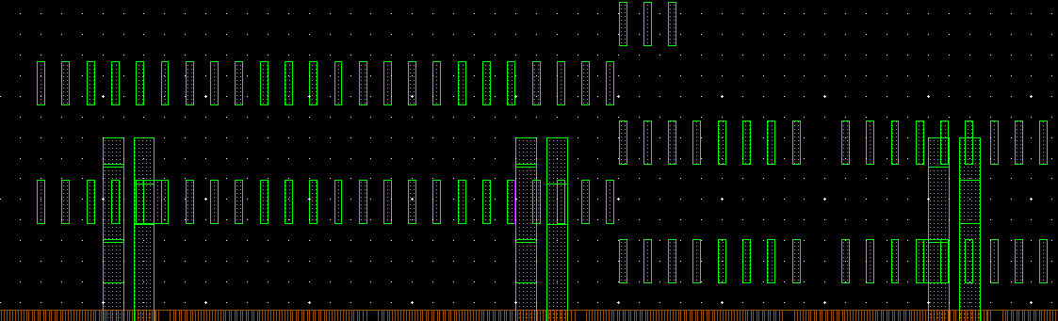
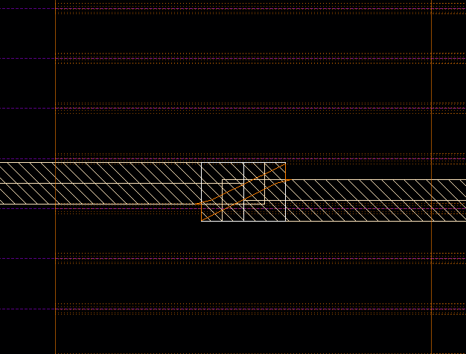
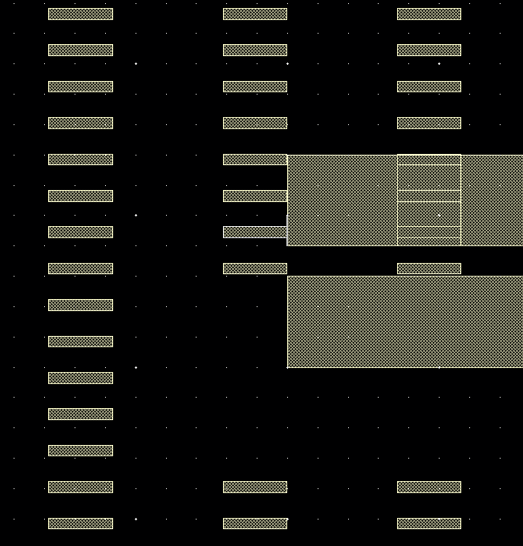
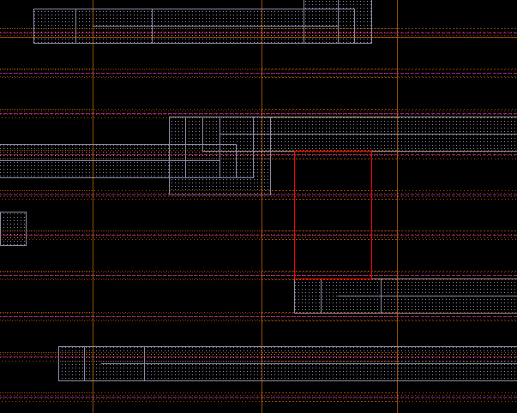
Innovus - Calibre Mismatch
3) Metal spacing errors (~ #200)

Slide 7
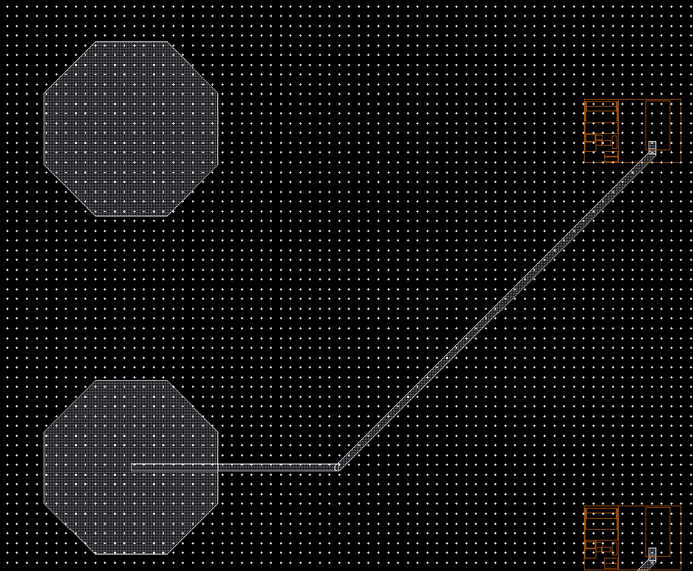
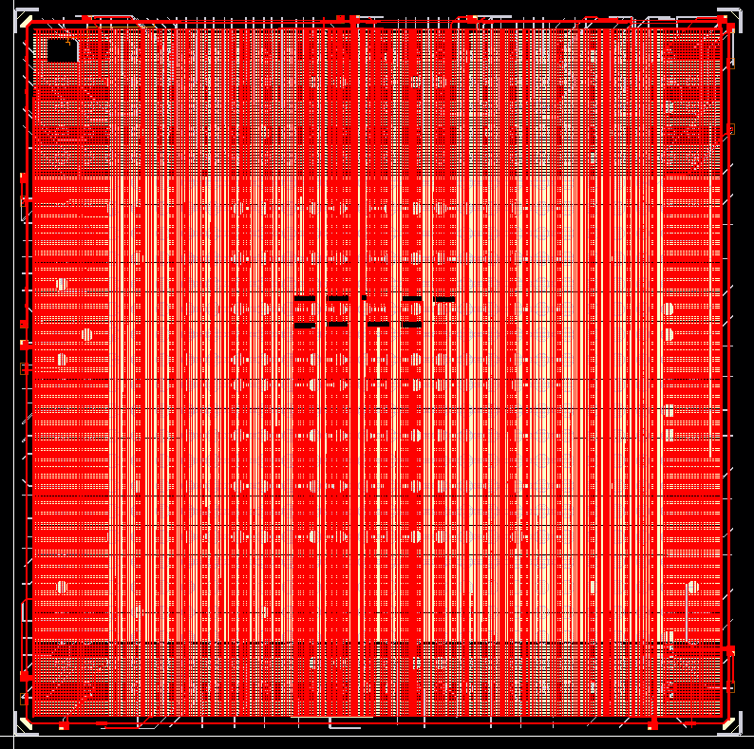
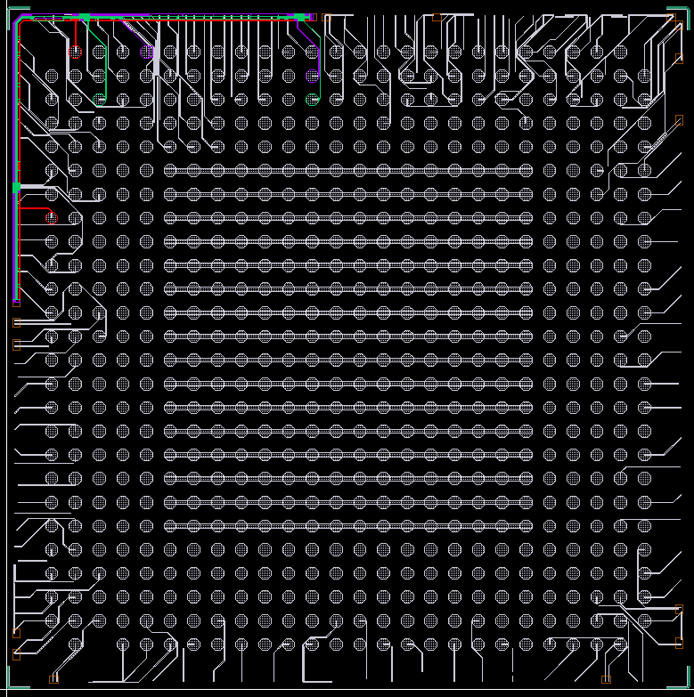
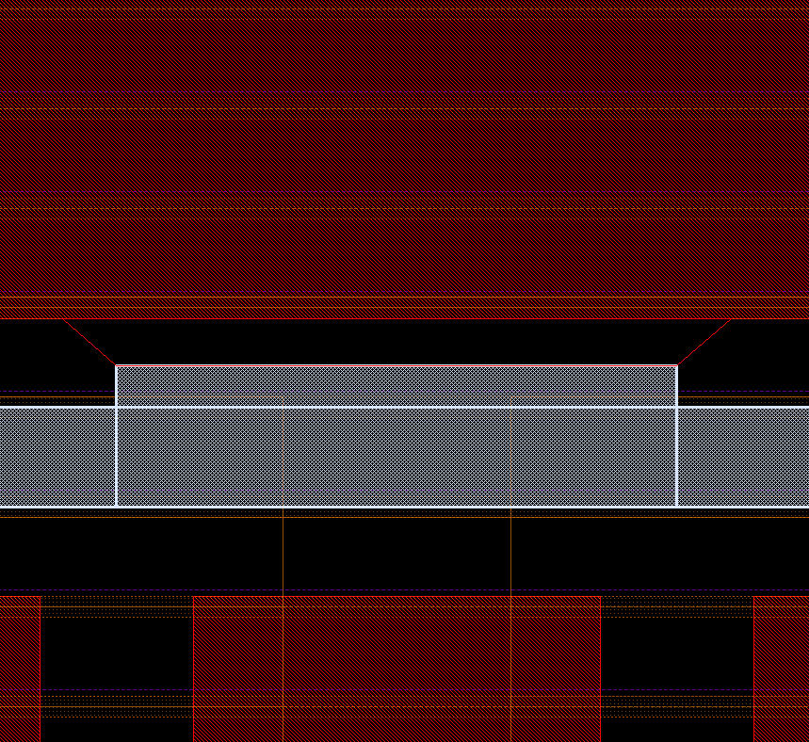
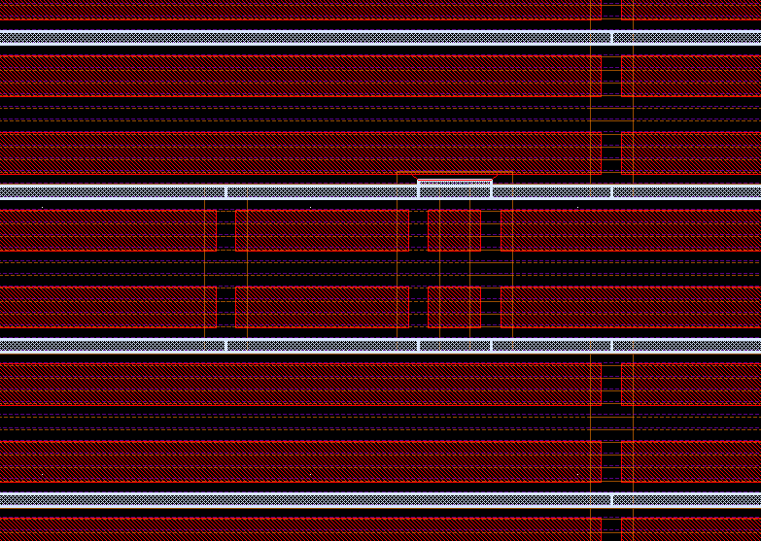
Innovus - Calibre Mismatch
4) Bumps are not connected to PADs (~ #150)
5) Power shortage
pad
no via8
bump
6) Cell misplacements
OD
filler
filler
filler
decap
boundary
filler
CPO
filler
filler

Slide 8
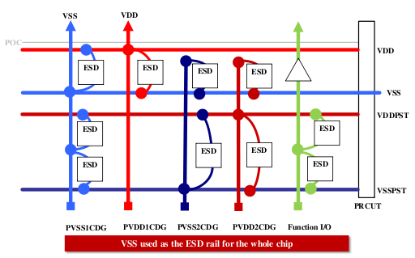
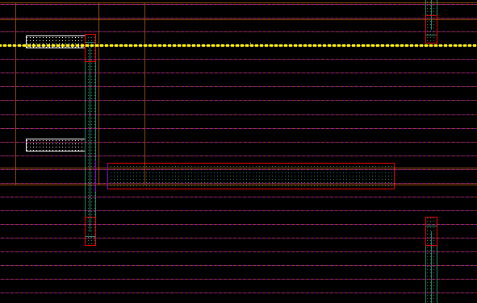
Innovus - Calibre Mismatch
7) Voltage dependent metal spacing / ESD ( > #300M)
→ Absence of back-to-back diode between two grounds causes ESD errors and voltage dependent metal spacing errors
Innovus cannot detect all DRC errors
More than 3 weeks are taken to fix these errors by manual layout revision

