Slide 1
What Is Interesting To Me Right Now …
Mark Horowitz
6/23/2018

Slide 2
Applications to Hardware

Slide 3
If You Are Building an Accelerator
The application better be parallel
The application better have locality
Performance/energy must be a critical issue

Slide 4
Remember It Must Be Cheap To Design
Application designer accessible
Little silicon expertise

Slide 5
Halide Example: Unsharp Masking
Func clamp, gray, blurx, blury, sharpen, ratio, unsharp;
Var x, y, c, xi, yi;
// The algorithm
clamp = BoundaryConditions::repeat_edge(in);
gray(x, y) = 0.3*clamp(0, x, y)+0.6*clamp(1, x, y)+0.1*clamp(2, x, y);
blury(x, y) = (gray(x, y-1) + gray(x, y) + gray(x, y+1)) / 3;
blurx(x, y) = (blury(x-1, y) + blury(x, y) + blury(x+1, y)) / 3;
sharpen(x, y) = 2 * gray(x, y) - blurx(x, y);
ratio(x, y) = sharpen(x, y) / gray(x, y);
unsharp(c, x, y) = ratio(x, y) * input(c, x, y);
// The schedule
unsharp.tile(x, y, xi, yi, 256, 256)
.accelerate({clamp}, xi, x)
.parallel(y).parallel(x);
in.fifo_depth(unsharp, 512);
gray.fifo_depth(ratio, 8);
// other schedules...

Slide 6
Architecture Template: Stencil Functions and Line Buffers
Stencil functions consume sliding windows of data
Huge locality
To capture this locality need to buffer a few lines
Line buffer is the hardware buffer block.

Slide 7
Dataflow IR Transformation
Pu, Jing, et al. "Programming heterogeneous systems from an image processing DSL." ACM Transactions on Architecture and Code Optimization (TACO) 14.3 (2017): 26.

Slide 8
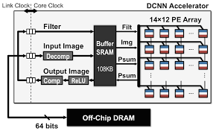
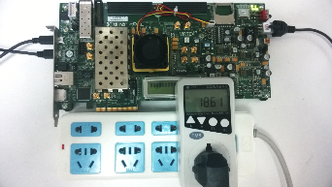
DNN Accelerators
Google TPU
Huawei Kirin NPU
Eyeriss
Can represent them as different schedules to a Halide program.
C. Zheng, et al (FPGA)
[1] https://cloudplatform.googleblog.com/2016/05/Google-supercharges-machine-learning-tasks-with-custom-chip.html
[2] https://www.electronicsweekly.com/news/ifa-2017-huawei-reveals-low-power-kirin-970-mobile-ai-chipset-2017-09/
[3] http://eyeriss.mit.edu/
Notes:
Industry
TPU, optimize for latency, big matrix multiply unit
Diannao, NLR
Eyeriss, optimize all kinds of data reuse, …
Zhang, FPGA, flexibility

Slide 9
Architecture Template for DNNs

Slide 10
Dataflow Impact
Most dataflows achieve close-to-optimal energy efficiency

Slide 11
Energy Breakdown Comparison
Use a smaller register file size can greatly improve overall energy efficiency, by reducing register file energy

Slide 12
What Are Other Applications Classes?

Slide 13
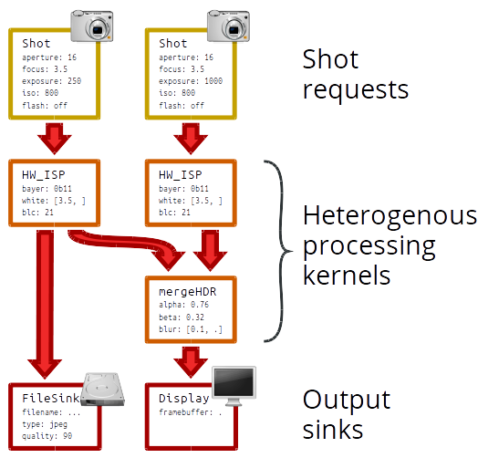
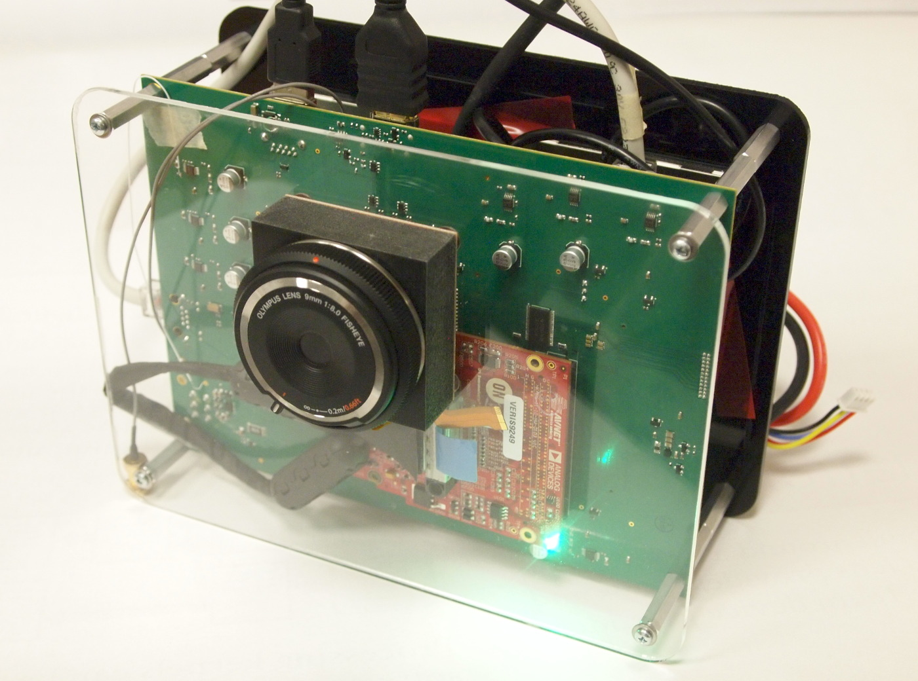
Connect Hardware to User Process

Slide 14
AHA CGRA Architecture
Design Space Exploration:
Tile Design
Programmable Routing
Tile Clustering
Memory Topology
TILE
TILE
TILE
TILE
TILE
TILE
16 bit bus
1 bit bus
Switch box
16 bit CB
1 bit CB

Slide 15
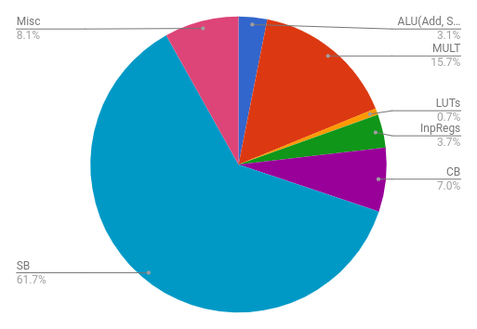
Area Breakdown for Simple 2:1 PE

Slide 16
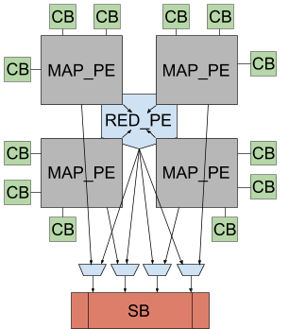
Clustering

