Slide 1
Agile Hardware Design For designing better chips
Priyanka Raina
AHA Retreat
June 23, 2018

Slide 2
Introduction
Completed my PhD from MIT in January
Advisor: Anantha Chandrakasan
Thesis: Energy-efficient circuits and systems for computational imaging and vision on mobile devices
Now a visiting research scientist at Nvidia Research
Will start at Stanford as an assistant professor in September

Slide 3

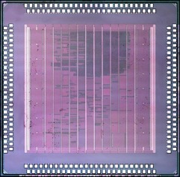

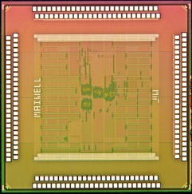


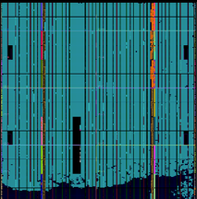
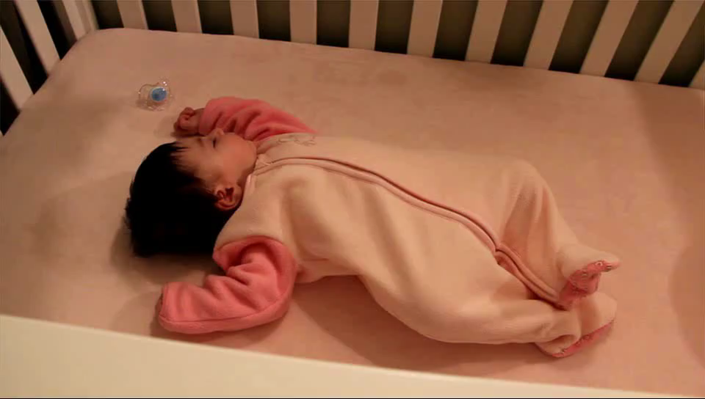
My PhD in one slide Energy-Efficient Imaging Accelerators
Image
Deblurring
[P. Raina, M. Tikekar, A. P. Chandrakasan
ESSCIRC 2016,
JSSC 2017]
Image Deblurring
Accelerator
HDR & Low Light Imaging
[R. Rithe, P. Raina, N. Ickes, S. Tenneti, A. P. Chandrakasan
ISSCC 2013,
JSSC 2013]
Reconfigurable
Computational Photography Processor
3 orders of magnitude reduction in runtime
4 orders of magnitude lower energy
Motion
Magnification
[P. Raina, D. Jeon, W. T. Freeman, F. Durand, A. P. Chandrakasan, In progress]
Motion Magnification Accelerator

Slide 4

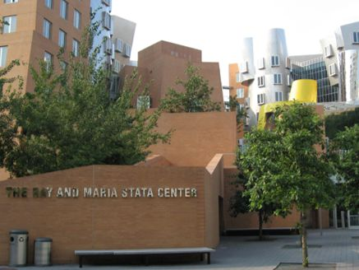
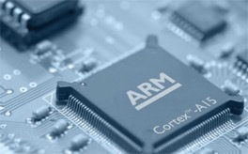
Mobile image processing is expensive
Image Capture
Computation
Mobile
CPU/GPU
13.6 minutes
2284 J per frame
1810 mAH battery
Phone dead after deblurring only 10 photos!

Slide 5
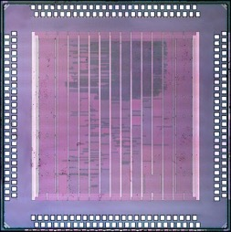
Accelerators to the rescue
Image Capture
Computation
[P. Raina, M.Tikekar, A. P. Chandrakasan
ESSCIRC 2016]
13.6 minutes
2284 J per frame
Deblurring
Accelerator
1.7 seconds
0.1 J per frame

Slide 6
Why are we designing accelerators?

Slide 7
Designing Specialized Hardware
Future is about applications running on accelerators
What applications to specialize?
To what degree to specialize?
Determine it by actually running the application using our end-to-end flow
performance
flexibility
Fixed Function
Accelerator
Temporally/Spatially
Configurable
Accelerator
GPU
CPU

Slide 8
Design Process
Design Space Exploration
Write RTL (Bluespec, System Verilog)
Bluespec Compiler
Verilog
Verilog Functional Verification
Application
Code C++
Synthesis
Verilog
Hardware C++ Model
Notes:
Why is specialized hardware more efficient than software running on CPU?
Efficiency comes from
Reducing instruction overhead
Exploiting spatial and temporal locality of memory accesses
Parallelism
Specializing the arithmetic operations

Slide 9
Design Process
Iterate for performance (area, frequency, power)
Iterate for correctness (mostly) and then performance (cycles)
Design Space Exploration
Write RTL (Bluespec, System Verilog)
Bluespec Compiler
Verilog
Verilog Functional Verification
Application
Code C++
Synthesis
Verilog
Hardware C++ Model
FPGA
Iterate for correctness
Notes:
Why is specialized hardware more efficient than software running on CPU?
Efficiency comes from
Reducing instruction overhead
Exploiting spatial and temporal locality of memory accesses
Parallelism
Specializing the arithmetic operations

Slide 10
Design Process
Backend
Post Layout Verification
DRC, LVS, Dummy Insertion
Gate Level Verification
Place and Route
Verilog
Layout
Timing Verification

Slide 11
Design Process Fixed Function Hardware
Bring-up
Packaging, Board Design, DRAM/
Processor Interface
It works :)
Write paper/sell chips
Software (Compiler)
Performance Measurement
Chip
Not time consuming because it basically does
here is the data
go
done

Slide 12
Design Process Configurable Hardware
Bring-up
Packaging, Board Design, DRAM/
Processor Interface
It works :)
Write paper/sell chips
Software (Compiler)
Performance Measurement
Chip
For configurable hardware compiler design has to be in parallel with hardware, so you can measure performance over real applications and iterate for performance

Slide 13
Where does the design time go?
For moderately flexible accelerators
Most time consuming
Design space exploration
Software
Verification
Moderately time consuming
Writing RTL
Iterating for performance
Depends on

Slide 14
What do I want to work on?
Designing efficient accelerators by
(Incremental) design space exploration (with increasing levels of fidelity) using real applications
(Incremental) specialization -- only where required for performance
For these joint design of software (both scheduler and driver) is critical
Architectural models that give quick feedback on performance
Hardware generators that expose parameters that are “important” for design space exploration
How to efficiently search through the parameter space
How to search for the best schedule

