Slide 1
Power Domain Based Design
Low Power Design

Slide 2
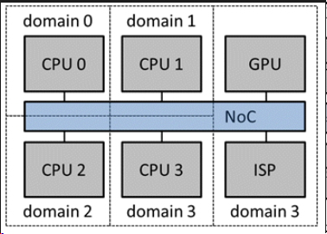
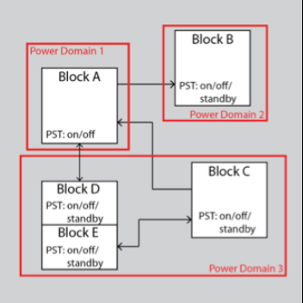
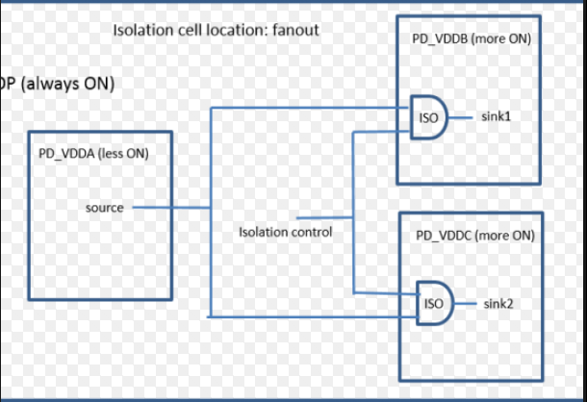
Power Domains
Low Power Cells
Isolation Cells
Level shifters
Retention Cells
Power Switches

Slide 3
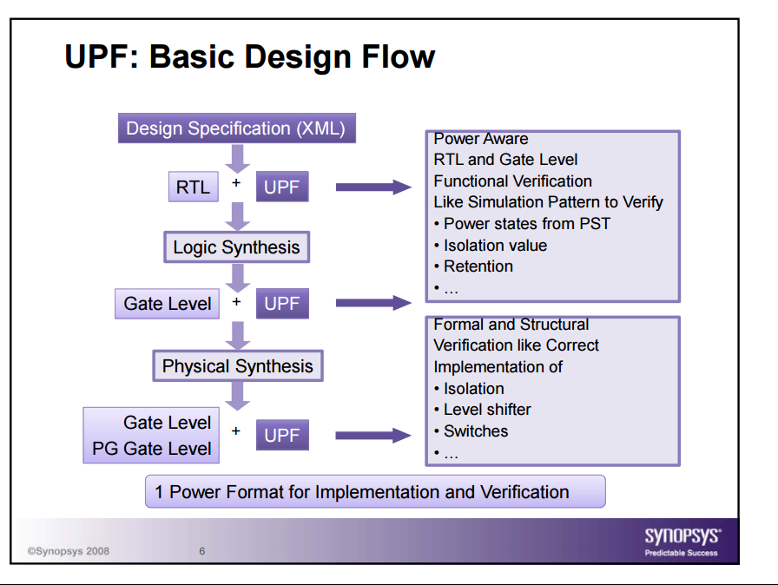
Low Power Design Flow

Slide 4
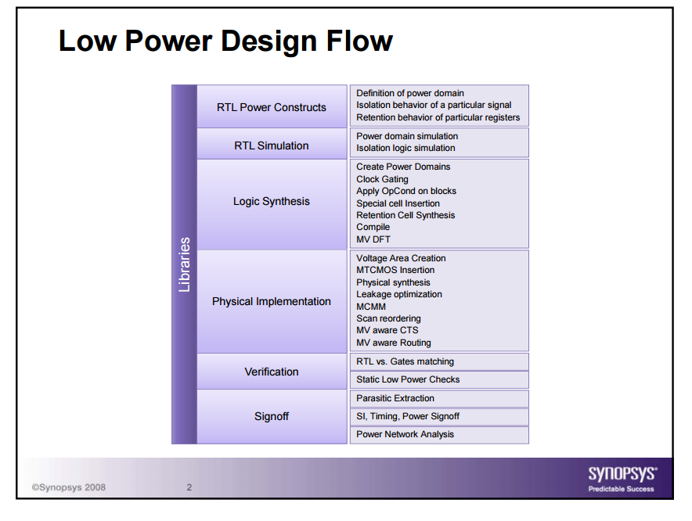
Low Power Design Flow

Slide 5
Power Intent File Contents
1. Creation of all the power domains
List of instances in the power domain
Primary power and ground for each domain
Ports for each domain
Connect power ports to the power nets
2. Creation of all the power domains
Power domain
Power and ground net
Clamp value
Applies to outputs, inputs info
Isolation control signal
Isolation control signal sense
Location (parent, self, top etc.)

Slide 6
Power Intent File Contents
3. Level shifter cells & level shifter control signals
4. Power Switch definitions (AON rail, switching rail, control for power switch)
Power domain
Input supply port
Output supply port
Control port
5. Retention Cells
Power domain
Retention power and ground
Retention control: Save signal and restore signal
Retention cell mapping

Slide 7
Power Intent File Contents
6. Power State Table (Lists all the scenarios that can be expected)
Port states
E.g. All_on, 1_off, 2_off, all_off

Slide 8
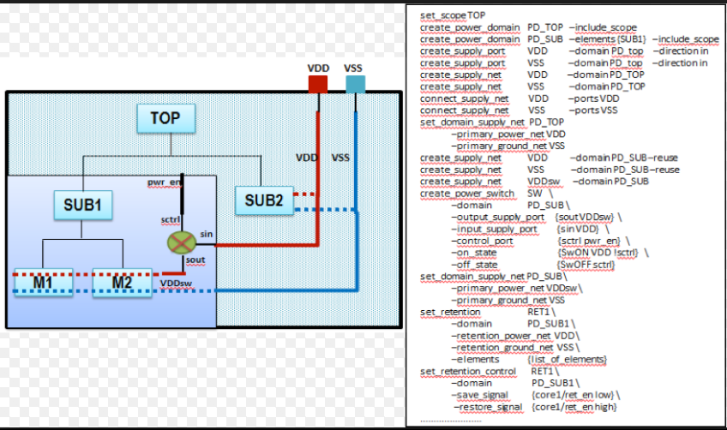
UPF File
http://semiengineering.com/upf-driven-rtl-power-budgeting-for-energy-efficient-designs/

Slide 9
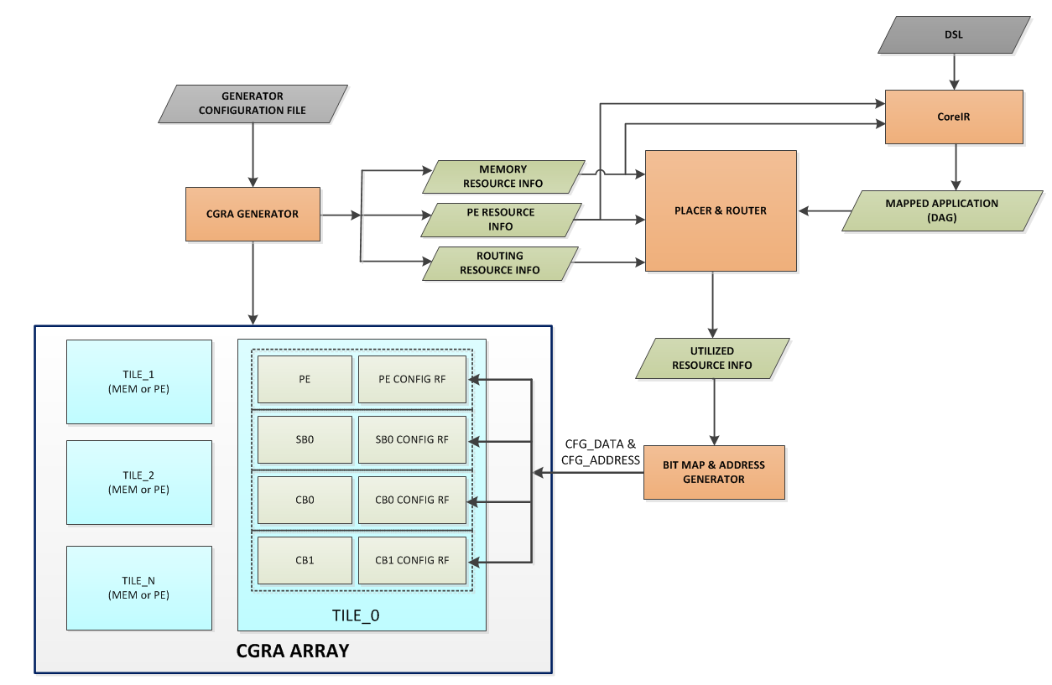
CGRA Flow

Slide 10
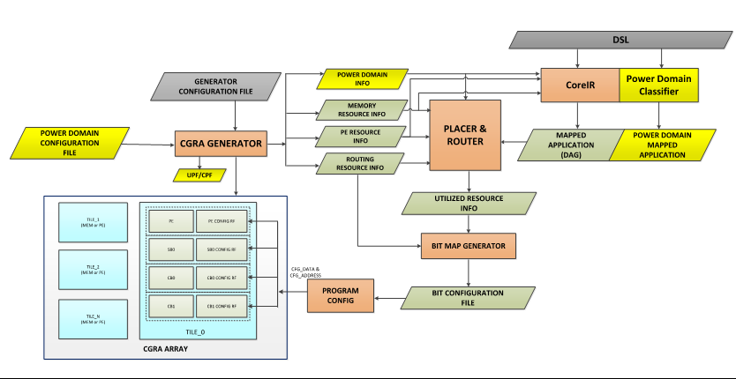
CGRA Flow – Power Domain Aware
*
*

Slide 11
CGRA Flow – Power Domain Aware
Power domain information will be needed at two levels:
For CGRA hardware itself, so it knows which part of the chip is in which domain
Give power domain partitioning information to CoreIR so it can map the applications to the appropriate power domain

Slide 12
Power Domain
PD1
PD2
Two power domains
AON & SD
Both operating on same voltage
Column based domains – in alignment with column based handling for other global signals
Generator Example:
PD1: column1: column{N/2}
PD2: column{N/2+1}:column
Generate UPF file from the generator
Use physical design generator flow to determine the power switch insertion
How many switches to add – redhawk analysis
Daisy chain or HFN

Slide 13
UPF File
######## Create Power Domains ###########
create_power_domain TOP create_power_domain AON -elements {COL1, COL2} create_power_domain SD –elements {COL3, COL4}
## Toplevel Connections ######
# VDD_HIGH (0.7V) create_supply_port VDD_HIGH create_supply_net VDD_HIGH -domain TOP create_supply_net VDD_HIGH -domain AON -reuse create_supply_net VDD_HIGH -domain SD -reuse connect_supply_net VDD_HIGH -ports VDD_HIGH
# VSS (0.0V) create_supply_port VSS create_supply_net VSS -domain TOP create_supply_net VSS -domain AON -reuse create_supply_net VSS -domain SD -reuse connect_supply_net VSS -ports VSS
### SD DOMAIN Power Connections ##########
create_supply_net VDD_HIGH_SD_VIRTUAL -domain SD
### Establish Connections ################
set_domain_supply_net TOP -primary_power_net VDD_HIGH -primary_ground_net VSS set_domain_supply_net AON -primary_power_net VDD_HIGH -primary_ground_net VSS set_domain_supply_net SD -primary_power_net VDD_HIGH_SD_VIRTUAL -primary_ground_net VSS
########## Create Shut-Down Logic for SD #######
create_power_switch SD_sw -domain SD -input_supply_port {in VDD_HIGH} -output_supply_port {out VDD_HIGH_SD_VIRTUAL} -control_port {SD_sd power_controller/SD_sd} -on_state {??}}
######### Isolation cell Settings for SD #########
set_isolation SD_iso_in -domain SD -isolation_power_net VDD_HIGH -isolation_ground_net VSS -clamp_value 1 -applies_to inputs
set_isolation_control SD_iso_in -domain SD -isolation_signal power_controller/SD_iso -isolation_sense high -location parent
set_isolation SD_iso_out -domain SD -isolation_power_net VDD_HIGH -isolation_ground_net VSS -applies_to outputs set_isolation_control SD_iso_out -domain SD -isolation_signal power_controller/SD_iso -location parent
### Create Power State Table ##################
add_port_state VDD_HIGH -state {HighVoltage 0.7} add_port_state SD_sw/out -state {HighVoltage 0.7} -state {SD_OFF off}
create_pst lvds_system_pst -supplies {VDD_HIGH VDD_HIGH_SD_VIRTUAL} add_pst_state RX_ON -pst lvds_system_pst -state { HighVoltage SD_OFF} add_pst_state ALL_ON -pst lvds_system_pst -state { HighVoltage HighVoltage}

Slide 14
Collaterals
Library:
Needs to be UPF Aware – Needs PG information
Power Collaterals:
Power switches (to shutdown domains)
Isolation cells (to isolate SD signals )
Level shifters (for multivoltage scenarios)

