Slide 1
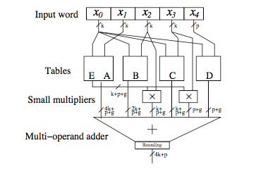
Next-Generation PE Architecture
Nikhil Bhagdikar
Motivation
Implementing Non Linear Functions
Efficient support for a wider range of applications
Better integration with AHA flow
Improve energy and area efficiency
Data Types
A new scheme for table based evaluation of functions [David et al., 2006]
Int4 for machine learning (inferencing)
Int8 for imaging pipelines
Int16 for imaging, vision, and machine learning (training)
B-Floats (16-bit 8+8 floating point)
Current Work: Evaluating efficiency tradeoff
Specialized units
Specialized routing in existing units
Non specialized
New Instructions
Improving Energy/Area Efficiency
Non linear functions (log, exponentials, trigonometric)
Packing (eg: two 8-bit objects to a 16-bit word)
Conversion (eg: int to float)
PE Area Distribution
*Data from 16nm CGRA chip taped out
Integration
Create a global spec for the PE
Improves compiler/mapper to hardware interface
New instructions are readily absorbed by the flow
Robust verification
Future Work:
Heterogeneity
Improved multipliers and pipelining
Data/Clock gating

