Slide 1
Garnet: The Next Generation CGRA Architecture
Priyanka Raina
May 10, 2019

Slide 2
Challenges with Jade CGRA
1. PE supports only simple integer operations
Porting applications that use floating point requires application expertise and manual effort

Slide 3

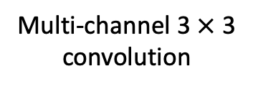

Challenges with Jade CGRA
Memory supports only line buffered pipelines
Most new applications even for imaging and vision use neural networks
Need a memory hierarchy with double buffers for energy-efficiency
Input
Multi-channel 3 $×$ 3 convolution
3 $×$3 convolution
$$⊗$$
$$⊗$$
K of these
Line Buffer
Double Buffer

Slide 4
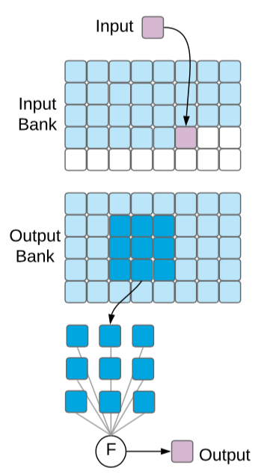
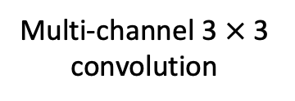

Challenges with Jade CGRA
Memory supports only line buffered pipelines
Most new applications even for imaging and vision use neural networks
Need a memory hierarchy with double buffers for energy-efficiency
Multi-channel 3 $×$ 3 convolution
2. Use a double buffer to overlap compute on current tile and fetching of next tile
3. Use a hierarchy of double buffers to maximize energy-efficiency
$$⊗$$
1. Bring in tiles of inputs and weights into local memory reuse them as much as you can
K of these

Slide 5
Challenges with Jade CGRA
Configuration over JTAG is slow
Large applications with multiple kernels don’t fit on the CGRA – need fast reconfiguration

Slide 6
Key (application driven!) architectural changes in Garnet CGRA
Support for Bfloat16, and for executing complex operations like divide using multiple PEs
Addition of a global buffer to create a memory hierarchy for efficiently executing neural networks, and double buffer support in all memories
Fast reconfiguration support using global buffer and control processor
Addition of configurable power domains

Slide 7
CGRA
Coarse Grained Reconfigurable Array (CGRA)
PE
MEM
PE
MEM
Tile
PE
MEM
PE
MEM
PE
MEM
PE
MEM
 | Processing Element
 | (PE) / Compute
 | Memory (MEM)
 | Switch box (SB)
 | Connection box (CB)
PE
MEM
PE
MEM

Slide 8
Interconnect
Keyi Zhang

Slide 9
Connection Box (CB) - Jade
10-to-1 mux
10 vertical 16 bit tracks
5 driven up, 5 driven down
PE
A
CB
B
CB
There are similar 1 bit CBs for feeding 1 bit inputs from 10 horizontal and vertical 1 bit tracks
SB
10 horizontal 16 bit tracks
5 driven left, 5 driven right

Slide 10
Connection Box (CB) - Garnet
10 vertical 16 bit tracks
5 driven up, 5 driven down
2 20-to-1 muxes
PE
B (identical mux as A)
CB
CB
A
There are similar 1 bit CBs for feeding 1 bit inputs from 10 horizontal and vertical 1 bit tracks
SB
10 horizontal 16 bit tracks
5 driven left, 5 driven right

Slide 11
Switch Box (SB)
4
3
2
1
0
4
3
2
1
0
PE
Pipeline register
4
3
2
1
0
4
3
2
1
0
4
3
2
1
0
4
3
2
1
0
4
3
2
1
0
4
3
2
1
0

Slide 12
Switch Box (SB)
4
3
2
1
0
4
3
2
1
0
PE
4
3
2
1
0
4
3
2
1
0
4
3
2
1
0
4
3
2
1
0
Figure shows connectivity for ‘0’ tracks
Similar connectivity for all other numbered tracks
PE output goes to all muxes
4
3
2
1
0
4
3
2
1
0

Slide 13
Processing Element
Nikhil Bhagdikar

Slide 14
Processing Element (PE) in Diablo
Two 16 bit operands
Three 1 bit operands
data0
data1
bit0
bit1
bit2
op_a_reg
op_b_reg
op_d_reg
op_e_reg
op_f_reg
clk
clk_en
op_b
op_d
op_e
op_f
op_a
rst_n
Add
Mult
And
8 entry
1 bit lut register
…
cfg_d
32
32
read_data
cfg_a
8
C, V, res_p
irq
cfg_en
ALU
flag_sel
Flag Logic
en_acc
res
res_p

Slide 15
Register Modes
data0
cfg_d[15:0]
Or cfg_d[0] for 1 bit registers
This particular register’s address
0 1
load = cfg_en && (cfg_a == F0)
1 0
load or (mode == delay) or ((mode == valid) && clk_en)
Previous slide shows only this dotted portion
In reality, the register is more complex because of debug functionality
reg
In both modes, the data is registered, in delay mode it is unconditionally registered, in valid mode it is registered only when clk is enabled
rst_n
1 0
mode == bypass

Slide 16
Accumulation Operation
ALU output
comp_res
0
To reset the accumulation register
For b, load signal can also be clk_en & en_acc (bit in the op code that enables accumulation)
The data going into the register can also be 0/output of the PE after accumulation
0 1
en_acc & op_d_p
cfg_d[15:0]
0 1
(cfg_en && (cfg_a == F1))
data0
load = (cfg_en && (cfg_a == F1)) |
(clk_en & en_acc)
0 1
load or (mode == delay) or ((mode == valid) && clk_en)
1 0
reg
rst_n
1 0
mode == bypass

Slide 17
Configuration Registers in Diablo
cfg_d[31:16]
cfg_d[15:0]
cfg_en && (cfg_a == FF)
1 0
1 0
rst_n
inp_code
op_code
inp_code
15 | 14 | 13 | 12 | 11 | 10 | 9 | 8 | 7 | 6 | 5 | 4 | 3 | 2 | 1 | 0
mode (f)
mode (e)
mode (d)
mode (b)
mode (a)
op_code
15 | 14 | 13 | 12 | 11 | 10 | 9 | 8 | 7 | 6 | 5 | 4 | 3 | 2 | 1 | 0
flag_sel
irq_en
en_acc
pe_op_code

Slide 18
Flag Logic
ALU produces
C = carry is generated
V = overflow
res 16b
res_p 1b
Z = res == 0
N = res is negative
Z ~Z C ~C N ~N V ~V C&~Z ~C|Z N==V N!=V ~Z|(N==V) Z|(N!=V) LUT ALU res_p
EQ NE CS CC MI PL VS VC HI LS GE LT GT LE LUT ALU
0 1 2 3 4 5 6 7 8 9 10 11 12 13 14 15
flag_sel
1b
res_p

Slide 19
Breakpoint in Diablo
res
debug_data
res_p
debug_bit
!=
!=
irq_en
irq_en
irq

Slide 20
Global Signal Flow
irq (interrupt request) signal is connected to global signal tiles (GST) in a hierarchical tree fashion
PE
PE
PE
PE
irq
PE
PE
PE
PE
…
PE
PE
PE
PE
PE
PE
PE
PE

Slide 21
Reading Diablo registers in debug
Lut
debug_data
debug_bit
op_a_reg
op_b_reg
op_d_reg
op_e_reg
op_f_reg
{inp_code, op_code}
0
8b
16b
1b
16b
16b
1b
1b
1b
32b
00 E0 E1 F0 F1 F3 F4 F5 FF else
cfg_a
32b
read_data

Slide 22
Clock Gating in Diablo
Each tile has 4 1 bit global signals coming in
These go into all three 1 bit connection boxes
There is another connection box that outputs the cg_en (clock gating enable) signal, reverse of which is the clk_en signal sent to the PE core
This connection box chooses this cg_en signal from 10 of the routing tracks on side 1 and the 4 global signals
Block diagram is on next slide

Slide 23
1 Bit Connection Boxes in Diablo
1 bit tracks
D
PE
CB
F
CB
cg_en
E
SB
CB
CB
1 bit tracks
4 global signal wires

Slide 24
Improvements in Lassen over Diablo
Lassen supports 16 bit Bfloat type
1 b sign, 8 b exponent, 7 bit mantissa
Same range as Float32
Bfloat add and multiply natively
Micro-instructions to implement Bfloat transcendentals (divide, exp, power, log, sin, cos)
Optimization passes (currently manual) to improve efficiency
Proposed improvements : 16-bit LUT for masking operations
Need review: Are the operations in lassen sufficient for implementing target applications

Slide 25
Diablo vs Lassen
New Ops in Lassen
Diablo Ops
Allows easy porting of applications!
Enables new applications that need a large range like DNN training or complex ops like divide
FPAdd
FPMult
FGetMant
FAddIExp
FSubExp
FCnvExp2F
FGetFInt
FGetFFrac
Add
Sub
Abs
GTE_Max
LTE_Min
Sel
Mult0
Mult1
Mult2
SHR
SHL
Or
And
XOr
Micro-instructions
Other FP instructions requested by Jeff: sub,
le lt, ge, gt, neq, neq,
neg, flr, ceil, abs, min, max, sqr

Slide 26
Transcendentals Example - Divide
divident = Data(0x4288) #68
divisor = Data(0x4020) #2.5
quotient = Data(0x41D9) #68/2.5 = 27.2
mant = pe_get_mant(asm.fgetmant(), divisor, Data(0))
lookup_result = mem_lut.div_lut(mant)
scaled_result = pe_scale_res(asm.fsubexp(), lookup_result, divisor)
quotient. = pe_mult(asm.fp_mult(), scaled_result, divident)

Slide 27
Bfloat LUTs
class tlut:
def div_lut(self, index):
return {
0 : 0x3f80,
1 : 0x3f7e,
2 : 0x3f7c,
…
126 : 0x3f01,
127 : 0x3f00
} [index]
def ln_lut(self, index):

Slide 28
Memory
Max Strange

Slide 29
Memory Core in Jade
There is a mux that chooses which one bit control signal goes out
0, 1, 2, valid, full, almost_full
Two banks both 16 bit wide and 512 entry
There is a read and a write phase

Slide 30
Memory
Two single port memory banks
FIFO Controller
Line Buffer Controller
Double Buffer Controller
SRAM

Slide 31
258 = 256 + 2 (padding)
66

Slide 32
0
forwardDataIn, validIn
Memory
data, valid
valid
1 0
forwardDataOut, validOut
forwardDataIn, validIn
Memory
data, valid
valid
1 0
forwardDataOut, validOut
forwardDataIn, validIn
Memory
data, valid
valid
1 0
forwardDataOut, validOut

Slide 33
P1
P2
P1
P3
P2
P3
0 | 1 | 2 | 3
66 | 67 | 68 | 69
132 | 133 | 134 | 135
9 output ports
0 | 1 | 2 | 3
66 | 67 | 68 | 69
132 | 133 | 134 | 135

Slide 34
Global Buffer
Taeyoung Kong

Slide 35
Global Buffer – Main Functions
Highly banked buffer for data reuse
Buffer to store bitstream for parallel reconfiguration
Design Philosophy: Make global buffer simple and flexible

Slide 36
Global Buffer – Components
Global Buffer
AXI – bank Interconnect
0
1
2
3
Bank Array
28
29
30
31
…
64b
32 SRAM banks
4 MB total
64 bit wide
8 I/O controller + controller<->bank interconnect
8 config controller + controller<->bank interconnect
…
…
I/O controller_0
Config controller_0
I/O controller_1
I/O controller_6
I/O controller_7
Config controller_1
Config controller_6
Config controller_7

Slide 37
Global Buffer – SoC interface
CGRA appears as a Memory to the SoC
SoC provides a wrapper that converts between this simple interface into AXI interface which has block transfers
Block = 256 words * 64 bits/word
Pipelined to support high clock frequency
To/from SoC
wdata (64b)
waddr
wen
raddr
ren
rdata (64b)
Address Decoders
0 | 1 | 2 |  | 31

Slide 38
Global Buffer – I/O controller
Weights
Inputs
Global Buffer
0
1
2
3
4
28
29
30
31
…
64b
…
I/O controller_0
I/O controller_7
Configurable in modes, number of types, capacity for different data
0 | 1 | 2 | 3 | 4
28 | 29 | 30 | 31
din
addr
addr
dout
…
16 x 32 CGRA

Slide 39
Global Buffer – I/O controller
To CGRA, we send out data and valid
From CGRA, we get data and valid
Addr
Ren
64b Data
Addr
Ren
64b Data
Start_addr
Addr
Gen
Addr
Gen
Num_word
16b Data
Valid
Addr_high
Addr_low
Ren
16b Data
Valid
<FIFO mode>
<SRAM mode>

Slide 40
Global Buffer – Parallel Reconfiguration
0 | 1 | 2 | 3 | 4 | 5 | 6 | 7 | 8 | … | 28 | 29 | 30 | 31
32 SRAM Banks
Decode Logic
Generates rden, addr
data
Global Address
…
8 config controllers
…
Configuration Bus from Global Controller
Configuration Bus
{config_write,
32b config_addr,
32b config_data}
0 | 1 | 2 | 3 | 4 | 5 | 6 | 7 | 8 | … | 28 | 29 | 30 | 31
32 CGRA Columns

Slide 42
Global Controller
Taeyoung Kong & Alex Carsello

Slide 43
Configuration – AXI4-Lite & JTAG
JTAG is able to write/read to CGRA configuration and TOP configuration
AXI4-Lite is able to write to TOP configuration
Global buffer
Parallel Config Controller
TOP configuration bus
Global
controller
wr_en
wr_addr[15:0]
wr_data[31:0]
rd_en
AXI4-Lite
wrapper
rd_addr[15:0]
rd_data[31:0]
interrupt
CGRA
configuration
bus
tck
tdi
trst
JTAG
tms
tdo

Slide 44
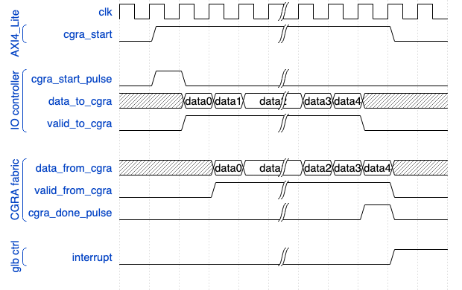
CGRA control – start & done
Block level of application is controlled by cgra_start and cgra_done
Global buffer
I/O controller
Global
controller
Input
data
Input
data
output
data
cgra_start_pulse
cgra_done_pulse

Slide 45
Global Signal Flow
<River-flowing input>
<River-flowing output>
Global signals
(clk, reset, config_wr)
32’h0
32’h0
PE
PE
config_read_data
PE
PE
PE
PE
PE
PE
PE
PE
PE
PE
PE
PE

Slide 46
Debug Support by JTAG
JTAG can do everything!
Debug CGRA fabric
Write/read CGRA-configuration registers
Write/read SRAM in CGRA fabric
4bit stall signal
Every tile has configuration registers to select a stall signal from 4bits
Debug CGRA fabric + global buffer
Write/read TOP-configuration registers
Write/read SRAM in global buffer
Write/read CGRA control register (cgra_start)

Slide 47
Power Domains
Ankita Nayak

Slide 48
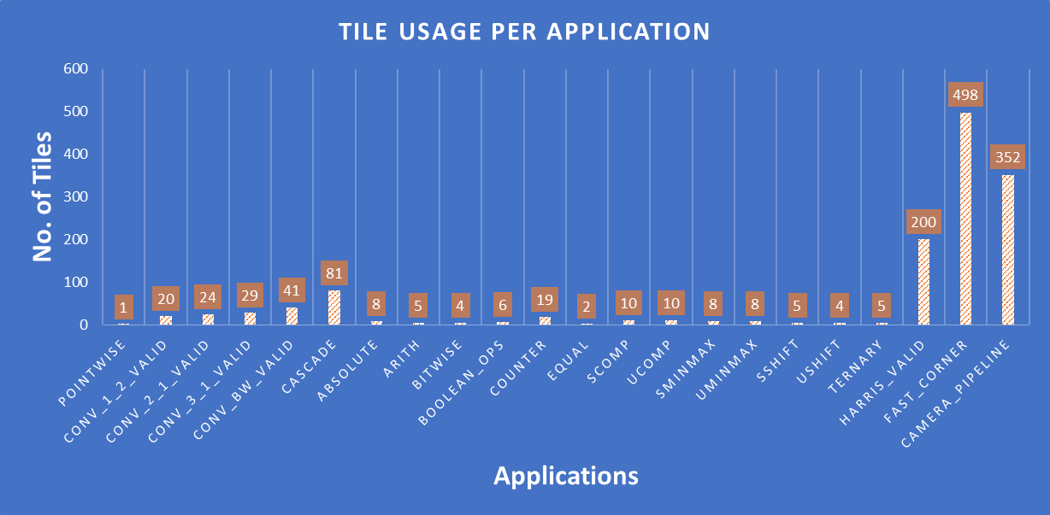
Motivation
Adoption of ‘Design for PPA’ mindset
Save power by turning off tiles in the fabric not actively used

Slide 49
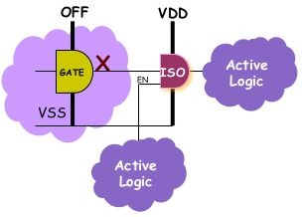
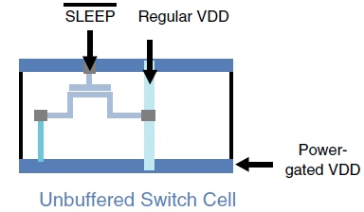
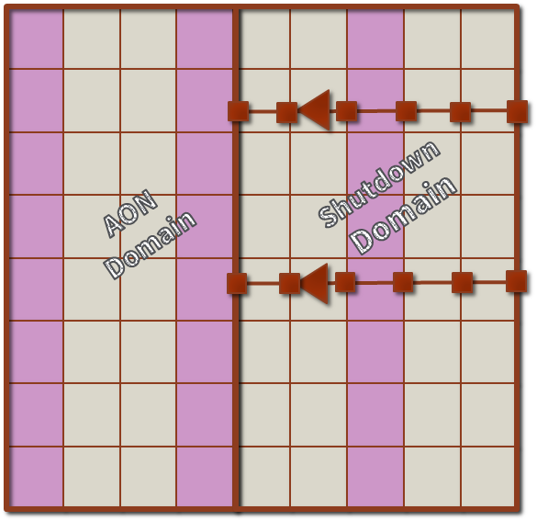
Architectural Features
1. Power Switch Network Architecture
2. Boundary protection between
the active and shutdown tiles
3. FT to connect IO near shutdown logic to the active part & for global signals

Slide 50
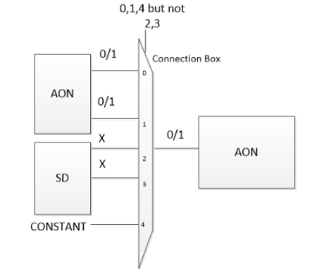
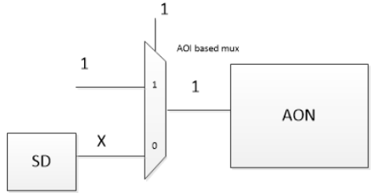
ON-OFF Boundary Protection
1. Redesign the muxes in the design to allow for inherent clamping mechanism
2. Use the existing muxes in the design
for boundary protection
AON : Always ON
SD : Shutdown

Slide 51
Tile Architecture
SD
Configuration register and its decode logic for enabling the power switches is kept ON
Buffers and logic on global signals are kept ON
All other logic is shutdown when the tile is turned OFF
PS EN
DECODE LOGIC
GLOBAL SIGNAL BUFFERS
AON
PS
PS
PS
PS
PS
PS
PS
PS
PS
PS
PS
PS

Slide 52
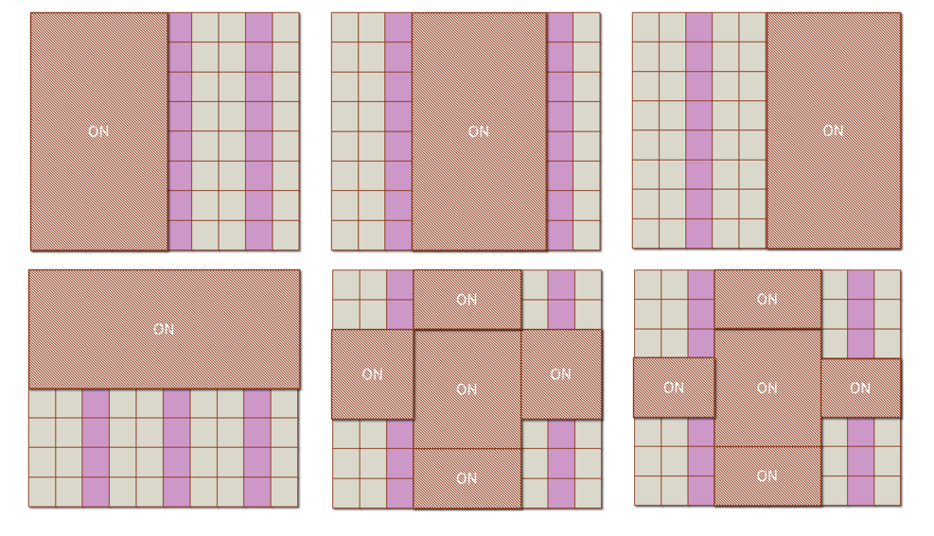
Top Level – Different sections can be turned ON/OFF by P&R

Slide 53
Summary of Garnet architectural features
Support for Bfloat16, and for executing complex operations like divide using multiple PEs
Addition of a global buffer to create a memory hierarchy for efficiently executing neural networks
Fast reconfiguration support using global buffer and control processor
Addition of configurable power domains

Slide 54
SoC
Control Processor
(ARM Cortex M3)
Application Processor
DRAM
DRAM Controller
Wake-up Interrupt Controller (WIC)
Nested Vector Interrupt Controller (NVIC)
Debug JTAG
Memory Protection Unit (MPU)
FPGA
TLX
I-Bus
D-Bus
TLX
AHB
AHB
CoreLink
AXI
AHB
AXI
AXI
AXI
SRAM
4 Banks
DMA Engine
DMA Engine
Global Buffer
CGRA
SoC

