Slide 1
Garnet: The Next Generation CGRA Architecture
Priyanka Raina
April 26, 2019

Slide 2
Challenges with Jade CGRA
1. PE supports only simple integer operations
Porting applications that use floating point requires application expertise and manual effort

Slide 3

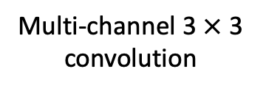

Challenges with Jade CGRA
Memory supports only line buffered pipelines
Most new applications even for imaging and vision use neural networks
Need a memory hierarchy with double buffers for energy-efficiency
Input
Multi-channel 3 $×$ 3 convolution
3 $×$3 convolution
$$⊗$$
$$⊗$$
K of these
Line Buffer
Double Buffer

Slide 4
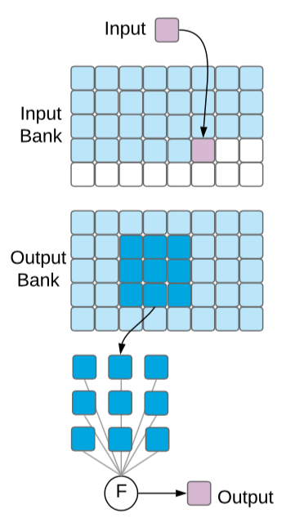
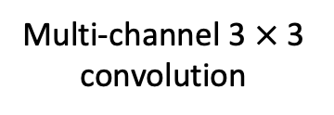

Challenges with Jade CGRA
Memory supports only line buffered pipelines
Most new applications even for imaging and vision use neural networks
Need a memory hierarchy with double buffers for energy-efficiency
Multi-channel 3 $×$ 3 convolution
2. Use a double buffer to overlap compute on current tile and fetching of next tile
3. Use a hierarchy of double buffers to maximize energy-efficiency
$$⊗$$
1. Bring in tiles of inputs and weights into local memory reuse them as much as you can
K of these

Slide 5
Challenges with Jade CGRA
Configuration over JTAG is slow
Large applications with multiple kernels don’t fit on the CGRA – need fast reconfiguration

Slide 6
Key (application driven!) architectural changes in Garnet CGRA
Support for Bfloat16, and for executing complex operations like divide using multiple PEs
Addition of a global buffer to create a memory hierarchy for efficiently executing neural networks, and double buffer support in all memories
Fast reconfiguration support using global buffer and control processor
Addition of configurable power domains

Slide 7
CGRA
Coarse Grained Reconfigurable Array (CGRA)
PE
MEM
PE
MEM
Tile
PE
MEM
PE
MEM
PE
MEM
PE
MEM
 | Processing Element
 | (PE) / Compute
 | Memory (MEM)
 | Switch box (SB)
 | Connection box (CB)
PE
MEM
PE
MEM

Slide 8
Interconnect
Keyi Zhang

Slide 9
Connection Box (CB)
10-to-1 mux
10 vertical 16 bit tracks
5 driven up, 5 driven down
PE
A
CB
B
CB
There are similar 1 bit CBs for feeding 1 bit inputs from 10 horizontal and vertical 1 bit tracks
SB
10 horizontal 16 bit tracks
5 driven left, 5 driven right

Slide 10
Switch Box (SB)
4
3
2
1
0
4
3
2
1
0
PE
Pipeline register
4
3
2
1
0
4
3
2
1
0
4
3
2
1
0
4
3
2
1
0
4
3
2
1
0
4
3
2
1
0

Slide 11
Switch Box (SB)
4
3
2
1
0
4
3
2
1
0
PE
4
3
2
1
0
4
3
2
1
0
4
3
2
1
0
4
3
2
1
0
Figure shows connectivity for ‘0’ tracks
Similar connectivity for all other numbered tracks
PE output goes to all muxes
4
3
2
1
0
4
3
2
1
0

Slide 12
Processing Element
Nikhil Bhagdikar

Slide 13
Processing Element (PE)
Two 16 bit operands
Three 1 bit operands
A
B
D
E
F
RegA
RegB
RegC
RegD
RegE
Add
Mult
And
8 entry
1 bit look-up table
…
flag
ALU
result

Slide 14
Diablo vs Lassen
New Ops in Lassen
Diablo Ops
Lassen supports 16 bit Bfloat type
1 b sign, 8 b exponent, 7 bit mantissa
Same range as Float32
Bfloat add and multiply natively
Complex ops like divide, exp, power, log, sin, cos using multiple PE and memory tiles
Allows easy porting of applications!
Enables new applications that need a large range like DNN training or complex ops like divide
FPAdd
FPMult
FGetMant
FAddIExp
FSubExp
FCnvExp2F
FGetFInt
FGetFFrac
Add
Sub
Abs
GTE_Max
LTE_Min
Sel
Mult0
Mult1
Mult2
SHR
SHL
Or
And
XOr

Slide 15
Complex Op Example
Draw the DAG for divide

Slide 16
Memory
Max Strange

Slide 17
Memory
Two single port memory banks
FIFO Controller
This figure needs more detail!
Line Buffer Controller
Double Buffer Controller
SRAM
In Jade memory tile there are some direct connections (not going through the CBs and SBs to chain line buffers)?

Slide 18
Global Buffer
Taeyoung Kong

Slide 19
Global Buffer – Main Functions
Highly banked buffer for data reuse
Buffer to store bitstream for parallel reconfiguration
=> Design Philosophy: Make global buffer simple and flexible

Slide 20
Global Buffer – Components
Global Buffer
AXI – bank Interconnect
0
1
2
3
Bank Array
28
29
30
31
…
64b
32 SRAM banks
4 MB total
64 bit wide
8 I/O controller + controller<->bank interconnect
8 config controller + controller<->bank interconnect
…
…
I/O controller_0
Config controller_0
I/O controller_1
I/O controller_6
I/O controller_7
Config controller_1
Config controller_6
Config controller_7

Slide 21
Global Buffer – SoC interface
CGRA appears as a Memory to the SoC
SoC provides a wrapper that converts between this simple interface into AXI interface which has block transfers
Block = 256 words * 64 bits/word
Pipelined to support high clock frequency
To/from SoC
wdata (64b)
waddr
wen
raddr
ren
rdata (64b)
Address Decoders
0 | 1 | 2 |  | 31

Slide 22
Global Buffer – I/O controller
Weights
Inputs
Global Buffer
0
1
2
3
4
28
29
30
31
…
64b
…
I/O controller_0
I/O controller_7
Configurable in modes, number of types, capacity for different data
0 | 1 | 2 | 3 | 4
28 | 29 | 30 | 31
din
addr
addr
dout
…
16 x 32 CGRA

Slide 23
Global Buffer – I/O controller
To CGRA, we send out data and valid
From CGRA, we get data and valid
Addr
Ren
64b Data
Addr
Ren
64b Data
Start_addr
Addr
Gen
Addr
Gen
Num_word
16b Data
Valid
Addr_high
Addr_low
Ren
16b Data
Valid
<FIFO mode>
<SRAM mode>

Slide 24
Global Buffer – Parallel Reconfiguration
0 | 1 | 2 | 3 | 4 | 5 | 6 | 7 | 8 | … | 28 | 29 | 30 | 31
32 SRAM Banks
Decode Logic
Generates rden, addr
data
Global Address
…
8 config controllers
…
Configuration Bus from Global Controller
Configuration Bus
{config_write,
32b config_addr,
32b config_data}
0 | 1 | 2 | 3 | 4 | 5 | 6 | 7 | 8 | … | 28 | 29 | 30 | 31
32 CGRA Columns

Slide 25
Global Controller
Taeyoung Kong & Alex Carsello

Slide 26
Configuration – AXI4-Lite & JTAG
JTAG is able to write/read to CGRA configuration and TOP configuration
AXI4-Lite is able to write to TOP configuration
Global buffer
Parallel Config Controller
TOP configuration bus
Global
controller
wr_en
wr_addr[15:0]
wr_data[31:0]
rd_en
AXI4-Lite
wrapper
rd_addr[15:0]
rd_data[31:0]
interrupt
CGRA
configuration
bus
tck
tdi
trst
JTAG
tms
tdo

Slide 27
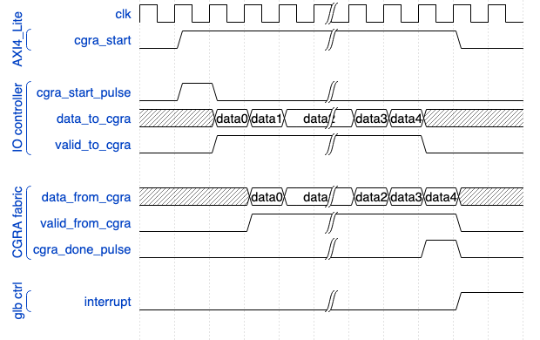
CGRA control – start & done
Block level of application is controlled by cgra_start and cgra_done
Global buffer
I/O controller
Global
controller
Input
data
Input
data
output
data
cgra_start_pulse
cgra_done_pulse

Slide 28
Global Signal Flow
<River-flowing input>
<River-flowing output>
Global signals
(clk, reset, config_wr)
32’h0
32’h0
PE
PE
Config_read_data
PE
PE
PE
PE
PE
PE
PE
PE
PE
PE
PE
PE

Slide 29
Debug Support by JTAG
JTAG can do everything!
Debug CGRA fabric
Write/read CGRA-configuration registers
Write/read SRAM in CGRA fabric
4bit stall signal
Every tile has configuration registers to select a stall signal from 4bits
Debug CGRA fabric + global buffer
Write/read TOP-configuration registers
Write/read SRAM in global buffer
Write/read CGRA control register (cgra_start)

Slide 30
Power Domains
Ankita Nayak

Slide 31
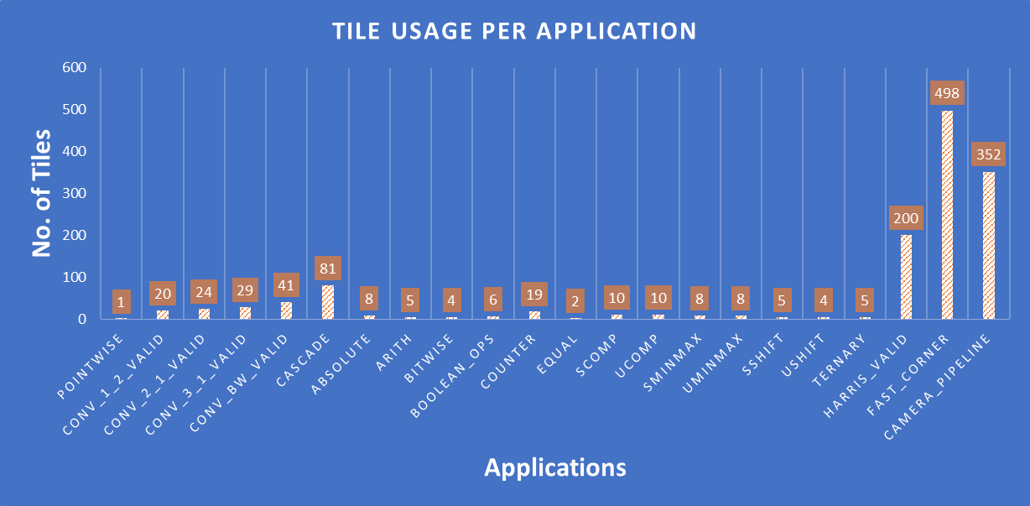
Motivation
Adoption of ‘Design for PPA’ mindset
Save power by turning off tiles in the fabric not actively used
Data: Jeff Setter

Slide 32
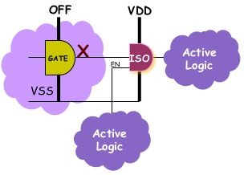
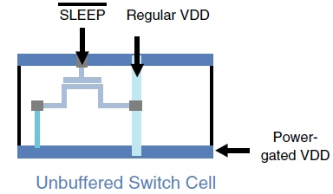
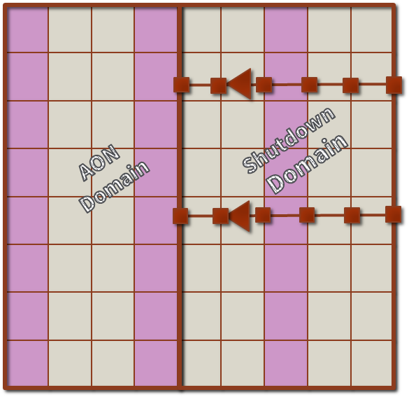
Architectural Features
1. Power Switch Network Architecture
2. Boundary protection between
the active and shutdown tiles
3. FT to connect IO near shutdown logic to the active part & for global signals

Slide 33
Tile Architecture
SD
Configuration register and its decode logic for enabling the power switches is kept ON
Buffers and logic on global signals are kept ON
All other logic is shutdown when the tile is turned OFF
PS EN
DECODE LOGIC
GLOBAL SIGNAL BUFFERS
AON
PS
PS
PS
PS
PS
PS
PS
PS
PS
PS
PS
PS

Slide 34
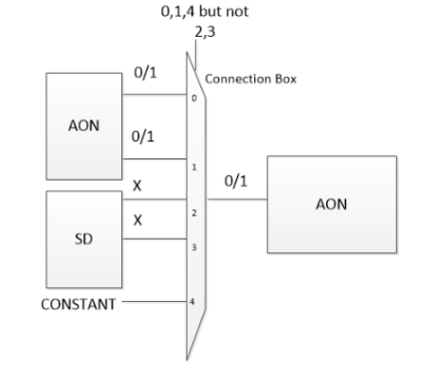
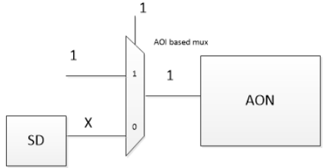
ON-OFF Boundary Protection
1. Redesign the muxes in the design to allow for inherent clamping mechanism
2. Use the existing muxes in the design
for boundary protection
AON : Always ON
SD : Shutdown

Slide 35
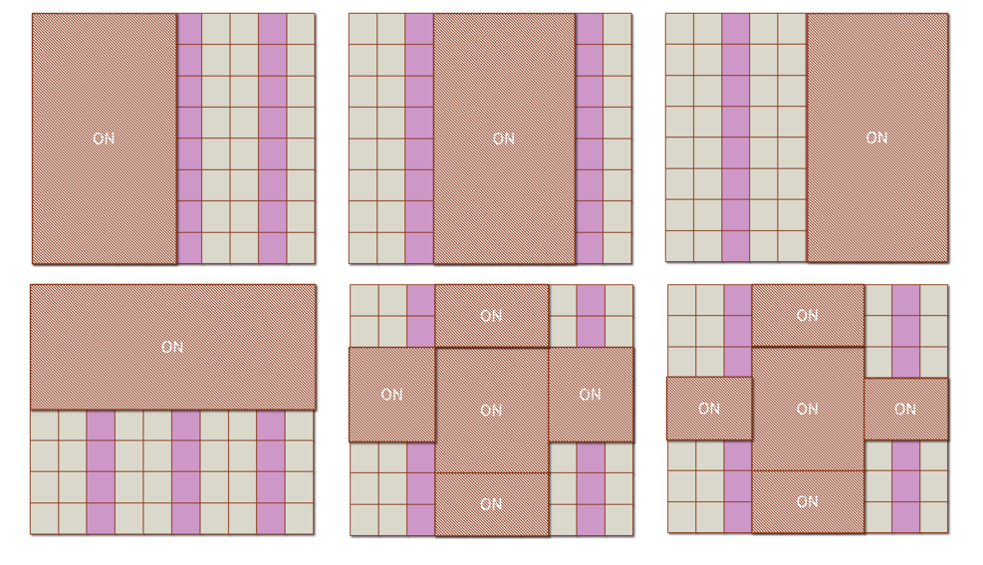
Top Level – Different sections can be turned ON/OFF by P&R

Slide 36
Summary of Garnet architectural features
Support for Bfloat16, and for executing complex operations like divide using multiple PEs
Addition of a global buffer to create a memory hierarchy for efficiently executing neural networks
Fast reconfiguration support using global buffer and control processor
Addition of configurable power domains

Slide 37
SoC
Control Processor
(ARM Cortex M3)
Application Processor
DRAM
DRAM Controller
Wake-up Interrupt Controller (WIC)
Nested Vector Interrupt Controller (NVIC)
Debug JTAG
Memory Protection Unit (MPU)
FPGA
TLX
I-Bus
D-Bus
TLX
AHB
AHB
CoreLink
AXI
AHB
AXI
AXI
AXI
SRAM
4 Banks
DMA Engine
DMA Engine
Global Buffer
CGRA
SoC

