Slide 1

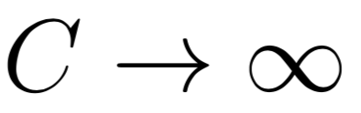
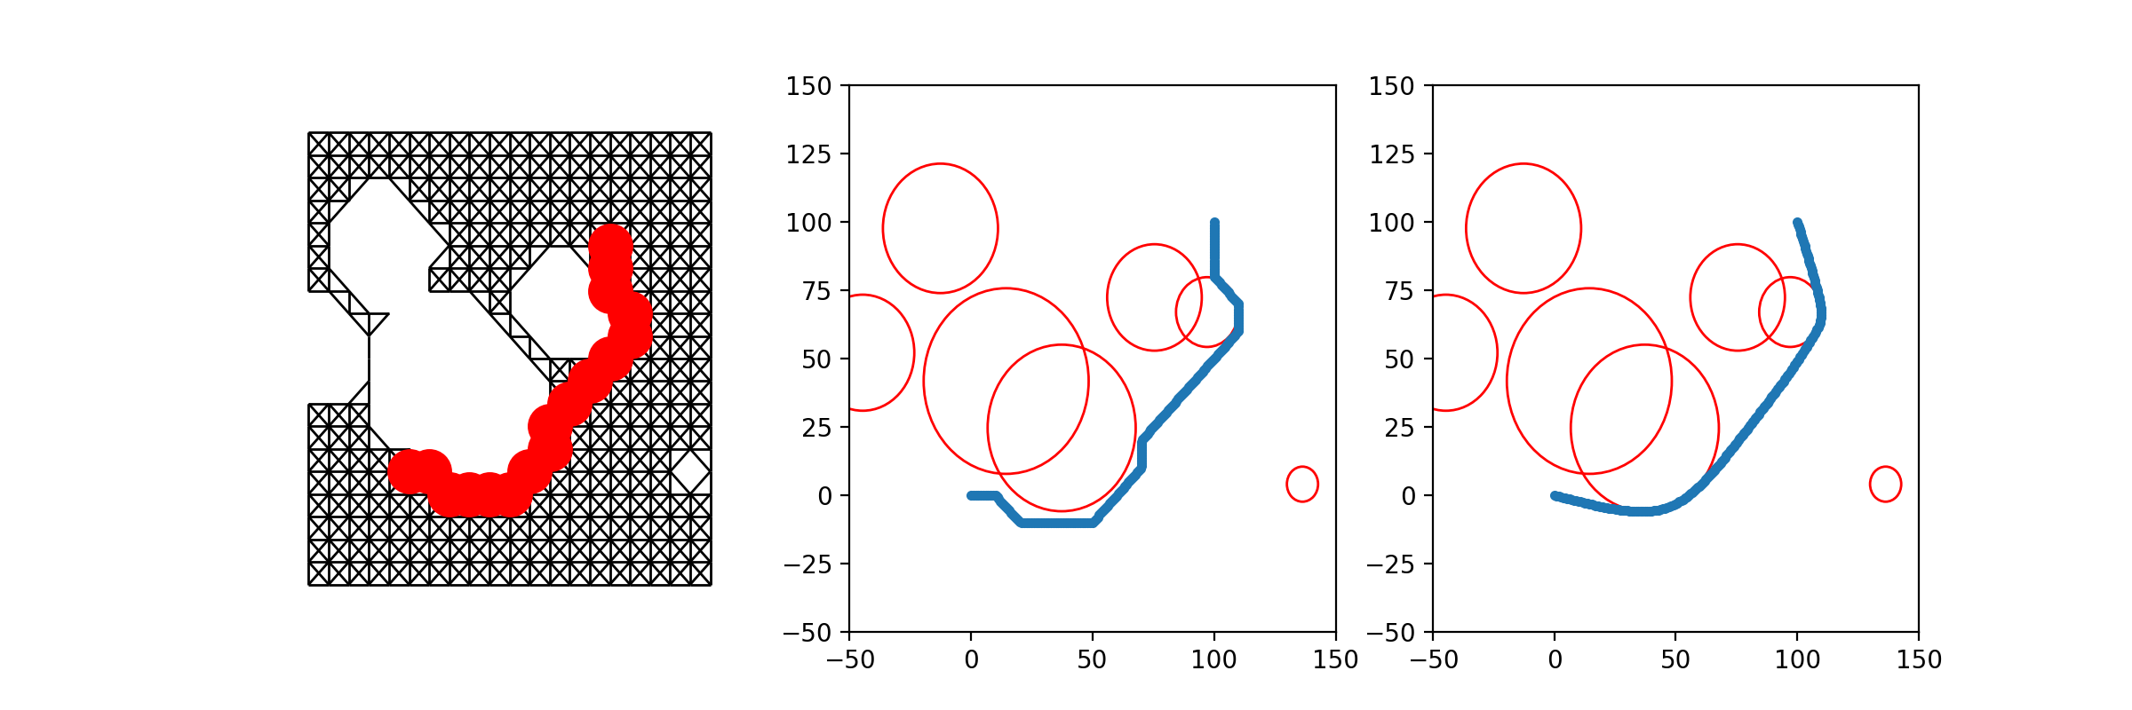
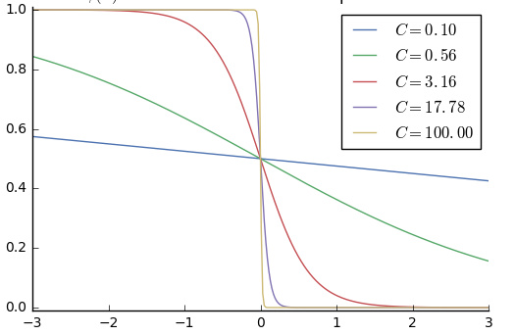
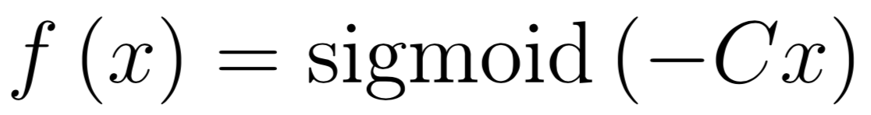
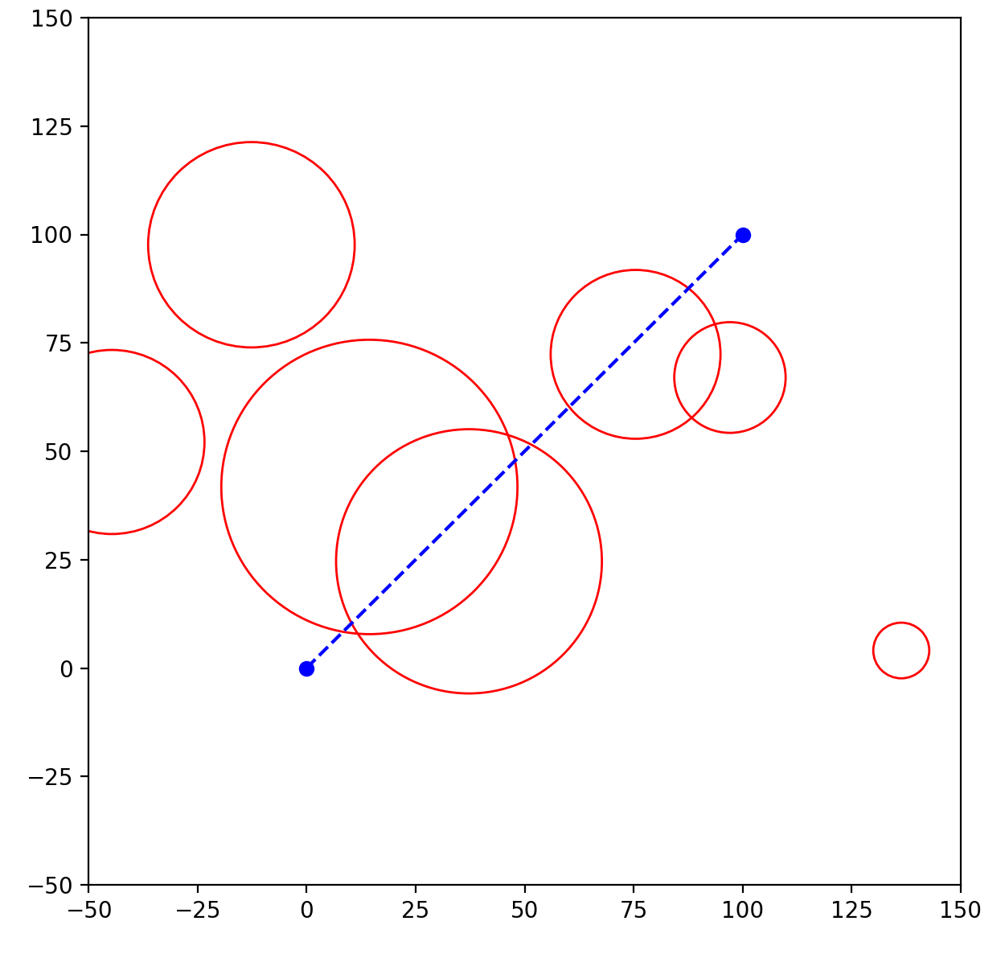
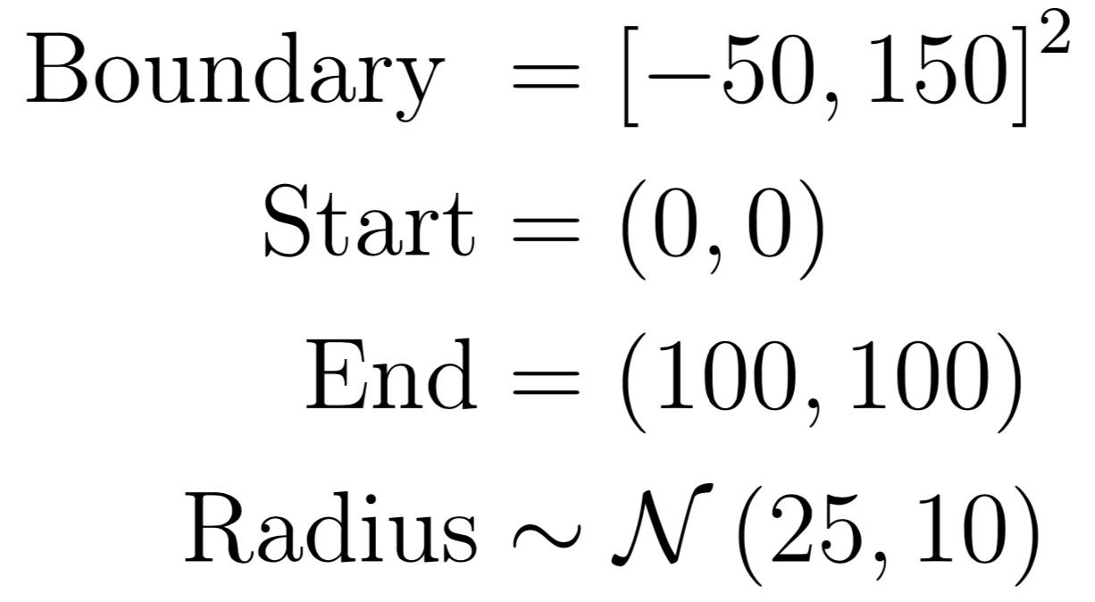
Methods for Autonomous Path Planning
Abhi Kulgod, Anthony Degleris, Isaac Scheinfeld
Motivation
Methods
Results
Graph Approximation and Optimization¹
This method approximates the best path by finding the shortest path in a space-filling graph, and then uses optimization techniques to stretch that path along the obstacles it passes by. The path is smoothed and stretched by using gradient descent to minimize the cost function
The sigmoid term penalizes being inside an obstacle, pushing the path outwards, while the second term keeps the points close together, stretching the path tight. As gradient descent converges we send and the sigmoid becomes increasingly steep, allowing the path to approach the obstacle in the limit.
Boundary function
Method Steps
Problem Setup
Environments were randomly generated with 1-8 circular obstacles distributed uniformly within the flight boundary. Those that covered start or endpoints were rejected. The goal was to plan a path within the boundary and outside of the obstacles, where a path was a sequence of points with adjacent points no more than 1 unit apart.
References
This method was developed jointly with Guillermo Angeris of StanfordAIR. His work can be found at https://guille.site.

