Slide 1

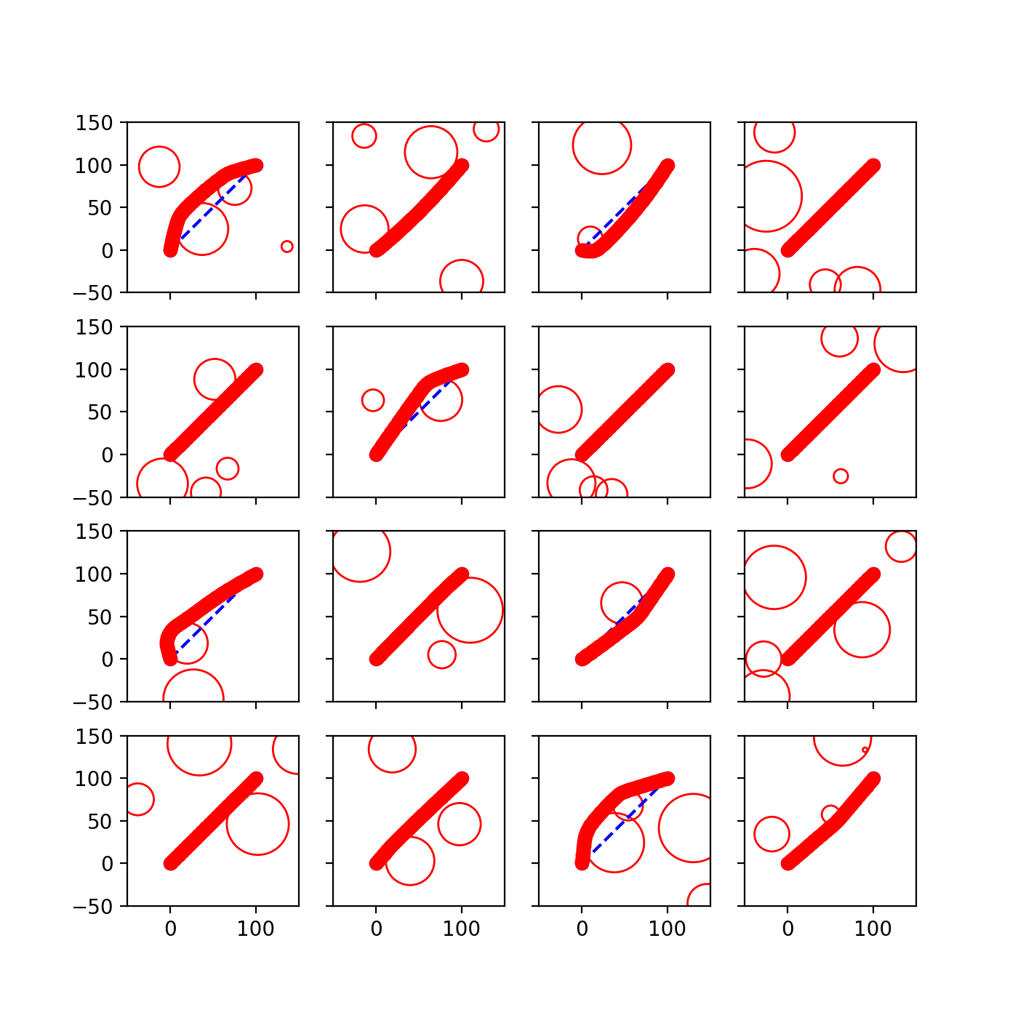
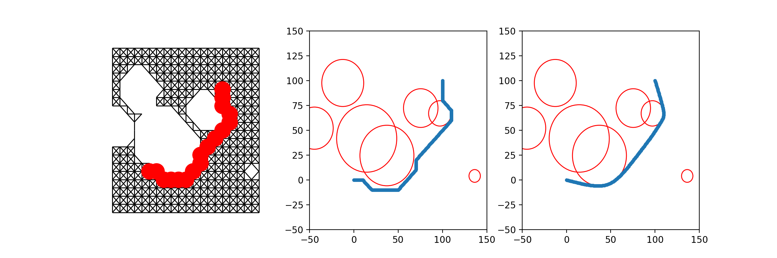
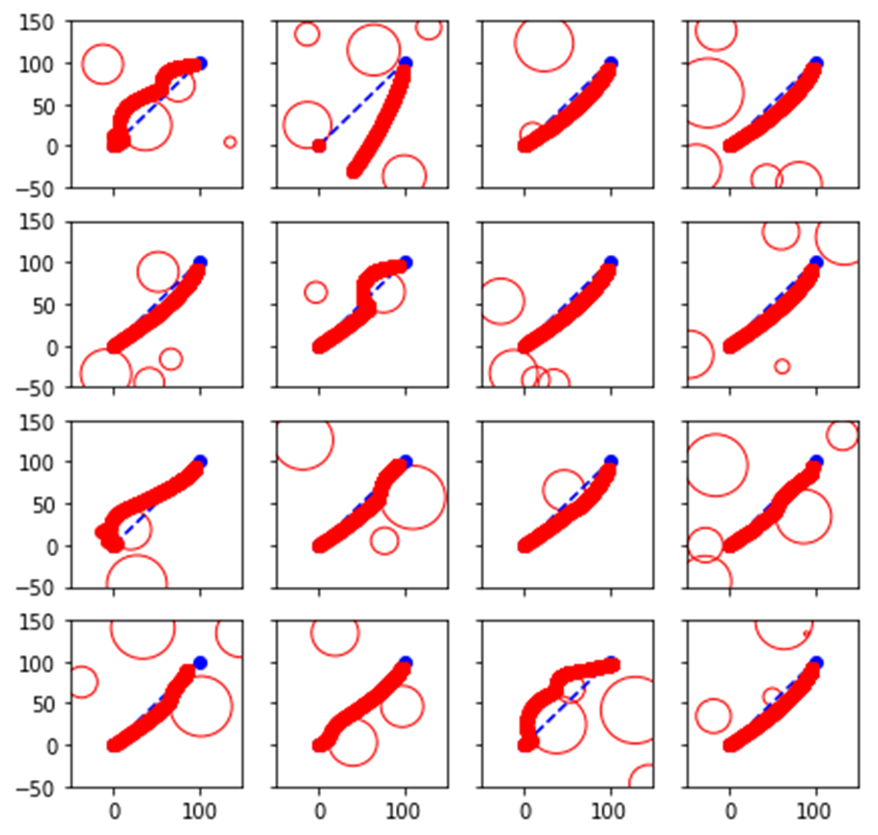
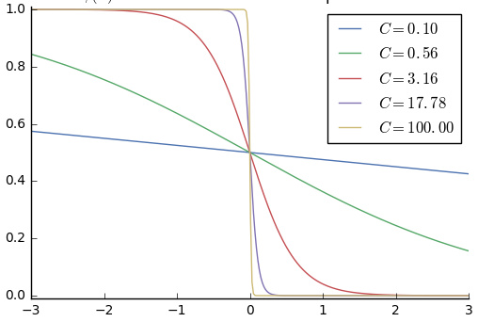
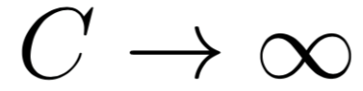
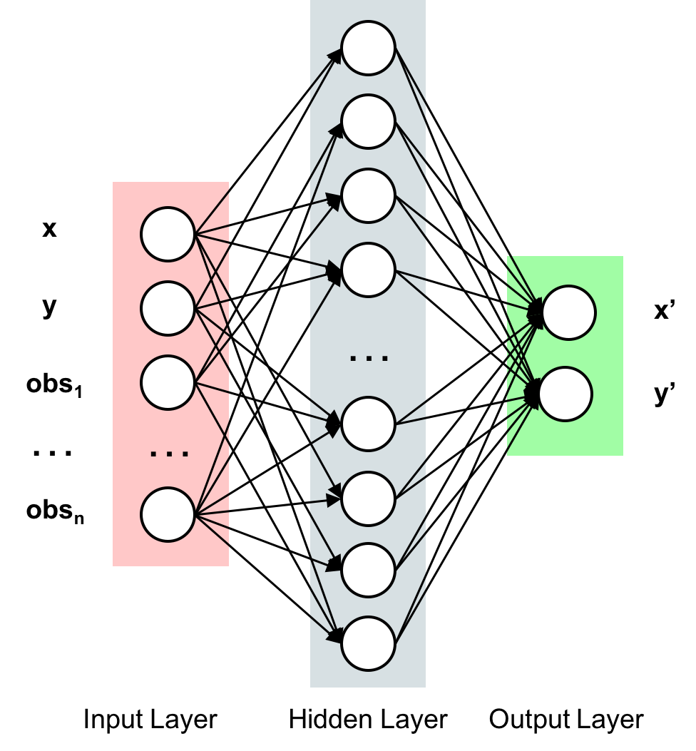
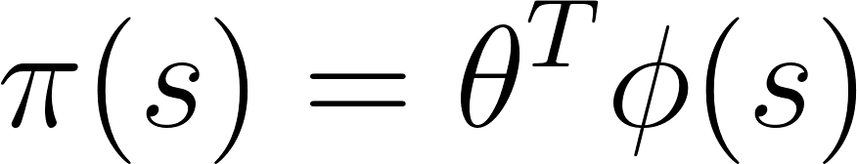
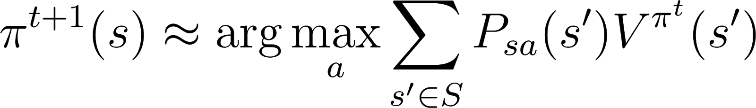
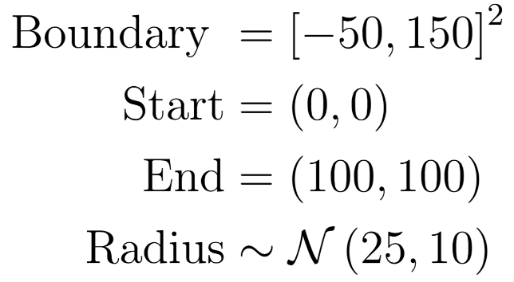
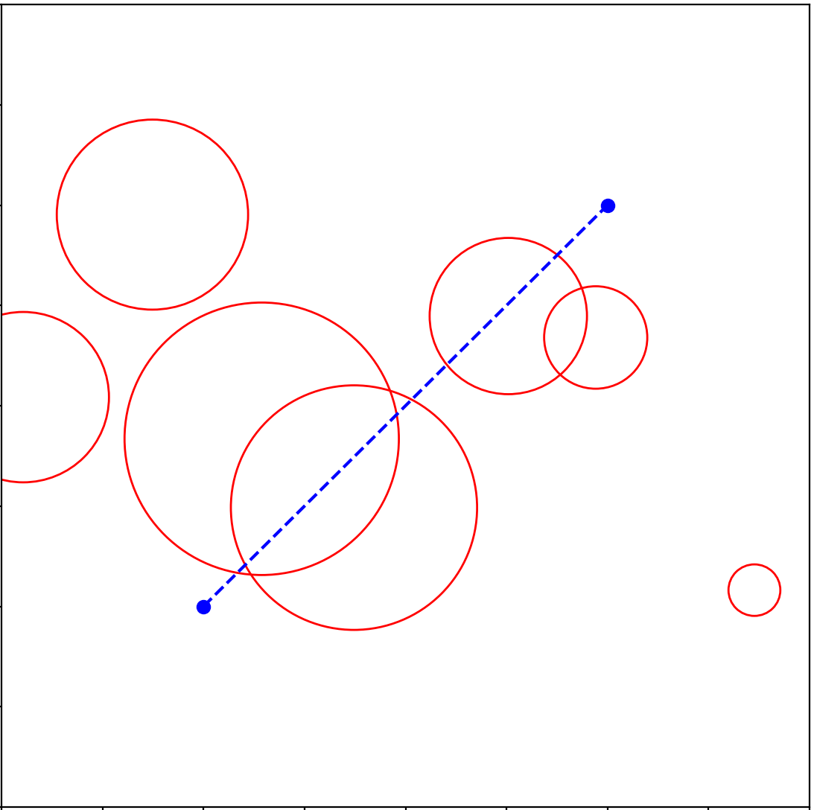
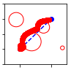
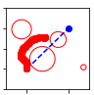
Methods for Autonomous Path Planning
Abhi Kulgod, Anthony Degleris, Isaac Scheinfeld
Motivation
Methods
Results
Path planning is the task of finding the optimal route between two points, avoiding any obstacles along the way
This task arises naturally in many vehicle control tasks, and our approach is modeled after drone navigation
Commonly used to maintain a safe distance from other aerial vehicles
Classical techniques often rely on simplifying assumptions and require a new solution each time the environment changes
Prefer a solution that makes fewer assumptions and generalizes well over different environments
Reinforcement learning techniques can implicitly learn a general solution
Graph Approximation and Optimization¹
Approximates the best path by finding the shortest path in a space-filling graph
Uses optimization (gradient descent) to stretch and smooth, minimizing
Sigmoid represents obstacle penalty. As
gradient descent converges, we send
hardening the boundary.
Algorithm | Success Rate | Average Path Length
Optimization | 1.0 | 156.4
FPI | 0.88 | 221.4
DFPI | ?? | ??
Fitted Policy Iteration (FPI)
Fit a model that predicts the path in general (not for a specific map)
State space is continuous and high-dimensional
Value function would be extremely complicated
Instead, estimate the policy directly
Update rule
Discussion
.
We could not train any fitted value iteration model to generate a meaningful model
The FPI model achieved surprising success
General models for path planning are possible
Direct policy approximation can replace value approximation in some problems
The DFPI results underperformed
Our neural network architecture failed to capture the feature complexity
Problem Setup
Randomly generated with 1-8 circular obstacles
Rejected obstacles covering endpoints.
Goal: Plan a path within the boundary and outside of the obstacles (path is a sequence of unit spaced points)
Deep Fitted Policy Iteration (DFPI)
Use a single layer feed forward neural network to improve policy approximation
Future Work
Neural Net Architecture
Improve NN architecture to capture problem
Address more complex problems (moving obstacles, path smoothness constraints, etc.)
Explore fitted policy iteration further, comparing it to fitted value iteration on known problems
Paths generated on one test map (DFPI fails)
References
[1]G. Angeris, "Some thoughts on global path optimization", 2017. [Online]. Available: https://guille.site/path-optimization-thoughts.html. [Accessed: 11- Dec- 2017].
[2]K. Gregory, V. A, V. Pong and P. Abbeel, "Uncertainty-Aware Reinforcement Learning for Collision Avoidance", 2017.
Optimization
FPI
Deep FPI

