Slide 1

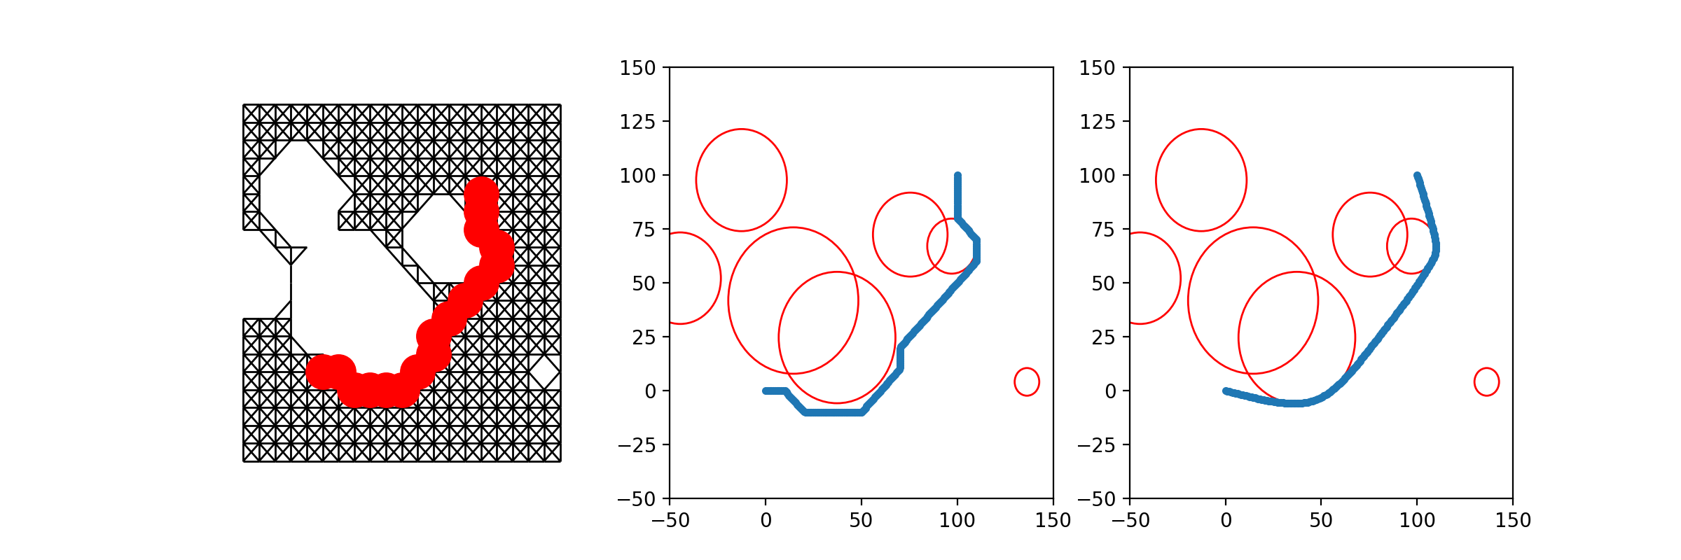
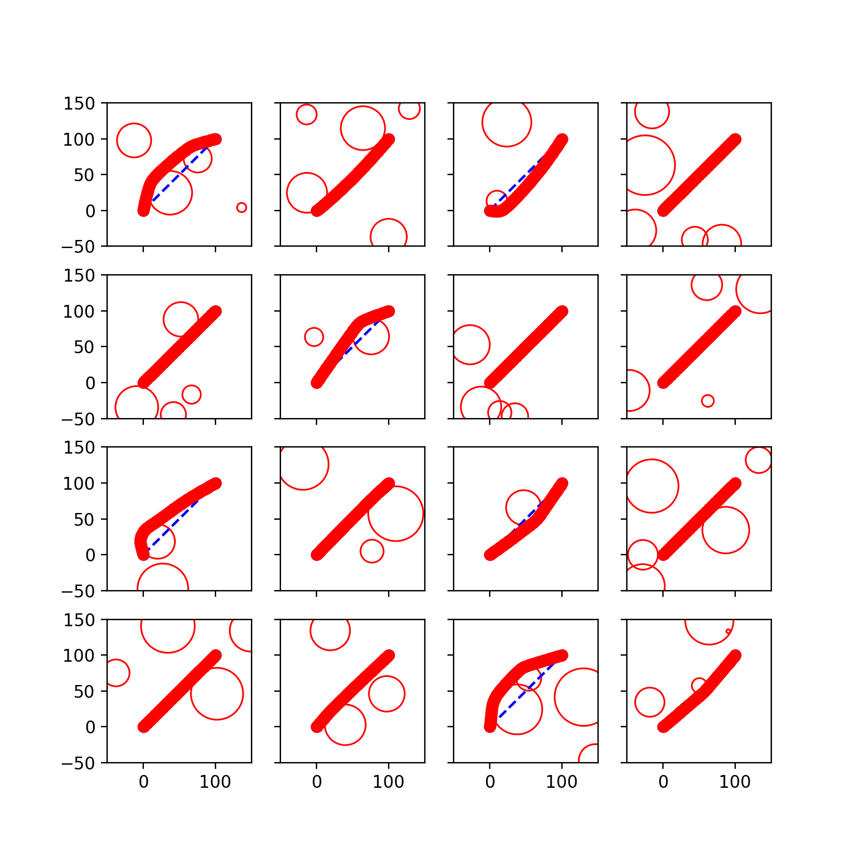
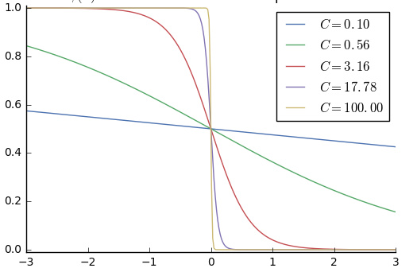
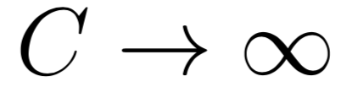
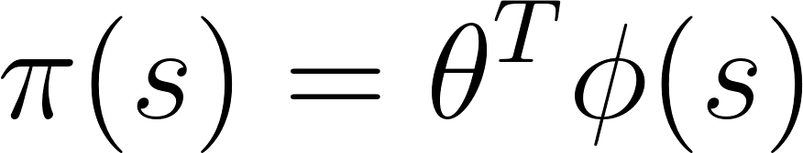
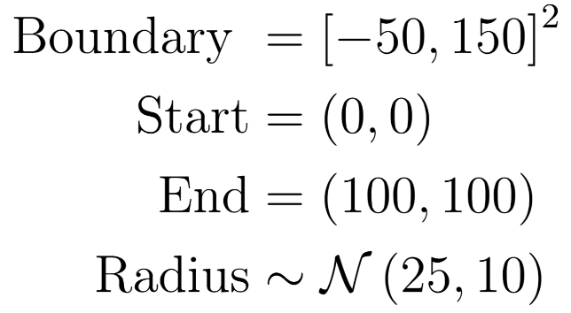
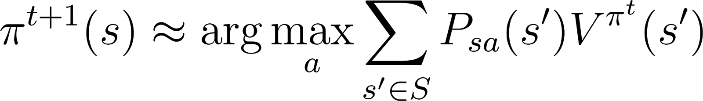
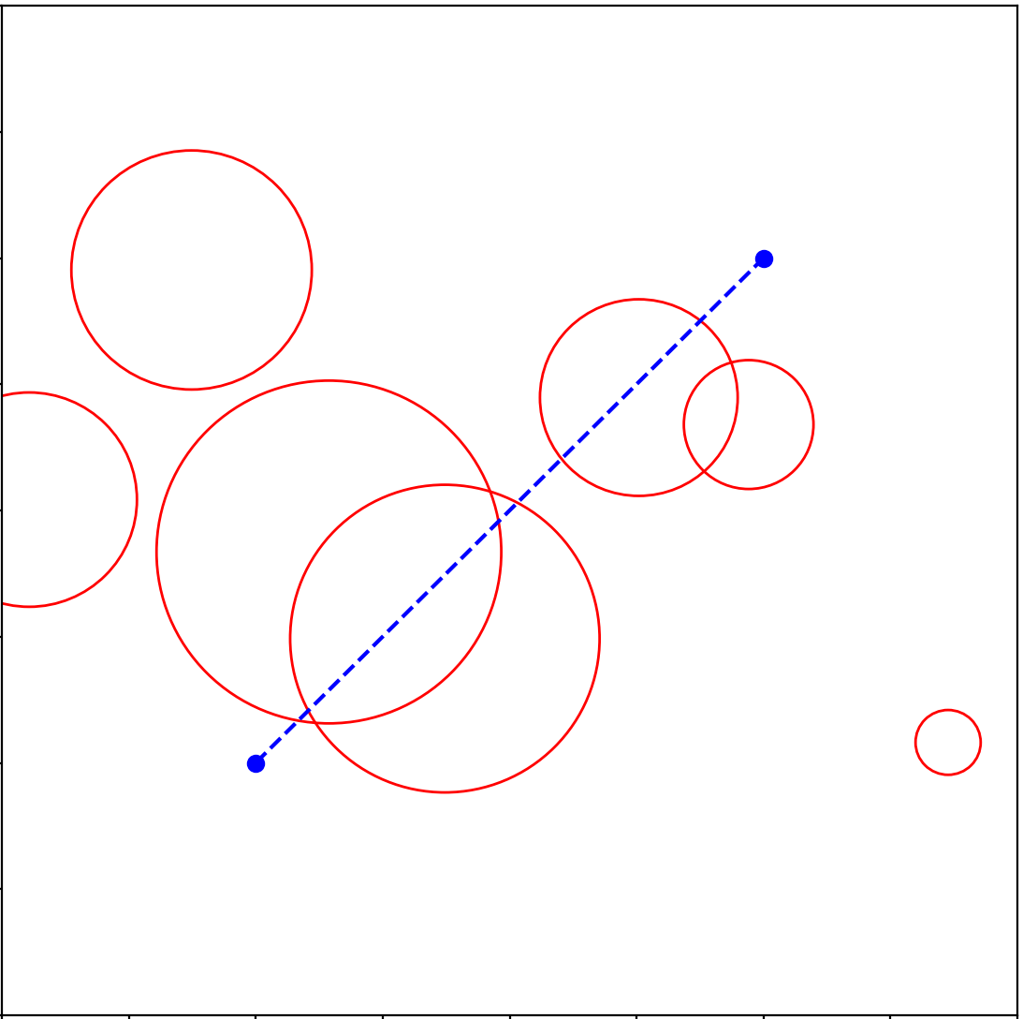
Methods for Autonomous Path Planning
Abhi Kulgod, Anthony Degleris, Isaac Scheinfeld
Motivation
Methods
Results
Path planning is the task of finding the optimal route between two points, avoiding any obstacles along the way
This task arises naturally in many vehicle control tasks, and our approach is modeled after drone navigation
Commonly used to maintain a safe distance from other aerial vehicles
Classical techniques often rely on simplifying assumptions and require a new solution each time the environment changes
Prefer a solution that makes fewer assumptions and generalizes well over different environments
Reinforcement learning techniques can implicitly learn a general solution
Graph Approximation and Optimization¹
Approximates the best path by finding the shortest path in a space-filling graph
Uses optimization (gradient descent) to stretch and smooth, minimizing
Sigmoid represents obstacle penalty. As
gradient descent converges, we send
hardening the boundary.
Algorithm | Success Rate | Average Path Length
Optimization | 1.0 | ??
FPI | 0.71 | 340.5
DFPI
Discussion
Problem Setup
.
Lorem impsum dorum
Randomly generated with 1-8 circular obstacles
Rejected obstacles covering endpoints.
The goal was to plan a path within the boundary and outside of the obstacles, where a path was a sequence of points with adjacent points no more than 1 unit apart.
Fitted Policy Iteration (FPI)
State space is continuous and high-dimensional
Value function would be extremely complicated
Instead, estimate the policy directly
Update rule
Deep Fitted Policy Iteration (DFPI)
Use neural network to improve approximation
References
[1]G. Angeris, "Some thoughts on global path optimization", 2017. [Online]. Available: https://guille.site/path-optimization-thoughts.html. [Accessed: 11- Dec- 2017].

