Slide 1
Principles of Robot Autonomy I
Section Logistics
Notes:
<number>

Slide 2
Sections
Modeled after sections in CS 106A/B/X/L
Provide hands-on experience for commonly-used tools in robotics
AKA tools you’ll be using for your homework and final projects
Taking feedback from previous years to heart
1

Slide 3
Section Logistics
First 15-30 minutes will be a presentation about the aims of the section, references, and a description of the hands-on activity you’ll be doing
Rest of the time (1.5+ hours) will be for you and a partner (your tablemate) to complete the hands-on activity
You submit your results on Gradescope when you’re done
1

Slide 4
Do I have to stay the whole time?
Once you complete the activity and submit your results, you can leave
1

Slide 5
Do I have to arrive on time?
Yes
… unless you have an overlapping class conflict. In that case, you should still arrive ASAP and make a group with someone else that is arriving similarly late
If you’re the only one that arrives late, then you can join an existing group
Section slides and the activity handout will be posted online, so you can still catch up
However, we will not stay after hours
5

Slide 6
Questions about Section Logistics?
5

Slide 7
Principles of Robot Autonomy I
Section 1: Introduction to Python3.8, Git, and Debugging
Notes:
<number>

Slide 8
Aims
Learn how to use Git for version control
Start working with Python 3.8 and some of its most common packages
Tips and tricks for debugging
7

Slide 9
OS Setup
Only need a local Python 3.8 installation for the first two sections
Later, we’ll be providing a server for running ROS remotely and rendering the visualization on your laptop
You have three options:
Install Python and run your scripts locally on Windows/MacOS/Linux
Set up a dual boot with Ubuntu 20.04
Set up a virtual machine with Ubuntu 20.04
7
Notes:
This year, we won’t be expecting you to install ROS locally on your machines – if this is something you’d like to do, you can, but instead we’ll be providing a server where you can collaborate with project partners to run ROS.
Thus, we only expect you to have a Python 2.7 installation locally and be able to run “basic” scientific computing packages i.e. numpy, scipy, etc.
However, if you’d like, we do want to point out you have two additional options to running locally:
You can set up a dual boot where you partition your hard drive to run a second OS (in this case, Ubuntu 16.04). This allows you to allocate full processing resources when you are running the second OS.
Alternatively, you can set up a VM (see the VM guide linked in the section hand out). The one draw back of the VM is that if your laptop isn’t very powerful, you may run into a very slow or laggy VM. But this way, you don’t have to partition the hard drive for the class and can delete the VM once you’re done with the class.
<number>

Slide 10
Git
Popular source code version control system
You probably already use it!
Github, BitBucket, etc. all support Git
Replaces the days of
Important_doc.docx
Important_doc_v2.docx
Important_doc_final.docx
Important_doc_final2.docx
Important_doc_final2_USE_THIS_ONE.docx
10
Notes:
<number>

Slide 11
Git
Strongly recommend getting used to using Git on your homework, sections, project, etc.
If you have a Github account, you can fork the homework repo and clone that out
11
Notes:
While you don’t necessarily need Git if you’re just working on the homework, we do encourage you to use it as a trial process for learning the simple commands e.g. `git commit`, `git push`, etc.
When it comes around to working in your groups of four, you’ll be much more comfortable in handing off code to your partners and all developing code on the same code base at the same time.
<number>

Slide 12
Python 3.8
We assume you already have some programming experience at the level of CS 106A
As a result, rather than providing a full-blown tutorial about Python, we’ll direct you to a previous year’s Python + NumPy tutorial (hands-on!)
It can be found online at: http://asl.stanford.edu/aa274_win1819/pdfs/recitation/Tut3_NumPy.pdf
11

Slide 13
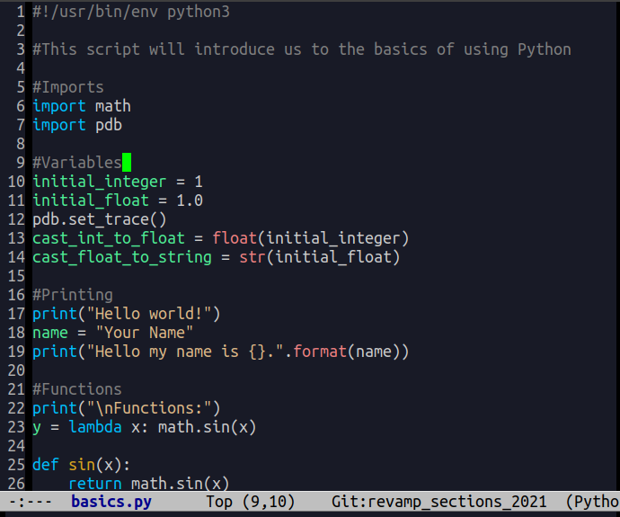
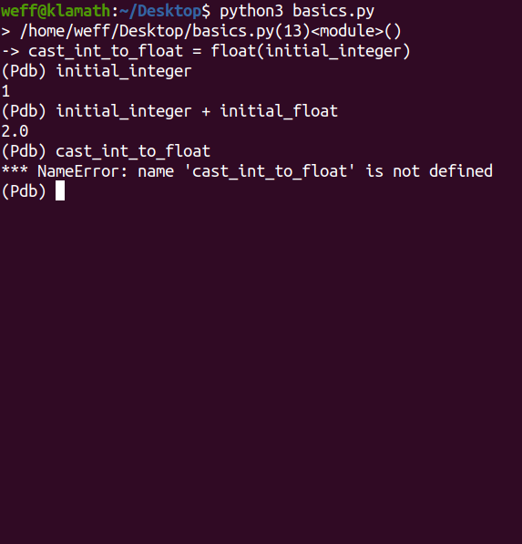
Debugging
pdb
11
Notes:
pdb is a useful tool that allows you to place break points in your code. For example, if you have a script with multiple function calls, you can click through and “inspect” the environment.
In the example here, you see that the initial_integer and initial_float variables are already instantiated and you can inspect those values and how they’re modified; but at this particular breakpoint, cast_int_to_float has no values as it hasn’t been assigned a value yet.
Warning: Make sure to remove any breakpoints or other debugging traces in your code during submission; this will cause the autograder to break!
<number>

Slide 14
Debugging
More generally the debugging process is:
Google it
Ask a peer in the class
Google it
If all else fails, then post on Edstem or at office hours
<number>
Notes:
In general, we want to emphasize that one of the objectives is to help you learn not only the technical content of how a robot stack comes together, but also the software engineering processes.
As a part of this, we really encourage you to learn how to leverage Google (and specifically Stack Overflow) as a tool for fixing common issues arising in Python and ROS before turning to your peers or the teaching staff.
<number>

Slide 15
Section 1
Focuses on Python and common use-cases for it in this course
We’ll ask you to perform a few basic mathematical operations and plot the results
<number>

