Slide 1
R an Introduction
A friendly beginning
Alma Parada
February 11, 2022

Slide 2
Pros and Cons of R
Modified from
https://techvidvan.com/tutorials/pros-and-cons-of-r/
Interact with databases
Software development
Machine learning
Various data types
Data cleansing, wrangling, webscraping
Compatible with other programming languages
Powerful Graphics
Flexible syntax
Parallel & distributed computing
Security
Package quality
Cross-platform
Slow speed
No compiler needed
Memory management
Massive contributions
Active Community
No dedicated support
STEEP learning curve
Statistics
Open-source

Slide 3

Goals of this Workshop
Reduce the fear
Familiarize yourself with the console & Rstudio
Learn basic and foundational vocabulary
Understand the basics of a function
Know where to get more packages and how to use them
Be able to find help and additional learning opportunities
Photo by Prateek Katyal on Unsplash

Slide 4
Course Outline
Hands-on Lab
Getting familiar with RStudio
Basic Commands
Objects
Vectors
Matrices & Data frames
Loading and exporting datasets
Packages
Case Study:
Microbial Community Analysis via Phyloseq & ggplot2
What is R?
Brief introduction
Getting started

Slide 5
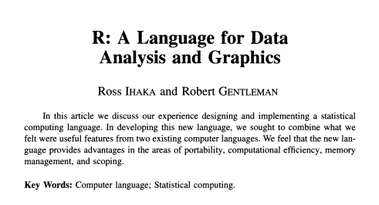
What is R?
Created in 1996
A system for statistical analyses and graphics
A software and a language
Based on the S language
Interpreted language
All commands entered are directly executed, you do not have to build a complete program
Dynamic programming language, R automatically interprets your code as your run it.

Slide 6
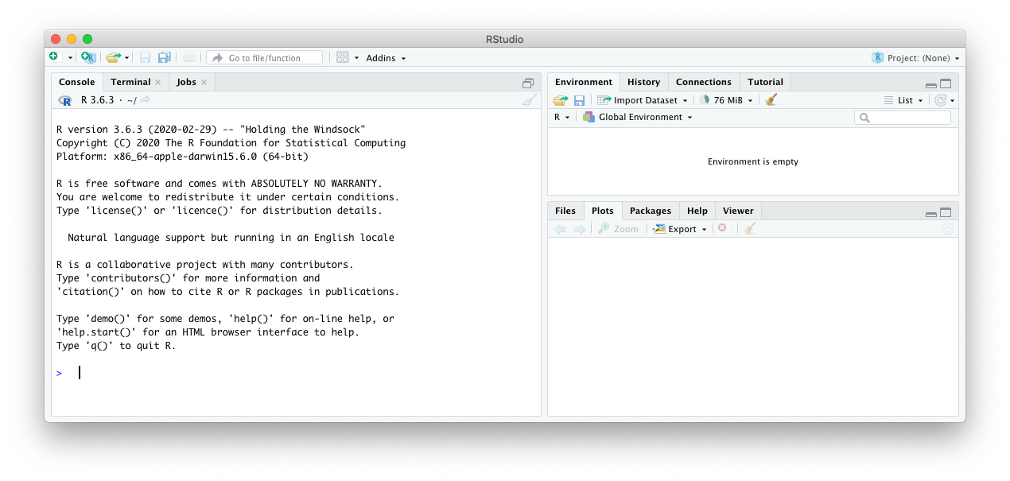
How to get started
You can access R directly from your terminal or its GUI
Today we will use RStudio
This provides you with a more user-friendly interface

Slide 7
Staying Organized
R Projects
Helps in keeping files organized by projects or analysis
Helps make work easy to share and reproduce
Opening a project file (.Rproj) directly and it will automatically start an Rstudio session and tell your computer that the relevant files are in the same folder
Commenting
Be generous in your use of comments!
Describe what you are doing in your words
Add the links to webpages you grabbed code from or found use full
Consider commenting on why something didn’t work rather than deleting all of the code, or comment the solution

Slide 8

Hands-on R time
Getting familiar with RStudio
Notes:
https://login.sherlock.stanford.edu/pun/sys/dashboard

Slide 9
Exercise 1 - Calculator
Let’s practice!
Choose a number and add 10 to it
Multiply the result by 3
Subtract 6 from the answer
Divide that answer by 2

Slide 10
Objects in R
When R is running, everything is in the active memory of the computer in the form of an object that has a name
Object = almost everything
Data set, variable, list, an integer, etc.
You can assign your own names to an object
x = 4 ; chicken = 2
You can perform actions on these objects
Operators Arithmetic, logical, comparisons, etc.
x + chicken will return 6
goose = x + chicken , where goose = 6
Functions A program or command stored as an object
factorial(goose)

Slide 11
Functions and Operators in R
A function is a set of statements organized to perform a specific task
Basic syntax
function_name <- function(arg1, arg2,…) {
Function body
}
function_name()
An operator is a symbol that tells R to perform specific mathematical or logical manipulations.
Tutorialspoint, R-operators
Sources:
Tutorialspint, R-functions
Tutorialspoint, R-operators
Notes:
Function Name − This is the actual name of the function. It is stored in R environment as an object with this name.
Arguments − An argument is a placeholder. When a function is invoked, you pass a value to the argument. Arguments are optional; that is, a function may contain no arguments. Also arguments can have default values.
Function Body − The function body contains a collection of statements that defines what the function does.
Return Value − The return value of a function is the last expression in the function body to be evaluated.

Slide 12
Hands-on R time
Objects

Slide 13
Exercise 2 - Objects
Let’s practice!
Save two numbers as two separate objects
Add the two numbers together and save it to a new object
Add 2 to the new object
Multiply all three objects together

Slide 14
Vectors in R
Vectors are a sequence of elements of a certain type
Two types of Vectors
Atomic vectors and Lists
Atomic vectors: All elements have the same type
Lists: R objects which contain elements of different types, like numbers, strings, vectors, and other lists. Lists can also contain a matrix of data or a function.

Slide 15
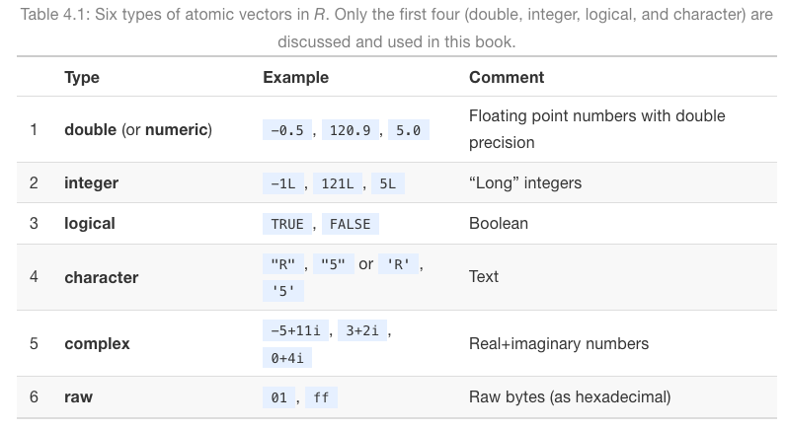
Atomic Vectors
We will focus mostly on atomic vectors, but will touch on lists peripherally
There are 6 atomic vector types, with 4 being most common
Both considered numeric
Most Common
Modified from https://discdown.org/rprogramming/vectors.html

Slide 16
Hands-on R time
Atomic Vectors – Part 1
Getting Familiar

Slide 17
Exercise 3 – Vectors
Let’s practice!
Create an integer vector with 10 elements, and a character vector with 4 elements
Check the data type for each vector
Find the mean and standard deviation for the integer vector
Create another numerical vector and multiply it to the integer vector

Slide 18
Working with Vectors: Element-wise execution
R does not follow rules of matrix multiplication
instead, it performs the same action on each element individually
Operation | z -1 | z / 2 | z * z
Element-wise execution | 1 - 1 | 1 / 2 | 1 * 1
 | 2 - 1 | 2 / 2 | 2 * 2
 | 3 - 1 | 3 / 2 | 3 * 3
 | 4 - 1 | 4 / 2 | 4 * 4
 | 5 - 1 | 5 / 2 | 5 * 5
Result | 0 1 2 3 4 | 0.5 1.0 1.5 2.0 2.5 | 1 4 9 16 25

Slide 19
Vector Recycling
Given two vectors of unequal lengths, R will repeat the shorter vector until it is as long as the longer vector
If the shorter vector does not divide evenly into the length of the long vector, R will return an error
Operation | q | 1:2 | z – 1:2
Element-wise execution | 1 | 1 | 1 - 1
 | 2 | 2 | 2 - 2
 | 3 |  | 3 - 1
 | 4 |  | 4 - 2
 | 5 |  | 5 - 1
 | 6 |  | 6 - 2
Result | 1 2 3 4 5 | 1 2 | 0 0 2 2 4 4

Slide 20
Hands-on
Atomic Vectors – Part 2
Performing actions on vectors
& basic statistics

Slide 21
Exercise 4 – Acting on vectors
Let’s practice!
Create a numerical vector of 100 elements
Identify 5 descriptive statistics about your data
Extra credit if you google search your way to other stats!
Save a histogram of your data in your output folder

Slide 22
Manipulating vectors
We can also select elements, create subsets, or modify vectors
There are many ways to do this:
Built-in Functions or use functions from other packages
Important thing to remember (especially for those knowledgeable of other languages) is that an R index begins with 1

Slide 23
Hands-on
Atomic Vectors – Part 3
Modifying vectors

Slide 24
Exercise 5 – Modifying vectors & stats
Let’s practice!
Create a numerical vector of at least 30 elements, include negative numbers
Subset all values greater than 0 and save them as new object
What is the mean, median, and variance of your new object?

Slide 25
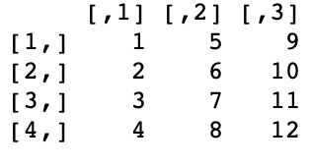
Matrix
A matrix is a two-dimensional data structure.
All the elements of a matrix must be of the same type (numeric, logical, character, complex).
Many of the functions we used to modify and manipulate a vector are similarly used to work with a matrix.
Now we just need to account for the rows and columns

Slide 26
Hands-on
Matrix

Slide 27
Exercise 6 – Working with a matrix
Let’s practice!
Create a numerical matrix object with 5 columns and 6 rows
Name the columns and rows
Find the mean value for your 3rd column

Slide 28
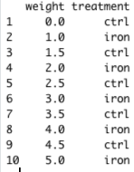
Data Frames
A data frame combines features of matrices and lists.
Basically, a rectangular list where each item has the same length
The items are the columns of the data frame
Each column must be the same type
Different columns can be different types

Slide 29
Hands-on
Data frames

Slide 30
Exercise 7 – Data frames
Let’s practice!
Create a 3 column by 5 row data frame, including a grouping variable
Name the columns and rows
Add a new column of data and create two new objects based on your grouping

Slide 31
Loading and exporting data
Lots of places to get Data
Import built in data
Often used in tutorials
Import tab-delimited (.txt), comma-separated (.csv) and many more!
Some file types may require installing new packages (we’ll get to it!)
Import from websites
Can import files such as .txt or HTML
Exporting data
Built in functions can help you export datasets and generated results
Installed packages can often help in making some output easier to export
Notes:
Download data https://drive.google.com/drive/folders/1GhHAjqD9rS_0GoLdUm_ASLBP3Bn5YXBC?usp=sharing

Slide 32
Hands-on
Loading and exporting data

Slide 33
Packages
What is a package?
A bundle of code someone else wrote, tested, and gave away.
Often designed to solve a specific problem.
May pull in functions from other packages (dependencies) or consist of a bundle of packages.
Tidyverse – consists of at least 8 packages
Where to get a package?
There are lots of places and methods, but best to begin through the Comprehensive R Archive Network (CRAN).
Most people wait until their package is stable (”bug free”) before submitting, so likely to have less problems
Can also get from other places, like GitHub

Slide 34
Hands-on R time
Install & load packages.

Slide 35
Using Phyloseq & ggplot2
Community Analysis
Phyloseq is a package that contains many functions to aid in analysis of microbial community analysis
Built-in functions call on many other stand-alone packages
Phyloseq object holds lots of data types, enabling easier access
This also helps in sharing multiple data set types for the same samples/communities
ggplot2 is a powerful visualization package that helps create publication “ready” figures
Phyloseq uses its own functions to call on ggplot2 functions
Structure of functions is very similar

Slide 36
Hands-on R time
Community analysis

Slide 37
You did it!
Take-aways
It’s going to take time and repetition
Write notes on your script to save you time later
Lots of great packages that can help you analyze your data
Consider the source, reach out to the developers
Many papers are now publishing their R scripts
Search forums and articles to get help and ideas
Often several solutions to a problem

Slide 38
Just a few additional places to learn more
Stanford
Can submit jobs to HPC
RStudio Server
Stanford Libraries SearchWorks – R data analysis
From the internet
Useful R commands
Importing Data
Info on commonly used built-in R datasets
Lots of publications for beginners with hands-on problem sets
Hands-On Programming with R
Youtube videos galore
R Markdown

Slide 39
Extra-credit – Google Searching Solutions
You have chemical measurements for many samples
you want to plotting line graphs
Google Search : line graphs ggplot2
First Hit
You need to count the number of times your chemical measurement went over a threshold
You want to learn about Loops
Google Search : Loops R
third Hit

