Slide 1
R an Introduction
A friendly beginning
Alma Parada
October 25, 2022

Slide 2
Pros and Cons of R
Modified from
https://techvidvan.com/tutorials/pros-and-cons-of-r/
Interact with databases
Software development
Machine learning
Various data types
Data cleansing, wrangling, webscraping
Compatible with other programming languages
Powerful Graphics
Flexible syntax
Parallel & distributed computing
Security
STEEP learning curve
Package quality
Cross-platform
Slow speed
No compiler needed
Memory management
Massive contributions
Active Community
No dedicated support
Statistics
Open-source

Slide 3

Goals of this Workshop
Reduce the fear of starting
Familiarize yourself with the console & Rstudio
Learn basic and foundational vocabulary
Understand the basics of a function
Know where to get more packages
Be able to find help and additional learning opportunities
Photo by Prateek Katyal on Unsplash

Slide 4
Course Outline
Hands-on Lab
Getting familiar with Rstudio
Basic Commands
Objects
Packages
Loading and exporting datasets
Vectors
Repetitive Tasks (Loops)
Matrices & Data frames
What is R?
Brief introduction
Getting started

Slide 5
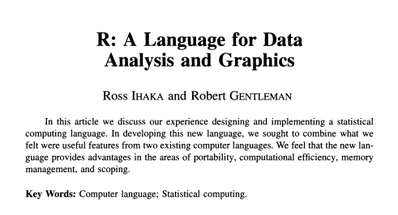
What is R?
Created in 1996
A system for statistical analyses and graphics
A software and a language
Based on the S language
Interpreted language
You do not have to build a complete program
Dynamic programming language
R automatically interprets your code as your run it

Slide 6
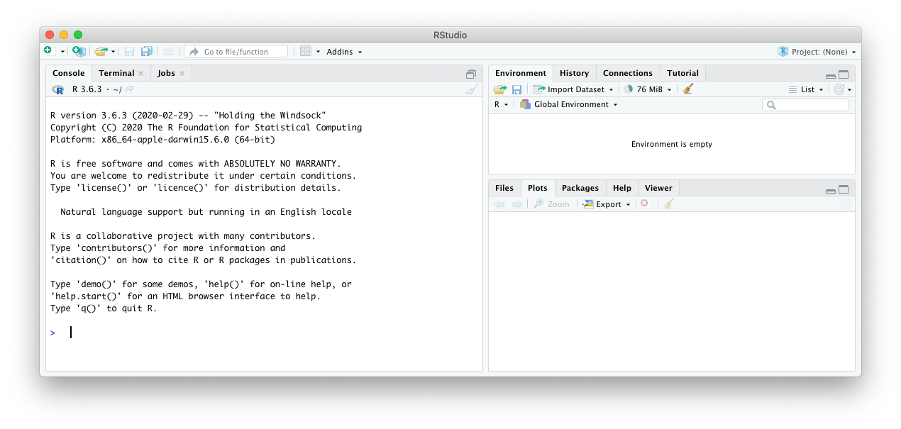
How to get started
You can access R directly from your terminal or its GUI
Today we will use RStudio
This provides you with a more user-friendly interface

Slide 7
Staying Organized
R Projects
Helps in keeping files organized by projects or analysis
Helps make work easy to share and reproduce
Opening a project file (.Rproj) directly and it will automatically start an Rstudio session and tell your computer that the relevant files are in the same folder
Commenting
Be generous in your use of comments!
Describe what you are doing in your words
Add the links to webpages you grabbed code from or found use full
Consider commenting on why something didn’t work rather than deleting all nonfunctional code, or comment the solution

Slide 8
Just a few additional places to learn more
Stanford
Can submit jobs to HPC
RStudio Server
Stanford Libraries SearchWorks – R data analysis
From the internet
Useful R commands
Importing Data
Info on commonly used built-in R datasets
Lots of publications for beginners with hands-on problem sets
Hands-On Programming with R
Basic R Guide for NSC Statistics
Youtube videos galore
R Markdown

