Slide 2
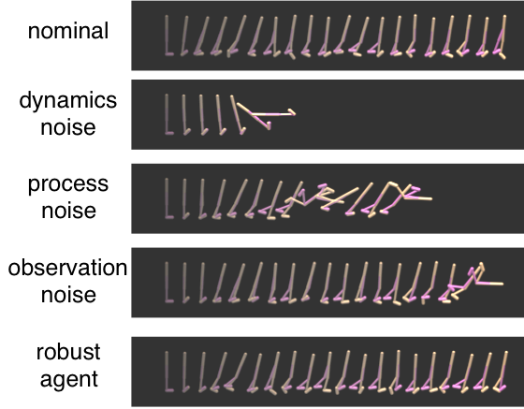
Nominal
Dynamics Noise
Process Noise
Observation Noise
ARPL Agent
Time

Slide 4
Hopper
Inv-Pendulum
Half-Cheetah

Slide 5
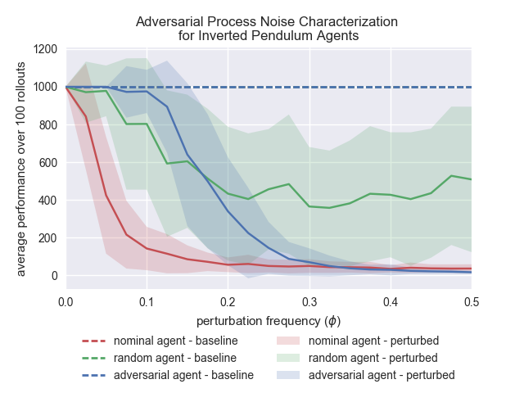
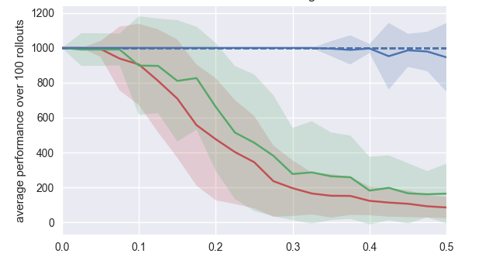

Inverted Pendulum
Adversarial Process Noise
Random Process Noise
Avg. Performance Over 100 Rollouts
Avg. Performance Over 100 Rollouts
(a)
(b)
Perturbation Frequency ($φ$)
Perturbation Frequency ($φ$)

Slide 6
Adversarial Process Noise
Random Process Noise
Avg. Performance Over 100 Rollouts
Avg. Performance Over 100 Rollouts
(a)
(b)
Perturbation Frequency ($φ$)
Perturbation Frequency ($φ$)

Slide 7
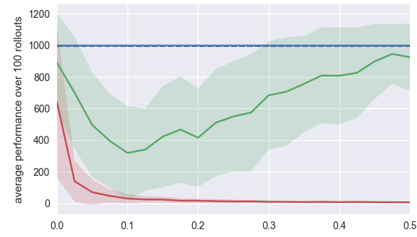
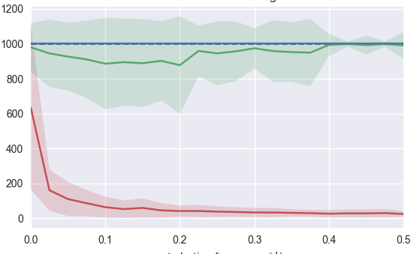
Inverted Pendulum
Adversarial Dynamics Noise
Random Dynamics Noise
Avg. Performance Over 100 Rollouts
Avg. Performance Over 100 Rollouts
(a)
(b)
Perturbation Frequency ($φ$)
Perturbation Frequency ($φ$)

Slide 8
Adversarial Dynamics Noise
Random Dynamics Noise
Avg. Performance Over 100 Rollouts
Avg. Performance Over 100 Rollouts
(a)
(b)
Perturbation Frequency ($φ$)
Perturbation Frequency ($φ$)

Slide 9
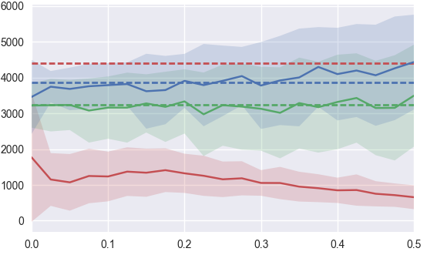
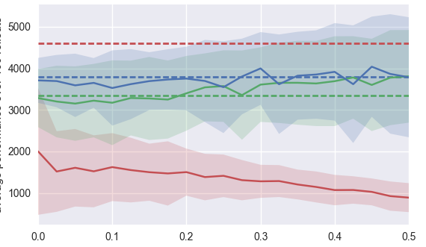
Walker
Adversarial Dynamics Noise
Random Dynamics Noise
Avg. Performance Over 100 Rollouts
Avg. Performance Over 100 Rollouts
(a)
(b)
Perturbation Frequency ($φ$)
Perturbation Frequency ($φ$)

Slide 10
Adversarial Dynamics Noise
Random Dynamics Noise
Avg. Performance Over 100 Rollouts
Avg. Performance Over 100 Rollouts
(a)
(b)
Perturbation Frequency ($φ$)
Perturbation Frequency ($φ$)

