Slide 1

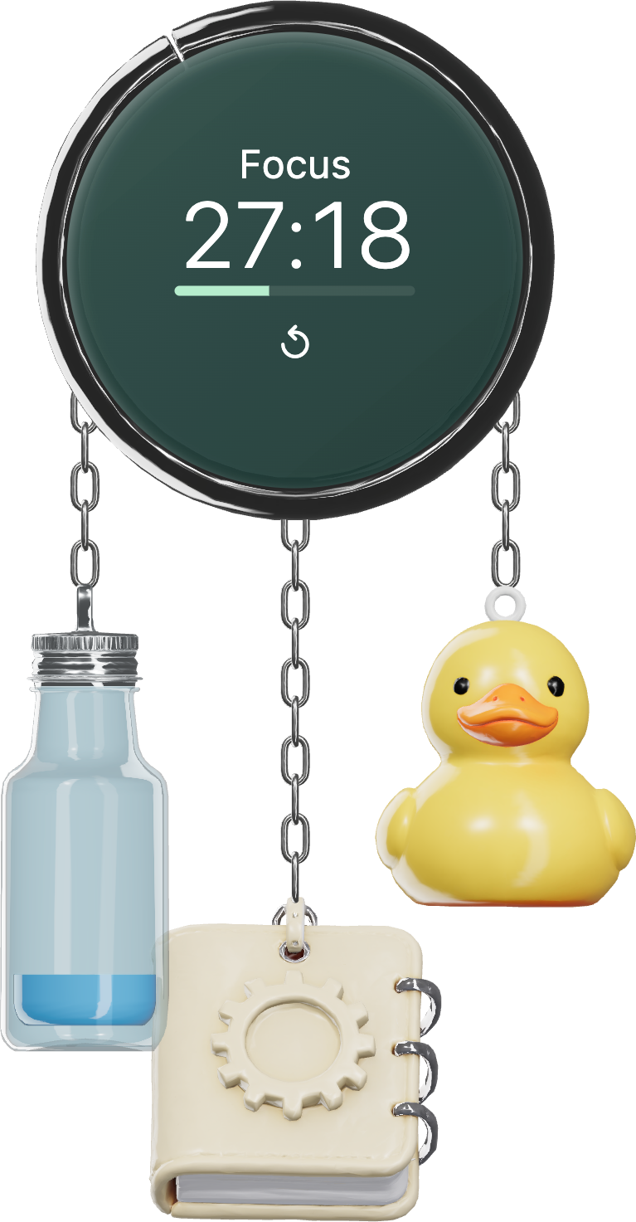
Charme
A desktop companion.
Notes:
Complete suspended arrangement with intact chain endpoints. Opening campaign composition.
Production: actual approved Magnific GLBs rendered by Charme Three.js scene; UI captures use fictional data. Generated backgrounds and display hardware are illustrative. Blue editorial edition, 3 October 2026.

Slide 2
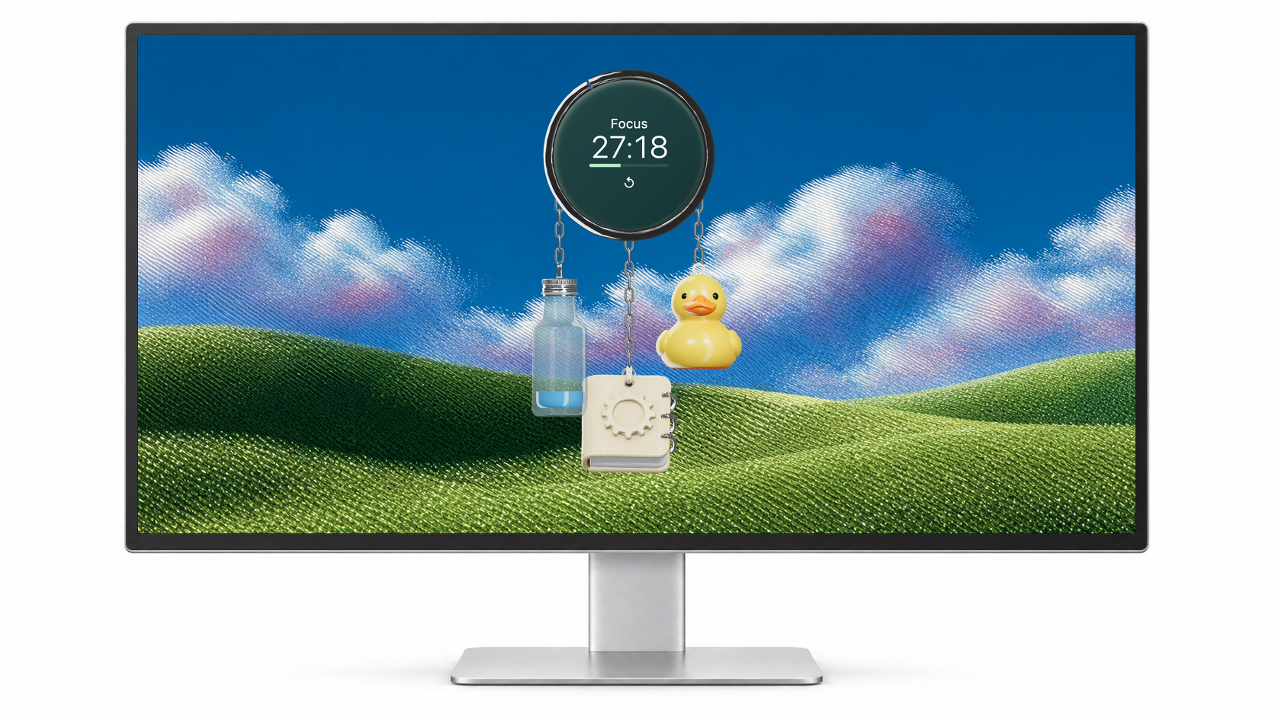
On your desktop.
Illustrative desktop mockup. Widget enlarged to show detail.
Notes:
Generated silver display with front-on screen, generated landscape extension and real widget composited inside. Hardware image is illustrative, not a native screenshot.
Production: actual approved Magnific GLBs rendered by Charme Three.js scene; UI captures use fictional data. Generated backgrounds and display hardware are illustrative. Blue editorial edition, 3 October 2026.

Slide 3

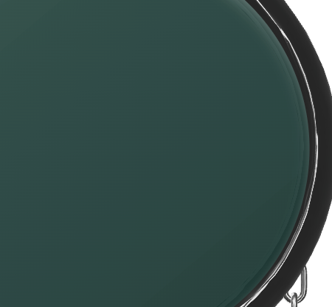
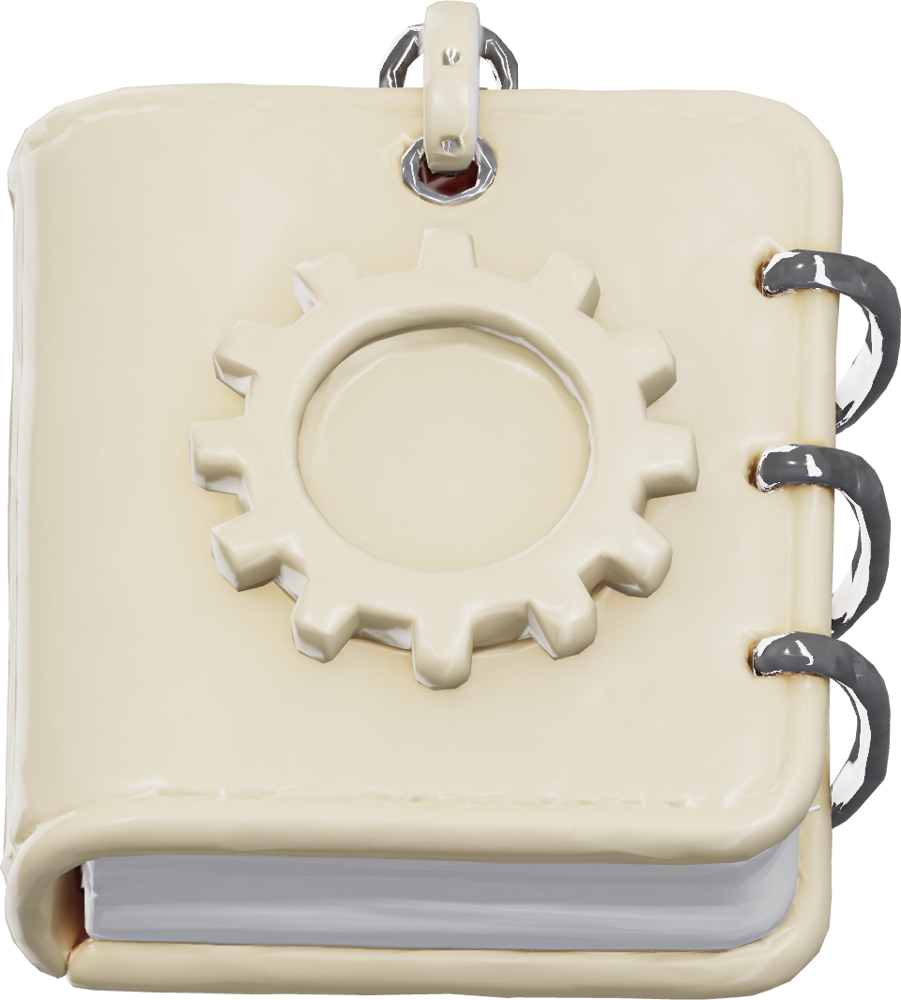
Chrome.
Glass.
Paper.
Reflective edges. A quiet surface.
Notes:
Deliberate macro crop of actual timer chrome and glass. Notebook uses existing embossed Magnific model.
Production: actual approved Magnific GLBs rendered by Charme Three.js scene; UI captures use fictional data. Generated backgrounds and display hardware are illustrative. Blue editorial edition, 3 October 2026.

Slide 4
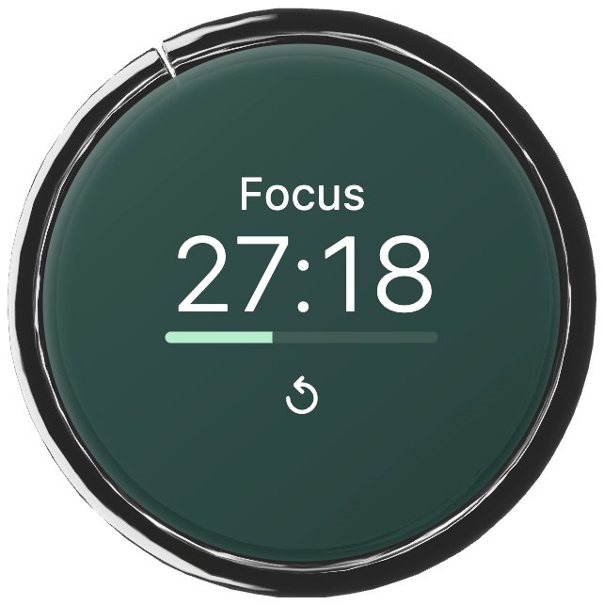
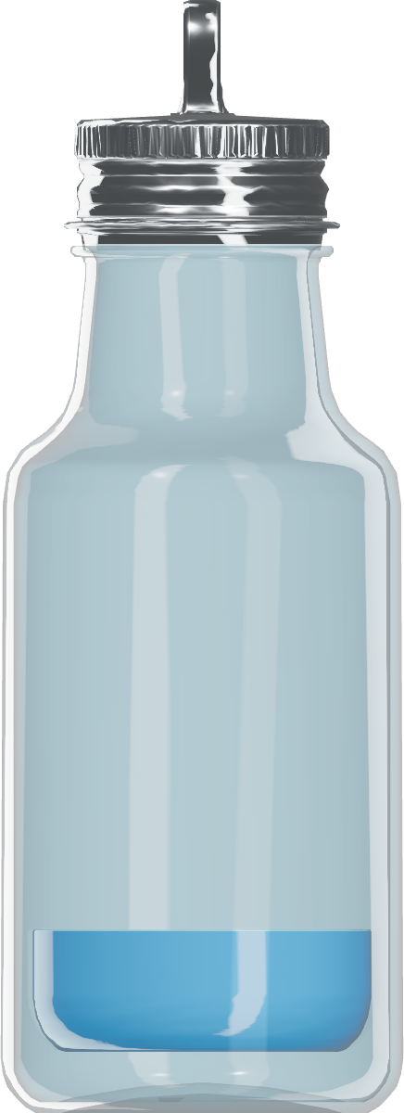
Focus
Water
Notebook
Notes:
Object studies from the production renderer, with unequal scale and aligned labels.
Production: actual approved Magnific GLBs rendered by Charme Three.js scene; UI captures use fictional data. Generated backgrounds and display hardware are illustrative. Blue editorial edition, 3 October 2026.

Slide 5
Focus.
Click to pause.
Click to resume.
Running
Paused
Notes:
Running and paused real component states; the app does not change timer face styling dramatically on manual pause. Captions disambiguate states. Timer commands verified in earlier isolated service test.
Production: actual approved Magnific GLBs rendered by Charme Three.js scene; UI captures use fictional data. Generated backgrounds and display hardware are illustrative. Blue editorial edition, 3 October 2026.

Slide 6
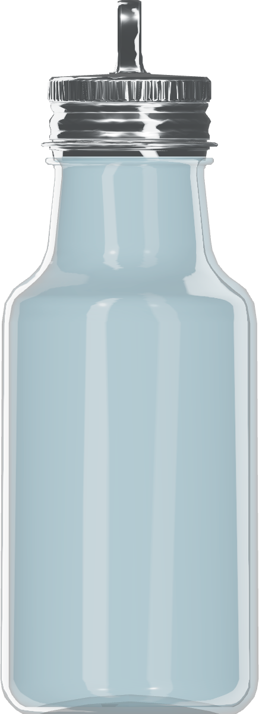
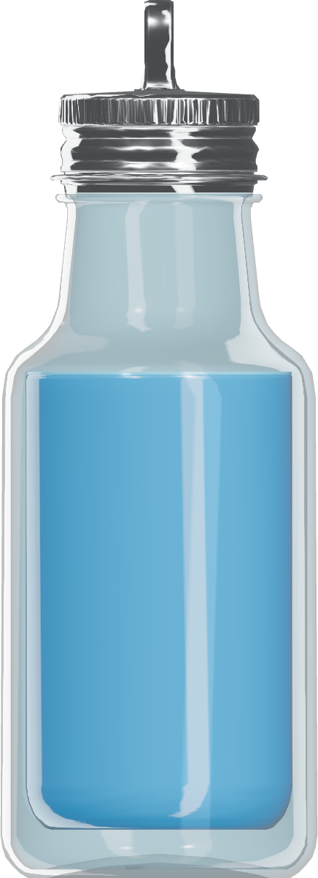
A little, often.
0 mL
350 mL
1.75 L
350 mL per serving. Default goal 1.75 L. Undo for 30 seconds.
Notes:
Exact 0%,20%,100% default hydration states. Visual fill represents consumed volume; configurable targets and overshoot remain exact in Controls.
Production: actual approved Magnific GLBs rendered by Charme Three.js scene; UI captures use fictional data. Generated backgrounds and display hardware are illustrative. Blue editorial edition, 3 October 2026.

Slide 7
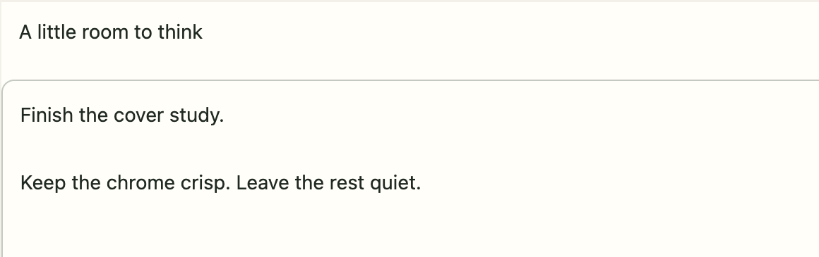
Keep a thought.
Open the notebook. Write. Saved on this Mac.
Notes:
Real note editor crop including Saved status. Fictional text. The crop omits surrounding dashboard navigation to preserve reading size.
Production: actual approved Magnific GLBs rendered by Charme Three.js scene; UI captures use fictional data. Generated backgrounds and display hardware are illustrative. Blue editorial edition, 3 October 2026.

Slide 8

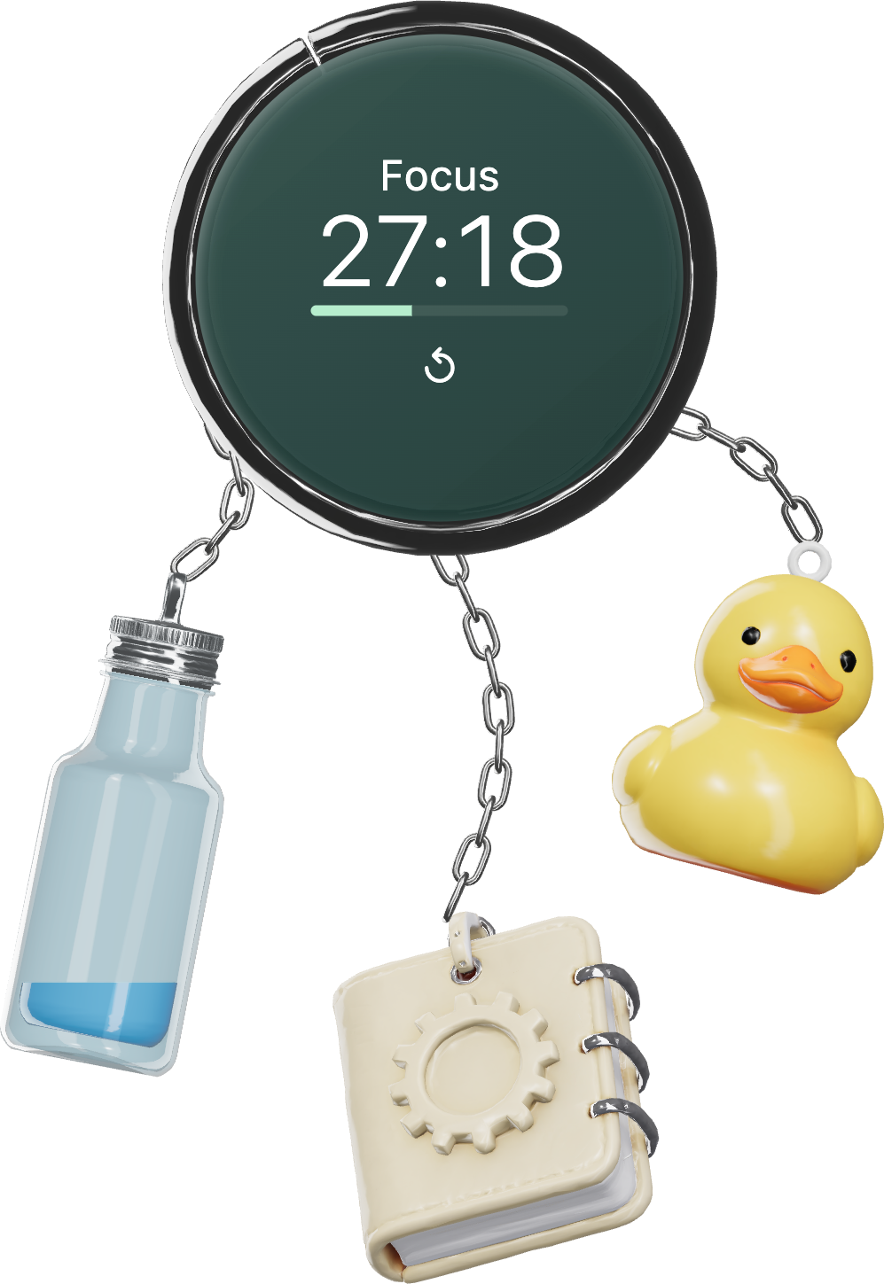
A little
movement.
Connected, even in motion.
Notes:
Staged dynamic pose using the same real meshes, per-instance transforms and connectedTether endpoint calculation. This still is not a live physics performance benchmark.
Production: actual approved Magnific GLBs rendered by Charme Three.js scene; UI captures use fictional data. Generated backgrounds and display hardware are illustrative. Blue editorial edition, 3 October 2026.

Slide 9
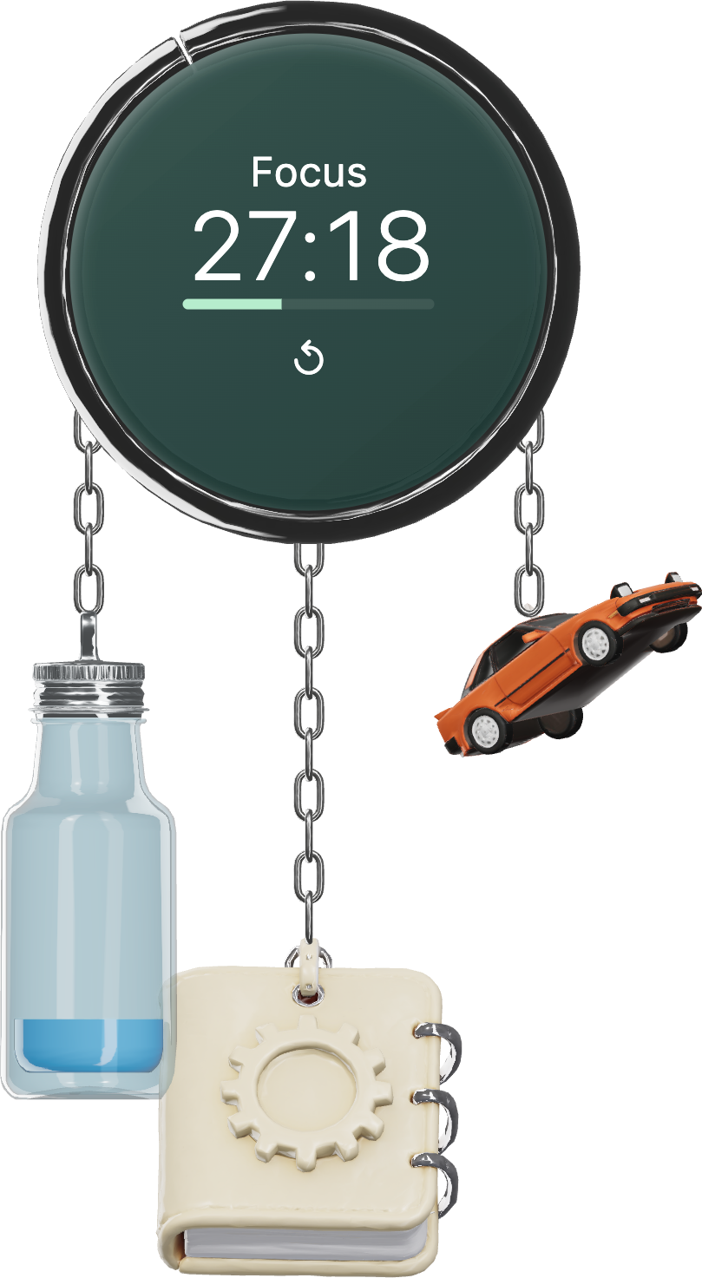
Make it
yours.
Ducky
Orange coupe
Notes:
Two achievable companion choices. Car uses calibrated roof-loop attachment; other fixed charms preserved.
Production: actual approved Magnific GLBs rendered by Charme Three.js scene; UI captures use fictional data. Generated backgrounds and display hardware are illustrative. Blue editorial edition, 3 October 2026.

Slide 10
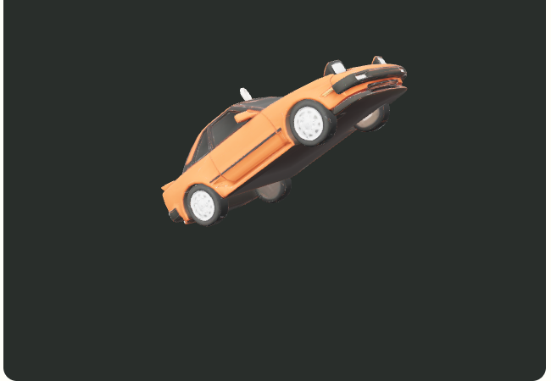


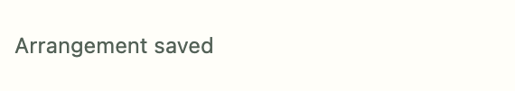
Preview.
Assign.
Apply.
Previewing does not change the arrangement.
Notes:
Actual Studio screenshots from the verified card preview, Replace in position A and Apply journey. Three crops retain relevant UI labels.
Production: actual approved Magnific GLBs rendered by Charme Three.js scene; UI captures use fictional data. Generated backgrounds and display hardware are illustrative. Blue editorial edition, 3 October 2026.

Slide 11
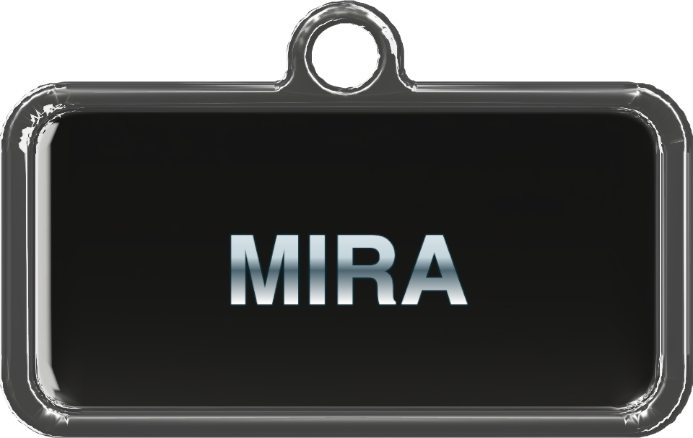
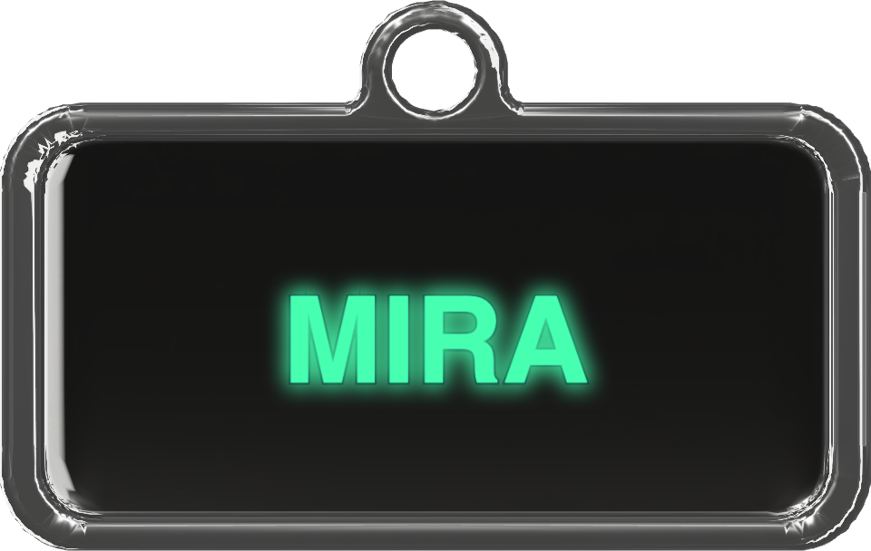
Your name.
Your finish.
Metal
Neon
Notes:
Same MIRA text and generated backing, same scale and camera. Metal and neon are dynamic material/text treatments.
Production: actual approved Magnific GLBs rendered by Charme Three.js scene; UI captures use fictional data. Generated backgrounds and display hardware are illustrative. Blue editorial edition, 3 October 2026.

Slide 12
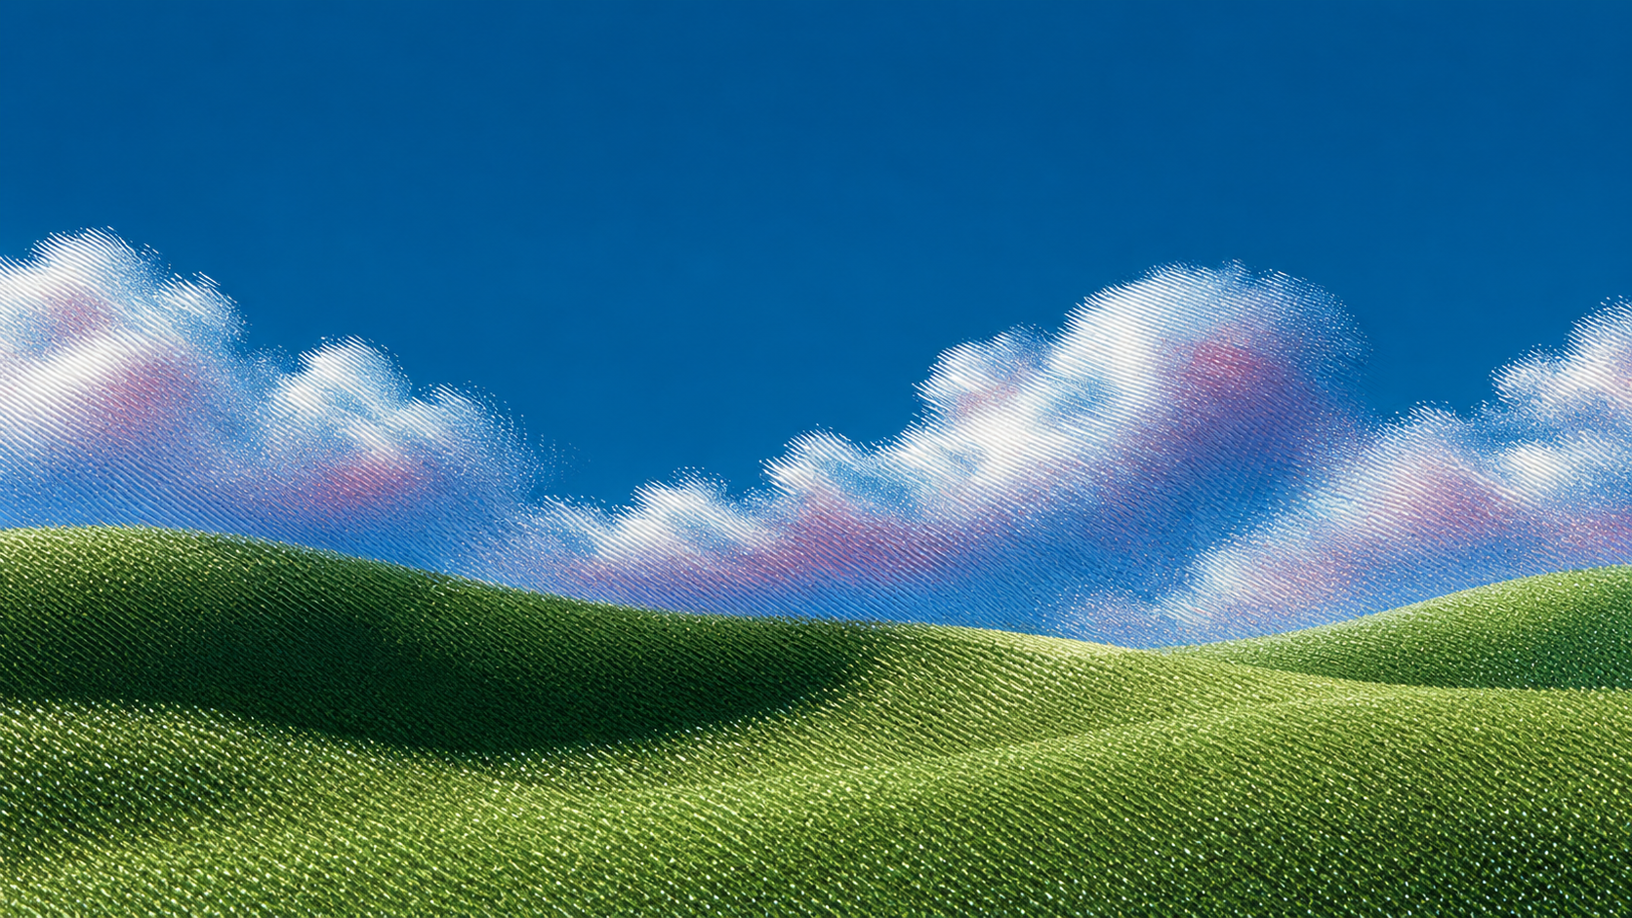
Charme
Browser preview
Installation status
A desktop companion.
Notes:
Composited desktop wallpaper context at illustrative scale. Browser preview and installation status link to existing site, unchanged by this edition. Development preview, not a verified signed release.
Production: actual approved Magnific GLBs rendered by Charme Three.js scene; UI captures use fictional data. Generated backgrounds and display hardware are illustrative. Blue editorial edition, 3 October 2026.

