Slide 1
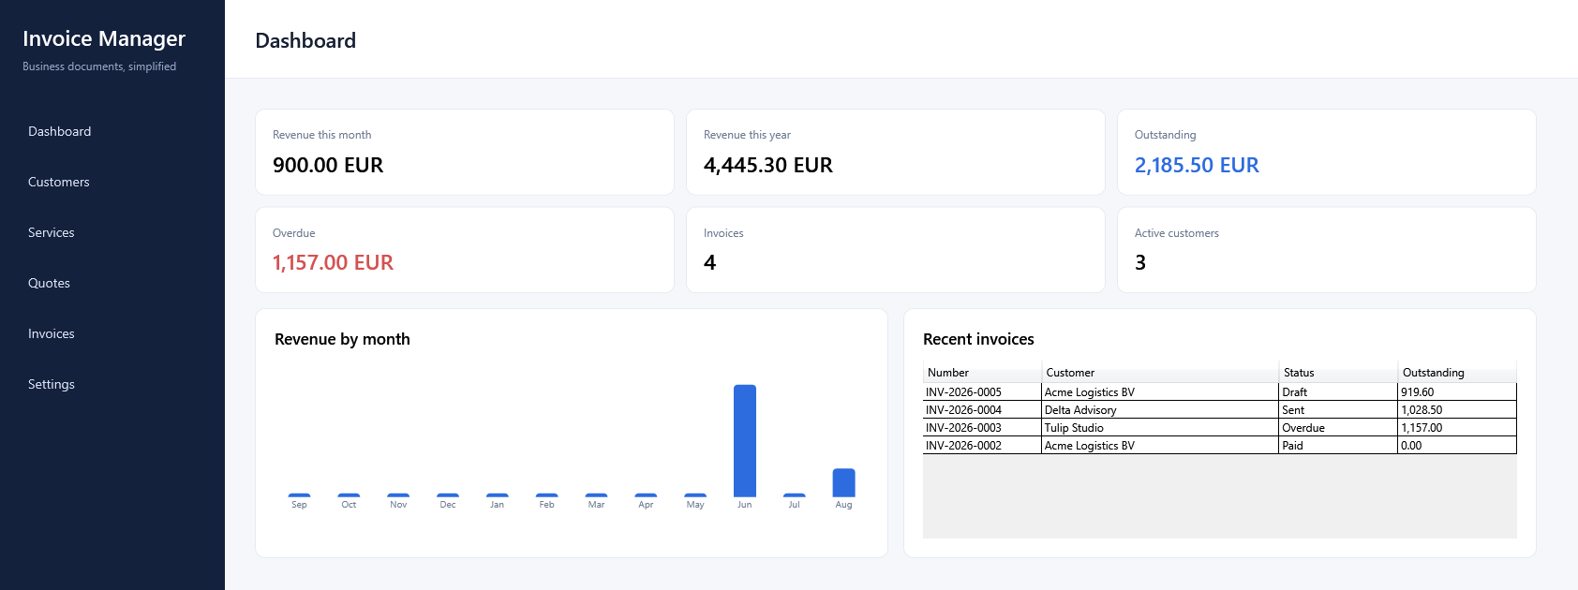
01 / PRODUCT
Invoice
Manager
Local-first quotation and invoicing
application for Windows
.NET 10 · WPF · Clean Architecture
EF Core · SQLite
97
0
win-x64
automated tests
build warnings
self-contained
Portfolio project · v1.0.0
Notes:
[Sources]
Local repository screenshot: docs/images/screenshots/01-dashboard.png
Project facts: README.md; docs/releases/v1.0.0.md

Slide 2
02
One workflow from quote to payment
A focused product boundary for freelancers and small businesses.
01
02
03
04
05
Company
Quote
Invoice
Payment
Reporting
Profile + defaults
Snapshots + VAT
Atomic numbering
Partial/full + voiding
Derived metrics
Local-first · EUR · SQLite · no cloud account required
INVOICE MANAGER / v1.0.0
02
Notes:
[Sources]
Project workflow and scope: README.md; docs/requirements.md; docs/business-rules.md

Slide 3
03
The difficult work is preserving business truth
Four invariants turn a CRUD workflow into dependable software.
01
Historical documents
02
Transactional numbering
Issuer, customer, line and logo snapshots keep issued output reproducible.
Numbers are allocated on first persistent save and protected by constraints.
03
Auditable payments
04
Deterministic time
Immutable transactions use one-time voiding instead of rewriting history.
Business dates and UTC audit instants are separated behind an injected clock.
INVOICE MANAGER / v1.0.0
03
Notes:
[Sources]
Implemented invariants: docs/domain-model.md; docs/business-rules.md; docs/decisions/README.md

Slide 4
04
Dependencies point toward the domain
Infrastructure implements ports; WPF remains a replaceable boundary.
APP
APPLICATION
DOMAIN
WPF · MVVM · Navigation
Use cases · Ports · Orchestration
Entities · Snapshots · Business rules
INFRASTRUCTURE
EF Core · SQLite · PDFsharp · File storage
Result: business rules remain testable without WPF or SQLite.
INVOICE MANAGER / v1.0.0
04
Notes:
[Sources]
Architecture implementation: docs/architecture.md; project references in src/*.csproj

Slide 5
05
The dashboard is derived from persisted business state
LIVE DASHBOARD
Revenue from active payments
Outstanding and overdue balances
Recent invoices
Zero-filled 12-month chart
Payment-based KPIs · balances · recent invoices · 12-month chart
No reporting cache or sample-only calculation layer.
INVOICE MANAGER / v1.0.0
05
Notes:
[Sources]
Local repository screenshot: docs/images/screenshots/01-dashboard.png
Dashboard behavior: docs/case-study.md; docs/testing-strategy.md

Slide 6
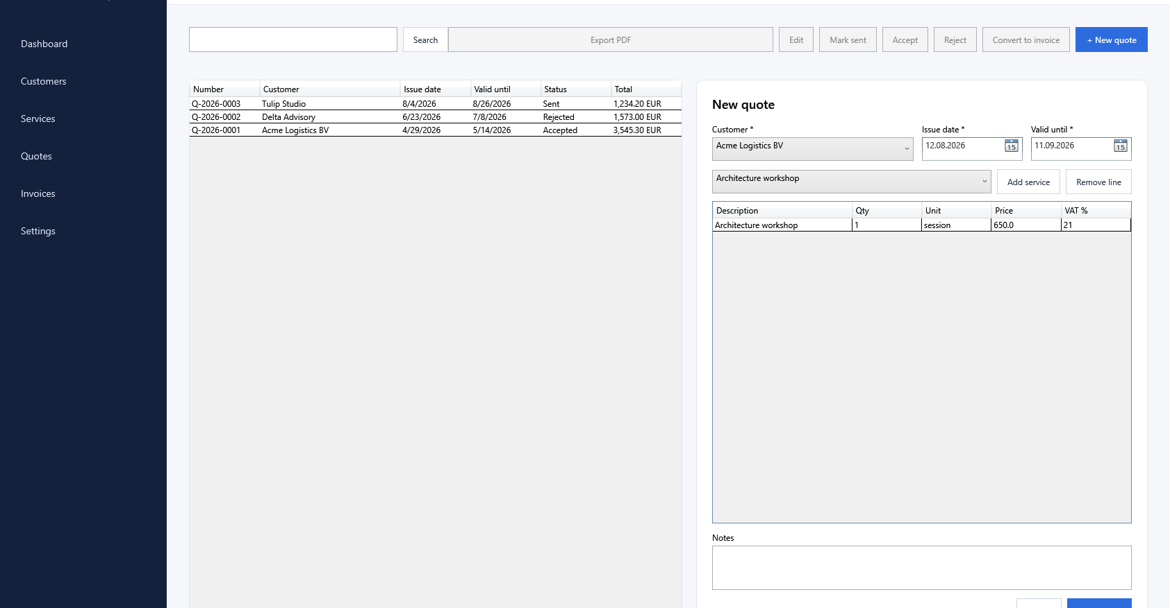
06
The quotation editor captures a stable business snapshot
QUOTATION WORKFLOW
Active customer and service selection
Editable line snapshots
Centralized VAT calculation
Draft → Sent → Accepted / Rejected
One-time conversion to Invoice
INVOICE MANAGER / v1.0.0
06
Notes:
[Sources]
Local repository screenshot: docs/images/screenshots/02-quote-editor.png
Lifecycle and conversion rules: docs/domain-model.md; docs/business-rules.md

Slide 7
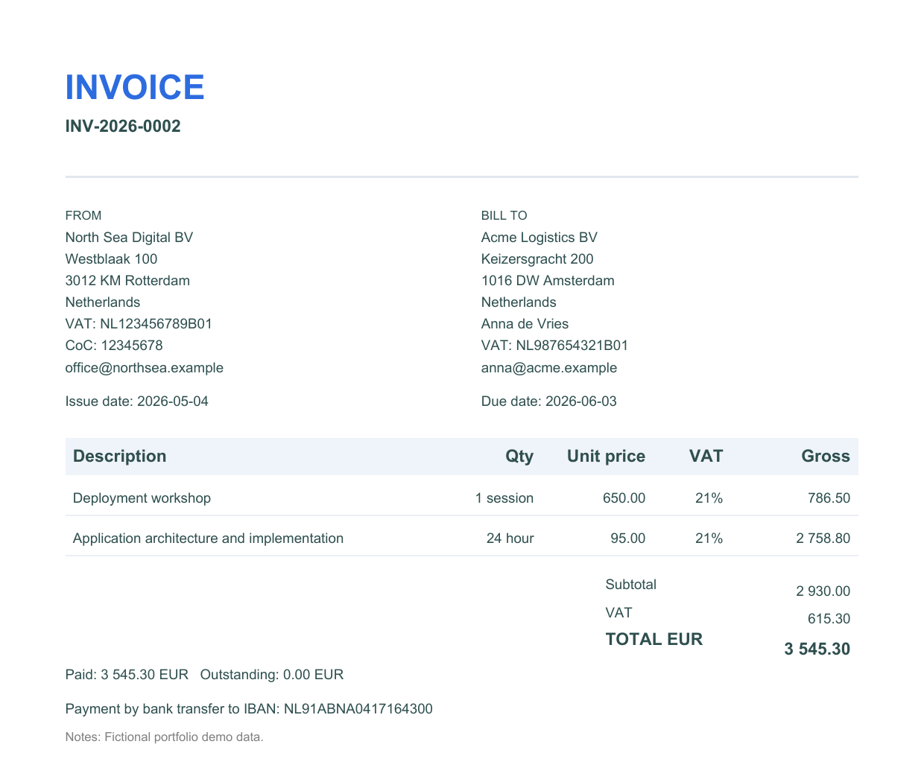
07
Issued documents remain reproducible
PDF generation reads persisted snapshots—not mutable source records.
Company changed?
Existing PDF unchanged
Customer moved?
Existing PDF unchanged
Service price changed?
Existing PDF unchanged
Logo changed?
Existing PDF unchanged
Snapshot boundary
Issuer · Customer · Items · Logo
INVOICE MANAGER / v1.0.0
07
Notes:
[Sources]
Local repository screenshot: docs/images/screenshots/03-invoice-pdf.png
Snapshot and PDF rules: docs/business-rules.md; ADR-0005; ADR-0009

Slide 8
08
Release quality is measurable
The same repository state was verified in a fresh clone.
97
0
0
0
automated tests
build warnings
build errors
known vulnerable dependencies
43 Domain
26 Application
28 Infrastructure
EF Core model verified
PDFs visually reviewed
Self-contained win-x64
INVOICE MANAGER / v1.0.0
08
Notes:
[Sources]
Verification evidence: docs/releases/v1.0.0.md; docs/milestone-reports/m7-completion.md; docs/testing-strategy.md

Slide 9
09 / RESULT
A small finished product—
with transparent engineering decisions
Invoice Manager demonstrates end-to-end software delivery:
v1.0.0
requirements → domain design → persistence → desktop UI
tests → documentation → release packaging
Windows x64
Local-first
GitHub-ready
Source, screenshots, ADRs, release notes and verified package prepared for publication.
Notes:
[Sources]
Project summary: README.md; docs/case-study.md; docs/releases/v1.0.0.md

