Slide 1

Arduino Based Fire Alarm System
By Stanimir, Stelian and Stoyan

Slide 2
Arduino Uno
Breadboard
Buzzer
Gas Sensor
I2C LCD Display
Components
Temperature Sensor
LEDs
Resistors
Potentiometer Buttons

Slide 3
Detects gas and temperature levels
Loud beeping sound when a potential fire hazard is detected
Ability to test and reset the alarm
Features
LCD Display monitors gas and temperature constantly
Adjustable gas threshold levels

Slide 4
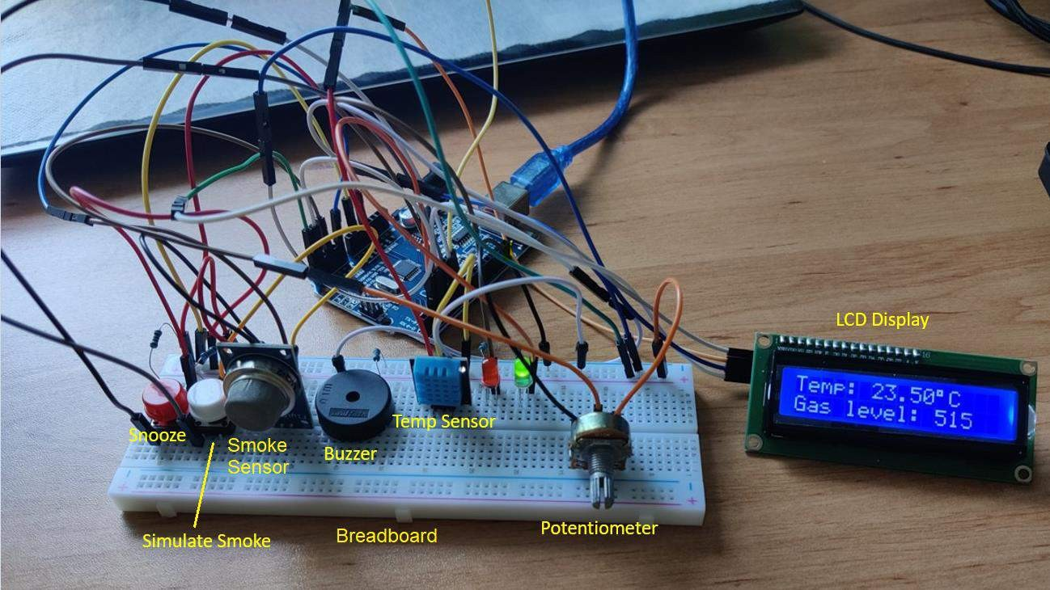

Slide 5
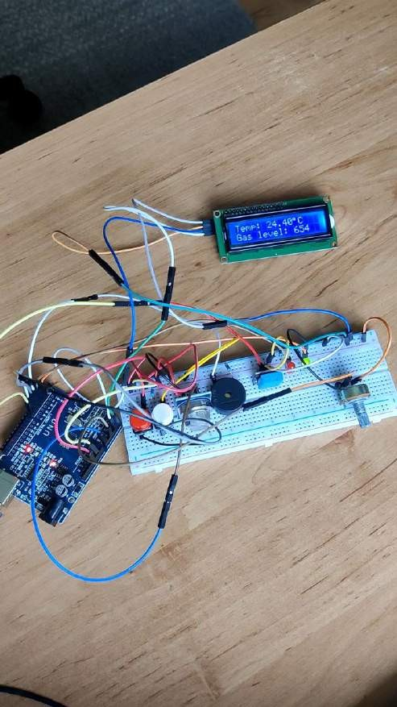

Slide 6


