Slide 1

PROS AND CONS OF AI
Student: Miroshnichenko Stanislav Sergeevich
Teacher: Reshetova Olga Alekseevna

Slide 2

Plan
1. History of AI
2. Main features
3. Pros and cons of AI
4. How will AI develop further?
5. AI usage statistics

Slide 3

Main features
It's Completely Free
It Understands Your Files
It's a Helpful Writer and Teacher
It's a Programming Assistant
It Has a Large Memory
It Can Search the Internet

Slide 4
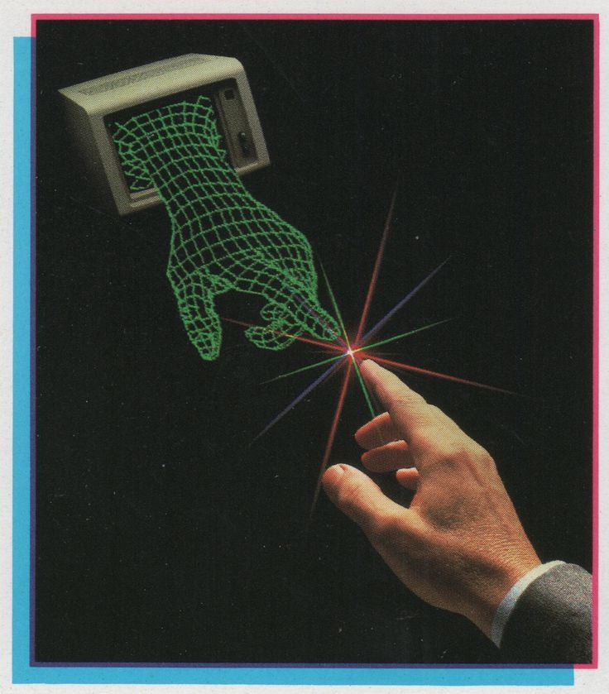
History of AI
1940s – Warren McCulloch & Walter Pitts create the first mathematical model of an artificial neuron, laying the foundation for neural networks.
2000s – Neural networks become actively integrated into internet technologies (search, recommendations, advertising).
2020s – Rise of generative AI models (ChatGPT, DALL·E, Midjourney) capable of creating text, images, videos, presentations, and code – becoming part of everyday life.

Slide 5
Pros of AI
The advantages of AI
✅High Efficiency: AI automates repetitive tasks to save time.
✅24/7 Availability: Machines do not need sleep, breaks, or vacations.
✅Reduction of Human Error: AI increases accuracy in calculations and data analysis.
✅Fast Decision-Making: Algorithms process massive datasets much quicker than humans.

Slide 6
Cons of AI
The disadvantages of AI
❌Job Displacement: Automation replaces human workers in many industries.
❌High Implementation Costs: Developing and maintaining complex AI systems is expensive.
❌Lack of Creativity: AI cannot think outside the box or feel true human emotions.
❌Bias and Discrimination: Algorithms can replicate prejudices found in their training data.

Slide 7
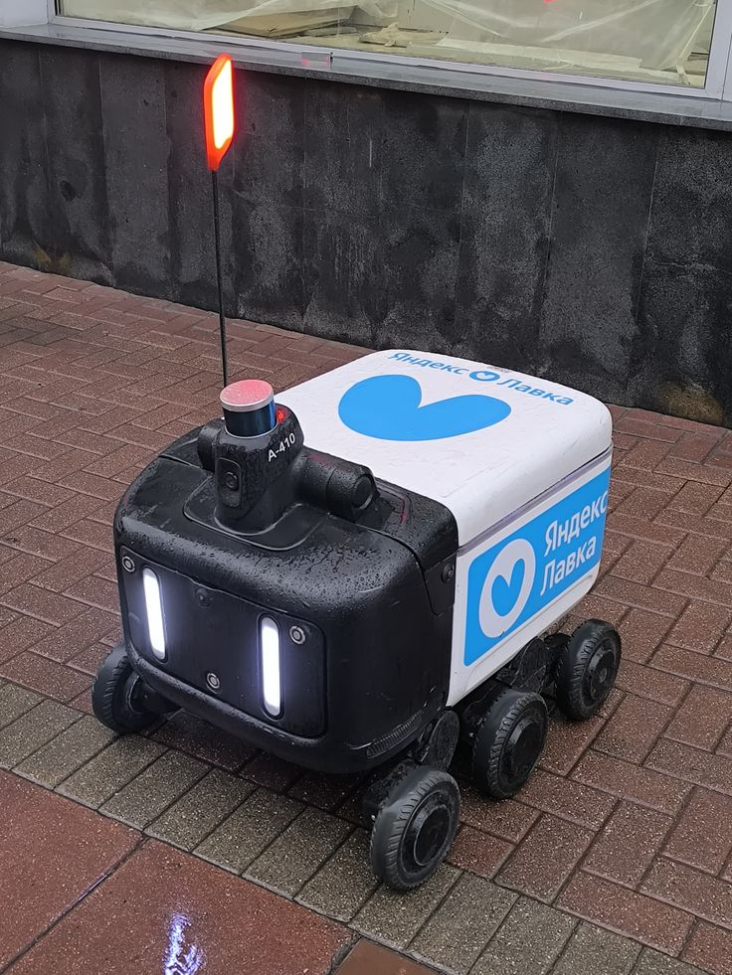
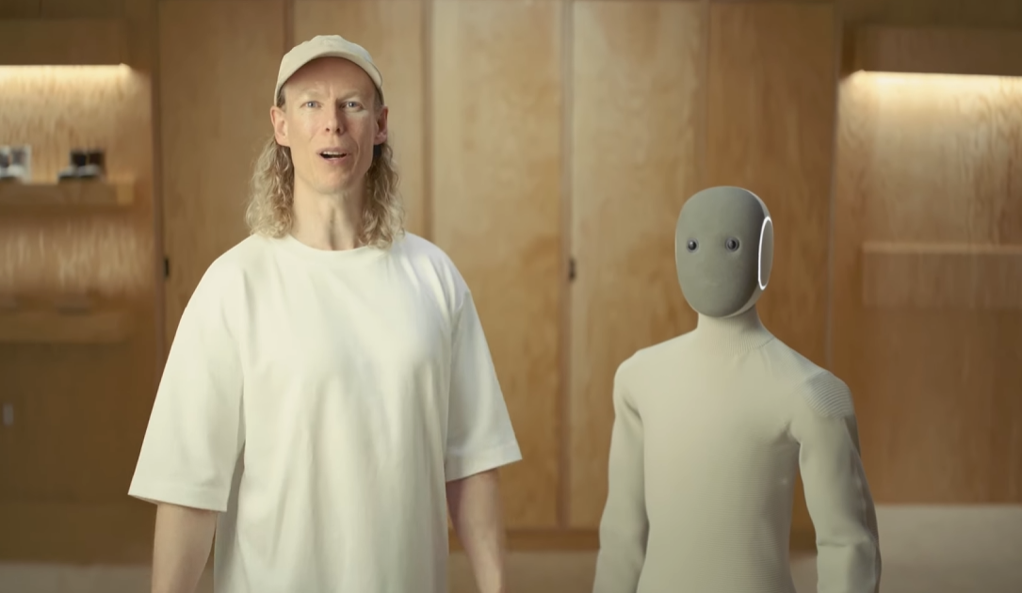
How will AI develop further?
The Shift to Autonomous Agents (Agentic AI): Autonomy—AI ceases to be merely a chatbot that responds sequentially to queries.

Slide 8
How will AI develop further?
Approaching AGI (Artificial General Intelligence): Timeline—Major laboratories (OpenAI, Anthropic, Google DeepMind) project the emergence of minimal AGI (intelligence equivalent to human intelligence across most cognitive tasks) as early as 2027–2028.

Slide 9
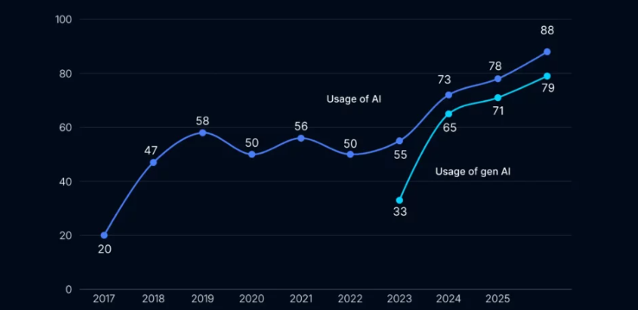
AI usage statistics

Slide 10
Resources
https://habr.com/ru/articles/865664/
https://habr.com/ru/articles/902602/

Slide 11
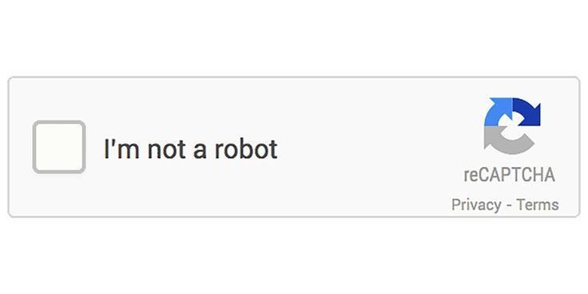
Thanks for your attention!!

