Slide 1



NEONEST
TEAM TRIPLE A

Slide 2

MISSION
Importance of fresh air
Possible health risks and discomfort
Live life freely

Slide 3
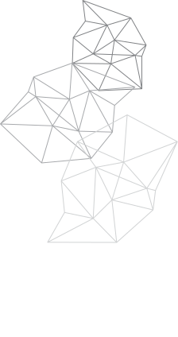
OPTIMAL LEVELS
CO2
40-60%
20-22
Below 1000 p.p.m
Humidity
Temperature

Slide 4



TECHNOLOGIES
Flutter
Python
ChatGPT

Slide 5


HOW DID WE SOLVE OUR PROBLEM
DIsplaying suggestions and warnings to user
Gathering information from the sensors and the user
Data processing using GPT -4o

Slide 6

POSSIBILITIES
-Versitility
-warnings for children and vulnerable groups
-be careful about plant drought

Slide 7
THANK YOU
TEAM TRIPLE A

