Slide 1
HW06_Median of arrays
2022 Algorithm

Slide 2
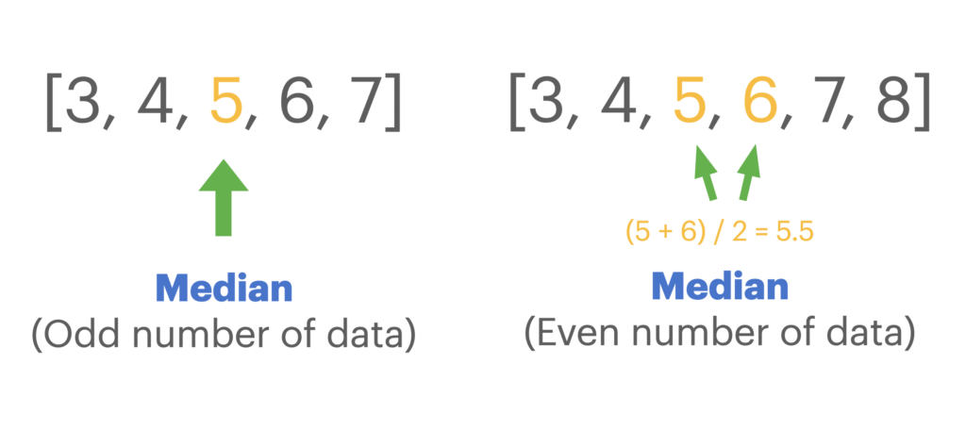
Assignment Requirement
Given you a 2-D array of integer arrays.
Each array in 2-D array must be sorted.
Please find the median of all numbers in this 2-D array.
And return the median as double type.
Notice! The length of array in 2-D array may be different.

Slide 3
Example 01
Input: {{1, 3, 10}, {-1, 5, 7}, {-2, 5, 12}}
Output: 5.0
Explanation:
{{1, 3, 10}, {-1, 5, 7}, {-2, 5, 12}}
After concatenate and sort…
{-2, -1, 1, 3, 5, 5, 7, 10, 12}
Median = 5.0 (double)

Slide 4
Example 02
Input: {{3}, {-1, 5}, {-2, 5, 12}}
Output: 4.0
Explanation:
{{3}, {-1, 5}, {-2, 5, 12}}
After concatenate and sort…
{-2, -1, 3, 5, 5, 12}
Median = (3+5)/2 = 4.0 (double)

Slide 5

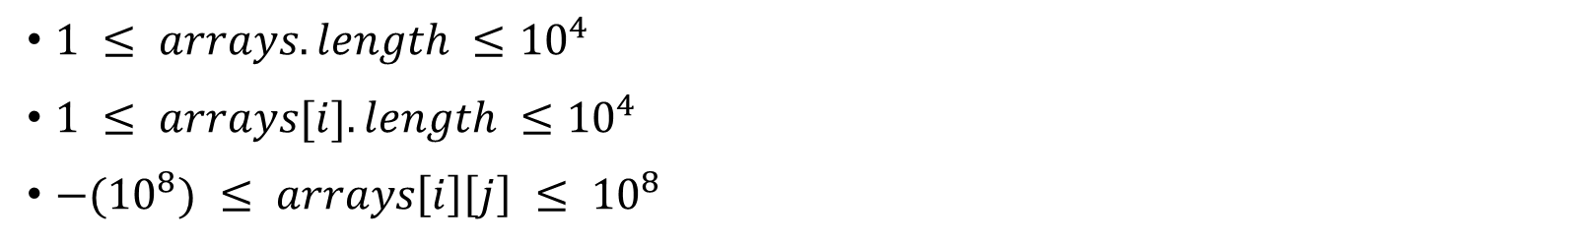
Constraints
$1 ≤ arrays.length ≤{10}^{4}$
$1 ≤ arrays[i].length ≤{10}^{4}$
${−(10}^{8}) ≤ arrays\left[i\right]\left[j\right] ≤ {10}^{8}$
Please inherit from this abstract class:
Please name your class as HW06_學號_版本號

