Slide 1
HW05:LianLianKan

Slide 2
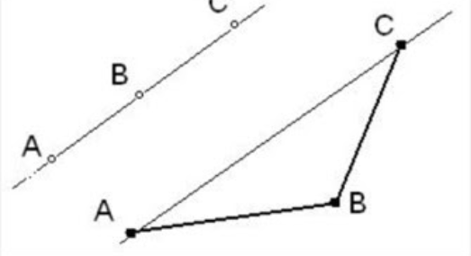

Assignment Requirement:
Your program will take a set that consists of two-dimensional points as input. Please determine whether the given set containing three points lie in a line
範例:
input: {{1,2},{1,3},{1,4}} output: true
input: {{0,0},{1,0},{1,1},{0,1}} output: false
C
Example:
Abstract class:

