Slide 1
HW10:StringSort

Slide 2
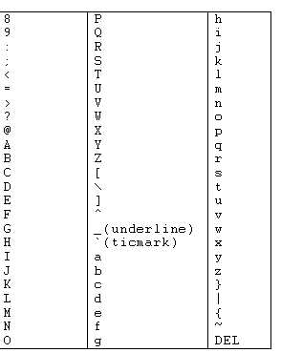
Assignment Requirement:
Your program will take a bunch of string arrays as input.
Please sort the string arrays by their vocabulary with ASCII Order Table
( the input arrays do not contain empty string and non vocabulary characters)
Sort priority:
1. ASCII Order
2. the length
Notes:
https://www.youtube.com/watch?v=dQw4w9WgXcQ

Slide 3
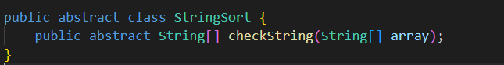
Assignment Requirement:
For example,
1.Input: [“Once",”a”,”upon” ,”time”] ,
Output: [“Once”,”a”,”time”,”upon”]
2.Input: [“aaaa",”aa”,”aaa” ,”a”,”aaa”] ,
Output: [“a”,”aa”,”aaa”,”aaa”,”aaaa”]
Abstract class:

