Slide 1
A tool to specify testable causal models of software behaviour
Hao-Hsuan Teng
Supervisor: Dr Neil Walkinshaw

Slide 2
Background
Computational model are important tools for scientific research and decision making.
These type of software often didn’t receive proper testing due to two reason:
Testing challenges that occur due to characteristics of scientific software.
Testing challenges that occur due to different trainings received by scientists and software engineer.
Advance methods are developed to help improve this process, but these advance methods are often too complicate to use, which discourage people from implementing those method.

Slide 3
Problem analysis
This project will mainly focus on a tool named Causcumber, which uses several other tools(Behave, Cucumber), combined with Casual testing to find the behaviour computational model.
Causcumber require user to manual code 5 files to test a model, and will require user to have knowledge in software testing to implement these files.
A way to simplify the testing process is need,
Reduce the need for user to manually code.
Provide user assisting information in the process.
Provide a guide for user on what to input in the process.

Slide 4
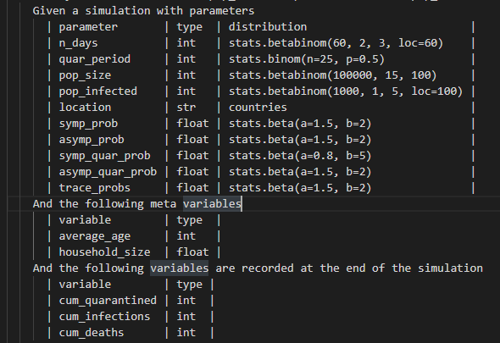
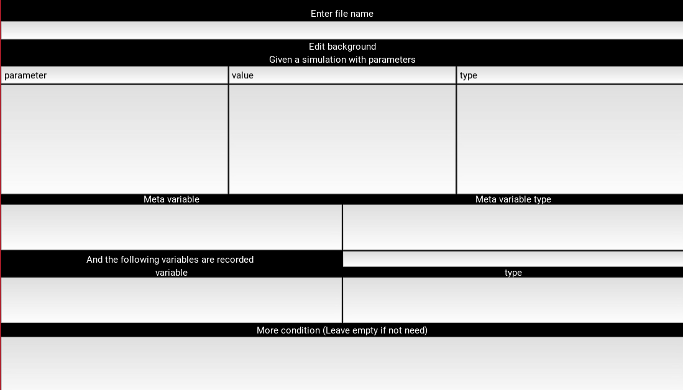
Design & Implementation
For the front end of the tool, the design will be transforming the structure of the file into the user interface.

Slide 5
Result
The implemented tool is used to carry out testing for two computational model, influenza1918 and Covasim.
By using the implemented tool, user won’t need to manually edit two of the five files, and during the editing process of these files, visual effects will be provided to assist user in the process.
As for the rest for the three files, most parts of the file will be auto generated, and the remains part will require for user to manually edit due to the difference in implementation methods of models.

Slide 6
Conclusion
Test computational model is an important step of development, but is often ignored.
Advance method such as Causcumber is useful, but are often too complicated for untrained user.
An assist tool is implemented, with the ability to turn user’s input into the file format accepted by Causcumber, and provide assist during the editing process.
With the help of assisting tool, user won’t need to manually edit as much as the original version, which can encourage more user to use Causcumber.

