Slide 1
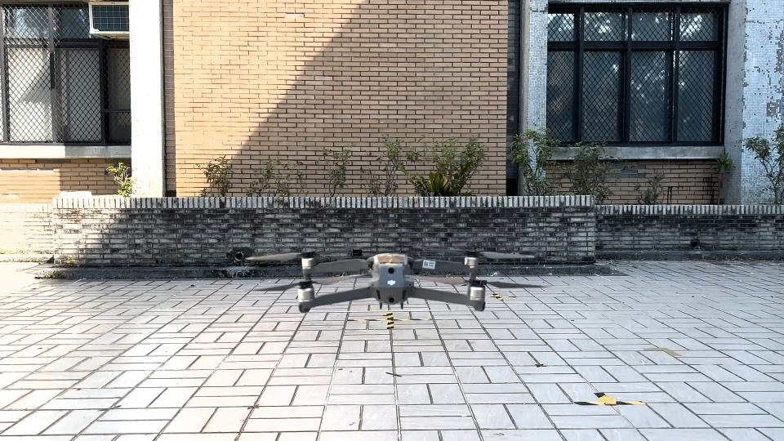
Comparative Study of Traditional Pattern Recognition and YOLOv8 for Small Drone Detection
PATTERN RECOGNITION · FINAL PROJECT
Lab412
Drone video and USV simulator · YOLOv8 vs. a detector built from course methods
Notes:
Our question: for detecting and tracking a small target in video, is a detector built only from classical pattern-recognition methods good enough, or do we need YOLOv8 - and can classical methods still help YOLOv8? We test on two platforms: a small drone filmed from the ground, and the leader boat seen from a follower USV.

Slide 2
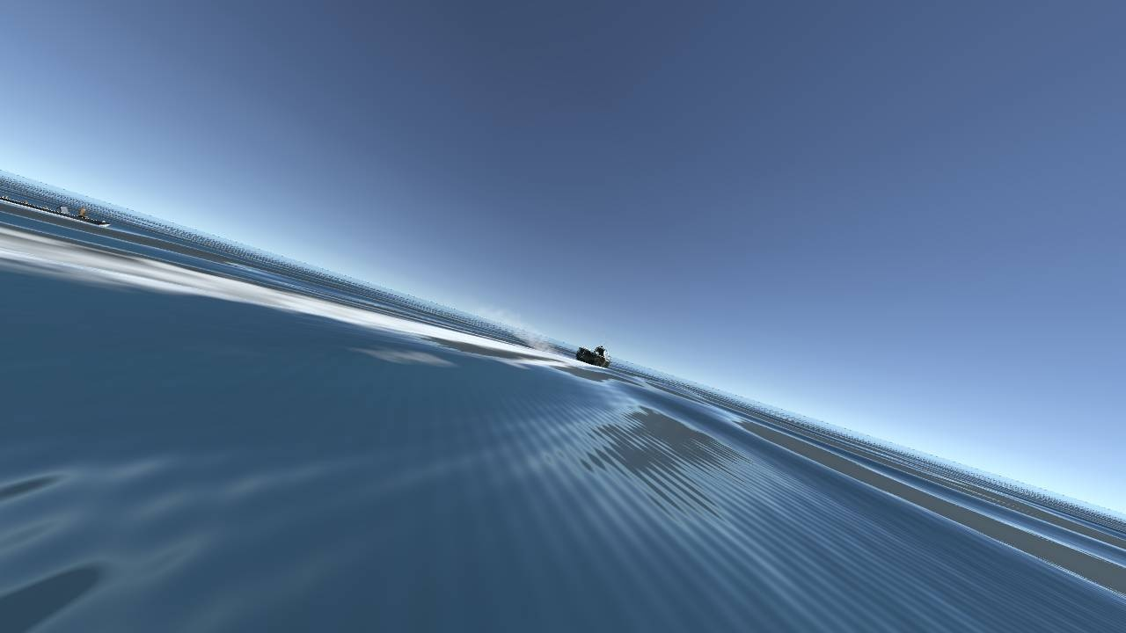
Two Questions About Small-Target Detection
INTRODUCTION
Goal: find and follow one small target in every frame, even when its box jumps up and down (the drone climbs, the boat camera pitches in waves).
Q1
Can traditional pattern recognition replace YOLOv8?
Traditional detector vs. YOLOv8
Same pipeline, two targets
Top: drone filmed from the ground. Left: leader boat seen by a follower USV in waves.
Q2
Can traditional methods improve YOLOv8?
YOLOv8 vs. YOLOv8 + MLE-learned tracker
Lab412 · Traditional Pattern Recognition vs. YOLOv8
2 / 16
Notes:
Both of our targets are small in the image and move fast vertically. YOLOv8 is the usual answer for detection. We ask two questions. Q1: if we build the detector only from what we learned in this course - Fisher LDA, PCA, Gaussian maximum likelihood, Bayes decision - how close do we get to YOLOv8? Q2: if we keep YOLOv8, can the same course methods make the tracking after the detector better than hand-tuned constants?

Slide 3
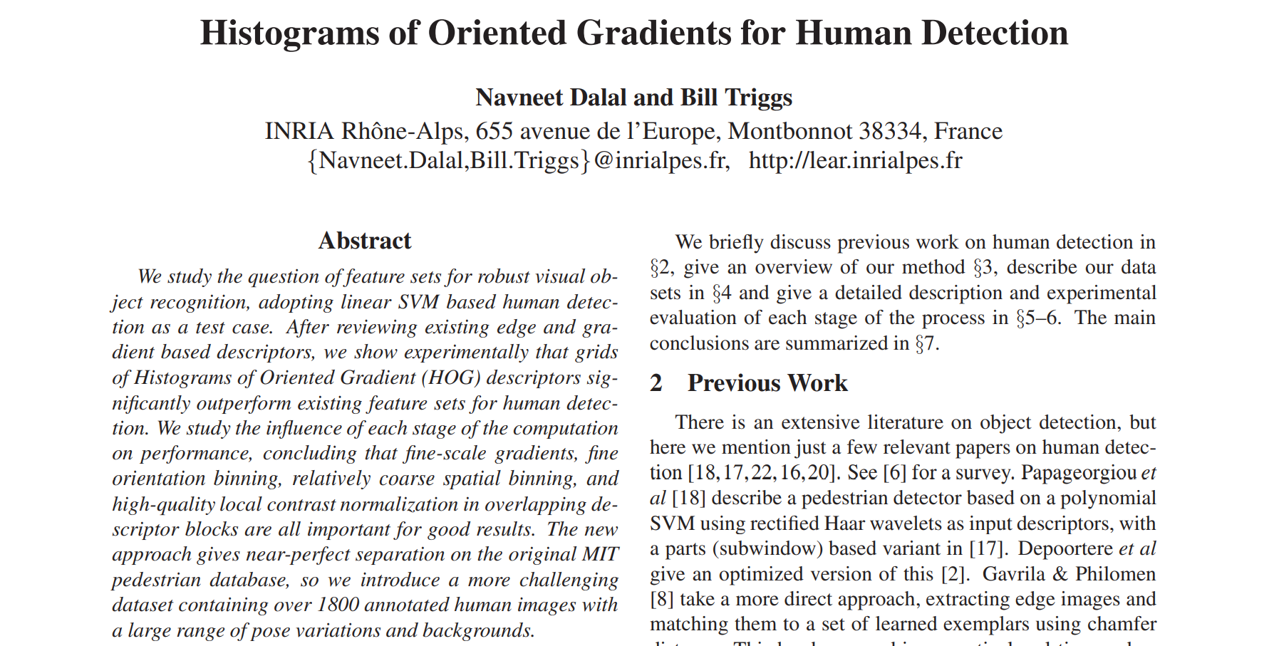
Related Work
BACKGROUND
Fisher 1936; Belhumeur et al., TPAMI 1997
Fisher linear discriminant; PCA + LDA ("Fisherfaces")
Duda, Hart & Stork 2001; Hughes 1968
Bayes decision, Gaussian MLE; too many dimensions for the data
Redmon et al., CVPR 2016; Jocher et al. 2023
YOLO one-stage CNN detector; YOLOv8 (Ultralytics)
Dalal & Triggs, CVPR 2005. Hand-designed features + a linear classifier, scanned over the image: the classic detector that CNNs replaced. Our traditional detector follows the same recipe.
Kalman 1960; Lucas & Kanade 1981
Kalman filter and optical flow between detections
Mehra, IEEE TAC 1970
Learning the Kalman noise Q, R from the innovations
traditional detector
deep detector
tracking
Lab412 · Traditional Pattern Recognition vs. YOLOv8
3 / 16
Notes:
Dalal and Triggs is the reference point for traditional detection: fixed features, a linear classifier and a sliding window. We build the same kind of detector from course methods: Fisher's discriminant instead of an SVM, PCA and a Gaussian Bayes classifier. YOLO is the deep-learning alternative. For tracking we use the Kalman filter with optical flow, and Mehra's idea of learning the filter noise from its innovations.

Slide 4
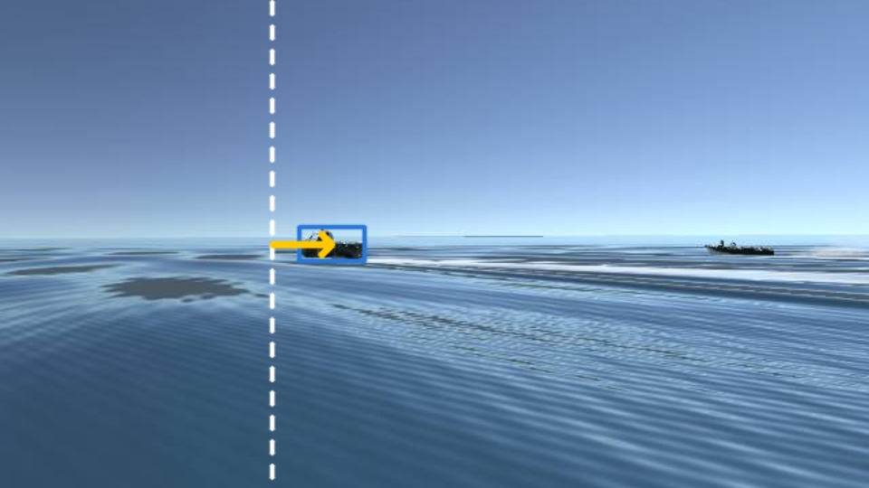
How the USV Fleet Uses the Detector
PLATFORM
Formation, top view
1
Camera
front camera, 1280x720, 10 frames/s
Leader
drives a set route
2
Detector + tracker
leader's box (this project)
3
Box → commands
offset → steering; box size vs. target size → throttle
Follower's front camera: box = leader, dashed line = image centre, arrow = offset. The boat on the right is the other follower.
4
Simulator
commands sent back to the boat (Unity)
Follower L
camera only
Follower R
camera only
Why it matters: a missing or wrong box means wrong steering. In waves the camera pitches, the box jumps vertically, and the follower can lose the leader.
about 22 m behind, 13 m to each side
Lab412 · Traditional Pattern Recognition vs. YOLOv8
4 / 16
Notes:
Briefly, how the boat platform works. A leader boat drives a set route. Two followers keep formation behind it using their front cameras. Each frame, the detector and tracker give the leader's box. The horizontal offset of the box from the image centre sets the steering, and the box size compared with the target size sets the throttle, so the box is the follower's only sense of where the leader is. That is why detection and tracking accuracy matter, and why waves are hard: the camera pitches and the box jumps. In this project we evaluate the detector and tracker offline on frames recorded from these runs; we do not change the controller.

Slide 5
Two Comparisons on One Pipeline
METHOD
DETECTOR
TRACKER · FLOW + KALMAN
Traditional detector
Fisher LDA scan + PCA + Gaussian Bayes
None
newest box as is
Camera
frame
Target
box
Hand-tuned
drone team's constants
YOLOv8s
CNN trained by the drone team
MLE-learned Q
fitted from training data
Comparison 1: change the detector, keep the tracker: traditional vs. YOLOv8 (Q1)
Comparison 2: keep YOLOv8, change the tracker: hand-tuned vs. MLE-learned (Q2)
Lab412 · Traditional Pattern Recognition vs. YOLOv8
5 / 16
Notes:
Every pipeline has two parts. The detector finds the target in a frame; the tracker smooths the box and fills the frames between detections, using Lucas-Kanade optical flow and an 8-state Kalman filter. Comparison 1 swaps the detector. Comparison 2 keeps YOLOv8 and swaps how the tracker's constants are chosen: by hand, or by maximum likelihood from training data.

Slide 6
A Detector Built Only From Course Methods
METHOD · COMPARISON 1
1
Ch. 1
2
Ch. 3-2
3
Ch. 1
4
Ch. 3-2, 3-1, 2
Features
Fisher LDA scan
Hard negatives
PCA + Bayes
Window resized to 24x17 px; grey level + gradient magnitude, each z-normalised: an 816-D vector x.
w = Sw⁻¹(m₁ − m₀), with shrinkage on Sw (816-D vs. few samples: Hughes). Score wᵀx at every position and 7 scales.
Retrain on the false peaks of step 2: the design cycle of evaluate, then improve.
Top 10 boxes → PCA to 30-D → one Gaussian per class, μ̂ and Σ̂ by MLE → P(target | x).
Output = box + posterior probability, used by the tracker exactly like YOLO's box + confidence.
Trained only on the training split. Drone: 40x11 window (drone boxes are wide); USV: 24x17. No neural network anywhere.
Lab412 · Traditional Pattern Recognition vs. YOLOv8
6 / 16
Notes:
The traditional detector uses only course material. Step 1 turns any window into an 816-dimensional vector. Step 2 is Fisher's linear discriminant; because the score is linear we can evaluate it at every position and scale. With 816 dimensions and limited samples the within-class scatter is badly estimated, the Hughes effect, so we shrink it towards a diagonal. Step 3 retrains on its own mistakes. Step 4 re-scores the best 10 boxes with PCA and a two-class Gaussian Bayes classifier whose means and covariances are maximum-likelihood estimates. On held-out data this re-scoring separates true and false boxes well: AUC 0.96 on the boat data.

Slide 7
YOLOv8 + Course Methods in the Tracker
METHOD · COMPARISON 2
Drone team's tracker (hand-tuned)
Course method: learn Q by maximum likelihood
YOLOv8s → Lucas-Kanade optical flow → 8-state Kalman filter
Process noise Q: fixed diagonal, tuned by eye on drone video
Measurement noise R = 60·(0.5 / conf)²
Gate: accept a box within 1.5 box sizes
Tuned for a 30 fps camera. The boat camera runs at 10 Hz, so the box moves about 3x further per step.
If the filter is right, each innovation ν = z − Hx̂ is Gaussian: ν ~ N(0, S(Q)) (Ch. 3-1)
Q̂ = argmax_Q Σₖ ln N(νₖ ; 0, Sₖ(Q))
Sₖ = H Pₖ Hᵀ + R depends on Q through the filter, so we search Q × {0.3 … 1000} on training data only.
Also tried: MLE-learned R and a minimum-risk Bayes gate (Ch. 2). They helped on the drone and hurt on the boat.
Lab412 · Traditional Pattern Recognition vs. YOLOv8
7 / 16
Notes:
The drone team's tracker works on the drone video, but its noise settings were chosen by hand. We replace the process noise Q with a maximum-likelihood estimate. If the filter model is correct, the innovations are zero-mean Gaussian with covariance S, so we pick the Q that makes the observed innovations most likely, the Chapter 3 principle with the innovations as the samples. Q is always fitted on training data, never on the test sequences.

Slide 8
Experimental Setup
EXPERIMENTS
 | Drone (real video) | USV leader boat (simulator)
Data | 3 videos, 1080p, 30 fps: testv4 (594 frames), IMG_7888 (932), Tello IMG_7923 (367; new drone, indoor) | 64 camera sequences, 1280x720, 10 Hz; 6 conditions: clear, rain, night, night+rain, dark storm, huge waves
Ground truth | Grounding DINO boxes fused and checked by eye (YOLO not used) | Exact boxes from the simulator
Train / test | Train on one video, test on the other; Tello: train on both, test once | Split by random seed: test seeds never seen in training
Score | Share of frames whose box overlaps the truth with IoU ≥ 0.5 | Same; detections reach the tracker 1 frame late (the real setup)
Statistics: Wilcoxon signed-rank test over sequences (USV); 95% block-bootstrap interval over 1-second blocks (drone). Slow-computer case: detections 3 frames late.
Lab412 · Traditional Pattern Recognition vs. YOLOv8
8 / 16
Notes:
Two platforms. The drone data is real video; its ground truth comes from a different detector, Grounding DINO, so it is independent of YOLO, and we checked it by eye. The boat data is from our USV simulator, where the true box is exact. We always test on data not used for training: a different video for the drone, a different random seed for the boat. The score is the share of frames with IoU of at least 0.5.

Slide 9
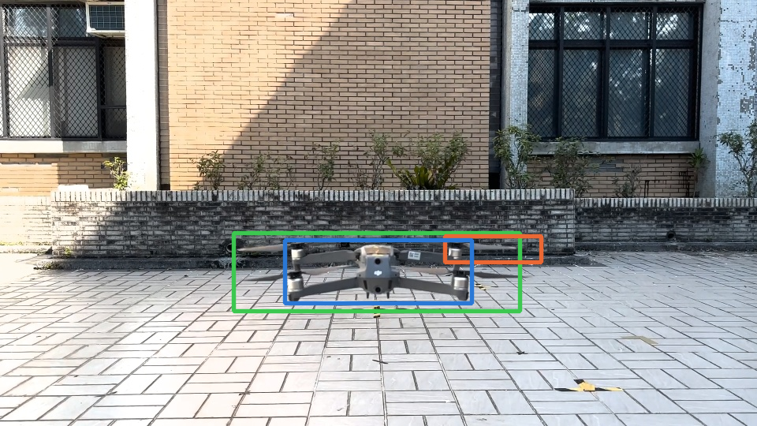
Traditional Detector vs. YOLOv8: Drone
RESULT 1 · DETECTOR
Ground truth
Traditional
YOLOv8
Brick wall and paving tiles give the linear template many drone-like edges. On the new indoor Tello video it almost never finds the drone.
Detector alone, 1-frame delay. Share of frames with IoU ≥ 0.5.
Lab412 · Traditional Pattern Recognition vs. YOLOv8
9 / 16
Notes:
Comparison 1 on the drone. Tested cross-video, the traditional detector reaches 10.7% and 14.6%, against 77.9% and 81.3% for YOLOv8. On the held-out Tello video, a different drone indoors, it finds almost nothing while YOLOv8 still gets a third of the frames. The picture is frame 100 of testv4: the traditional box sits on part of the drone and the wall behind it.

Slide 10
Traditional Detector vs. YOLOv8: USV
RESULT 1 · DETECTOR
31% vs 73%
all conditions
16% vs 76%
at night: the template needs light
2 / 64
sequences where the traditional pipeline beats YOLOv8 (p = 6×10⁻¹²)
Detector alone, 1-step delay, 64 test sequences.
Lab412 · Traditional Pattern Recognition vs. YOLOv8
10 / 16
Notes:
On the boat the traditional detector is reasonable in clear water, 65 percent, and drops in rain. At night and in the dark storm it nearly disappears: the boat is almost black, so a template of grey level and edges has nothing to match. YOLOv8 hardly changes across conditions. Over all 64 sequences the traditional pipeline wins only 2. It is also slower: about 110 to 180 ms per frame on one CPU core, against about 11 ms for YOLOv8 on a GPU.

Slide 11
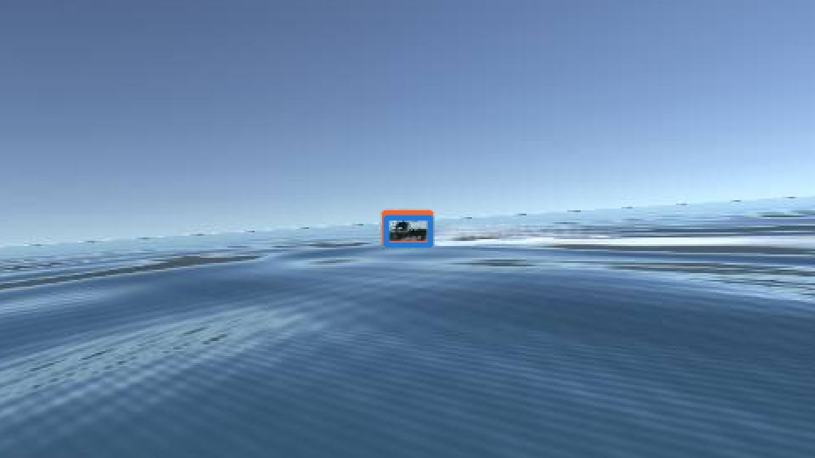
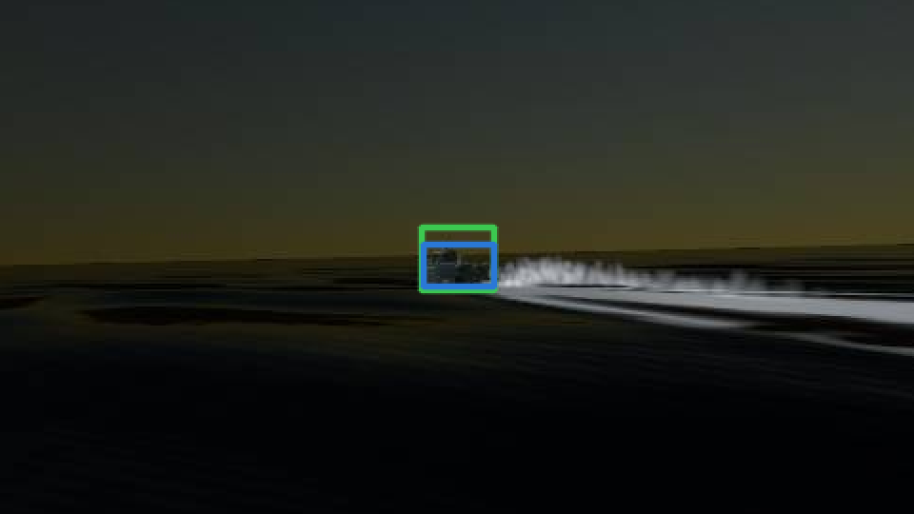
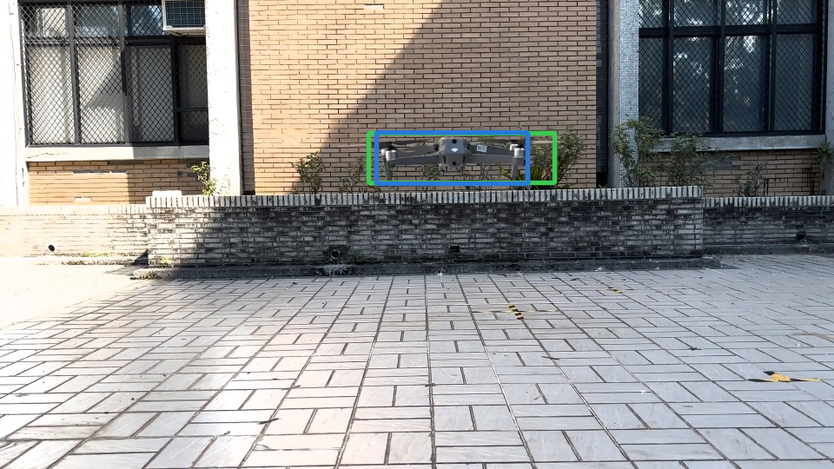
What the Two Detectors Return
RESULT 1 · DETECTOR
USV, clear: both boxes on the boat
USV, night: no traditional box; YOLOv8 still finds the boat
Drone, IMG_7888: no traditional box above threshold
Ground truth
Traditional detector
YOLOv8
Same thresholds, no tracker: the difference is the features. Frames are taken at fixed positions (frame 350 of a test sequence; frame 200 of IMG_7888), not chosen for the result.
Lab412 · Traditional Pattern Recognition vs. YOLOv8
11 / 16
Notes:
Three typical frames. In clear water both detectors find the boat. At night only YOLOv8 does. On the drone video the traditional detector's best box is below the confidence threshold, so it reports nothing.

Slide 12
YOLOv8 vs. YOLOv8 + MLE-Learned Q: Drone
RESULT 2 · TRACKER
+3 to +25
points over the hand-tuned tracker in all 6 drone tests (1- and 3-frame delay)
70% vs 33%
held-out Tello video: learned Q vs. YOLOv8 alone (95% CI of the gain over hand-tuned: +9 to +43)
1-frame delay (the real setup). Q learned on the other video(s).
Lab412 · Traditional Pattern Recognition vs. YOLOv8
12 / 16
Notes:
Comparison 2 on the drone. The tracker with the maximum-likelihood Q is best on all three test videos. With a 3-frame delay, which imitates a slower onboard computer, the gain over the hand-tuned tracker is about 25 points on both training videos. On the held-out Tello video, a new drone and a new scene, the learned tracker reaches 70 percent against 33 for YOLOv8 alone.

Slide 13
YOLOv8 vs. YOLOv8 + MLE-Learned Q: USV
RESULT 2 · TRACKER
64 / 64
sequences where learned Q beats hand-tuned (p = 4×10⁻¹²); 28 / 30 in extreme waves
4 of 6
conditions where it is also higher than YOLOv8 alone; tie in huge waves
59% vs 73%
dark storm: here YOLOv8 alone is better
64 test sequences. MLE picks Q = 10x the drone value (10 Hz vs. 30 fps).
Lab412 · Traditional Pattern Recognition vs. YOLOv8
13 / 16
Notes:
On the boat the hand-tuned tracker is worse than YOLOv8 alone everywhere: its constants were tuned for a 30 fps drone camera. Maximum likelihood finds a Q ten times larger, which matches the frame-rate ratio, and the learned tracker beats the hand-tuned one on all 64 sequences. Against YOLOv8 alone it is higher in clear, rain, night and night+rain, ties in huge waves, and loses in the dark storm, where detections are sparse and the camera pitches unpredictably, so a fresh detection beats a prediction.

Slide 14
All Four Pipelines Side by Side
RESULT 3 · BOTH COMPARISONS
Pipeline | USV, all 64 sequences | USV, dark night, night+rain, storm | Drone mean of 2 videos | Drone, held out Tello video
● Traditional detector | 30.8% | 13.7% | 12.7% | 0.3%
● Traditional + learned Q | 35.1% | 9.6% | 6.7% | 0.3%
● YOLOv8 | 72.6% | 75.5% | 79.6% | 33.0%
● YOLOv8 + learned Q | 72.0% | 72.5% | 84.4% | 70.3%
Green = best in column. Share of frames with IoU ≥ 0.5, 1-frame delay. The detector decides most of the score. The learned tracker adds on top of YOLOv8 (not in the dark); on top of the traditional detector it helps only on the USV.
Lab412 · Traditional Pattern Recognition vs. YOLOv8
14 / 16
Notes:
This table puts both comparisons together. Changing the detector from traditional to YOLOv8 is worth 35 to 65 points. Changing the tracker from none to the MLE-learned one is worth a few points on the boat and up to 37 points on the held-out drone video when the detector is YOLOv8; the traditional detector gives too few correct drone boxes to follow. YOLOv8 with the learned tracker is the best or tied for best everywhere except the dark conditions on the boat, where YOLOv8 alone is best.

Slide 15
What We Learned
DISCUSSION
Why the traditional detector loses
What course methods do add
Light. A fixed template of grey level and edges: USV 65% in clear water, 16% at night, 9% in the dark storm.
Clutter. Brick and tiles look like drone edges; a new drone indoors: 0%.
Capacity. One linear direction in 816-D from about 1-12 k boxes; YOLOv8 learns its features from far more data.
Speed. 110-180 ms per frame on one CPU core vs. about 11 ms for YOLOv8 on a GPU.
MLE beats hand-tuning on both platforms: 64/64 USV sequences, +3 to +25 points on the drone.
It adapts to the detector: on the USV, Q x10 for YOLOv8 and x30 for the noisier traditional detector.
Not a fix for a bad detector: traditional + learned Q 31% → 35% on the USV; on the drone (13% correct boxes) it cannot help.
Limit: with sparse detections (dark storm) prediction drifts; YOLOv8 alone wins.
In one line: the detector sets the ceiling; course methods decide how close the tracker gets to it.
Lab412 · Traditional Pattern Recognition vs. YOLOv8
15 / 16
Notes:
Why does the traditional detector lose? Its features are fixed: grey level and edges. They fail when the light changes and when the background has the same kind of edges as the target. A single Fisher direction is a very small model for 816 dimensions; we needed shrinkage just to estimate the scatter matrix. But course methods are not useless: used for the decision and estimation parts around a learned detector, they replace hand-tuned constants with values learned from data, and that transfers across platforms.

Slide 16
Conclusion and Future Work
CONCLUSION
Next steps
Q1 Replace YOLOv8 with traditional PR?
No. 31% vs. 73% on the USV, about 13% vs. 80% on the drone, and it fails in the dark.
Weather classifier (LDA / Bayes) that picks a learned Q per condition, for the dark storm
Bayes fusion of YOLOv8 confidence and the Fisher score
Real boat footage; more drone videos
Non-parametric densities (Parzen, k-NN) for the Bayes gate
Q2 Improve YOLOv8 with traditional PR?
Mostly yes. The MLE-learned tracker beats hand-tuning in every condition, and beats YOLOv8 alone in all drone tests and 4 of 6 boat conditions.
Take-away: use a learned detector to find the target, and course methods (MLE, Bayes) to set the tracker from data instead of by hand.
Notes:
To answer our two questions: traditional pattern recognition cannot replace YOLOv8 for detection here. But the same methods are valuable after the detector: learning the tracker's noise by maximum likelihood beats hand-tuned constants on both platforms and usually beats YOLOv8 alone. The open problem is the dark storm; a condition classifier that selects a Q learned for that condition is our next step.

