Slide 1



STARTING
A TOY STORE
IN TORONTO
Yunqian Cao
Stanley (Zhengpeng) Gong

Slide 2





Insights in the toy industry
Data preparation
Data analysis
Conclusion
Contents

Slide 3





Insights in the toy industry
OPPORTUNITIES
CHALLENGES
Online learning
High revenue growth (2018-2023)
Price-based competition
Decrease in the profit margin
Notes:
opportunities:
1. Since the COVID-19 pandemic, more people adopted working-from-home styles and more chlidren have adapted to online learning. The time and chances for children to get together with friends are reduced, so parents seek to purchase more toys for their children.
2. According to the report of IBIS World, there is a large growth in the revenue of the toy industry from 2018 to 2023 in Canada. The overall profits, the number of employees, the number of businesses, and the average wage have also increased from 2018 to 2023.
challenges:
1. The products sold by different stores tend to be the same, so many businesses choose to lower the prices of toys to attract customers.
2. The report of IBIS World also indicates a decrease in the profit margin from 2018 to 2023 in Canada.
Therefore, we suggest that opening a toy store in Canada can be prospective, but this business also needs the consideration of competition.

Slide 4





Toronto Neighborhood Data
Extract postal codes, boroughs, and neighborhoods information from Wikipedia
Add geographical coordinates
1
Data Preparation
Demographic Data
2
Select areas in Central Toronto
Filter for #children, rate of children, median income, #employed, and unemployment rate from 2021 census
Competitors Data
3
Obtain competitor information through Foursquare Places API
Compute #competitors and collect customer reviews
Notes:
dataset1:
· source - wikipedia for postal codes in Toronto & geographical coordinates
· variables - (1) postal code, (2) borough, (3) neighborhood, (4) latitude, (5) longitude
dataset2:
· source - Statista database, 2021 Census of Population
· range - only select areas in Central Toronto
· variables - (1) the number of children in the region, (2) the rate of children in the population of the region, (3) the median after-tax income in 2020 among recipients, (4) the number of employed individuals, (5) the unemployment rate in the region
dataset3:
· source - Foursquare Places API
· variables - (1) the number of other toy stores in the region, (2) the reviews from customers on these stores

Slide 5

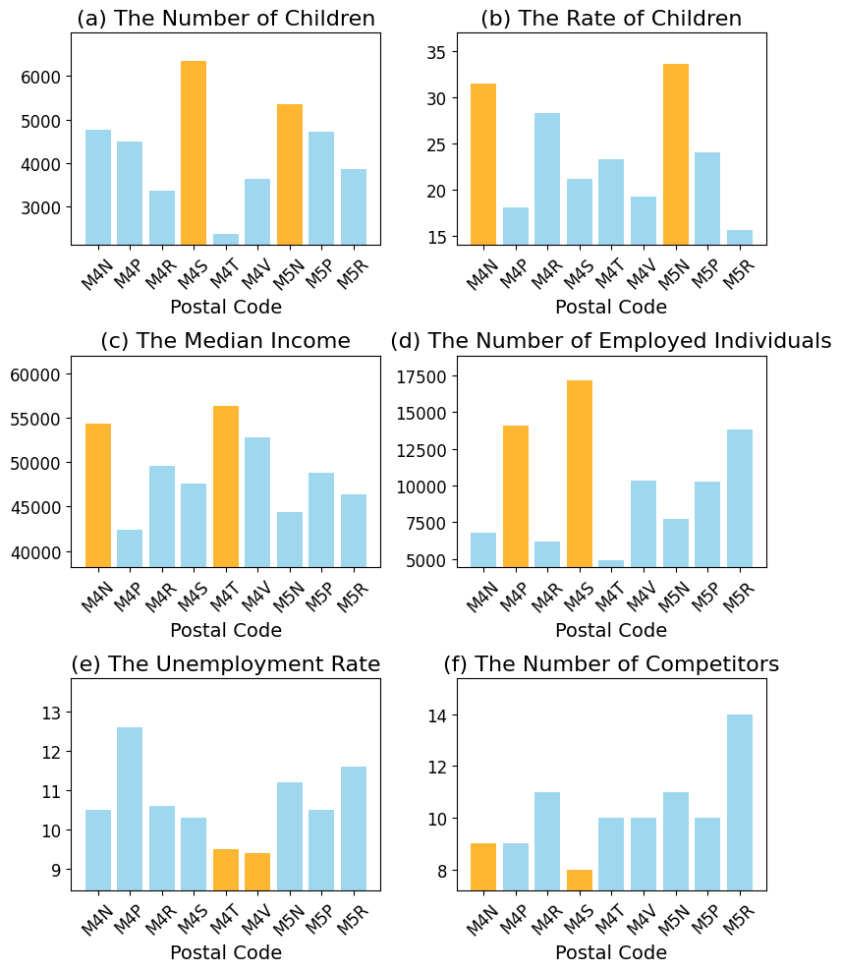



Data
Analysis
Notes:
We have 9 regions with different postal codes in Central Toronto, and we produced several bar plots using the datasets to select a best region.
The color of orange means that these two regions are the top 2 among the 9 regions under that criterion.
Figure (a): M4S has the largest number of children -> a large need in toys
Figure (d): M4S also has the largest number of employed individuals -> a large number of adults who can afford toys
Figure (e): M4S does not have the lowest unemployment rate, but the unemployment rate is still low enough
Figure (c): M4S does not have the largest median income, but the median income is still high, and toys for children are generally inexpensive -> toys are affordable
Figure (f): M4S has the smallest number of competitors -> least competition in the region
Thus, we chose M4S, namely 'Davisville', to open a new toy store.

Slide 6

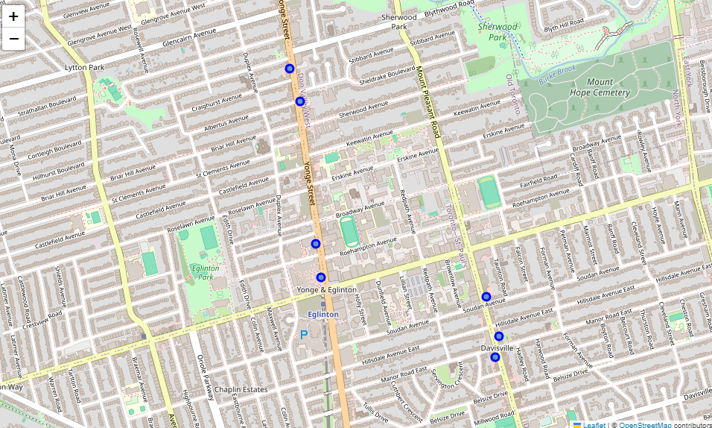
TOY STORES IN DAVISVILLE
Data
Analysis
Notes:
This map shows the existing toy stores in Davisville.
The current existing toy stores are located on two main streets.
Thus, to avoid severe competition with existing toy stores and to better serve the needs of nearby potential customers, we suggest that the new toy store can be located at the middle of Yonge Street, or the north part of Mount Pleasant Road.

Slide 7
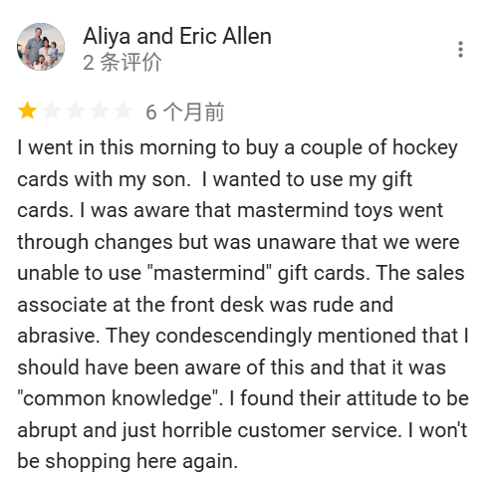
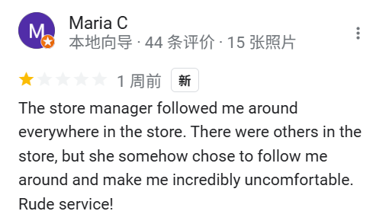
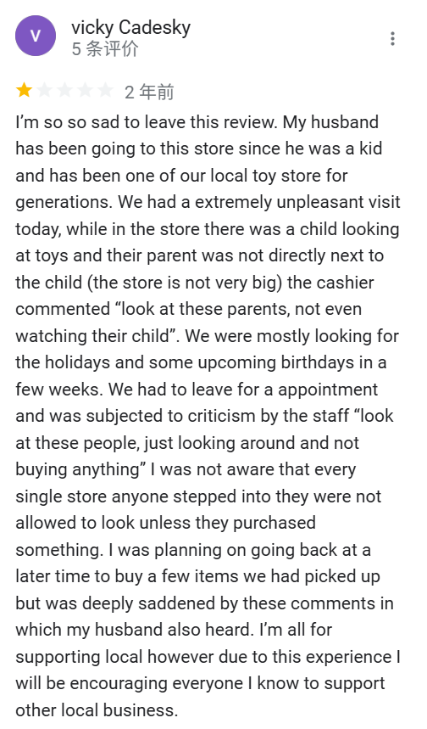
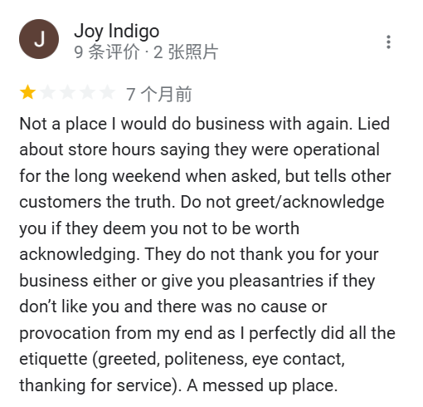
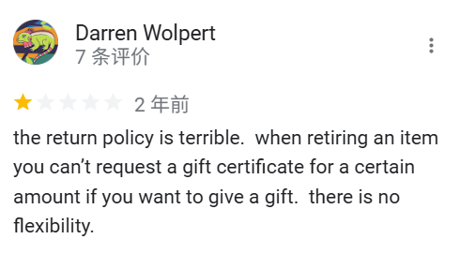
Notes:
This map shows the existing toy stores in Davisville.
The current existing toy stores are located on two main streets.
Thus, to avoid severe competition with existing toy stores and to better serve the needs of nearby potential customers, we suggest that the new toy store can be located at the middle of Yonge Street, or the north part of Mount Pleasant Road.

Slide 8
CUSTOMER REVIEWS
Negative:
Only accept cash
Unsure which toys are in the store
Poor service
Positive:
Free gift wrapping
Birthday party
Friendly staff
Email list for discount coupons
Fantastic prices
Chain store
Data
Analysis
Notes:
We then collected the reviews from customers on the existing toy stores in Davisville.
Most reviews are positive. Here are some points that customers find satisfied with the stores.
Few negative points mentioned by the reviews are listed above. A store does not accept phone payment or card payment. A person asked whether a specific toy was sold in the store, suggesting that there is no easy way for customers to get a list of what toys are in the store.
Based on these reviews, we can come up with our unique strategies.

Slide 9
BECOME COMPETITIVE
Learn from existing stores:
Friendly to customers
Offer discounts & Hold events
Gain special advantages:
Digitalization of products list
Accept cash, card, phone, etc.
Offer other services (e.g., gift wrapping, gift purchase consulting, etc.)
Data
Analysis

Slide 10


Insights
Profitable, but fierce competition
Location
CONCLUSION
Davisville (postal code M4S) for less competition and more needs
Strategy
Specialized services, friendy staff, ...

