Slide 1
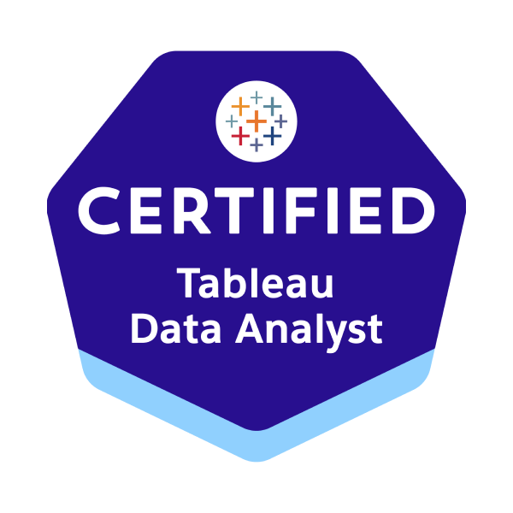







Tableau Data Analyst
Power BI Data Analyst
Associate
Alteryx Designer Expert
Alteryx Server Admin.
SnowPro Core
Databricks Data Engineer
Associate
DBT Analytics
Engineer Certification
AWS Solutions
Architect Associate

