Slide 1
Bible
What is Market Basket Analysis?
Originally a retail technique, stores use it to find products that get bought together (e.g. bread and butter).
Market Basket Analysis
Here its applied the same idea to Scripture. Instead of products in a cart, its books of the Bible appearing in the same Genesis verse cross-reference.
Using cross-reference data to find which books of the Bible get cited together from Genesis verses
The question we're asking:
"When a Genesis verse references one book, which other books tend to show up in the same cross-reference?"

Slide 2
The Data
837
65
6.4
transactions (Genesis verses)
unique books appear as items
books per basket on average
Each transaction is one Genesis verse. The items are the books its cross-references point to. Here's a real example:
Genesis 1:1
→
Psalms
Isaiah
Jeremiah
John
Romans
"In the beginning God created the heaven and the earth."
Hebrews
Exodus
Revelation
Job
+ 15 more…

Slide 3
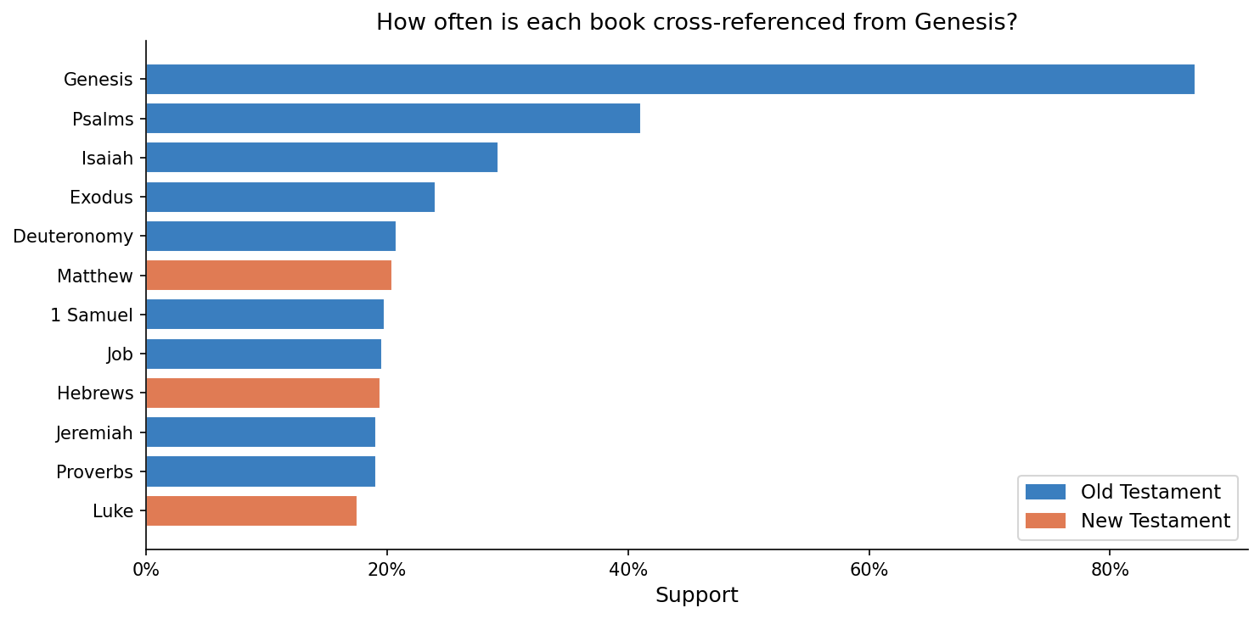
Support
How often does a book appear across all 837 Genesis verse baskets?
Support(A) = baskets with A ÷ total baskets
Example from the data:
Genesis 1:1 — one of 344 baskets containing Psalms
"In the beginning God created the heaven and the earth." → cross-references include Psalms 8:3: "When I consider thy heavens, the work of thy fingers…"
344 out of 837 baskets contain Psalms → Support = 344 ÷ 837 = 0.41
Filter out anything below 10%, too rare to be a real pattern.

Slide 4
Confidence
If a Genesis verse references Isaiah, how likely is it to also reference Jeremiah?
Confidence(A → B) = Support(A and B) ÷ Support(A)
Example from the data:
Genesis 1:1 — a basket that contains BOTH Isaiah and Jeremiah
"In the beginning God created the heaven and the earth."
Isaiah 37:16 (one of its cross-refs)
Jeremiah 10:12 (another cross-ref in the same basket)
"O LORD of hosts, God of Israel, that dwellest between the cherubims, thou art the God, even thou alone…"
"He hath made the earth by his power, he hath established the world by his wisdom…"
89 baskets contain both Isaiah and Jeremiah. 246 contain Isaiah. Confidence = 89 ÷ 246 = 0.36
So when a Genesis verse references Isaiah, there's a 36% chance it also references Jeremiah in the same cross-reference.

Slide 5
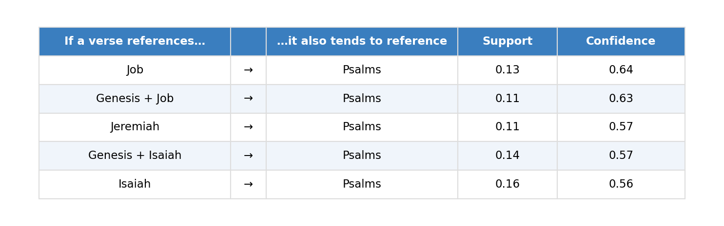

Slide 6
Lift
Is that 36% confidence actually meaningful, or is it just because Jeremiah is commonly referenced anyway?
Lift(A → B) = Confidence(A → B) ÷ Support(B)
Lift > 1
they co-occur more than you'd expect by chance ✓
Lift = 1
independent — knowing A tells you nothing about B
Lift < 1
they actually avoid each other
Back to our example — Isaiah → Jeremiah:
Isaiah → Jeremiah | Confidence = 0.36 ÷ Support(Jeremiah) = 0.19 = Lift 1.90
Genesis verses that reference Isaiah cite Jeremiah nearly twice as often as you'd expect by chance. This makes historical sense, both prophets were active during the same Babylonian period.

Slide 7
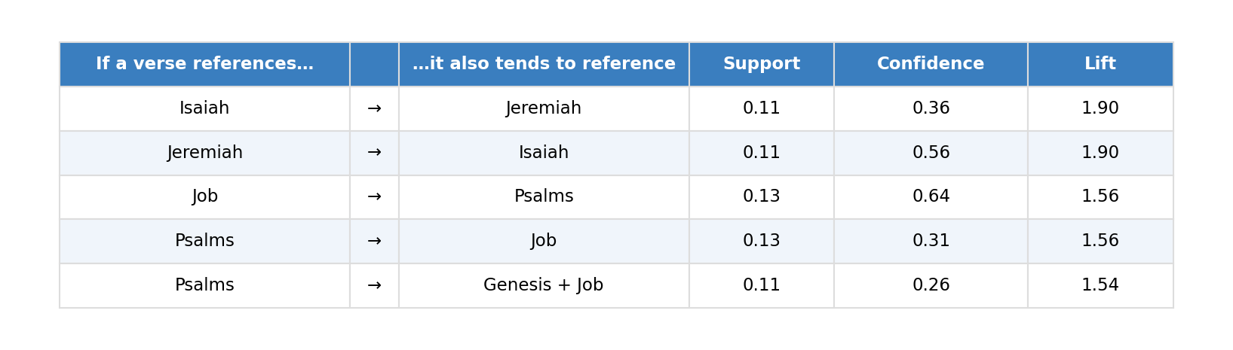

Slide 8
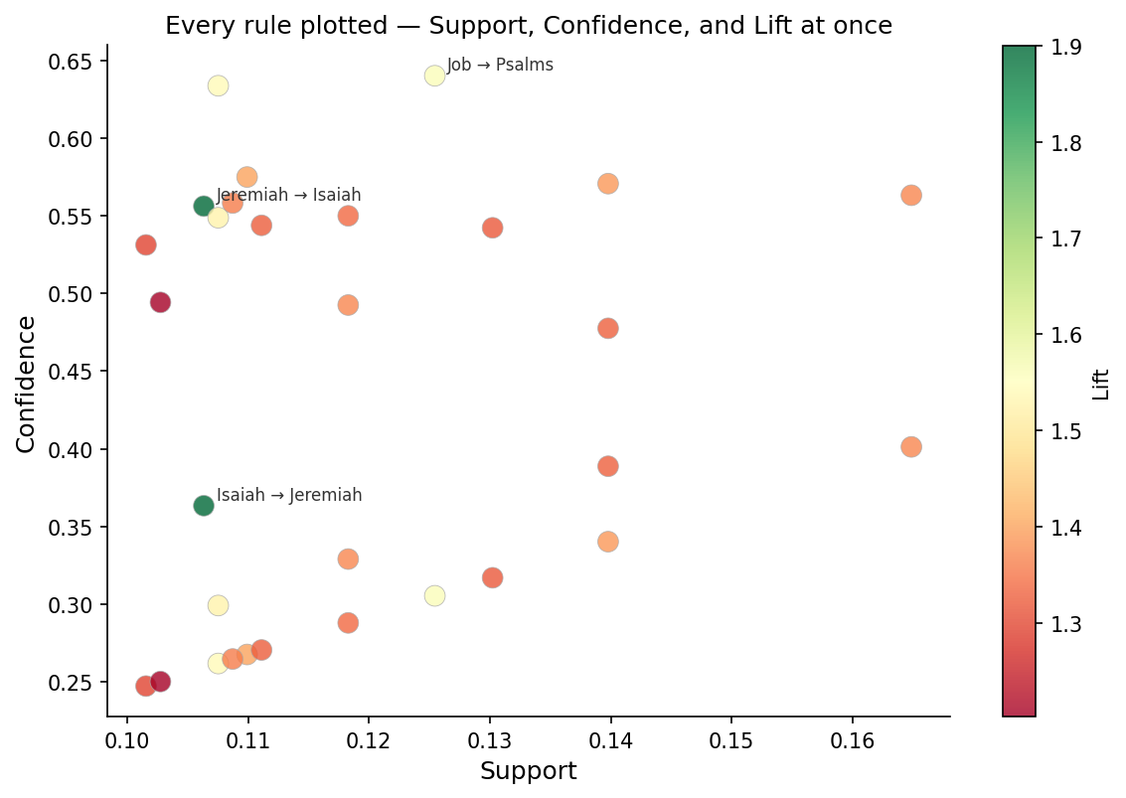
Putting It All Together
X axis — Support
how common the pattern is
Y axis — Confidence
how reliable the rule is
Color — Lift
how meaningful vs random chance
Top-right, warm color
= the strongest rules

