Slide 1
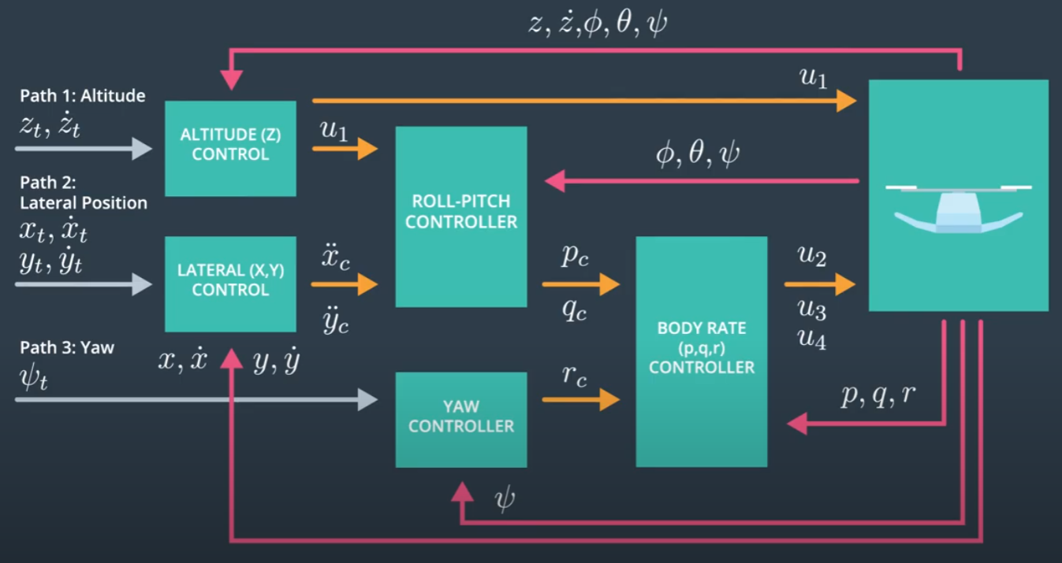
Copyright: Udacity

