Slide 1
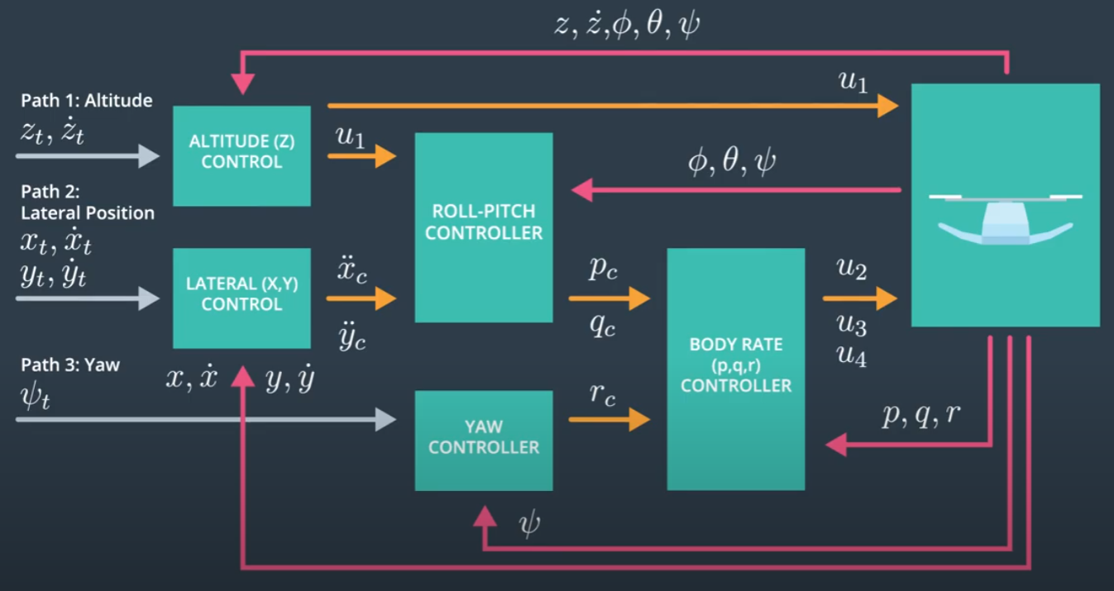
Drone Rotor
Engines
Copyright: Udacity

