Slide 1
Report

Slide 2
Summary
Myeloid data perhaps usable
Alignment rates around 30%
Total number of aligned read small, less than 10 million per sample
T cell data not usable so far
Alignment rate in single digit

Slide 3
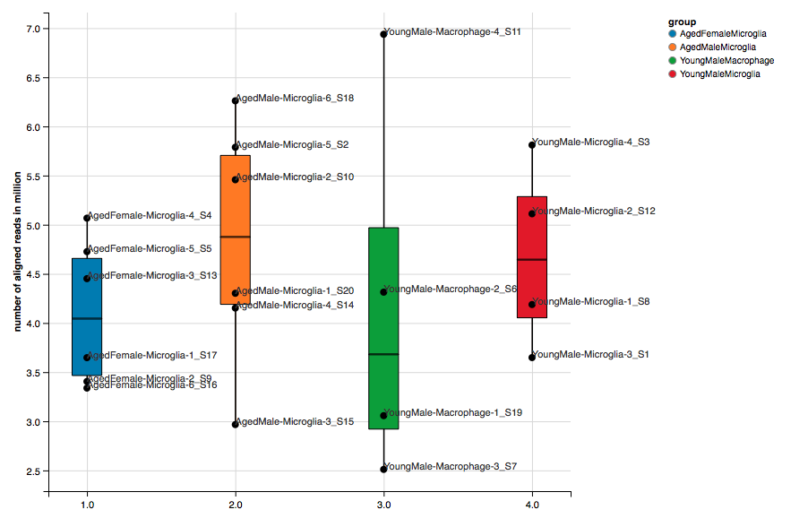
Total aligned reads: 2.5 to 7 million

Slide 4
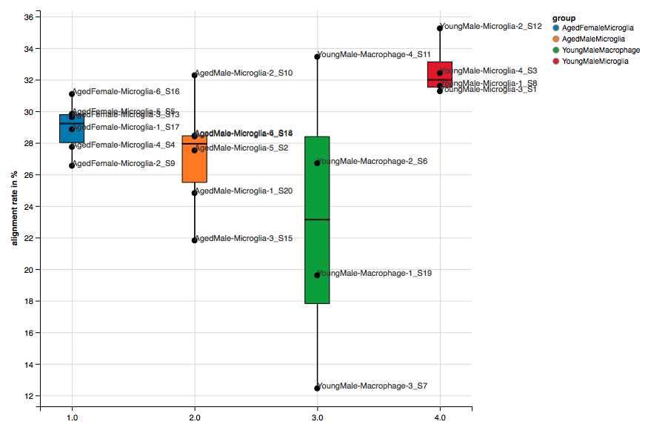
Alignment rate: 13% to 35%

