Slide 1
Report

Slide 2
Summary (May 2016)
T cell data quality varied much sample by sample
Alignment rates 2% to 29%

Slide 3
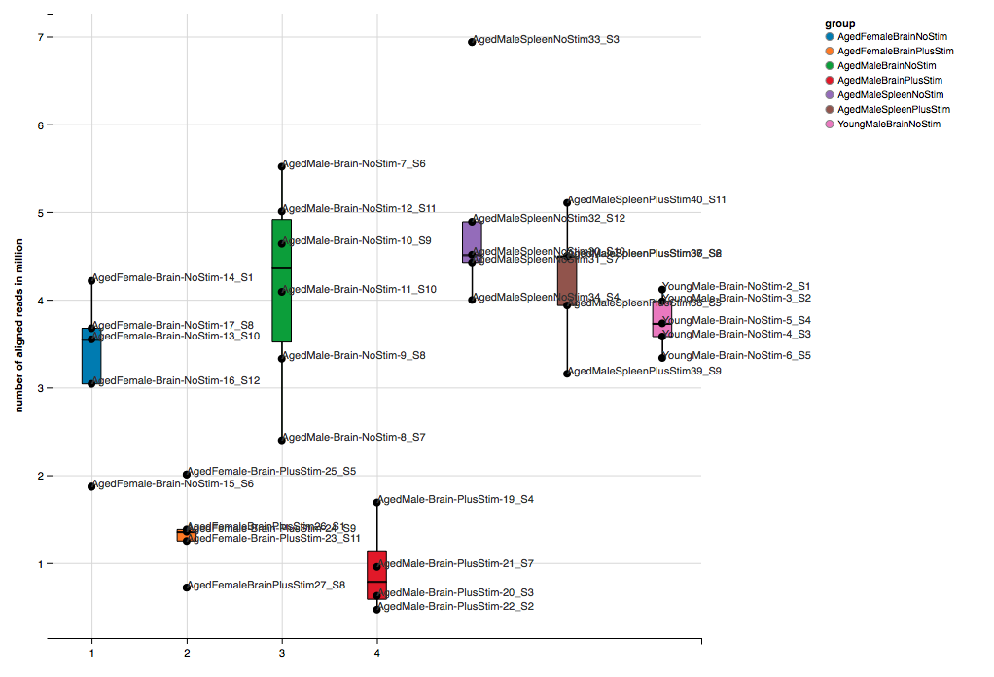
T cells: total aligned reads: 0.5 to 7 million

Slide 4
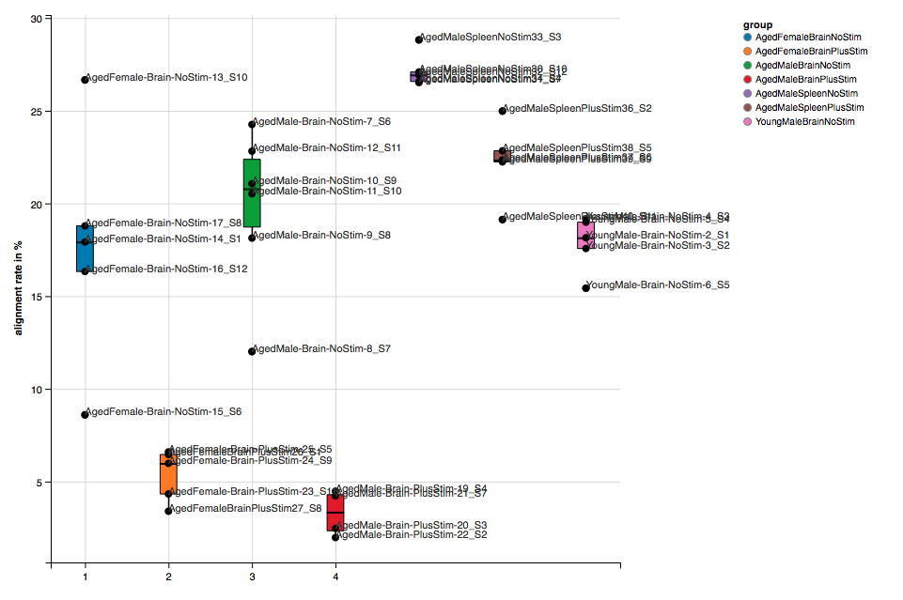
T cells: Alignment rate: 2% to 29%

Slide 5
Summary (April 2016)
Myeloid data perhaps usable
Alignment rates around 30%
Total number of aligned read small, less than 10 million per sample

Slide 6
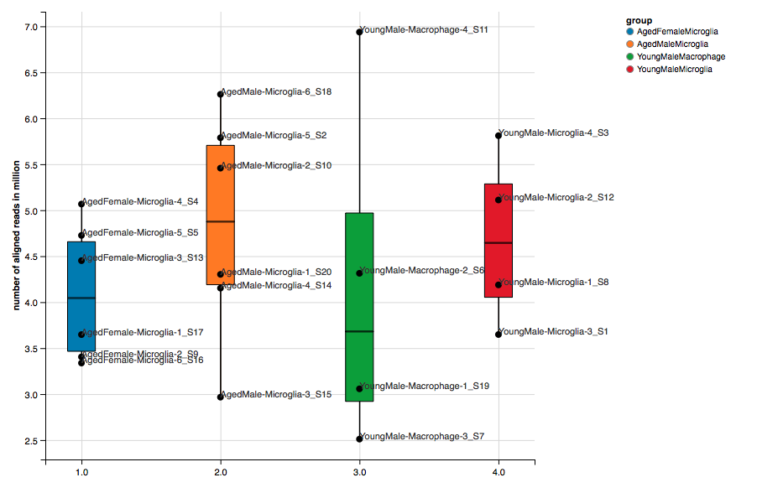
Microglia: Total aligned reads: 2.5 to 7 million

Slide 7
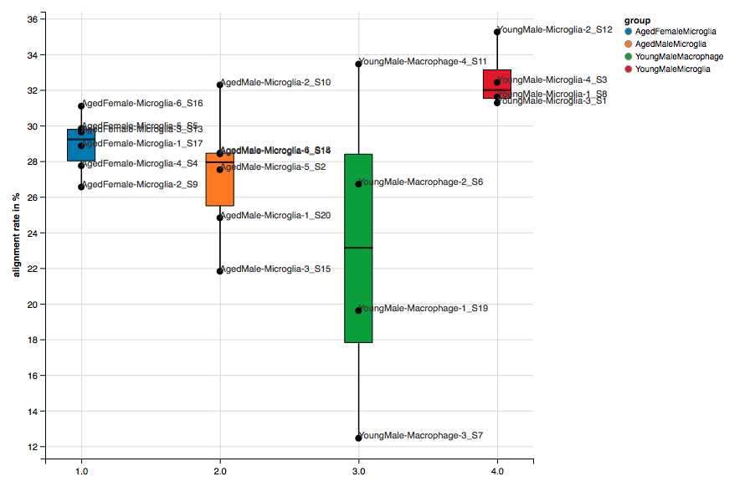
Microglia: Alignment rate: 13% to 35%

