Slide 1
Welcome to my
PORTFOLIO
DATA
NEED
USER
UX DESIGNER
SYSTEMS THINKING
EVIDENCE-LED
SERVICE
CONTEXT
</>
UX / UI
01

Slide 2

01 / ABOUT ME
Hello, I am
Stanslous Nhau
Call me Stan.
I entered UX through an unconventional route: statistics. My training taught me to interrogate evidence, identify patterns and question assumptions; UX gave those skills a human focus. Today, I use research, systems thinking and design to understand not only what people do, but the conditions shaping those behaviours.
“Clarity, built on evidence, delivered with empathy.”
THE DIFFERENTIATOR
Iterate
Statistics → UX
Same instinct for evidence.
A new focus: people.
1
2
3
4
5
Observe
Understand
Design
Test
Measure
02

Slide 3
02 / HOW I THINK
My approach
Systems thinking helps me look beyond the interface, mainly at the relationships, constraints, incentives and feedback loops around it.
PEOPLE
SERVICE
Needs, behaviours,
expectations
USER
EXPERIENCE
Processes,
channels, touchpoints
Signals, evidence,
measurement
Goals, constraints,
trade-offs
03

Slide 4



04 / BACKGROUND
My journey.
EXPERIENCE
CAPABILITY MATRIX
UluntuXD
Design
User Experience Designer
Figma · Prototyping · Components · Responsive layouts
Sept 2026 — present
Research
EDUCATION
Interview protocols · Interviews · Synthesis · Usability testing
UX/UI Design Program
March 2026 -August 2026
Strategy + Data
Nelson Mandela University
BCom Statistics
2022 - 2026
Systems thinking · Statistics · Evidence synthesis · AI-assisted workflow
</>
UX / UI
Germiston High School
2017 — 2021
06
04

Slide 5





UX RESEARCH CASE STUDY
Client Banking Client (Tier-1 African Bank)
API Community of practice.
Engagement FUSE Community of Practice
Team: 7 Designers
From Fragmented Capability to Connected Ecosystem
My Role UX Researcher
Shared for portfolio purposes under NDA. Client identity, verbatim findings, and internal artifacts have been anonymized or generalized to protect confidentiality. The Community of Practice covered here has not yet been built or shipped.
1

Slide 6



PROJECT CONTEXT
A discovery engagement for the human layer of the ecosystem
The API Marketplace already exists as a live platform. What hadn't been resolved was the human side: whether teams trusted, found, and reused what was on it. This case study covers the discovery phase for FUSE, the proposed API Community of Practice.
The Ask
The Gap
Confidentiality
Establish qualitative evidence of how the live API Marketplace was being experienced, to inform the design of FUSE.
Leadership suspected collaboration, discoverability, and reuse were breaking down on the platform but had no structured evidence of where or why.
Contracted under NDA. Client identity, org structure, and verbatim quotes are withheld or generalized throughout this deck.
Confidential — UX Research Case Study
2

Slide 7

MY CONTRIBUTION
Worked on the research end-to-end, from protocol to insight
01 - Protocol Design
02 - Stakeholder Interviews
03 - Mapping & Synthesis
Designed the full interview protocol: research objectives, opening/consent framing, a five-section question flow, scenario-based prompts, and role-specific tracks for executives.
Facilitated 16 interviews across solution architects, SMEs, business analysts, developers, UX designers, Heads of APIs, and executives.
Clustered raw interview data into affinity groups, surfaced recurring patterns, and distilled them into thematic insights and a maturity read for leadership.
Confidential — UX Research Case Study
3

Slide 8


RESEARCH DESIGN
Four objectives shaped every question I wrote
Understand how the API ecosystem is experienced across product, platform, architecture, engineering, delivery, and business teams.
1
Identify opportunities and barriers related to collaboration, discoverability, reuse, and knowledge-sharing.
2
Assess organisational readiness for an API Community of Practice and broader ecosystem enablement.
3
Establish qualitative indicators of ecosystem maturity to inform FUSE's design, operating model, and governance approach.
4
Confidential — UX Research Case Study
4

Slide 9



METHODOLOGY
A five-step path from raw conversation to strategic theme
Recruit & Brief
Cross-functional stakeholders
Affinity Map
Cluster raw data into patterns
2
4
1
5
3
Design Protocol
Synthesize
Objectives, flow, prompts
Interview
Themes, maturity, recommendations
30–45 min, think-aloud
My hand touched every stage of this chain. That continuity is what let subtle, cross-cutting signals like unspoken incentive problems surface in synthesis instead of getting lost in handoffs between researcher, interviewer, and analyst.
Confidential — UX Research Case Study
5

Slide 10
01 · PROTOCOL DESIGN
Designing a protocol that surfaces behaviour, not opinion
My thinking
Protocol briefly
Open with consent, framing, and a think-aloud instruction, the goal was psychological safety, not evaluation.
Opening
Consent, framing, think-aloud (3–5 min)
Sequence from context → current-state → delivery behaviour → culture → future vision, so trust builds before asking about friction.
Their Context
Role, ecosystem relationship, discovery habits ( 5–7 min)
Current State
What works, friction, reinvention (10–12 min)
Use scenario-based prompts (“imagine a change is made to a shared API…”) to get concrete behaviour instead of self-reported opinion.
Delivery Behaviour
Scenario-based reuse & governance probes (10–12 min)
Write a separate executive track focused on strategic risk, investment, and leadership's role, same themes, different altitude.
Culture & Readiness
Knowledge-sharing, incentives, community appetite (8 min)
Future State & Close
2-year vision, biggest lever, referrals (8 min)
Confidential — UX Research Case Study
6

Slide 11
02 · STAKEHOLDER INTERVIEWS
Getting honest signals
Who I spoke to
How I ran the room
16 interviews across 7 stakeholder groups
Framed it as diagnosis, not audit
Solution Architects
Told every stakeholder explicitly that this wasn't a performance evaluation, which opened candour about failures and workarounds.
Subject Matter Experts (SMEs)
Business Analysts
Named the observers
Developers
Silent note-takers were disclosed upfront, so nobody was surprised mid-conversation, protecting trust in the process.
UX Designers
Heads of API's
Followed energy, not just the script
Executives & business stakeholders
Used open follow-up prompts (“walk me through a recent example…”) to chase specificity wherever a stakeholder got animated.
Each session ran 30–45 minutes, was recorded with consent for analysis only
Watched for what wasn't said
Hesitation, deflection, and vague answers around ownership and incentives were as telling as direct complaints.
Confidential — UX Research Case Study
7

Slide 12

03 · AFFINITY MAPPING
Turning interview transcripts into defensible themes
01
02
03
04
Fragment
Cluster
Label
Weight & Prioritize
Broke every transcript into single observations, one sticky note, one idea, stripped of speaker identity.
Grouped observations bottom-up by underlying behaviour, not by which question prompted them.
Named each cluster as a pattern (e.g. discovery friction, fragmented ownership) and checked it against multiple stakeholder groups.
Scored clusters by frequency, intensity, and business impact to separate systemic themes from one-off anecdotes.
I ran this as a facilitated exercise with the wider project team about what a pattern really meant before it became a “finding.” That gave the final themes more credibility with leadership.
Confidential — UX Research Case Study
8

Slide 13
FINDINGS
Six themes emerged, the deepest ran behavioural
Discovery is people-dependent
Fragmented ownership
Teams found APIs through tribal knowledge and personal networks, not systems, confidence in “what exists” was low across every group.
Unclear accountability for shared capabilities discouraged reuse and made governance feel like friction rather than support.
Duplication is normalised
Governance felt like a gate
Reinventing capability was seen as lower-risk than finding and trusting someone else’s, a rational response to poor visibility.
Process was associated with delay, not enablement, which pushed teams toward workarounds.
Deep-rooted habits
Incentives don't reward reuse
Ways of working had calcified over years; “how we've always done it” outweighed the case for a new shared model.
Recognition and delivery pressure both favoured shipping something new over reusing or contributing to shared capability.
Highlighted themes (5–6) were the deepest and most consequential, cultural habits and incentive structures that no amount of tooling could fix on its own.
Confidential — UX Research Case Study
9

Slide 14


THE REFRAME WE PROPOSED
From a machine to an organism
Because the deepest blockers were habits and incentives, tooling alone (the Marketplace platform) wouldn't fix them. We recommended reframing FUSE's operating model itself.
Today: the Machine model
Proposed: the Organism model
Fixed parts, fixed processes: designed once, expected to run unchanged
Self-organizing parts that sense conditions and adapt continuously
Central control; teams execute a defined sequence rather than adapt it
Distributed ownership; this grows and tends the ecosystem
Efficient when conditions are stable; brittle when context shifts
Resilient by design keeps working even as teams, priorities, and technology shifts
Reuse and collaboration are steps in a process, not behaviours that are rewarded
Reuse and contribution are incentivized as healthy behaviours, not extra process
Confidential — UX Research Case Study
10

Slide 15
EVIDENCE TRACEABILITY & IMPACT
How the research became defensible
The case study now shows how raw stakeholder signals moved from observation → cluster → theme → recommendation, while still protecting NDA constraints.
Evidence chain
This case study demonstrates research planning, stakeholder interviewing, synthesis, systems thinking and executive-level framing — the core strengths I would bring into a UX Researcher or UX Designer role.
Portfolio signal
1. Raw signals were anonymised and broken into single observations.
2. Observations were clustered by behaviour, not by interview question.
3. Themes were checked across multiple stakeholder groups.
4. Recommendations were tied back to repeated patterns, not isolated comments.
Key decision: avoid treating the Marketplace as only a tooling problem. The evidence pointed to culture, incentives and ownership as equal design constraints.
Leadership takeaway: the machine → organism framing gave the client a simple way to discuss why an operating model was needed, not just another platform layer.
Confidential — UX Research Case Study
11

Slide 16
ANONYMISED EVIDENCE CHAIN
Example of how a stakeholder signal became a strategic recommendation without exposing confidential material.
Raw signal
Cluster
Theme
Implication
Recommendation
Teams often discover APIs through people, not the Marketplace.
Discovery depends on informal networks and tribal knowledge.
Knowledge exists, but it is not institutionalised as a shared asset.
A tooling fix alone will not change reuse behaviour.
Design FUSE as an operating model that rewards contribution and reuse.
Why this matters: it makes the insight traceable, defendable and safe to share in a portfolio under NDA.

Slide 17

WHAT COMES NEXT
Beyond this client engagement, the following section is a self-directed showcase, speculative concepts I've explored independently.
Self-Directed
Exploratory

Slide 18

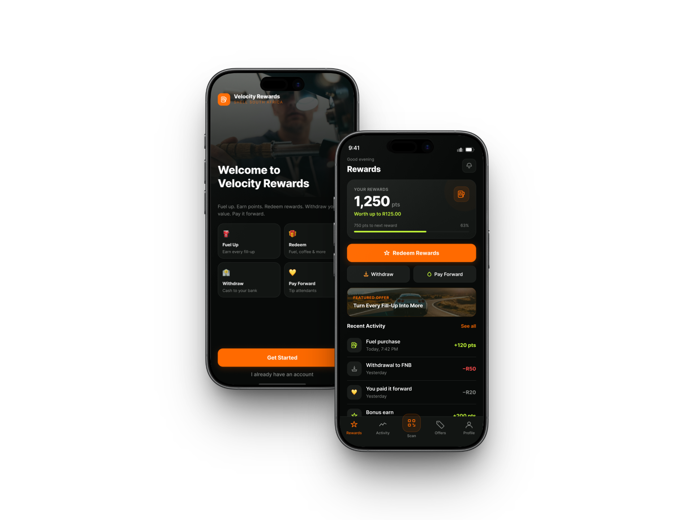
01
Shell Velocity Rewards MVP
Designing a petrol-retail rewards experience around the real rhythm of a fuel stop.
JOHANNESBURG PILOT
CARD-AGNOSTIC
CASHLESS
Concept project · individual contributor
DESIGNED FOR THE NEXT STOP
VISIBLE VALUE
Flexible redemption. Payment freedom. Intentional tipping.
01

Slide 19
02
CONTENTS
From forecourt friction to repeat engagement.
01 Project framing
02 Research + competitor signal
03 Three hypothesis archetypes
04 MVP definition
05 Success model
06 Journey + interaction design
07 Final UI + next iteration
02

Slide 20
“
Picture Lindiwe, pulling into a Shell garage on her way to work. She's filled up here a dozen times this year. She has no idea how many rewards she's sitting on, and no real reason to check.
Her card's buried in a drawer at home somewhere. As far as she's concerned, whatever she's earned might as well not exist.

Slide 21
1
PRODUCT DISCOVERY & CONTEXT ALIGNMENT
The problem and the opportunity
South African motorists who refuel at Shell service stations in Johannesburg just like Lindiwe have a card-based programme which ties their rewards to a card they hardly carry and a points balance they never see, while also lacking an easy digital way to tip fuel attendants.
That's not a minor UX gap. A programme customers can't see or act on daily is a programme that costs money to run without earning the repeat visits it's meant to buy. Low visibility isn't just an inconvenience; it's the mechanism that erodes the entire business case for the programme.
We will conduct an exploratory investigation to identify core friction points and define a focused, frictionless MVP digital rewards ecosystem.

Slide 22
2
PRODUCT DISCOVERY & CONTEXT ALIGNMENT
Research method
I audited loyalty models across five fuel-retail and adjacent high-frequency categories: supermarket loyalty, banking rewards, and fuel rewards to see which mechanics correlated with sustained use versus quiet abandonment.
Sasol Rewards
BP Rewards
Engen 1App
Discovery Vitality Money
eBucks
WHY A COMPETITOR ANALYSIS?
Constraints
This was self-directed work, without access to real Shell users or stakeholders to validate assumptions through interviews. Rather than skip research, I substituted a structured competitive and market audit for direct interviews, a reasonable trade-off in early concept work, but one that means the findings are directional, not validated.

Slide 23
2
PRODUCT DISCOVERY & CONTEXT ALIGNMENT
Full competitive audit (1 of 2)
Works with any
card/payment method
Cashless, instant
redemption
Built-in
tipping
Sasol Rewards
Simple, familiar earn rate customers already trust simplified earn-rate (points per litre)
Shared family/friends account builds habitual use
Wide network of stations across the country
BP Rewards
Stacks with Smart Shopper for a near-best combined earn rate
Backed by an established retail partner network
Cashback feels tangible and easy to understand
Engen 1App
In-house wallet app layered onto Clicks ClubCard and FNB eBucks
Value depends on holding specific partner cards
Several users report unclear point tracking and hard-to-read text

Slide 24
2
PRODUCT DISCOVERY & CONTEXT ALIGNMENT
Full competitive audit (2 of 2)
Works with any
card/payment method
Cashless, instant
redemption
Built-in
tipping
eBucks
Deep bank integration drives loyalty across many categories
High reward ceiling for top-tier banking customers
Rewards extend across groceries, travel, and more
Discovery Vitality
Highest possible cashback, up to 50% on fuel spend
Strong behavioural engagement through driving-score gamification
Reinforces an existing wellness/insurance relationship
Tappy
Already solves cashless tipping for petrol attendants directly
No app, card, or bank account needed for the attendant
Fast, lightweight rollout with minimal setup cost
Poor / not offered
Partial
Strong / fully offered

Slide 25
2
PRODUCT DISCOVERY & CONTEXT ALIGNMENT
What the market is telling us
Visibility is one of the strongest disengagement signals
The clearest market signal: when customers cannot easily see points, value and redemption options, the programme becomes easier to ignore.
Invisible value gets abandoned
Customers who couldn't easily see what they'd earned, or how to use it, simply stopped engaging.
01
02
Visibility
Flexibility
“Pay It Forward” is a defensible asset
No competitor offers an equivalent mechanic; this is Shell Velocity's most distinctive lever.
Flexibility that exists on paper isn't flexibility
Several programmes offered genuinely flexible redemption: partner catalogues, multiple reward types, tiered perks, but buried those options three or four menus deep, or gated them behind thresholds the customer couldn't see until reached.
Visibility and flexibility must work together, not just exist separately. That combined finding set the direction for the design.

Slide 26

Lindiwe Sibanda
Hypothesis 1 of 3
Hypothesis proto-persona · The Balance- and Value-Conscious Parent
Age: 45
Occupation: Associate Consultant
Children: 2
Payment method: Debit card / occasionally cash
Moment of Truth
Behaviours
“If it saves us money on the school run and the weekend wash, we're in.”
Refuels 2–3 times a week, often with her children in the car
Uses the convenience store regularly to buy her children snacks
Switches between card and cash depending on what she has in her wallet
Goal
Frustrations
Motivations
Redeem points across services (fuel, wash, kiosk)
Track shared/family rewards balance easily
Stretch family budget further
Redemption restrictions that don't match real spending habits
Confusing points-to-value conversions
Rewards tied to a single card, restricting shared use
Being able to use rewards flexibly across all services
Transparency and fairness
Tangible, easily understood value systems that aren't confusing

Slide 27
What our three hypothesis personas revealed
The common thread beneath all three personas is control:
Control over which payment method is used
Control over where value can be redeemed
Control over how generosity is expressed
HUMAN CONTROL
AUTONOMY
Fully Autonomous
Human-Machine Interface
Fully Manual
The MVP's job is to remove the constraints that currently take that control away.

Slide 28

MVP DEFINITION
The MVP is four behaviours, not a long feature list.
01 SEE IT
One unified, visible balance
02 USE IT NOW
Redeem during the fuel stop
03 PAY MY WAY
Keep payment card-agnostic
04 THANK CLEARLY
Separate digital tipping from redemption
PRODUCT PRINCIPLE
If it does not help at the pump, it does not belong in the MVP.

Slide 29
3
MVP DEFINITION
Core MVP success matrix
How I'd measure success
01
SIGN-UP RATE
REJECTED
Curiosity can be bought; it does not prove behaviour changed.
02
REDEMPTION RATE
SECONDARY
Proves the flow works, but not whether the customer returns.
03
REPEAT ENGAGEMENT
PRIMARY
Directly tests whether visibility and control create habit.
30/60
PRIMARY
WHY
day return rate
repeat engagement
the experience should earn another stop

Slide 30
JOURNEY DESIGN
The digital flow mirrors the physical station journey.
Launch app
Log in
Sign up
Home dashboard
Fuel payment
Rewards
Tip attendant
Profile & wallet
Choose pump / amount
Points balance
Select attendant
Pay by card
Redeem reward
Withdraw money
Choose tip amount
Add card
Add bank
Receipt
Earn points
Bank / card payout
Tip confirmation

Slide 31


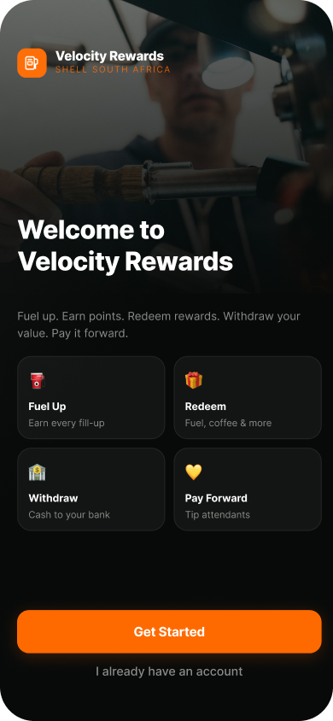

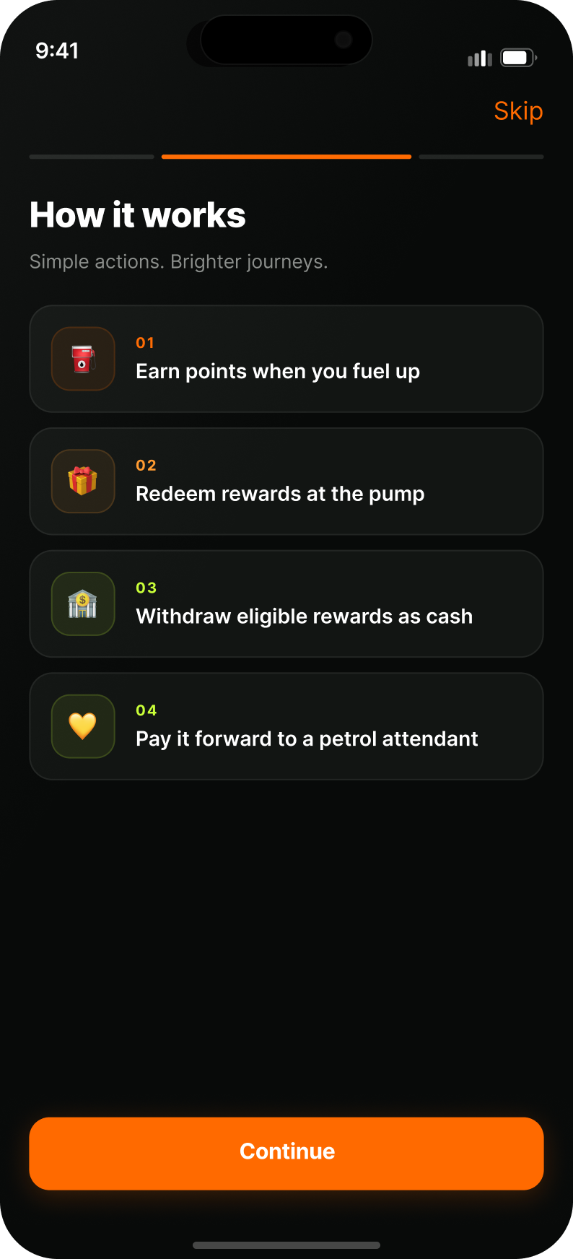

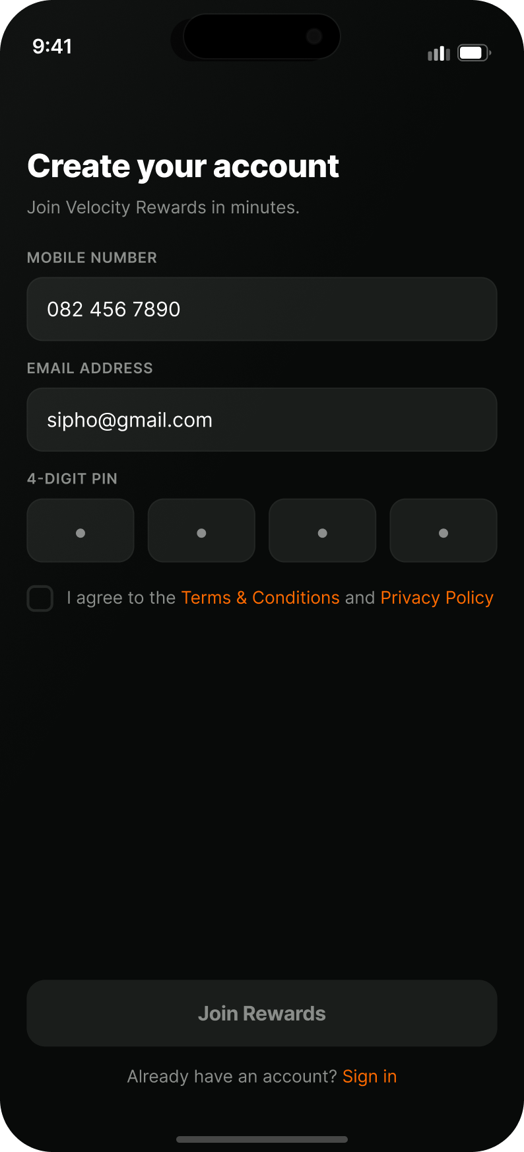
32
DESIGN SCREENS

Slide 32
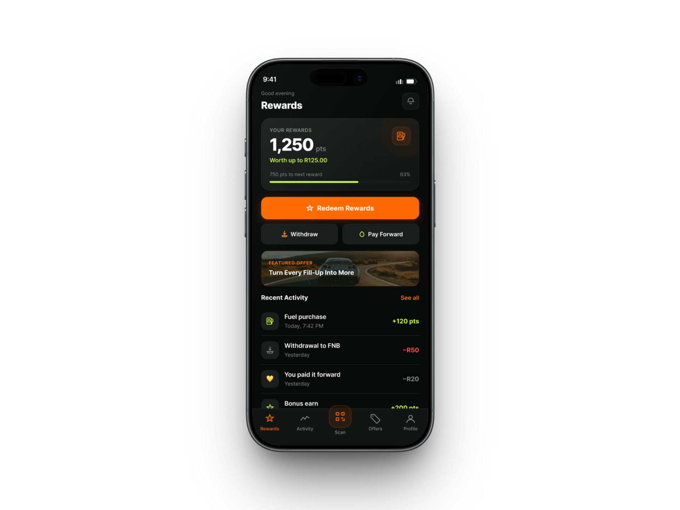
DESIGN DECISIONS
Key decisions & visual design system
01 SEE IT
One unified balance, not separate wallets
Fuel and in-store purchases feed a single visible points balance instead of separate pools. Alternative considered: mirroring the business structure with distinct fuel-points and shop-points wallets. I ruled this out because it recreates the fragmentation problem in a new form, many balances are harder to track than one, even if each is individually visible. A single number reinforces the “one programme” mental model the whole redesign is built around. Strategically, this turns rewards from a passive back-end benefit into an active part of the customer experience. The design decision supports both user clarity and stronger perceived programme value.

Slide 33
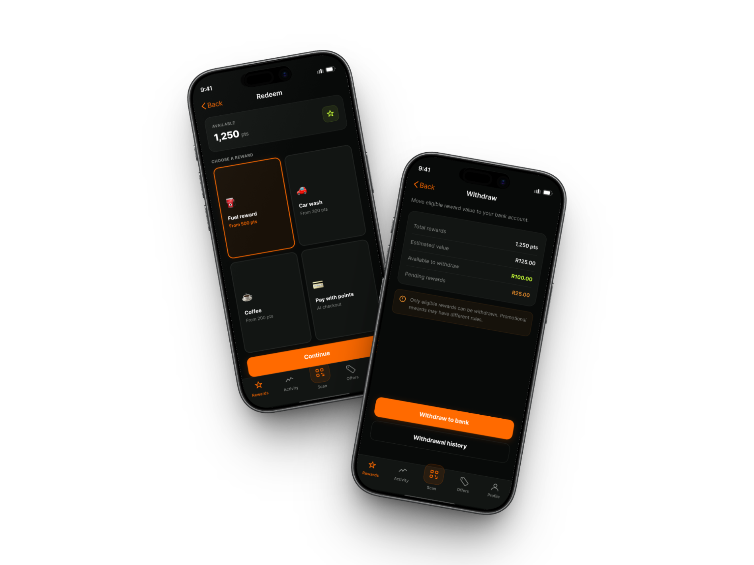
DESIGN DECISIONS
Key decisions & visual design system
02 USE IT NOW
Real-time visibility and control over point usage
Reduce redemption friction: Rejected a conventional points model that relies on high redemption thresholds, delayed rewards or restricted catalogues. Those approaches may support long-term accumulation, but they weaken immediacy and can make the benefit feel distant. Velocity instead allows users to redeem or withdraw value closer to the moment it is earned. Strategically, this reduces the distance between behaviour and benefit, making the programme more relevant to everyday fuel needs. The principle is simple: value should not only be earned; it should be usable..

Slide 34
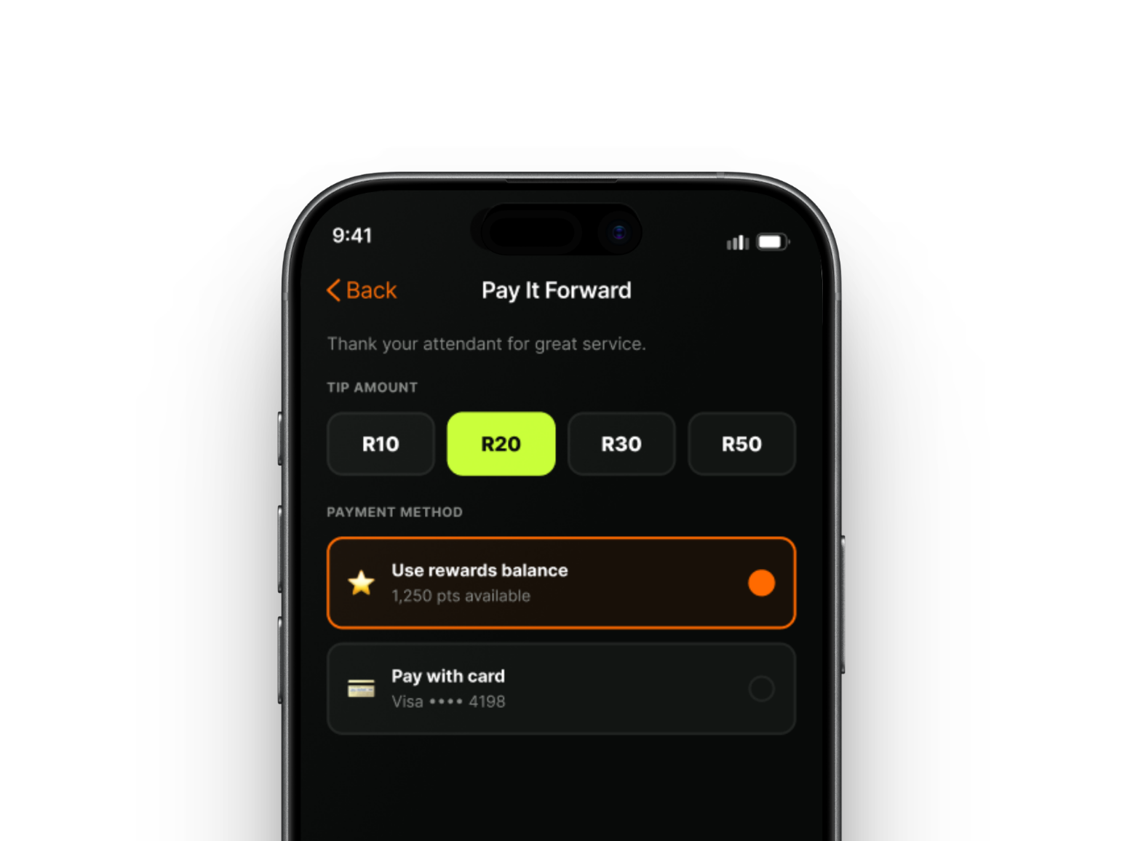
DESIGN DECISIONS
Key decisions & visual design system
03 PAY MY WAY
Preserve customer freedom
We deliberately moved away from a bank-linked or single-card loyalty structure, where customers need a specific financial product to qualify. That model was rejected because it creates unnecessary dependency and excludes users whose existing payment habits do not match the programme. Velocity keeps earning more payment-agnostic, allowing the customer to retain control over how they pay. Strategically, this broadens participation and positions Shell, rather than a banking partner, at the centre of the loyalty relationship.

Slide 35
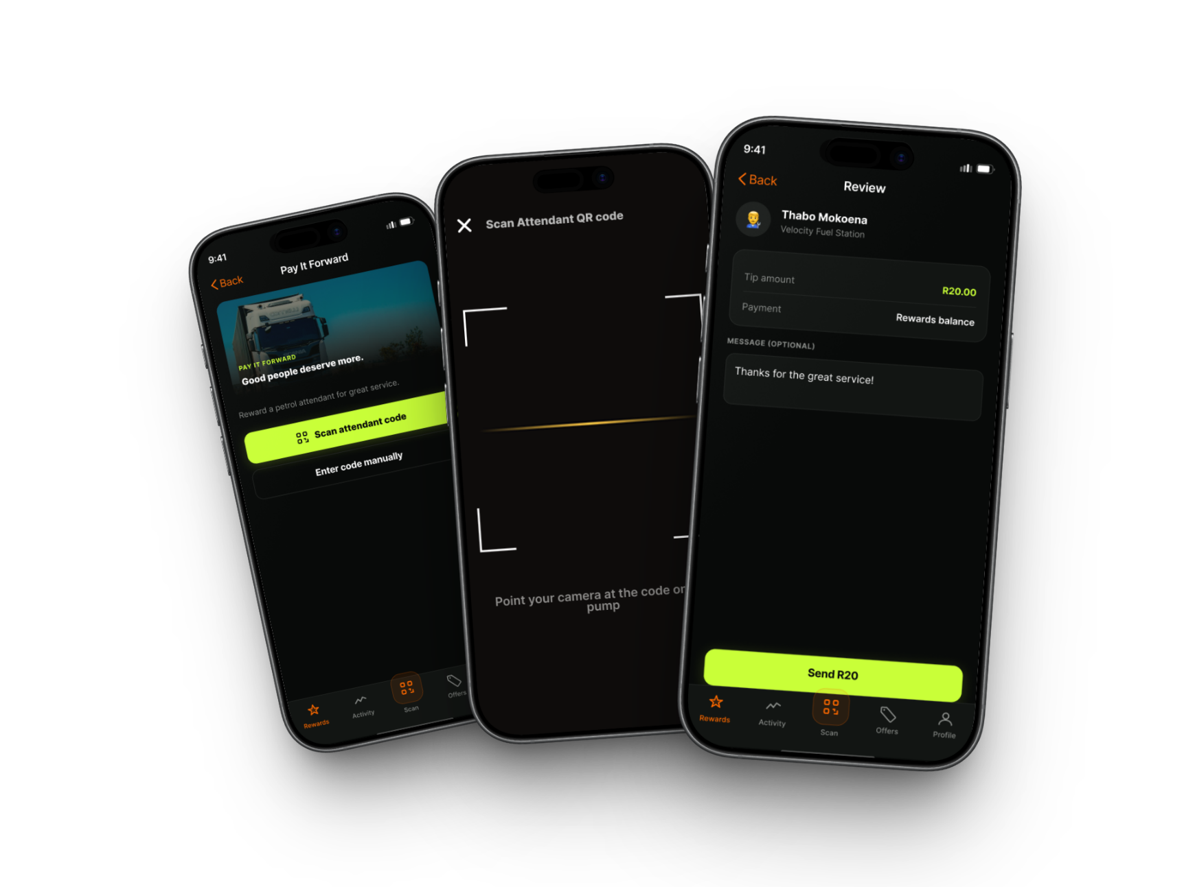
DESIGN DECISIONS
Key decisions & visual design system
04 THANK CLEARLY
Bring the human service layer into the ecosystem
We rejected both a purely transactional digital journey and a tipping model where gratuity is bundled invisibly into the fuel payment. Velocity separates tipping from the fuel transaction and makes the recipient and amount explicit. Strategically, this preserves the human layer of the forecourt experience while still supporting a cashless future. It creates transparency for the customer and clearer recognition for the attendant.

Slide 36
NEXT ITERATION
The next test belongs at the station.
The concept should now meet real motorists, attendants and operational constraints.
01 INTERVIEWS
Validate visibility, flexibility and payment freedom.
02 TASK TESTS
Test comprehension of balance, redeem and tip flows.
03 LIVE PILOT
Track return behaviour and service-time impact.
04 ITERATE
Keep only the mechanics that earn another visit.
PORTFOLIO TAKEAWAY
I used imperfect evidence to make a precise design bet then defined how I would prove or disprove it.

Slide 37
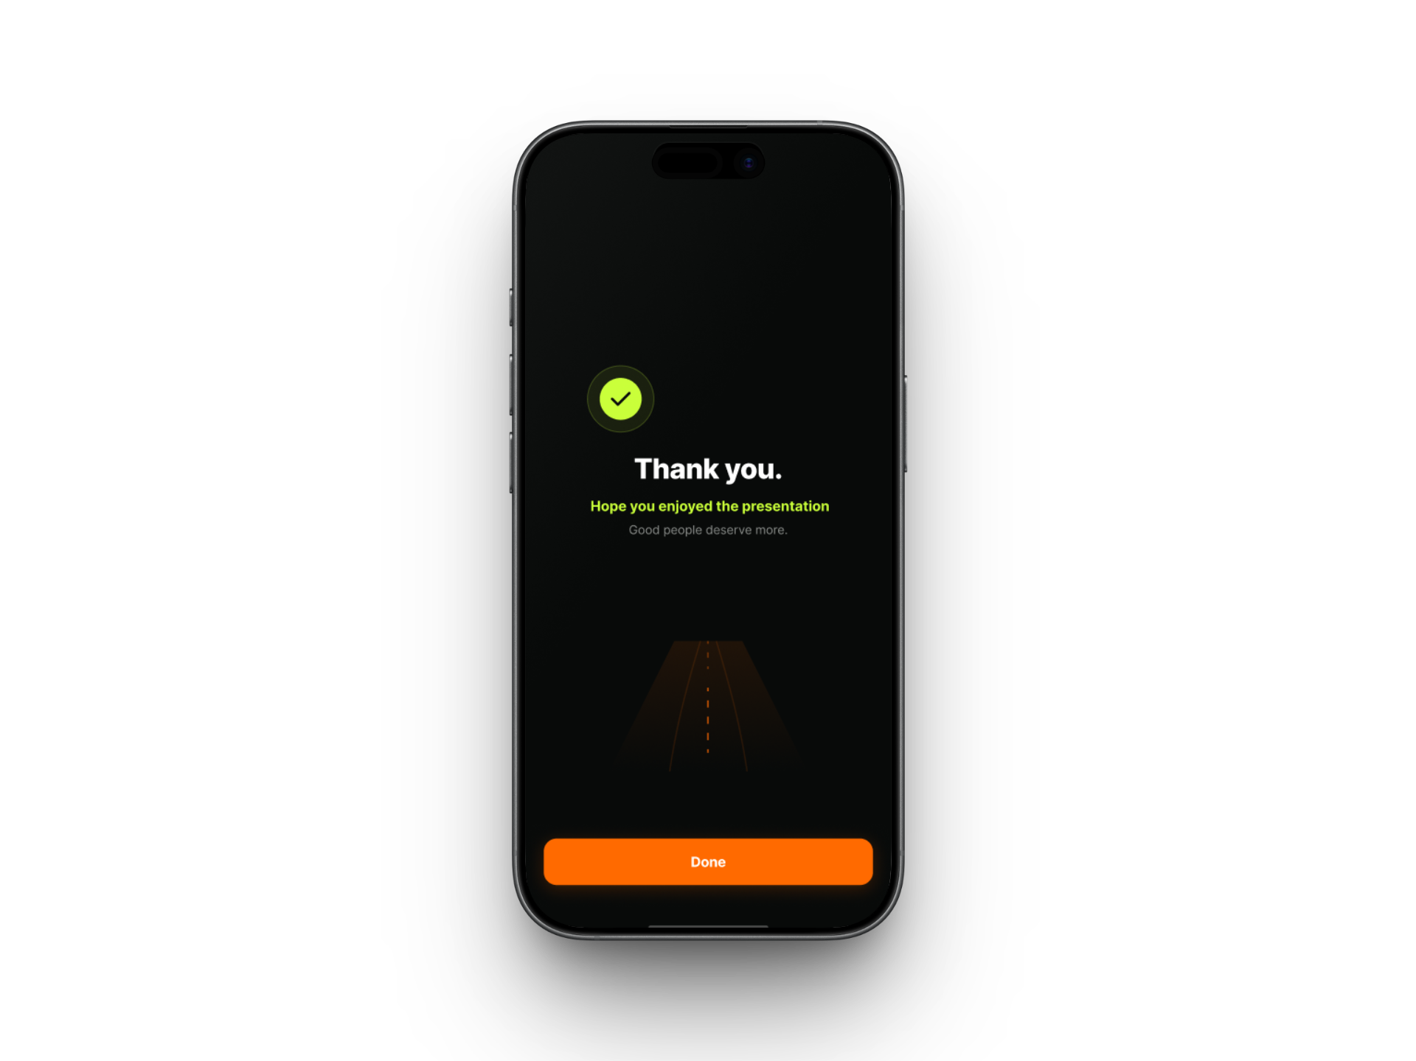
THANK
YOU
A rewards experience designed around the real rhythm of the forecourt.
SEE VALUE · USE IT NOW · COME BACK
DESIGNED FOR
THE NEXT STOP

Slide 38

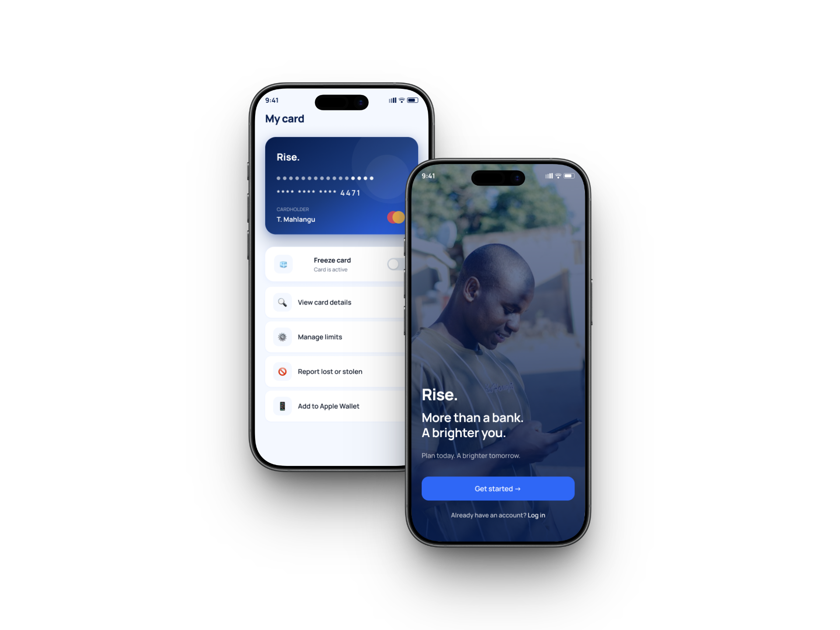

02
RISE
Real Income, Steady Earnings
Youth unemployment in South Africa has climbed for a decade from 36.9% in 2015 to 47.4% by Q2 2026. This study explores what happens on the other side of that statistic: not the job search, but the first few months of being paid.
MY ROLE
STATUS
Individual Contributor, UX Designer
Design exploration, not built or shipped
01

Slide 39
“
I finally have a job. Why do I feel like I'm failing at it before I've even started spending?
Thabo, 23 - four months into his first job
02

Slide 40
1
PRODUCT DISCOVERY & CONTEXT ALIGNMENT
The problem and the opportunity
Nobody puts the real cost of finding work in the job advert, the taxi fare to an interview two zones away, data for a video call, a CV printed at the internet café because the library queue was too long. Thabo applied to 38 jobs, had three interviews and one almost-offer that turned out to be a scam, before landing his role.
That history is exactly why the first payslip carries so much weight, and why existing accounts miss it. Getting the job doesn't end the pressure, it just changes shape: young people manage the biggest financial transition of their lives with the least support from the institutions built to help and often conclude, quietly, that banks were never really for them.
As we observe existing youth accounts, they do not respond with a plan for uncertainty, a place for family obligation, or a way to ask a “stupid” question without shame.
03

Slide 41
2
PRODUCT DISCOVERY & CONTEXT ALIGNMENT
Research method
I went looking for statistics that could test three different explanations for the same behaviour, rather than one that simply confirmed a hunch. If young people were genuinely just “bad with money,” you'd expect one of these to be weak and the others fine. Instead, all three came back low.
1
The Emotional State
2
The Skills Gap
3
The Outlook
75%
39%
+50%
of South Africans under 35 report financial anxiety or stress, up 18% year-on-year
feel confident in their own digital financial skills
say they don't know how to build a stable financial future
(Debt Rescue Money Stress Tracker, 2026)
(SA Social Media Landscape report)
(Old Mutual Youth Generational Wealth Survey)
Three different angles on the same population, all pointing the same direction, this is what turned “maybe it's a mindset problem” into “this is structural.”
04

Slide 42

03 · SYNTHESIS
A persona that keeps the real-world pressure visible
THABO MAHLANGU · “THE CAUTIOUS PROVIDER”
BEHAVIOURS
DECISION-MAKING
FRUSTRATIONS
MOTIVATIONS
Checks balance after payday, debit orders and larger purchases.
Asks: “What will I have left after this?”
Bank shows what happened, not what happens next.
Support home without losing progress.
Mentally splits money into transport, home, food and “do not touch” money.
Chooses reversible money moves over locked commitments.
Jargon makes him feel judged or behind.
Build credit without debt anxiety.
Uses banking apps confidently but avoids unclear money products.
Needs costs, timing and consequences visible before acting.
Unexpected deductions break his sense of control.
End the month with money remaining.
THABO MAHLANGU
23 · Johannesburg · first job · R6,800/month
TRIGGERS
MENTAL MODEL
PRODUCT IMPLICATION
COMPOSITE PERSONA
Payday: allocates obligations before wants.
Money in → obligations → safe to use → must remain.
Shift from balance visibility to financial confidence.
Recently entered formal employment and is learning to balance independence with responsibility at home. His income represents progress, but every decision is filtered through one question:
Family request: recalculates what is safe.
A traditional balance does not answer his real question.
Prioritise safe-to-spend, upcoming deductions, buffer warnings and clear confirmations.
“If I spend this now, will I still be okay later?”
Buffer drops: immediately reduces spending.
Confidence comes from projection, not just visibility.
Design for pressure moments, not only account management.
Core need: financial breathing room, keeping his buffer above zero.
SYNTHESIS MOVE
Thabo is not asking for a more feature-rich banking app. He needs a banking experience that protects his financial breathing room and helps him know he will still be okay.
05

Slide 43
The recurring loop revealed the intervention point
1
Payday arrives
A standard user journey would show Thabo receiving pay, opening an app, and adjusting a budget, a straight line with a beginning and an end. I didn't use that framing, because a straight line can't explain why the same problem comes back every month. Mapping it as a loop instead surfaces the thing a linear journey hides: the same starting conditions produce the same ending conditions unless something inside the loop changes. Naming the loop is what makes it possible to pick a deliberate point to interrupt.
2
Family remittance claims a fixed share, immediately
3
Little or no buffer remains
4
Shame blocks help-seeking
5
No habit or safety net forms
Where RISE intervenes
Of the five points in the loop, only one is inside a product's control: the gap between buffer depletion and shame blocking help-seeking (3→4). RISE can't change what family expects or when payroll runs, but it can make checking in on money feel private and judgment-free enough that shame doesn't get the final word.
06

Slide 44
4
SUCCESS MATRIX
How I would measure success
1
Sign-up rate
Rejected
Easy to inflate with a marketing push; tells you nothing about whether the moment was handled differently.
How many first-job earners create an account
2
App opens on payday
Secondary
Shows a habit forming around the moment, but not whether anyone is actually better off because of it.
Whether the calm notification gets attention
3
Buffer balance > 0
Primary
Directly tests whether the design interrupted the loop, a habit that doesn't survive to next payday hasn't changed anything.
Whether a safety net survived the month
07

Slide 45
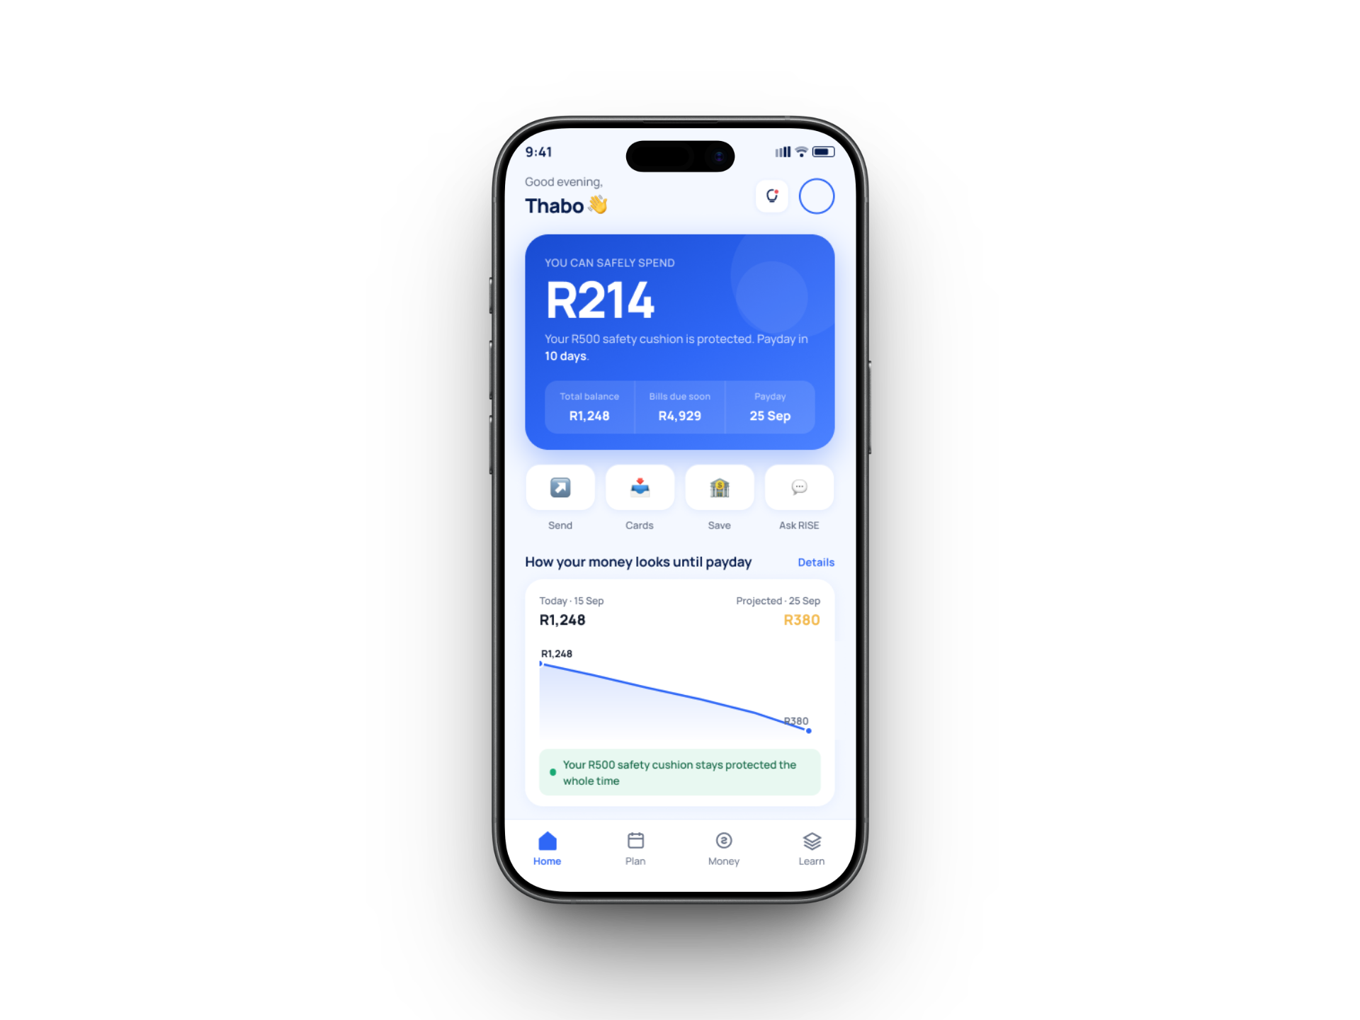
5
KEY DESIGN DECISIONS
Designing the first few months
I made the Buffer a first-class financial object, not another savings account.
The Buffer is deliberately surfaced during onboarding and throughout the experience as money that protects Thabo from falling below zero. I chose this because the research suggests that his primary measure of financial progress is not wealth accumulation yet; it is surviving the month with something left. The alternative was to treat the buffer as a conventional savings goal alongside things like a phone, holiday or emergency fund. I rejected that because it would make an essential safety mechanism compete with aspirational goals. Strategically, RISE distinguishes between money that protects stability and money that funds ambition, making the hierarchy clearer. This also aligns directly with the success metric already defined in the case study: maintaining a buffer above zero
08

Slide 46
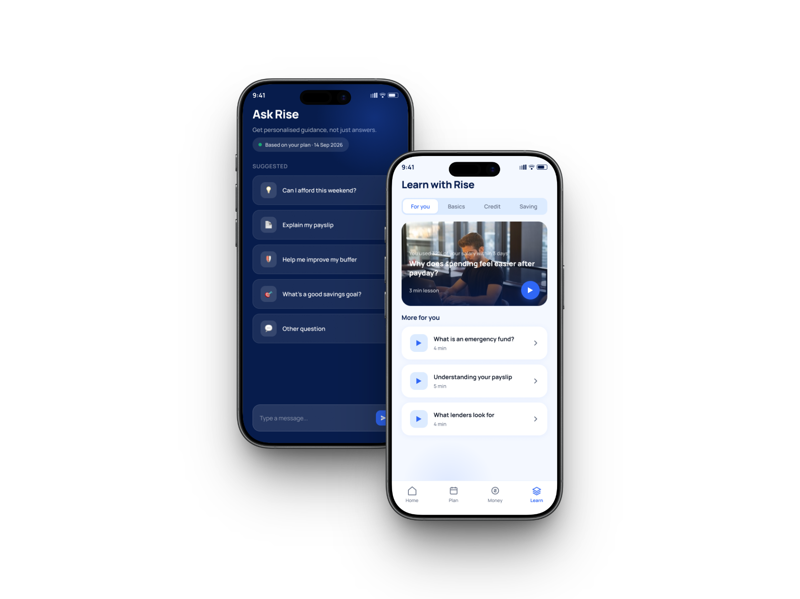
5
KEY DESIGN DECISIONS
Ask a question, learn at your pace
A quick-question channel, not a support ticket
The Ask RISE experience gives the user a clear place to ask financial questions and uses suggested prompts to reduce the anxiety of starting from a blank screen. I chose this because someone early in their financial life may not know the terminology required to search a help centre correctly, and embarrassment can prevent help-seeking altogether. The alternative was an FAQ, chatbot hidden behind a support icon, or formal ticketing workflow. I rejected those because they optimise support operations rather than the psychological barrier identified in the research. RISE therefore treats asking for help as a normal banking behaviour, not an escalation.
Progressive lessons, not a wall of terms
Money 101 appears alongside everyday banking features rather than sitting in a separate learning portal. Lessons are short, progressive and connected to the kinds of financial decisions a first-job earner is already making. I chose this because financial education is most useful when it appears near the moment of uncertainty. The alternative was a traditional financial literacy hub containing articles, definitions and long-form content. I rejected that because it assumes users know what they need to learn and are motivated enough to search for it. The new design treats learning as contextual support, not homework, extending the original progressive-learning decision in the deck.
09

Slide 47
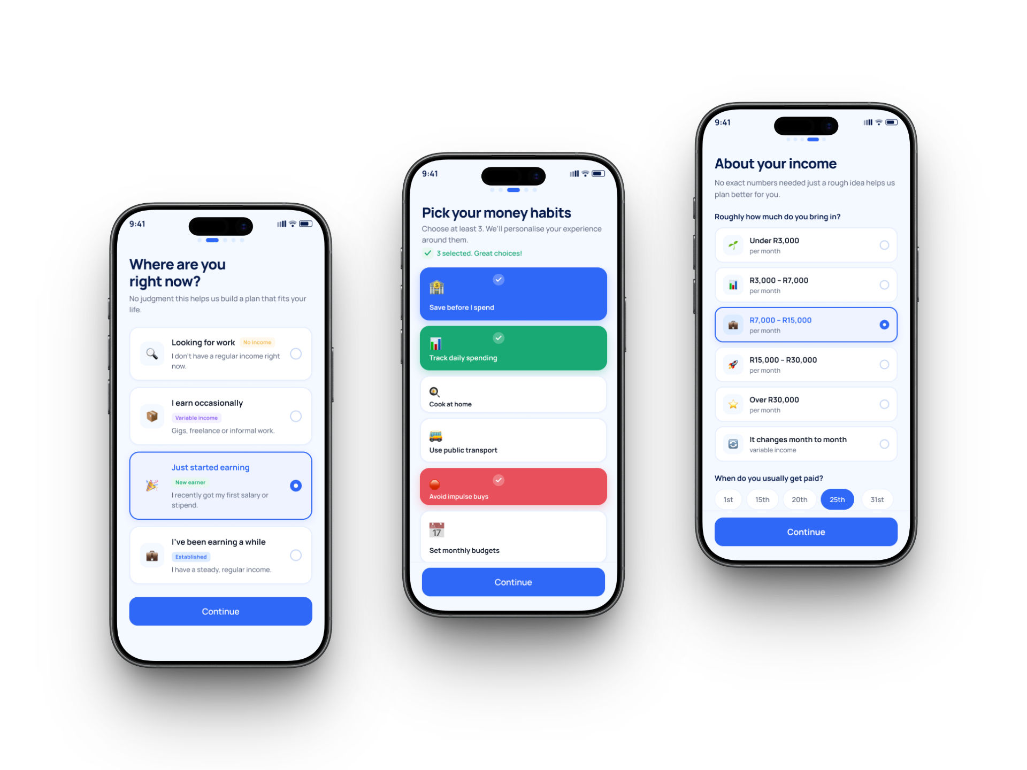
5
KEY DESIGN DECISIONS
Onboarding starts with context, not KYC
Turned onboarding into progressive financial context gathering
The onboarding flow now asks a sequence of lightweight questions about employment stage, income and financial priorities instead of collecting everything on one dense screen. This allows RISE to begin understanding Thabo's financial reality before presenting recommendations. I chose progressive disclosure because income alone does not tell us whether someone is stable: a newly employed person, someone on probation and someone several months into a role may earn the same salary but require very different support. The alternative was conventional KYC-first onboarding with identity, contact and income information presented as one compliance-heavy sequence. I rejected that as the dominant experience because it tells the bank who the customer is, but not what financial transition they are currently navigating.
10

Slide 48
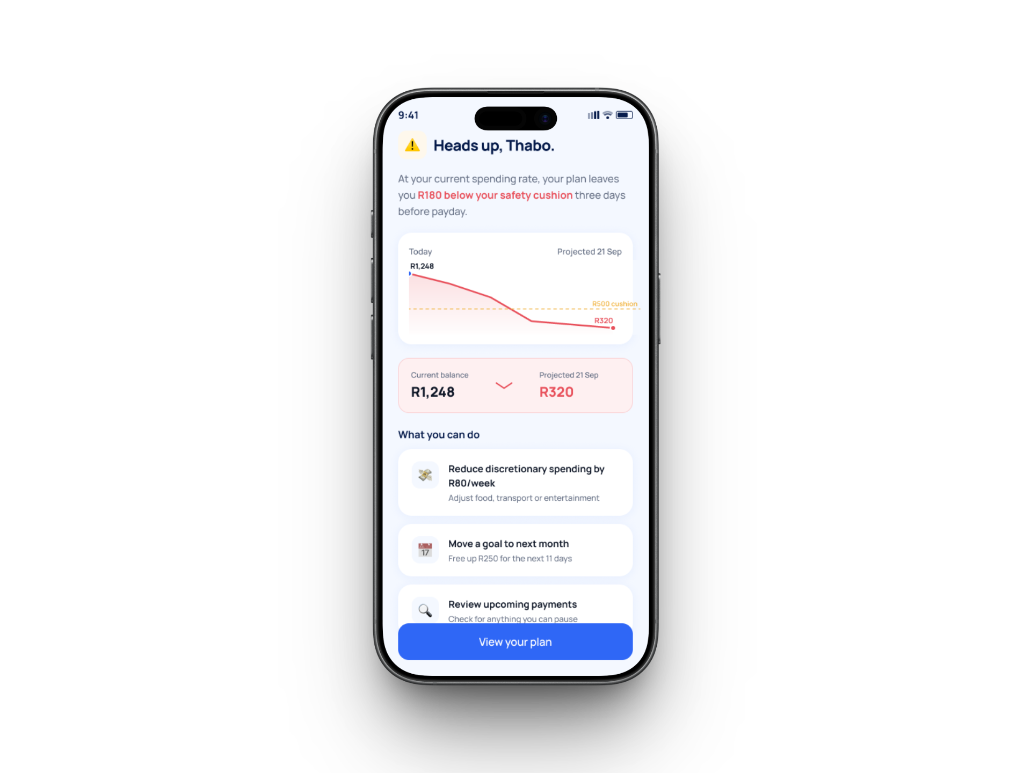
5
KEY DESIGN DECISIONS
Buffer warning to intervene before the problem becomes a crisis
Accessibility checks: readable 16px+ text, visible focus states, clear risk colours with supporting labels, and large tap targets.
Warn before the buffer breaks, not after the balance is gone
RISE warns the user when an action is likely to reduce their protected buffer, rather than waiting until the account is already low. I considered a conventional fixed-threshold alert, but rejected it because it reacts too late and ignores upcoming obligations. The warning instead uses the user’s financial context to show what may happen next, how much remains safe to spend, and what action can protect their breathing room. This turns the alert from a notification into a decision-support moment. Strategically, this is where RISE moves beyond a normal banking app. Most banking products tell users when money is low. RISE tries to predict when their financial breathing room is about to disappear.
11

Slide 49
Design system + accessibility
Visual language, interaction states and basic accessibility considerations used across the RISE prototype.
Accessibility checks: readable 16px+ text, visible focus states, clear risk colours with labels, and large tap targets.
Typography - base 16, scale 1.25
H1
60px / 3.813rem
Core Blue
Deep Navy
#285EF6
#071846
H2
39px / 2.438rem
Primary actions, selected states
Ask RISE, focused guidance
H4
31px / 1.938rem
Obligation Orange
Risk Red
#EC592D
#F14A46
Text heading
24px / 1.563rem
Required costs
Buffer warning and risk state
Text body
20px / 1.250rem
Sky Tint
Safety Green
#EEF4FF
#008200
Text label
16px / 1.000rem
Selected cards and calm surfaces
Goals, progress, on-track states
Radius scale
Ink
State Grey
xs 4 · sm 8 · md 12 · lg 16 (base 4, step 4)
#111111
#5A5A5A
Primary text
Secondary/supporting text
Buttons
Primary: Action Blue fill, white text · Disabled: Blue-100
11

Slide 50
ACCESSIBILITY + HANDOFF CONSIDERATIONS
What I would prepare before moving RISE from concept into a build-ready product conversation.
Accessibility
Design system handoff
Product risk checks
• Do not rely on colour alone for buffer risk states.
• Use plain-language labels for money movement and consequences.
• Keep primary actions thumb-reachable and at least 44px high.
• Maintain visible focus / selected states for interactive elements.
• Components for cards, warnings, inputs, buttons and progress states.
• Variants for neutral, success, warning and risk states.
• Tokenised colour, radius and typography scales.
• Annotated states for loading, empty, error and confirmation.
• Test comprehension of “buffer” vs “available balance”.
• Stress-test irregular income and family obligation scenarios.
• Validate privacy and tone for Ask RISE questions.
• Review edge cases before linking to live banking data.

Slide 51
VALIDATION & NEXT STEPS
Testing the concept without inventing results
The next step is a small moderated usability test with first-job earners before claiming impact.
Test focus:
• Can participants explain the difference between available balance and protected Buffer?
• Do buffer warnings help them decide before a risky spend?
• Does Ask RISE feel private and safe enough to use?
• What breaks when income is irregular rather than monthly?
Iteration rule: keep only patterns that participants understand without facilitator explanation.
12

Slide 52
STANSLOUS NHAU
UX Designer · Research · Product thinking · Systems thinking
Johannesburg, South Africa
Email · LinkedIn · Portfolio website

