Slide 1

2026 DATA SCHOOL HACKATHON · SYN BANK CHALLENGE
Peeping through the keyhole:
Understanding wallet share
Seen
“I don't play the odds, I play the man.” – Harvey Specter
Avengers Assembly
Presented by: Aiden Wood, Adriaan Mostert, George Mato, Jack Moon and James Stapylton-Smith
Notes:
Open with the keyhole image, not the model. One sentence: Syn Bank sees every rand that crosses its own desk and nothing that crosses anyone else's. Ten minutes: the problem, how we thought about it, what the engine produces, Gen AI, bonus areas, limitations.

Slide 2
THE PROBLEM
Looking through a keyhole into a very large house
Syn Bank sees its own room perfectly.
Every payment, every trade finance line, every cross-border transfer that crosses its desk is recorded exactly.
But Syn Bank is never a client's only bank.
A JSE-listed corporate runs mandates across several institutions at once. Everything flowing to competitors sits behind the door, in the dark.
So the commercial question — how much of this client's business do we actually have? — cannot be answered by looking harder at our own records.
What Syn Bank
can see
Everything else. the client's true total wallet
A perfect record of one room is not a picture of the house.
Notes:
This is the whole problem in one image. Do not rush past it — the judges need to feel why the obvious approach fails before they will care about a Bayesian answer.

Slide 3
HOW WE READ THE PROBLEM
The data is complete and blind at the same time
Before modelling anything we asked what kind of gap this actually is. That answer decided the whole approach.
01
02
03
It is a census, not a sample
The missing part is not random
So more internal data never closes it
Internal records are not a noisy sample of the client's activity. Within Syn Bank they are total and exact.
What is absent is one specific thing — every rand the client chose to place elsewhere. That is a structural blind spot, not noise that averages out.
No amount of extra transaction history reveals a competitor's mandate. The answer has to come from outside the bank, or be stated as an honest estimate.
A problem you cannot observe is not a measurement problem. It is a belief problem — and beliefs are what Bayesian methods are built to handle.
Notes:
This slide is the bridge and the strongest thing we can say about our own thinking. If a judge only remembers one line, make it the last one: unobservable means belief, and belief means Bayes. It also pre-empts 'why not just build a regression'.

Slide 4
THE DESIGN DECISION
We’re smart enough to know we could be wrong
The brief asks how big the wallet is. The honest reply is a range, and a range is more useful to a banker than a false decimal point.
A single figure cannot be checked.
Nobody at Syn Bank will ever see the true wallet, so a point estimate can never be proved right or wrong — it can only look confident.
A range carries its own warning label.
A wide interval tells the banker the number is soft and to probe in the meeting. A tight one tells them to back it. Same effort, far better decisions.
WHAT WE REPORT INSTEAD
A point guess
looks precise, proves nothing
A credible range
most likely value, plus how sure we are
Every wallet figure in this deck is the middle of a range, never a lone number.
Notes:
If asked why not a point estimate: because the target is unobservable, so precision is unfalsifiable and the interval width is itself commercial information. The reported centre is the median of the posterior, not the mean — happy to explain why offline.

Slide 5
THE EVIDENCE
Every signal lights one more corner of the room
Four kinds of evidence, none of which is a wallet figure on its own. Each one tells us where the truth cannot be, and the room gets brighter.
01
02
03
04
Published financials
Cross-border payments
Trade finance activity
Our own ledger history
Annual reports and cashflow statements: what the client spends, earns and moves in a year.
SWIFT activity revealing the scale and rhythm of international business we may only partly serve.
Guarantees and facilities that imply a wider programme than the slice booked with us.
The starting belief, and the one number in the whole problem we know with certainty.
A disclosure is not a wallet figure. Revenue and operating costs do not say what a company banked, or with whom — they cap what it could plausibly have moved. Each signal is translated into banking volume before it is allowed to change our belief, and anything that cannot be tied to a single product pillar is discarded rather than smeared across all three.
Notes:
The obvious challenge is 'you cannot read wallet off an income statement' — we agree, and the translation step is exactly why. If pressed: each metric carries a conversion multiplier to banking volume and is rescaled to the observation period before it enters the update. Detail is in the methodology document.

Slide 6
02 — METHODOLOGY OVERVIEW
Our Approach
1
2
3
4
❯
❯
❯
Ingest Data
Estimate Wallet
Quantify Share & Gaps
Generate AI Insights
Combine internal Syn Bank records with public financial data
Model each client's total addressable banking spend
Measure Syn Bank's current capture vs. the total wallet
Turn gaps into ranked, banker-ready recommendations
Internal Data (Syn Bank)
External Data (Public)
Transactional ledger (50 corporate clients)
SWIFT cross-border payment data
Trade finance instruments (LCs, guarantees)
Annual reports & JSE SENS announcements
Public Ledgers and Cashflow Statements from our clients
Bloomberg open data & DealMakers SA
Syn Bank Share of Wallet Intelligence Engine
3
Notes:
OUR APPROACH & DATA: Update the data source bullets if your team used additional or different datasets/sources.

Slide 7
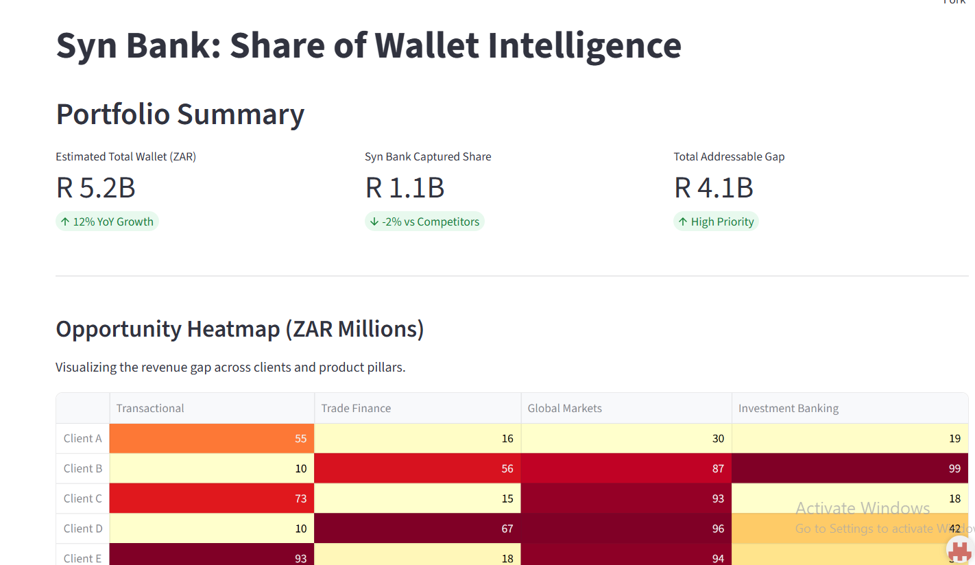
RESULTS
What the coverage banker sees
The coverage banker will be presented with a dashboard that includes a drafted briefing note, a 3-4 sentence summary generated by the Claude API.
The note will detail the client's expected
cash position, whether the upcoming week is a good window for outreach (including the reasoning), and one concrete talking point.
Our engine delivers the definitive Total Wallet Size (TAW) across Transactional Banking, Investment Banking, and Global Markets.
Notes:
Fill the three stat boxes and the chart from the final pipeline run before submitting. Say out loud: rank on rand gap, not percentage share, and always name the pillar so the call has a product hook.

Slide 8
04 — EXECUTIVE DASHBOARD
Portfolio Overview: MTN Group
R 88,414 bn
19,97%
R 53084.33 m
Total Estimated Wallet
Syn Bank Current Share
Growth Opportunity Identified
What This Means
Syn Bank currently captures an estimated 19.99% of total client wallet across the portfolio.
The remaining 80.1% — roughly R53084.33m — is flowing to competitor banks.
This gap is the addressable opportunity ranked in the following slides.
Syn Bank Share of Wallet Intelligence Engine
5
Notes:
PORTFOLIO OVERVIEW: Replace the KPI numbers and right-click the donut chart -> Edit Data to insert your real portfolio totals.

Slide 9
GENERATIVE AI
Gen AI where it is measurable, not decorative
Three roles, all downstream of the numbers. The estimate is deterministic and reproducible; the language layer makes it usable.
Statement extraction
1
Pulls the relevant disclosures out of annual reports and JSE announcements into a structured signal table. Measurable: extraction accuracy against a hand-checked sample, and hours of manual reading removed.
Financial statement scraping
2
Scrapes the web for public information on ledgers and cashflows to automatically put the data into our models, adapting for varying fiscal years
Summary generation
3
Once we have gotten the data and analysed it, producing summaries that are easy to understand and quick to make saves crucial time that could be spent on more skillful work
Prompts, workflow and code for all three are included in the submitted repository.
Notes:
Gen AI is a fifth of the score and the brief warns against cosmetic use. The guardrail point — aggregates only, never raw transactions — lands well with banking judges.

Slide 10
BONUS FOCUS AREA 1
Agents for cash cycles and engagement timing
Three raw sources are aggregated to one row per client per week, then two purpose-built models are chained through an orchestrator.
Feature builder
Forecasting agent
Engagement timing
Briefing agent
→
→
→
weekly per client
next week's inflow and outflow
when to make the call
the client note
What the chain gives a coverage banker
HOW IT FITS THE WALLET ENGINE
A forecast of the client's cash position for the week ahead, per client.
A flag for the moment the client is most likely to be receptive to a call.
A short written note explaining why this client, this week, this product.
The wallet engine answers who to call and which product to lead with.
This chain answers when — the week the client is actually receptive.
Together they turn a ranked gap list into a dated call plan.
Notes:
Performance figures deliberately kept off the slide. If a judge asks: training error is low, and engagement AUC is near 1.0 because the label is currently a deterministic heuristic of the features — a sanity check, not a generalisation claim, and swappable for real CRM meeting outcomes. Name that yourself before they find it.

Slide 11
BONUS FOCUS AREA 2
Latency: never recompute what has not changed
Each client carries a checkpoint recording the latest transaction the models were trained on. Every run is gated on that one comparison.
New run
triggered
anything new
since last run?
yes →
Warm-start retrain
continue, don't restart
Update checkpoint
and score
→
→
no ↓
Where the time actually goes
Reuse cached models
Work is redone only for clients with genuinely new activity.
Retraining continues from where it left off instead of starting cold.
Exactly one language-model call sits at the very end of the chain.
A dashboard refresh on an unchanged client costs a model load, not a retrain.
Notes:
The answer to the latency question is structural, not infrastructural: checkpoint gating plus warm starts, and exactly one LLM call at the tail of the chain.

Slide 12
HONESTY
What this does not do yet
Stating the shortcoming and potential improvements if we were to continue work
Known limitations
What we would build next
Turning a disclosure into banking volume relies on assumptions that are currently fixed rather than uncertain.
All sources are treated as equally reliable — a simplification forced by having only a handful of signals per client.
The range covers what we modelled, not competitor channels we have never seen at all.
Product pillars are added together independently, so any link between them is unmodelled.
The history is short and synthetic, and engagement labels are a heuristic rather than real meeting outcomes.
Let the conversion assumptions be uncertain too, so that error shows up in the range instead of hiding in the estimate.
Weight sources by how reliable they have proven to be, once more disclosures per client exist.
Backtest against clients whose competitor mandates later became public, to check our ranges were honest.
Replace heuristic engagement labels with real CRM meeting outcomes.
Track briefing-to-meeting conversion as the measurable return on the Gen AI layer.
Notes:
Do not rush this slide. Naming the failure modes before the panel does is the cheapest way to earn analytical rigour marks.

Slide 13
Thank you
"There are things known and there are things unknown, and in between are the doors of perception." — Aldous Huxley
Avengers Assembly · 2026 Data School Hackathon · Syn Bank Share of Wallet Challenge
Notes:
Close on the one-sentence value claim, then take questions. Likely questions: why a range rather than a number, how the ceiling is enforced, what happens when a client has no external signals at all.

