Slide 1
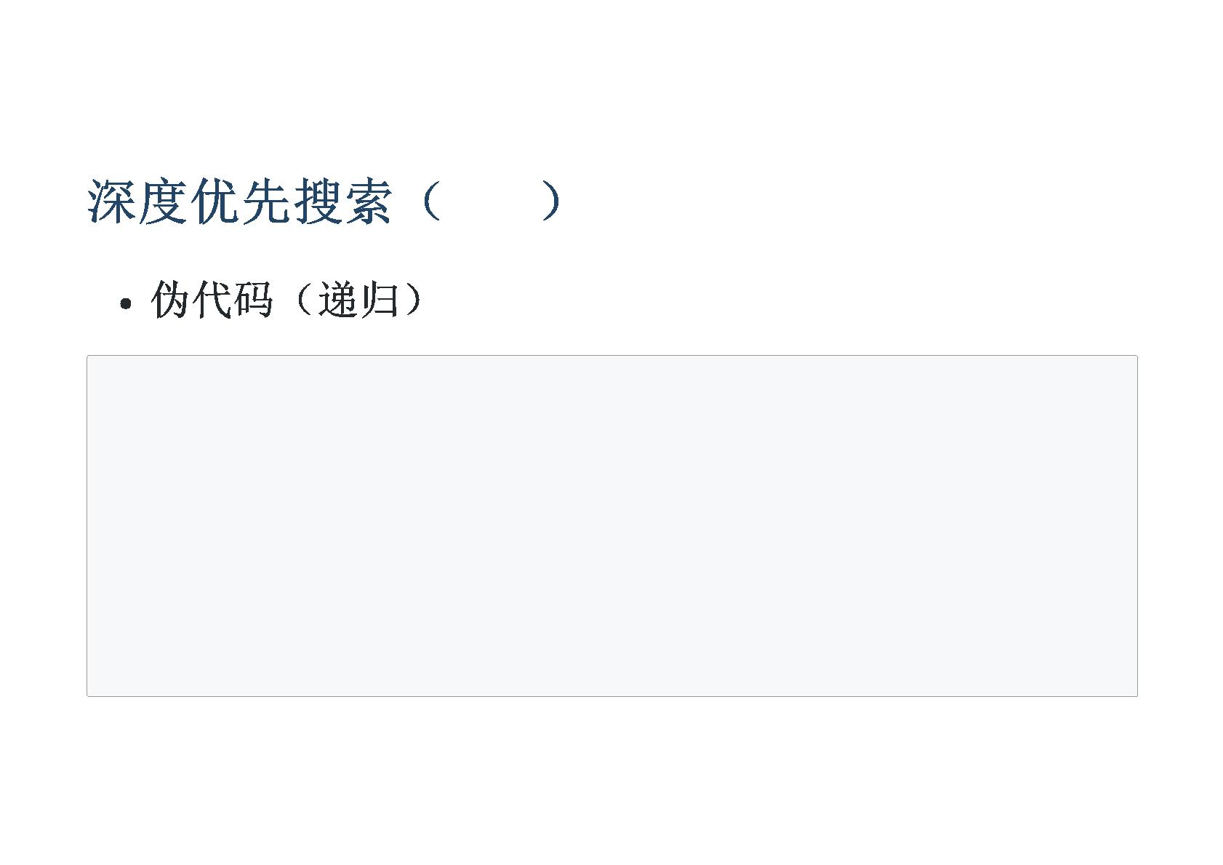
DFS
DFS(currentStatus):
if currentStatus equals finalStatus then
//we find one answer
return
for nextStatus in adjacent status of currentStatus
if nextStatus is valid then
record the effect of currentStatus to nextStatus
DFS(nextStatus)
remove the effect of currentStatus to nextStatus
15

Slide 2
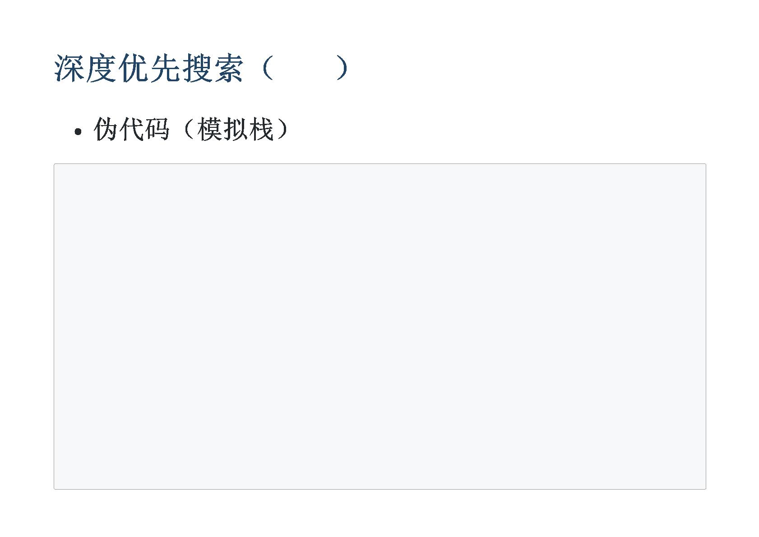
DFS
DFS():
stack<status> stk
push startStatus into stk
while stk is not empty:
currentStauts := top of stk
pop the top of stk
if currentStatus equals finalStatus then
//we find one answer
continue
for nextStatus in adjacent status of currentStatus
if nextStatus is valid then
record the effect of currentStatus to nextStatus
push nextStatus into stk
remove the effect of currentStatus to nextStatus
16

Slide 3
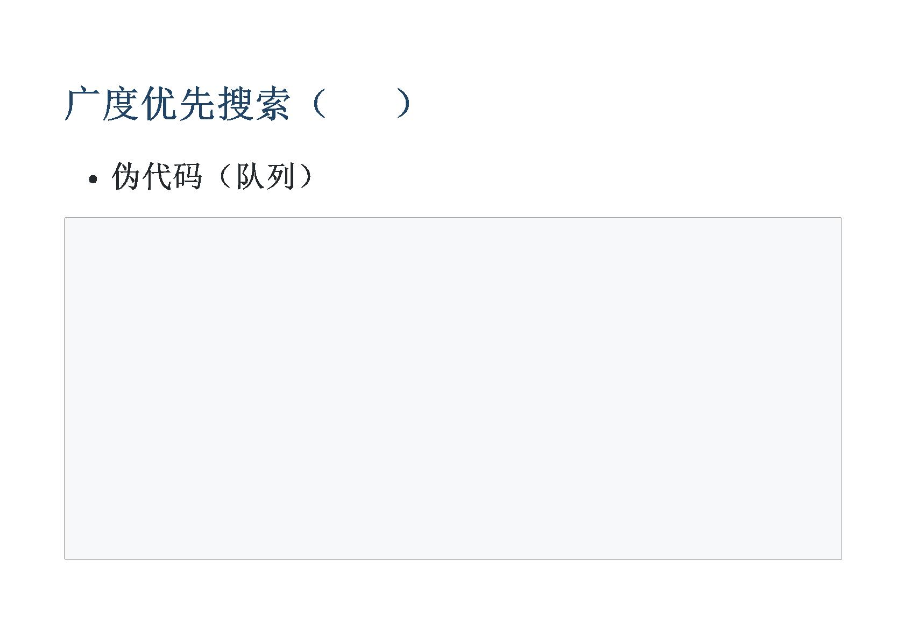
BFS
BFS():
queue<status> q
push startStatus into q
while q is not empty:
currentStauts := front of q
pop the front of q
if currentStatus equals finalStatus then
//we find one answer
continue
for nextStatus in adjacent status of currentStatus
if nextStatus is valid then
push nextStatus into q
19

