Slide 1
Overview of Survey Results

Slide 2
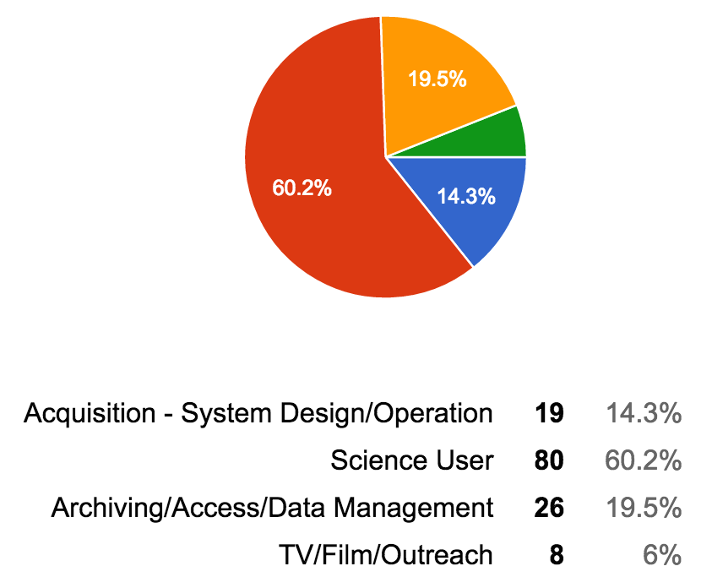
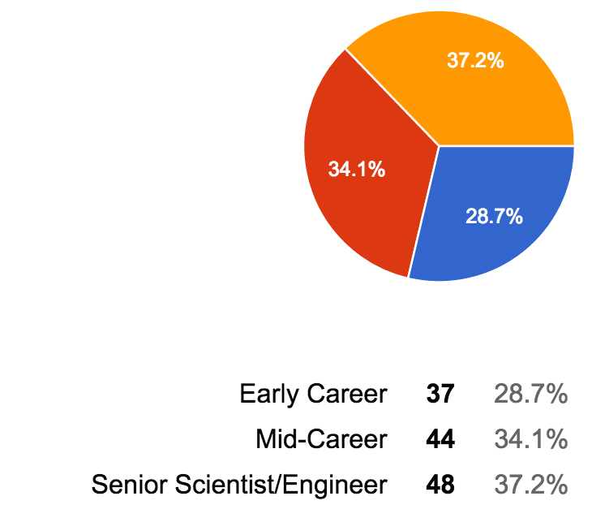
Survey Overview – 133 Responses

Slide 3
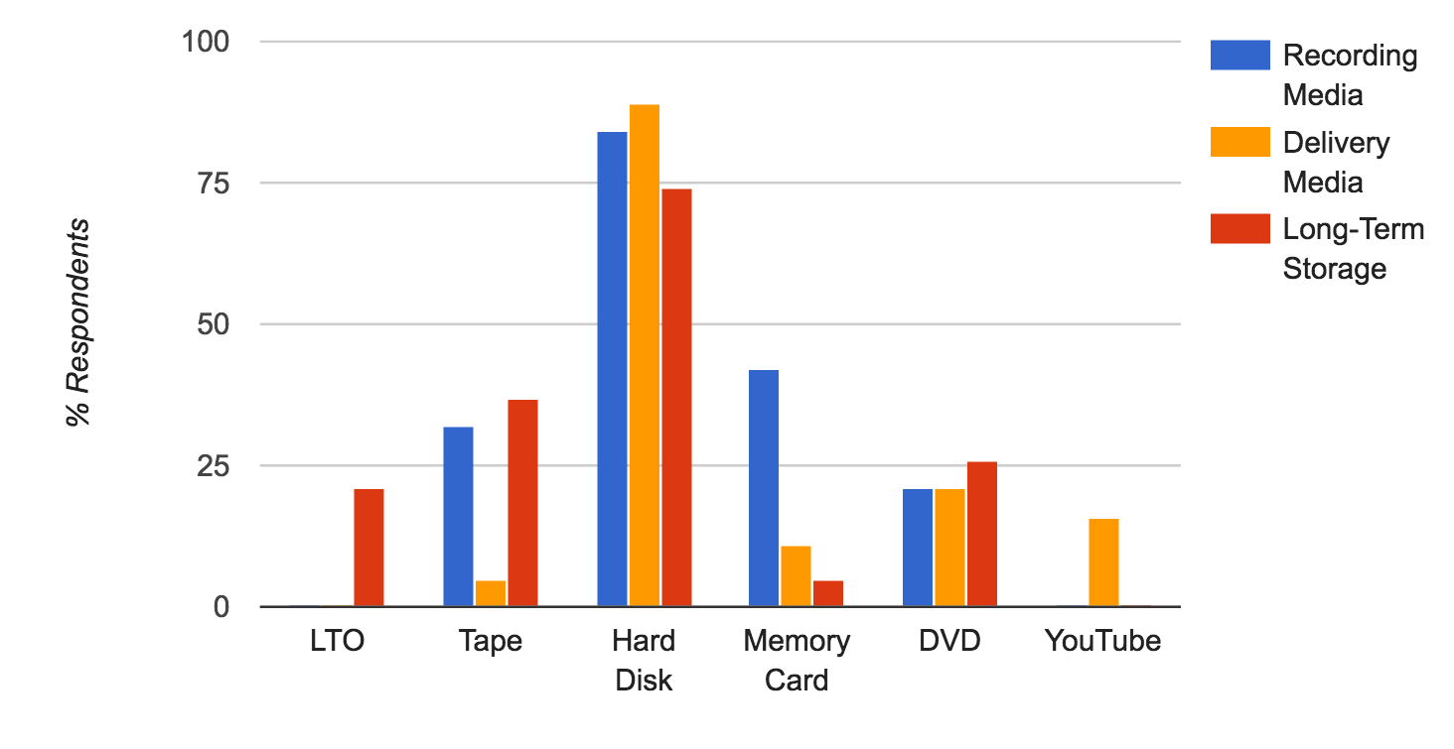
Recording/Storage Media

Slide 4
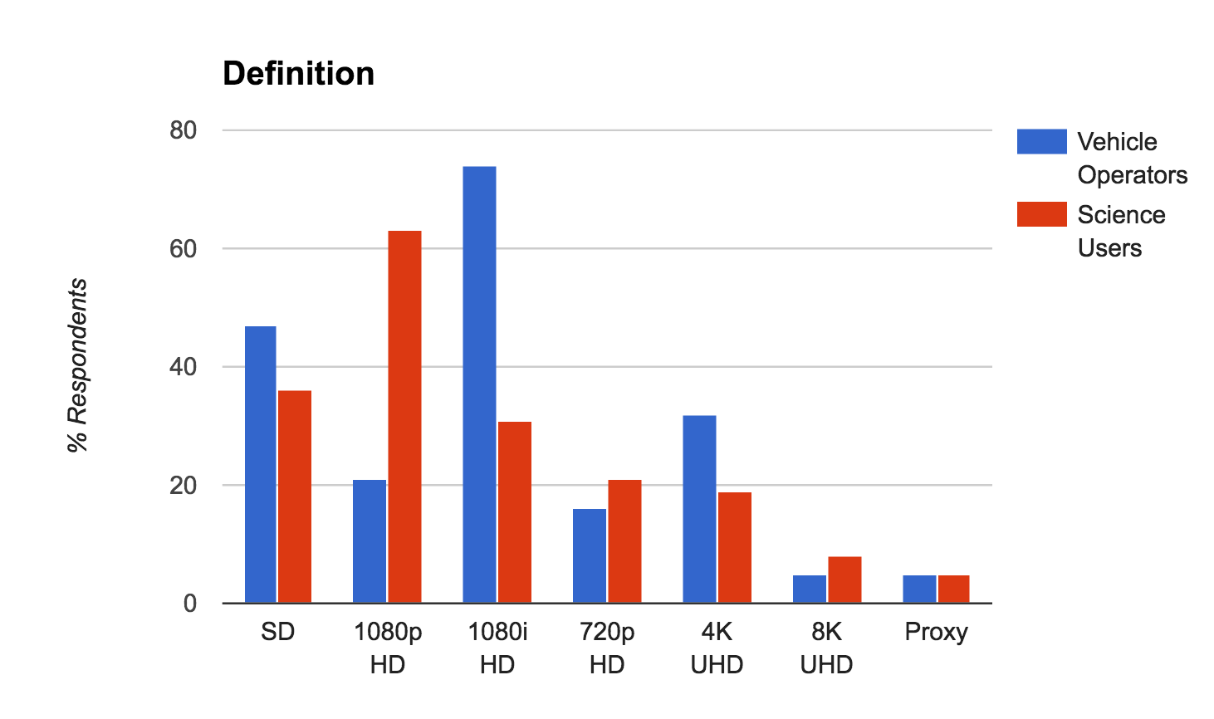

Slide 5
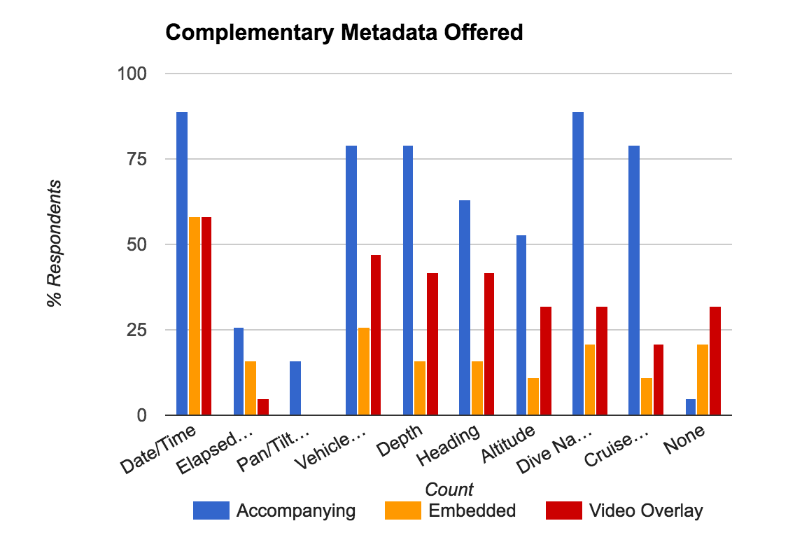

Slide 6
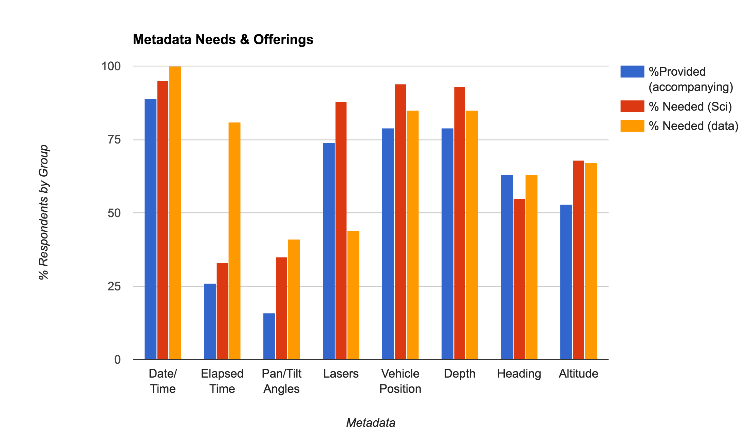

Slide 7
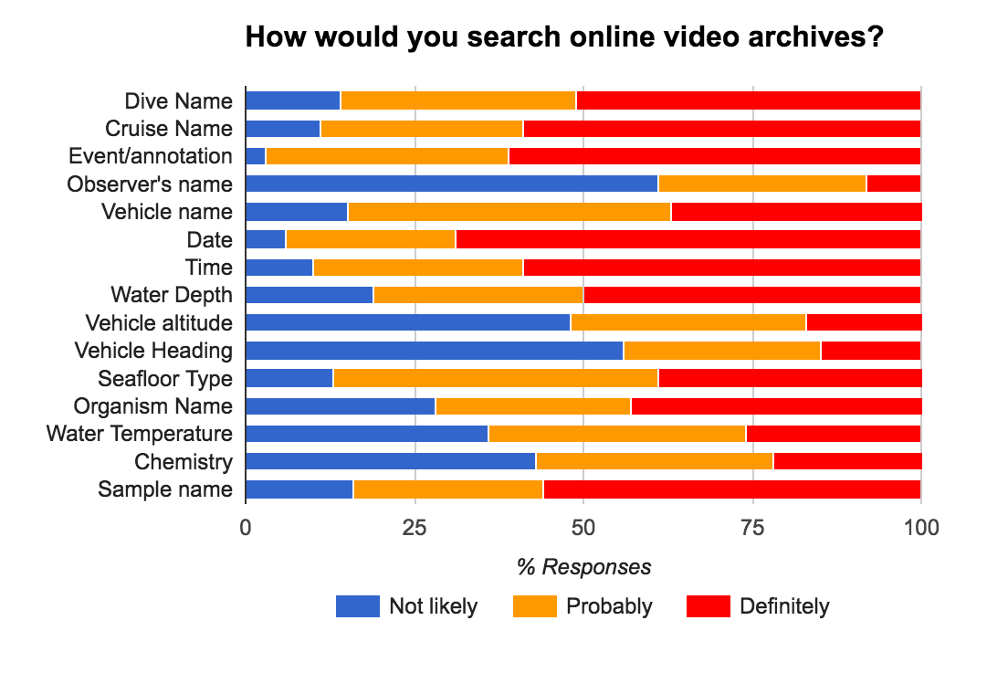
Hidden Metadata Needs

Slide 8
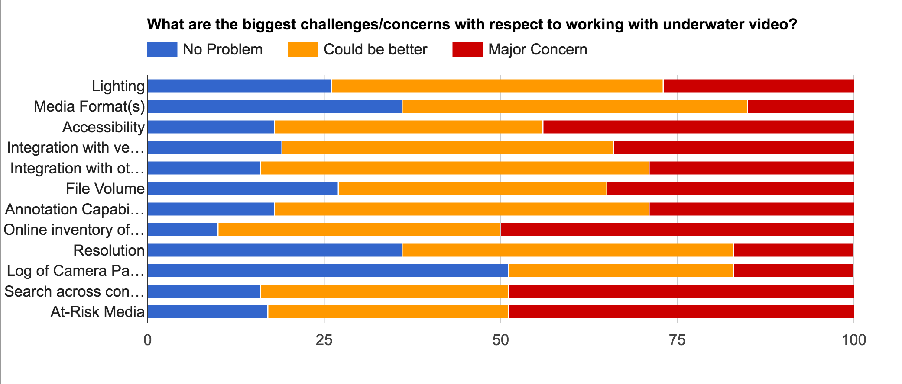
Overall Concerns

Slide 9
Annotation Guides
http://www.explorers-log.com
http://ropos.com/images/cssf/documents/irls_user_guide.pdf
http://oceanexplorer.noaa.gov/okeanos/collaboration-tools/im-eventlog/welcome.html
Hidaka-Umetsu et al., 2015

Slide 10
Challenges/Opportunities
“Figuring out how to make the hours and hours of dive video collected discoverable, interesting and relevant to an audience outside of the (very small) deep sea research community”
“Ability to work with video in same way as other GIS layers”
“In addition to dealing with the growing volumes of video content now, we have large volumes of legacy content that are at risk need to be rescued.”
“Easy discoverability and open access to video archives is likely the biggest challenge...”
“Ideally bind metadata to the video stream not just the audio.”
“Unified community approach to problem.”
Mosaics, 3D Reconstructions, Machine Learning, VR…

