Slide 1

User interfaces for enhancing video content
Jonathan Howland
Woods Hole Oceanographic Institution
jhowland@whoi.edu

Slide 2
Acknowledgements
This talk represents the work of many WHOI people including:
Steve Lerner
Andy Maffei
Steve Gegg
Many others
Numerous scientists on several research expeditions provided suggestions and feedback

Slide 3
Outline
Jason Event Logger
Jason Virtual Van
Alvin Frame Grabber
Real Time and Post Dive Discussion

Slide 4
Purpose and History
Result of realization that most of Jason video data was going unused and unanalyzed.
Goal was to provide a “bookmark” capability
Searchable, indexable
Tied to imagery
Event Logger->Jason Frame Grab->Virtual Van->Alvin Frame Grabber

Slide 5
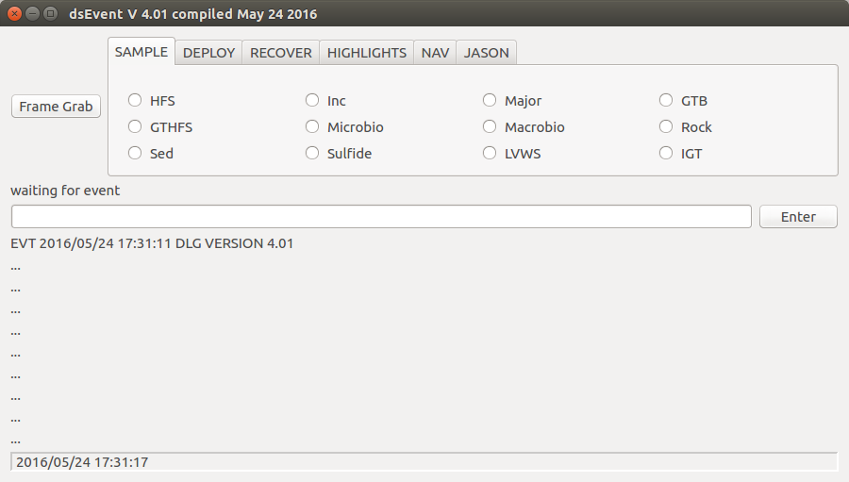
Event Logger

Slide 6
Event Logger
Categories(tabs)/events(buttons) are generated at run time using simple ASCII configuration files
Supports free form text as well
Hot buttons

Slide 7
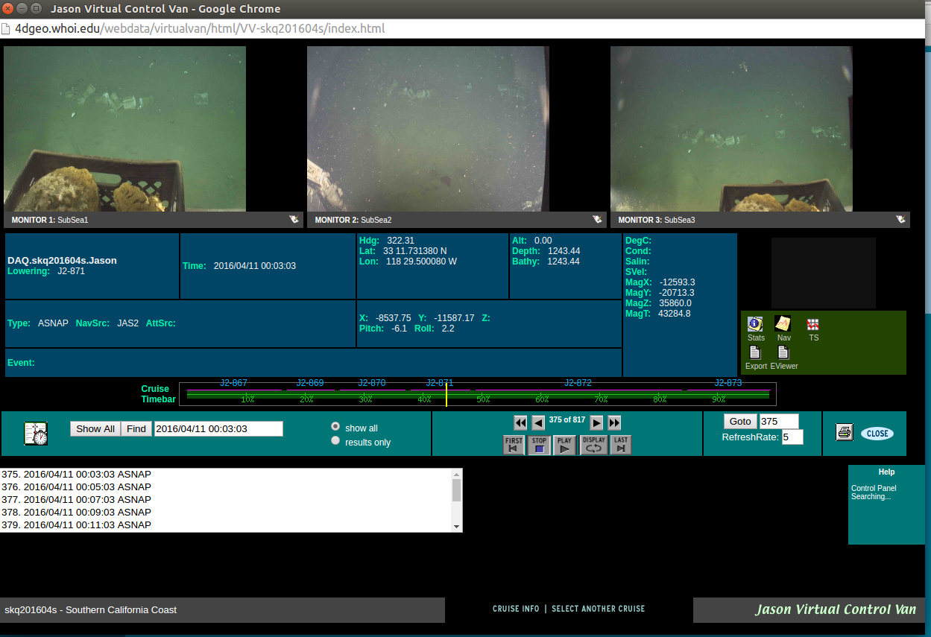
Jason Virtual Van

Slide 8
Jason Virtual Van
Real time data acquisition system collects navigation and other vehicle data and saves it in a flat file “Electronic Index Card” for each event/frame grab
Frame Grabs (currently HD jpgs) are grabbed on a regular basis and upon receipt of an “event” from the Event Logger
Available in real time shipboard—as it happens—and post dive/cruise

Slide 9
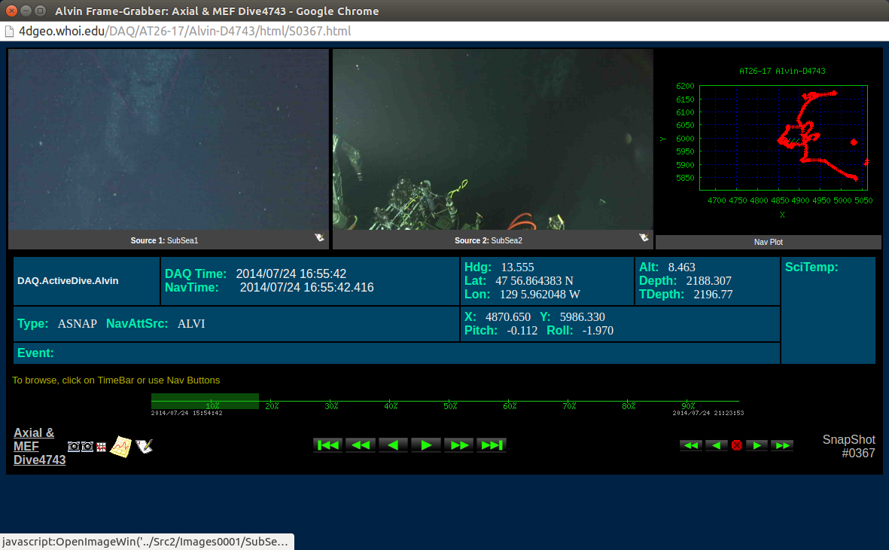
Alvin Frame Grabber

Slide 10
Alvin Frame Grabber
Configured in sphere, but not interactive
Frame grabs happen at regular interval
Web site ready for scientist review upon recovery

Slide 11
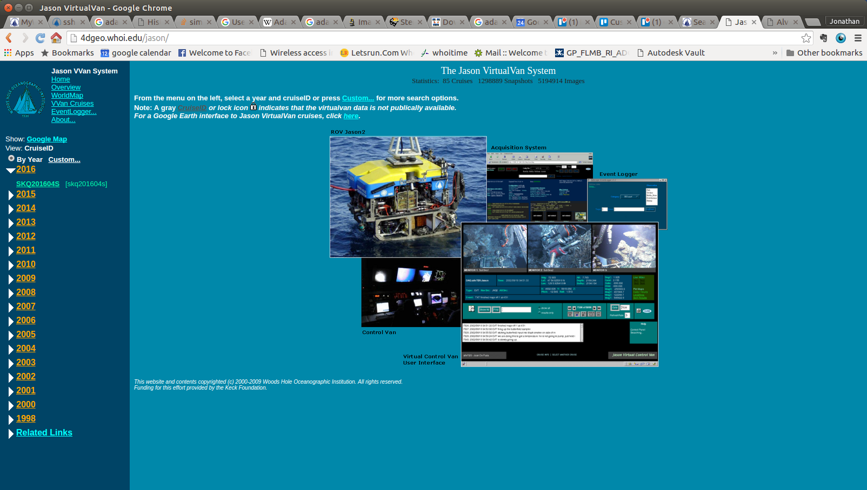
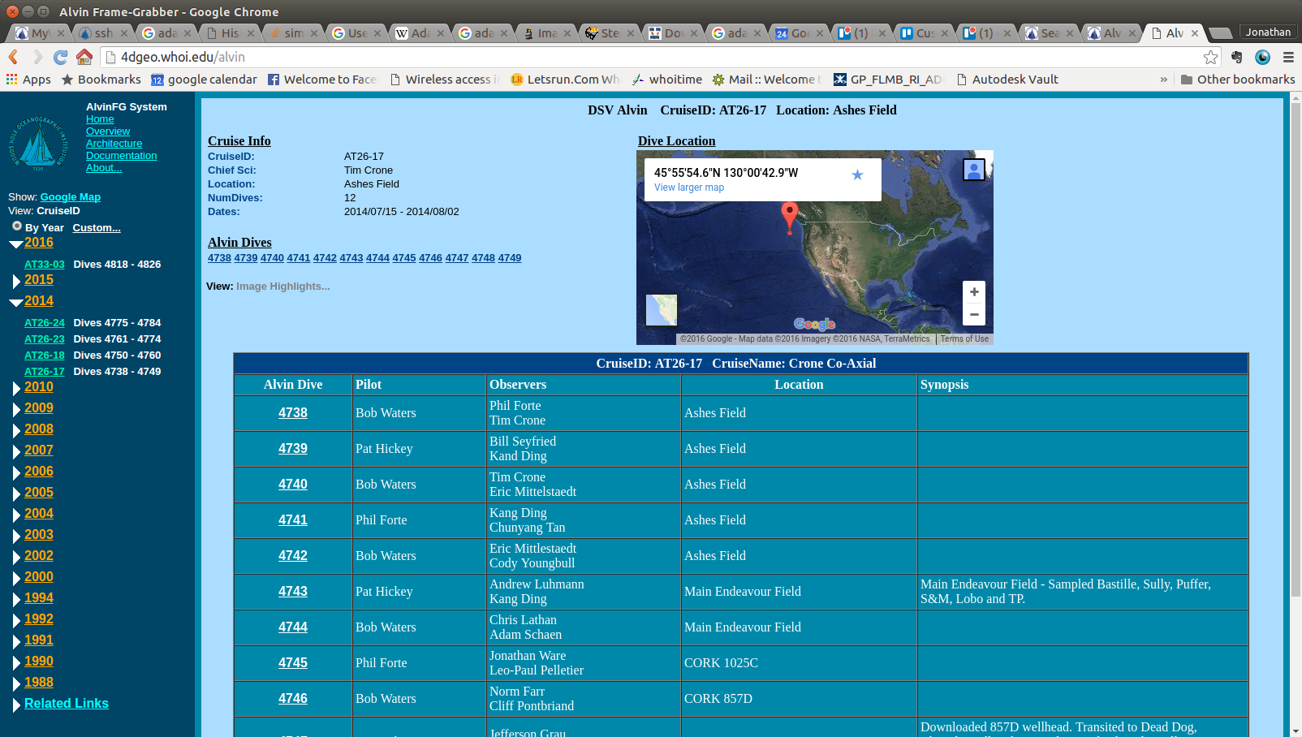
Ashore…

