Slide 1
Video Asset Management
Essence and Metadata:
Best Practices and Examples from the
Media and Entertainment Industry

Slide 2

Presenters
Bryan Staffaroni
Senior Director,
Media Asset Management
Willis Peligian
Owner /
principal consultant

Slide 3
Agenda
Best Practices
Essence
Metadata
Examples from WWE
Essence
Metadata
Notes:
Our presentation is divided into two parts
I will present an outline of Best Practices in Asset Management
Bryan will present some real-world Asset Management Examples from WWE
CHANGE
And both of us will be focused on Essence and Metadata

Slide 4
Best Practices Methodology Overview
Goals /
Vision
Operations
Personnel
Technology
Finance
Notes:
While today’s presentation is focused on Asset Management, with particular emphasis on Essence and Metadata, it is prudent to evaluate total requirements whenever looking establish and/or modify fundamental technology and operations.
I’ll share with you my methodology, which has served many clients well for more than 25 years
DHANGE
Begin by establishing overall goals
business rationale
mission
vision
Goals / Visions are achieved through Operations
Operational Processes are performed by People in an Organization that defines roles and responsibilities
People are enabled with tools / Technology provides Tools to enable People and/or Processes
Financial considerations are typically a key factor in any effort
Quantify costs and benefits
CHANGE
This all looks simple enough, nice and linear
Start with Goals / Vision, and end with Financial considerations.
Don’t stop here, though:
Iterate through the process at least twice, or even more times.
optimizes to ensure opportunities for efficiency and economy are fully exploited
CHANGE
So, we will not deal with Goals / Visions, or Personnel or Finance
CHANGE
Our focus today is on Operations and Technology
CHANGE

Slide 5



Best Practices End-to-End Ops / Tech Overview
Acquire
Process
Distribute
Conform
extract / wrap
enc. / dec.
transcode
scan conv.
mix / shuffle
transform
Manage
QA / QC
log
catalog
Package
linear
- live
- scheduled
playback
on demand
Deliver
network
- stream
- file
physical
media
Pass Thru
as-is
modify
Conditional Access
push / pull
interactive
rights / privileges
Store
ingest
hierarchical
Produce
edit
versions
Notes:
Now that we have some basic concepts of Essence and Metadata handling, let’s look at an overview of typical Media Asset Operations and Technology
Three broad operational categories: Acquisition, Processing and Distribution
CHANGE
Acquisition sources include: Moving images, Audio, Still images, Computer-generated content (e.g. graphics, titling) and Data:
And there are typically multiples of each Essence source in most applications.
One person’s Data is another person’s Metadata – and vice-versa.
for the purposes of this presentation, Data in the context of Acquisition covers data as well as metadata.
CHANGE
Acquired essence and/or metadata often arrive in a form that is incompatible with internal systems, so need to be Conformed.
If arriving in a Container or Wrapped file structure, then may need to be extracted (unwrapped) for use.
If essences arrive as discrete elements, and internal systems required containerized / wrapped file structures, then may need to be wrapped: e.g. ZIP archive, QuickTime, MP4…
Essence may be encoded in a format that is incompatible, so often needs decoding, transcoding, and/or scan rate conversion. For Example:
JPEG still image to TIFF is a transcode.
1080p to 1080i is transcode.
1080p 60 to 1080p 50 is scan rate (frame rate) conversion.
1080p 60 to 1080i 50 requires both a transcode AND a scan rate conversion.
Audio may arrive as discrete channels:
If internal requirements fewer channels than the total supplied channels:
could package multiple audio signals into AES3 standard of the AES/EBU (Audio Engineering Society / European Broadcasting Union)
If AES3 is not supported, then mixing down to fewer channels may be required – referred to as Flattening.
if discrete channels are to be maintained, but require re-ordering, then swapping channels may be required – referred to as Shuffling.
Data often needs to be re-mapped to conform with internal database requirements – referenced here as Data Transformation.
CHANGE
Acquired content typically needs to be stored – unless purely a pass-thru with no requirement for later retrieval.
Ingest – gets content into system, making it available for follow-on processes.
Hierarchical storage architectures are considered cost-effective: On-line, Near-line, Off-line, Cloud:
On-line – HDD, SSD; immediately available.
Near-line robotic digital tape library: restores to On-line storage for end-user access.
Off-line digital tape – some legacy systems keep videotape off-line: restored to On-line storage for end-user access.
Cloud storage can offer similar experience to On-line or Near-line, depending upon implementation: may or may not be restored to On-line storage for end-user access.
CHANGE
Acquired essence is often checked to ensure integrity:
Quality Control technologies can perform this function automatically.
Mission-critical content may still be spot-checked manually.
Adding metadata increases value of essence
Auto-capture whenever possible: GPS, Time / Date, Equipment ID...
Pull data from other systems to auto-populate metadata fields: e.g. financial, scheduling system…
Logging adds context – Manually-keyed-in.
Cataloguing adds structure to aid in search / retrieval:
Metadata Schema.
Taxonomy.
Essence and/or Metadata typically take one of two paths:
Pass-Thru to destination(s).
Produce derivative(s).
CHANGE
If Passed-Thru:
Can be ‘As-is”.
Often requires modification:
Essence
Language translation, Video Overlays…
Metadata
Captions, Watermarks
Requires Real-Time processes.
CHANGE
If Produced:
Implies Editing:
Typically leads to requirement for Version Management – special case of Asset Management.
Moving on to Distribution,
CHANGE
Essence and/or Metadata are typically Packaged in preparation for Delivery,
Two forms of Packaging are common: Linear (Streams), and On-Demand (Files or Streams).
If Linear Streams, can be:
Live – i.e. Passed-Thru OR
Scheduled Playback.
If On-Demand, can be Files or Streams:
Often require multiple versions to satisfy varying end-user requirements:
Alternatively, could rely on end-user to transcode.
CHANGE
Delivery can be via a Network, or Physical Media.
If via a Network, can deliver Streams or Files:
Stream can be Live or On-Demand:
Live – implies single stream
On-Demand – implies requirement for delivering multiple streams simultaneously.
File – On-Demand
Physical Media – often required for large quantities that would be impractical for network delivery
Typically Digital tape (LTO), HDD or SSD
CHANGE
No matter the delivery method, some sort of access controls are typically implemented:
Pushing content is by default a form of access control, as delivery is initiated by the originator:
Can still incorporate user-privileges in metadata for additional access control – e.g. password protection, time / date restrictions, other DRM…
Allowing end users to Pull content adds a layer of access control:
Is typically accompanied by some user privilege through DRM.
Interactive content enables simultaneous Push and Pull:
Can configure access restrictions for each to meet requirements.
Rights and Privileges can be appended to metadata and/or inherited from metadata captured upstream in the processes noted previously.
Often “Watermark” content to help identify unauthorized access
CHANGE
And, finally, anything that is Delivered ends up being a Source that is Acquired by a recipient, closing the loop in our ecosystem.
Admittedly, we could delve deeper into any one of the areas outlined here.
This Overview, however, should provide enough detail to inform our upcoming discussions.

Slide 6
Best Practices Essence / Metadata Handling
Essence Formats
Archive Master format – preservation, future-proofing
Mezzanine format – for intermediate processes
Multiple delivery formats – to serve end-users with varying requirements
Metadata Handling
Separate essence and metadata
common metadata file format is XML
maintain associations among multiple essences and metadata
Combined
container / wrapper
metadata embedded in essence
Notes:
Essence formats are an important consideration:
Need to serve varying needs.
Ideally want a Master from which all required formats can be derived.
Future proofing is well-served by archiving in the highest quality:
typically in the acquisition format
sometimes with a different file structure / wrapper / container
Mezzanine formats for intermediate processes:
Editing, Browsing…
Typically create other versions from a Mezzanine file.
End-users have varying requirements, so need multiple delivery formats.
CHANGE
Essence and Metadata may be handled either as separate entities, or as a combined element
Integrity is best when metadata is combined with essence:
If handled as discrete entities, need to ensure association between / among essences and metadata is maintained
common metadata file exchange format is XML (eXtensible Mark-up Language): used for VoD submissions to Hulu, Netflix, Amazon…
Essence can be extracted from containerized / wrapped files.
have to trust end-user to maintain associations between/among essences and metadata.
Embedding metadata into essence almost always ensures associations maintained:
essence can be processed in a way that overwrites / blocks embedded metadata.
properly configured essence technology systems will ensure this doesn’t happen.
commonly used for handling the most crucial metadata: timecode, captions.
CHANGE

Slide 7
Best Practices Metadata Systems
Essence systems often include metadata tools
acquisition, ingest, storage, editing, QA / QC…
Logging
Cataloguing
metadata authoring / editing software
digital asset management software
spreadsheets
hybrid
Integration is key
Notes:
Essence
CHANGE

Slide 8
Goals
Best Practices
Essence
Metadata
Examples from WWE
Essence
Metadata
Notes:
That covers Best Practices
CHANGE
Now, Bryan will share some real-world examples from WWE.

Slide 9
Examples from WWE Quantities / Scale
Acquisition
Arena Events: 6 per week / 350 annually
Weekly Ingest Average: 800 hours
WrestleMania week Ingest: 1,551 hours
Hierarchical Storage
On-line – 1 Petabyte
Near-line – 7.5 Petabytes / 340,000 hours
Off-line – 7,000 LTO tapes + 120,000 videotapes
Notes:
I thought it might be useful to start with a perspective about the scale of WWE’s operations.
While we handle all of the essence asset types Wills outlined earlier, I will focus just on video.
Referencing categories from the End-to-End Overview:
Let’s start with Acquisition
Weekly average ingest = 800 hours
WrestleMania is our largest annual event, and during that week, we ingested 1,551 hours
hierarchical storage
???
7.5 PB Near-line – which is approximately 340,000 hours
and in our off-line storage warehouse, we have more than 7,000 LTO tapes, plus 120,000 videotapes

Slide 10
Examples from WWE Quantities / Scale
Production
Original Programs: 6 per week
Distribution
Linear Streams
650 Million TV households
177 countries
75 + languages
8 Billion YouTube views
On-Demand
5,000 + hours in VoD library
Notes:
WWE produces 6 original programs every week – one for each arena event.
Distribution includes both Linear Streams and Video on Demand
Linear Streams
WWE reaches 650 million households worldwide
in 177 countries
in more than 75 languages
and here is a statistic, WWE is the number 1 YouTube channel, with more than 8 Billion video views
Our Video On Demand library contains more than 5,000 hours – and growing.

Slide 11
Examples from WWE Video Formats
Acquisition
arena events – DNxHD 1080i 59.94 @ 145 Mbits/sec
Mezzanine
DNxHD 1080i 59.94 @ 145 Mbits/sec
Production
DNxHD 1080i 59.94 @ 145 Mbits/sec
Archive
current additions are DNxHD
multiple legacy formats
Distribution
multiple codecs, containers
Notes:
We recently standardized on a single encoding format across Acquisition through Production – DNxHD 1080i 59.94 @ 145 Mbits/sec
The archive contains many legacy formats.
Distribution requires many difference codecs and containers
Determined by distribution partner requirements

Slide 12
Examples from WWE Asset Management
Hybrid systems
Ingest
auto-capture some metadata
manual-entry most metadata
Logging – Dixon Sports Logging System
standard fields + custom fields
integrated with proxy browse system
Editing – Avid Interplay, GrassValley
rich metadata – auto-capture and manual entry
Microsoft Excel Spreadsheets / Workbooks
manual entry
Notes:
How do we manage all that media? We use a hybrid asset management approach.
Ingest systems include features for auto metadata capture as well as manual entry
We use a sophisticated logging software application – Dixon Sports Logging
while Dixon comes with standard fields, we have customized it heavily to meet our needs
we also integrated Dixon with our proxy browse system
Our Avid and GrassValley editing systems have a rich set of asset management features that we utilize
And Excel worksheets and workbooks help us keep track of everything
requires significant manual data entry
requires thoughtful and careful implementation, especially with such a large volume of assets under management

Slide 13
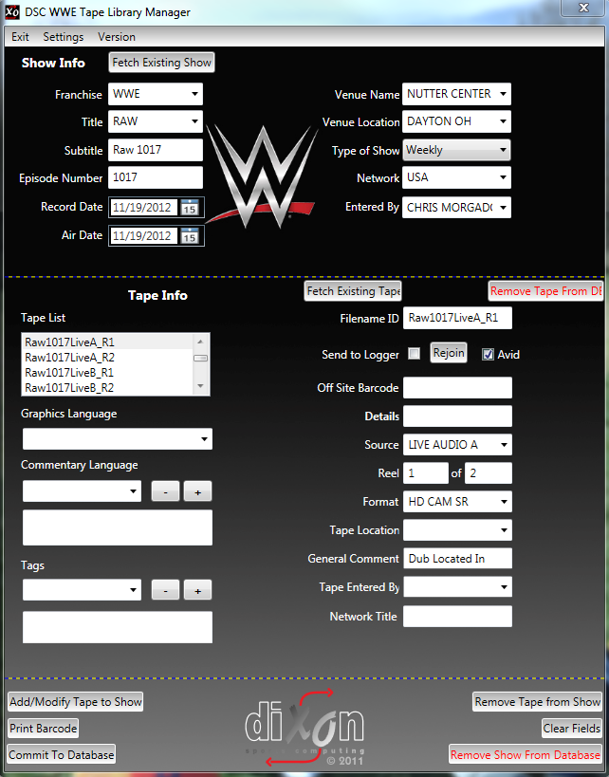
Examples from WWE Asset Management – Dixon
Notes:
Here is a screen shot from the Dixon logging system.

Slide 14
Examples from WWE Asset Management – Dixon

Slide 15
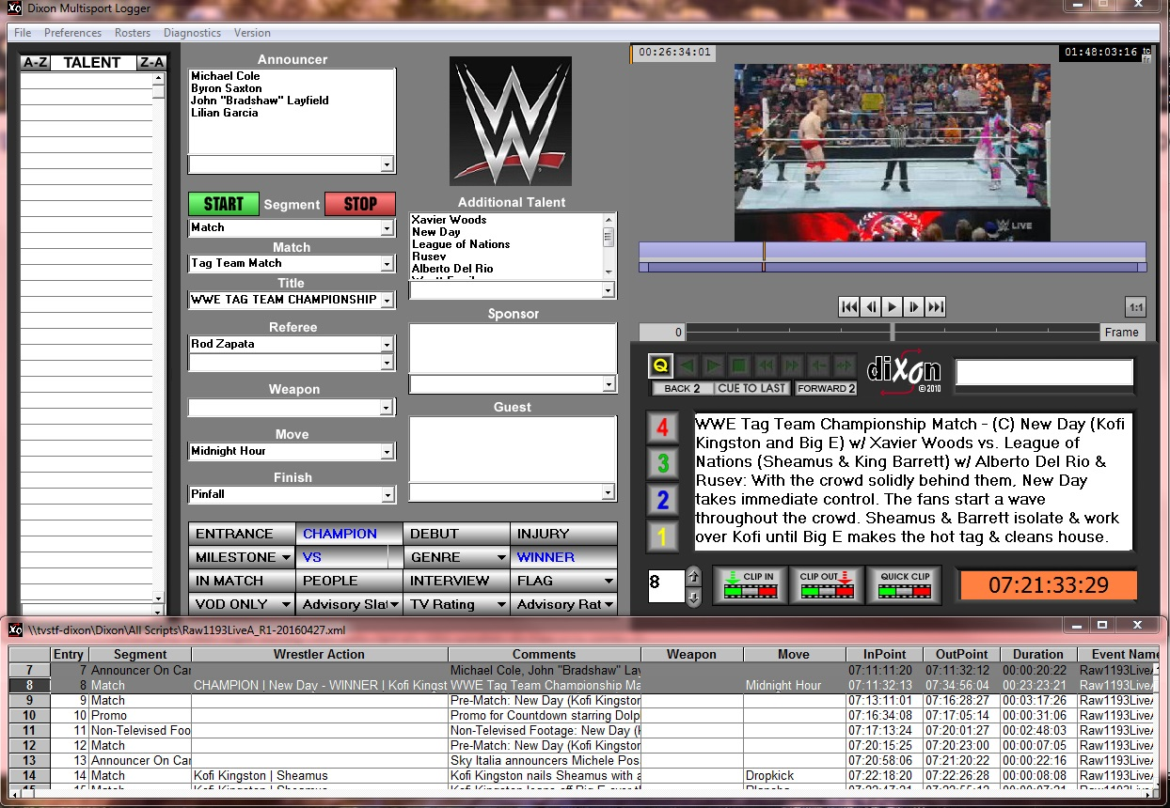
Examples from WWE Asset Management – Dixon
Notes:
Here is a view of the Dixon system as a logger would use it
notice the proxy browse video in the upper right corner
many drop-down boxes ensure consistent data entry, minimizing free-text entry

Slide 16
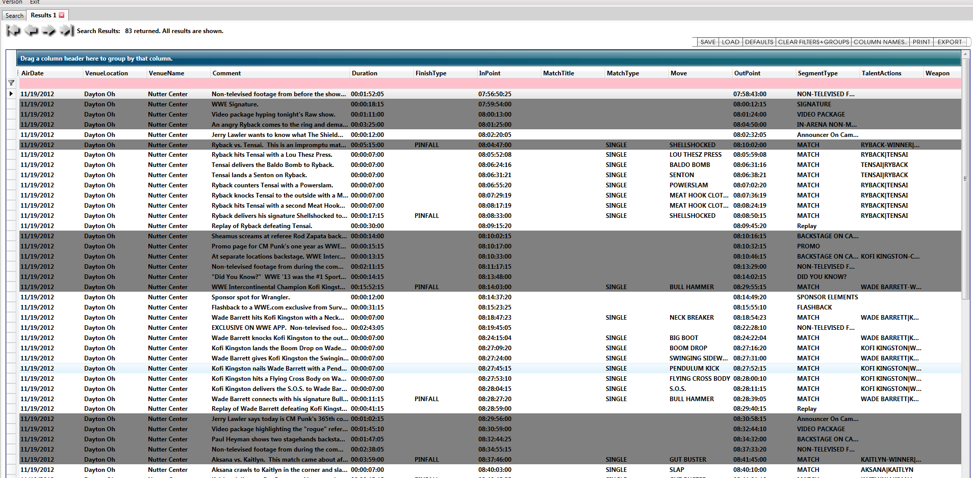
Examples from WWE Asset Management – Dixon
Notes:
And here is what a results page looks like after one has searched for something in Dixon

Slide 17
Examples from WWE Asset Management – Excel WrkBk
Notes:
Here, you can see the multiple worksheets in one of the Excel workbooks.

Slide 18
Thank You
Bryan Staffaroni
Willis Peligian
Notes:
So, there we have a quick overview of best practices and some real-world examples from WWE.
Thank you.

Slide 19
Best Practices Planning
Essence
formats, protocols
internal (house)
external
sources and destinations
interfaces – internal / external
networked streams / files
physical media
quantity
rights / access privileges
turnaround time
correlations / sync
with what precision
storage / preservation
hierarchies
duration
formats / protocols
rights / access privileges
Metadata
formats, protocols
internal / external
sources and destinations
interfaces – internal / external
schema / taxonomy
fields
standard / custom
data mapping – internal / external
file structures of existing tech systems
acquisition
storage
management
production
delivery
capture / entry
auto-populate
human-keyed

Slide 20
Best Practices Metadata Schemata
M & E – oriented metadata schemata
OMF, AAF, AMWA, MXF, AXF…
Most are based on Dublin Core
open metadata initiative
ISO, IETF, NISO standardizations
used in many disciplines
Customized to suit unique requirements
extensible
Interfacing among disparate systems
XML – eXtensible Markup Language

Slide 21
Examples from WWE Asset Management – Dixon

Slide 22
Examples from WWE Asset Management – Dixon

Slide 23
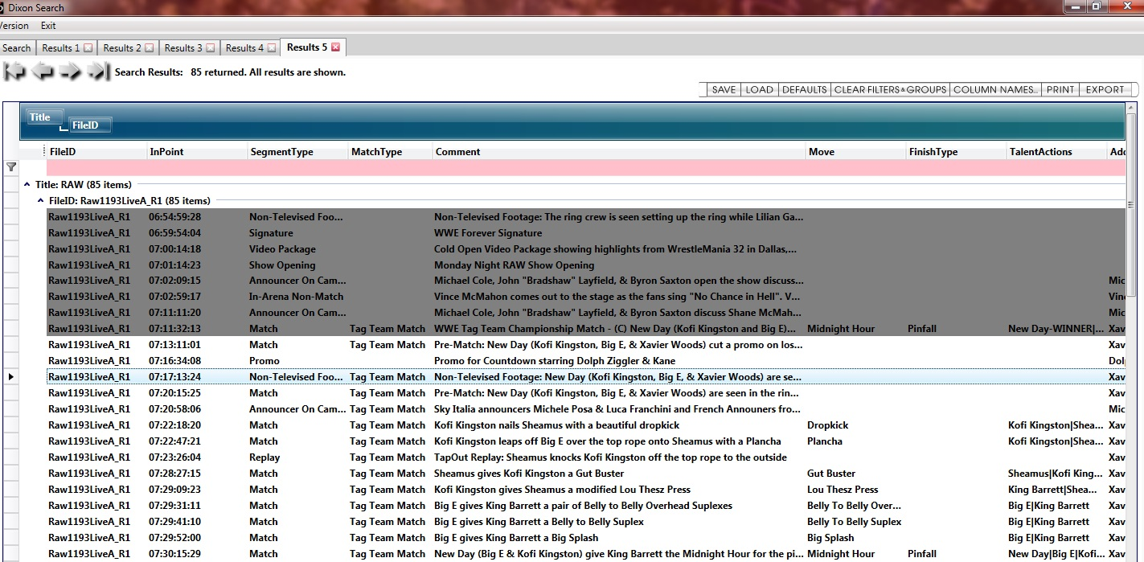
Examples from WWE Asset Management – Dixon

Slide 24
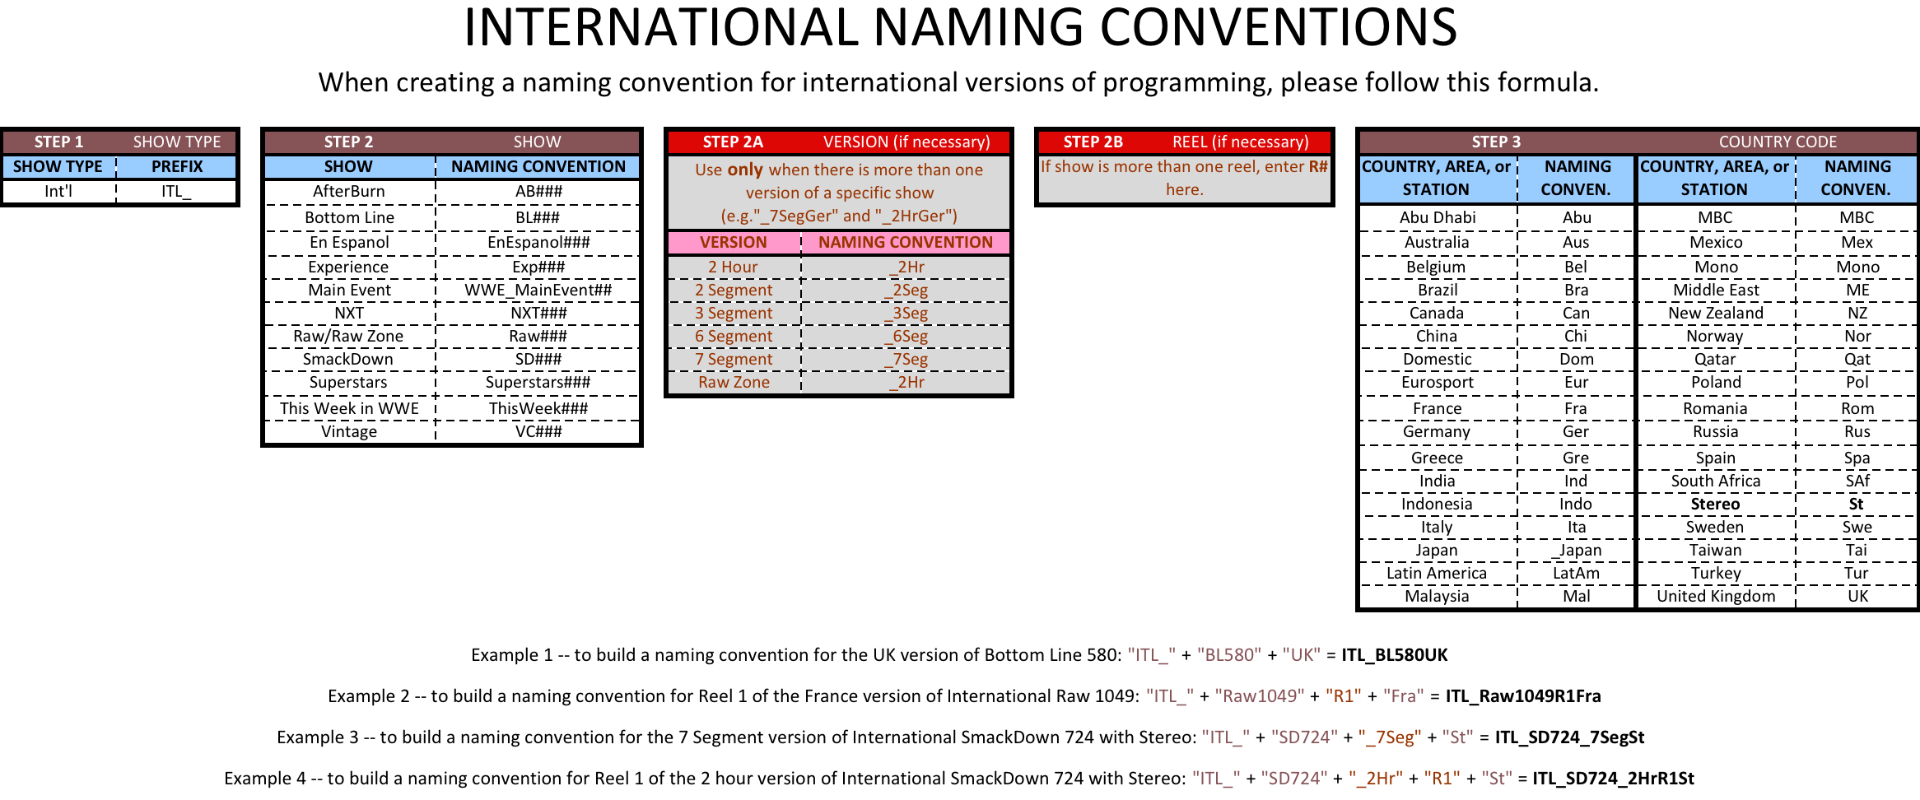
Examples from WWE Asset Management – Excel

Slide 25
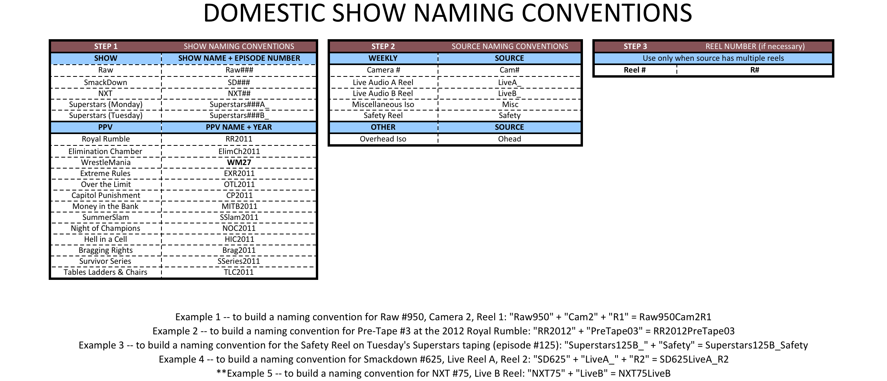
Examples from WWE Asset Management – Excel

Slide 26
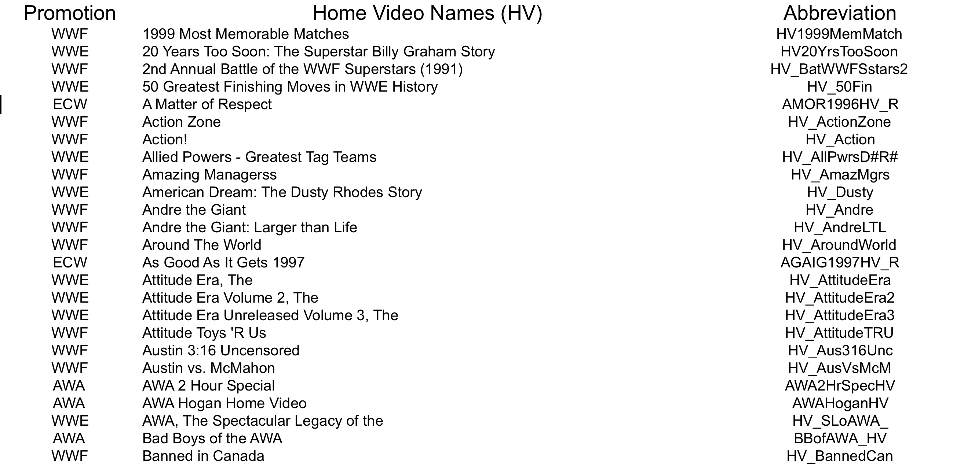
Examples from WWE Asset Management – Excel

Slide 27
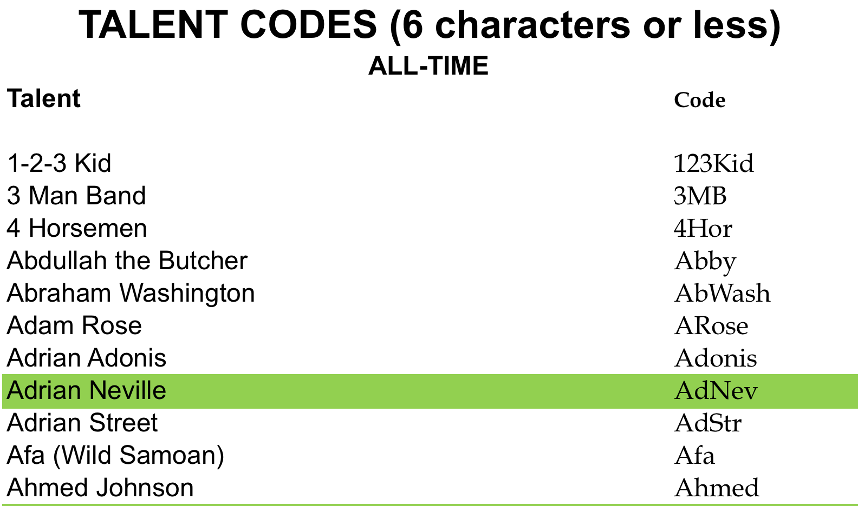
Examples from WWE Asset Management – Excel

