Slide 1
Torchvision Object Dectection Finetuning
21800777 한성화

Slide 2
Defining Dataset
Defining Model
Model Test

Slide 3
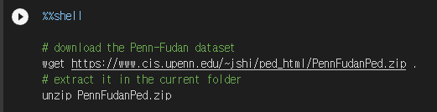
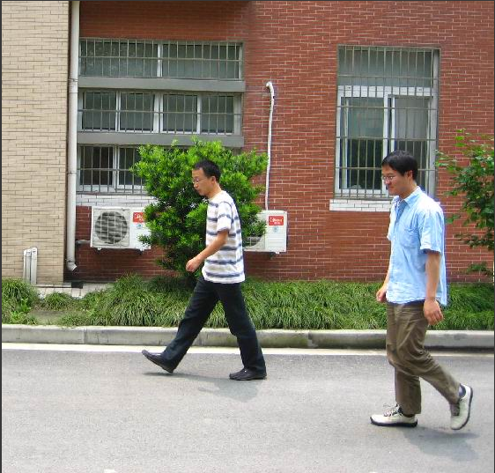
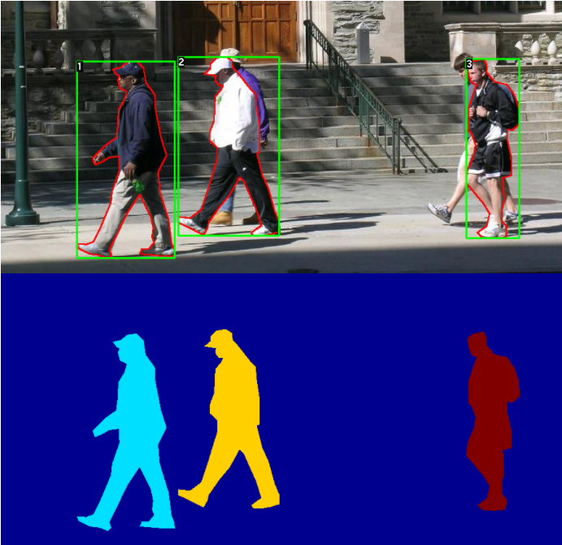

Defining Dataset (Penn-Fudan Database)

Slide 4
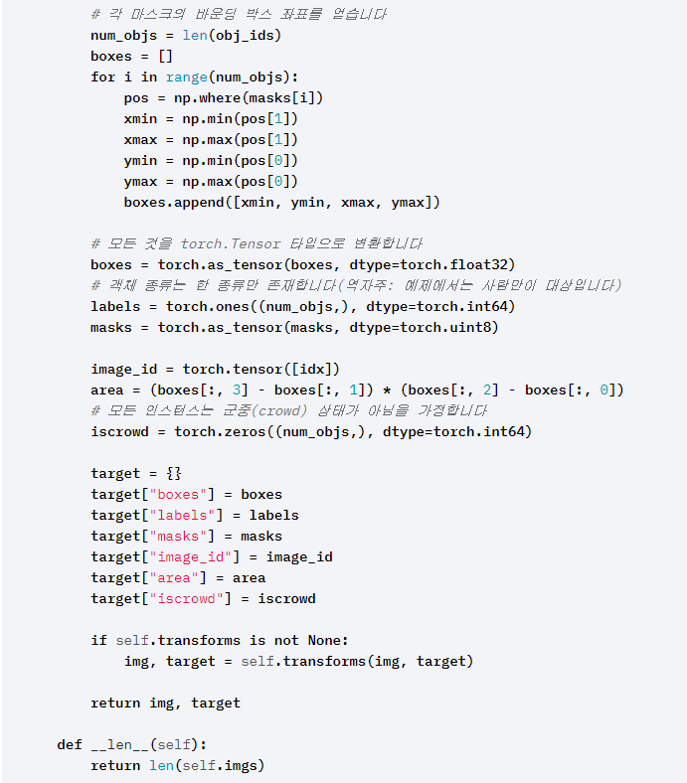
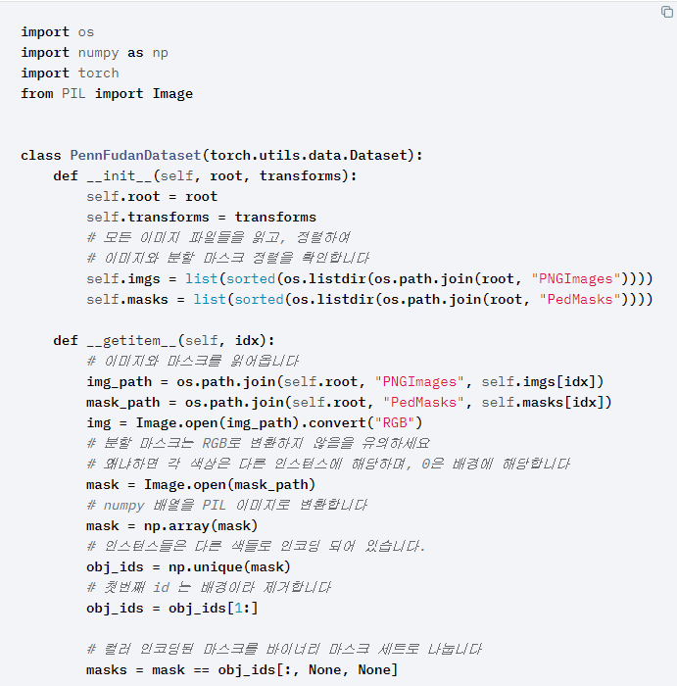
Defining Dataset (Penn-Fudan Database)

Slide 5
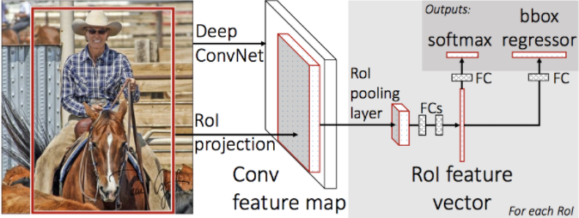
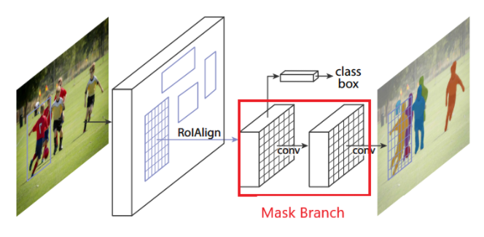
Defining Model(Mask R-CNN)
Mask R-CNN = Faster R-CNN + Mask Branch
Modifying model
Finetuning from a pretrained model
Modifying the model to add a different backbone(ex ResNet, VGG16)

Slide 6
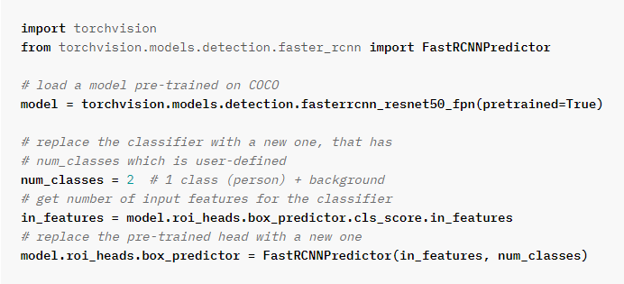
Finetuning from a pretrained Model

Slide 7
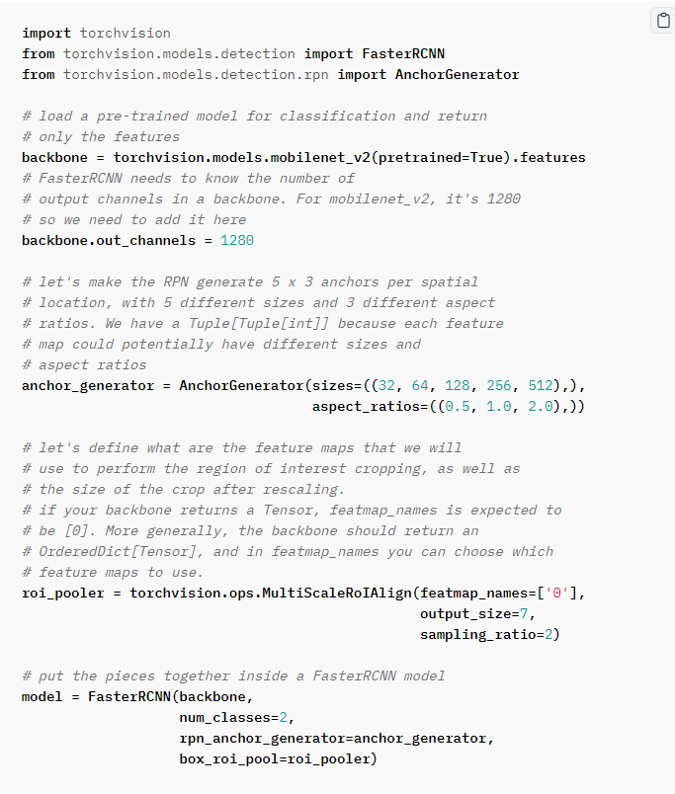
Modifying the model to add a different backbone

Slide 8
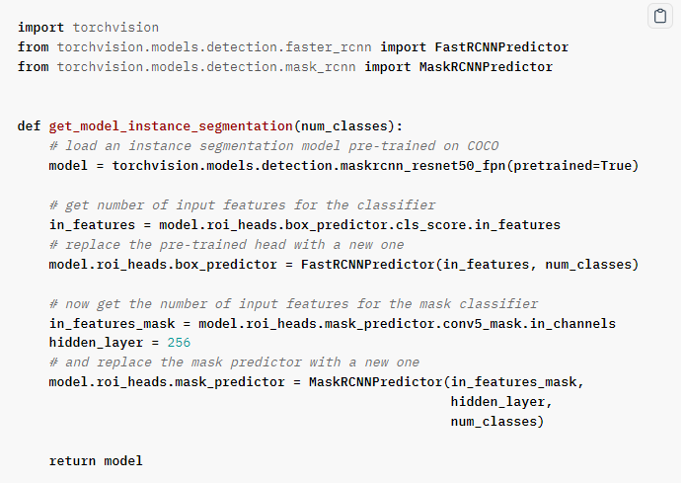
Instance Segmentation Model

Slide 9
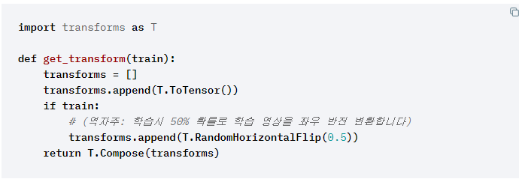
Data Augmentation Function

Slide 10
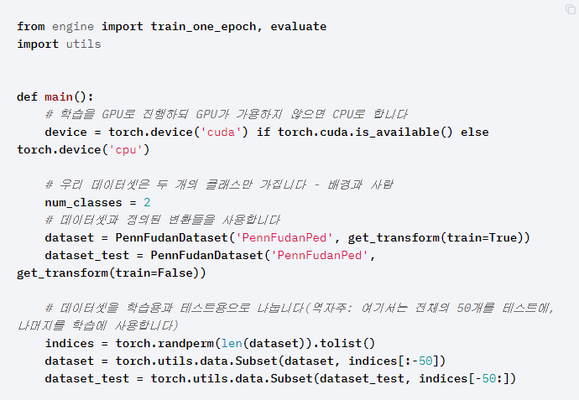
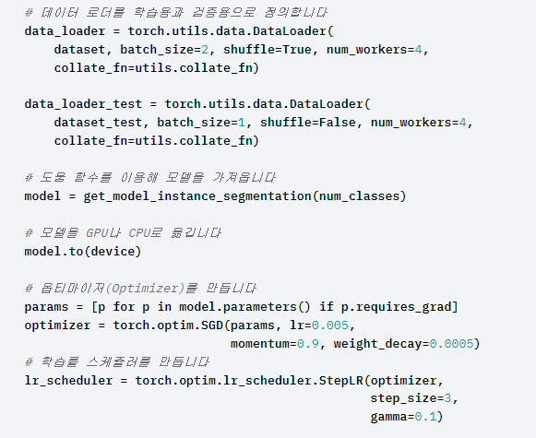
Model Test

Slide 11
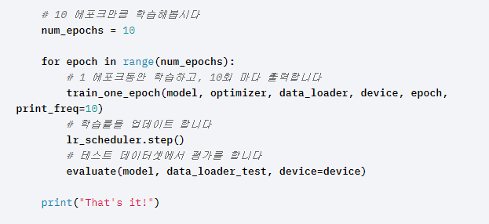
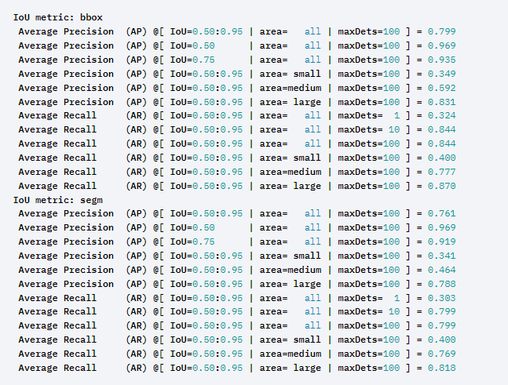
Model Test

Slide 12
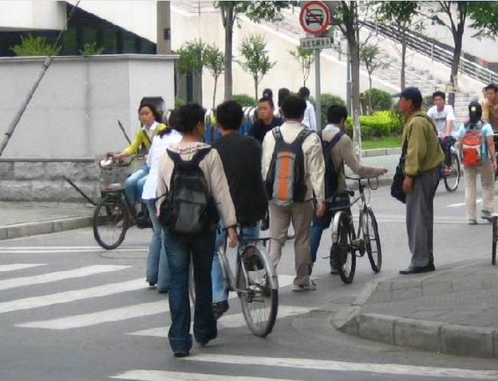


Model Test

Slide 13
Transfer Learning for Computer Vision

Slide 14
Transfer Learning
Finetuning the Convolution Network
Convolution Net as Fixed Feature Extractor

Slide 15
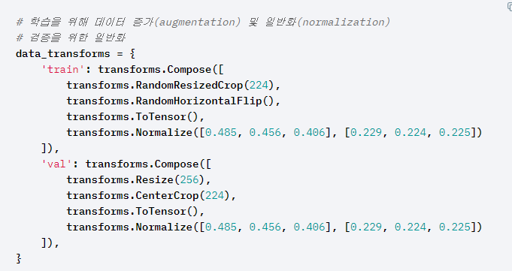
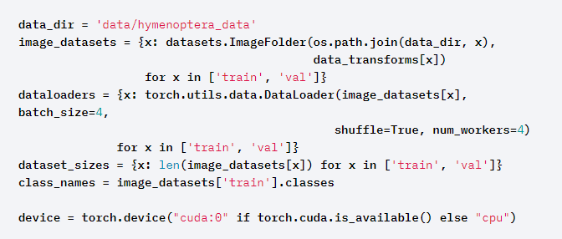
Data Transform

Slide 16
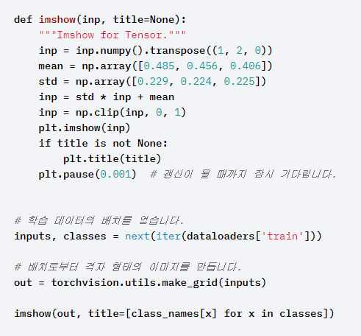
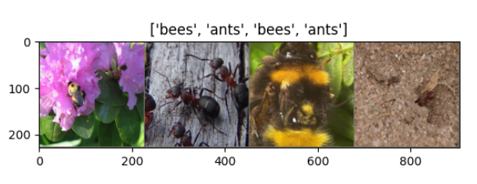
Visualize a few Images

Slide 17
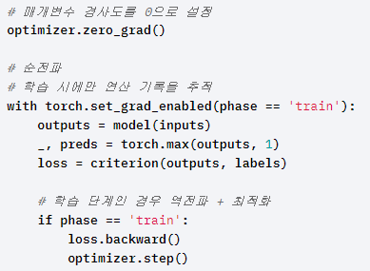
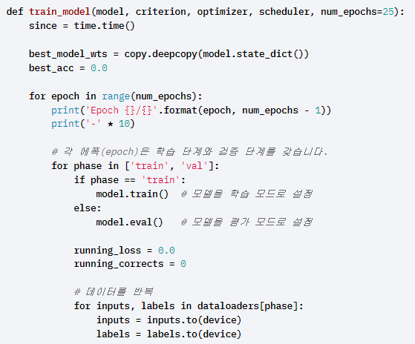
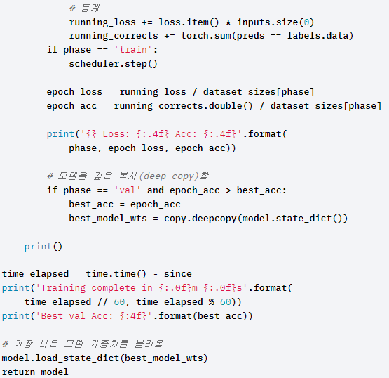
Train Model

Slide 18
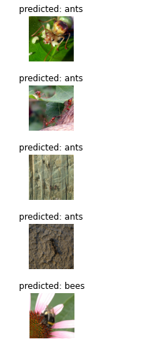
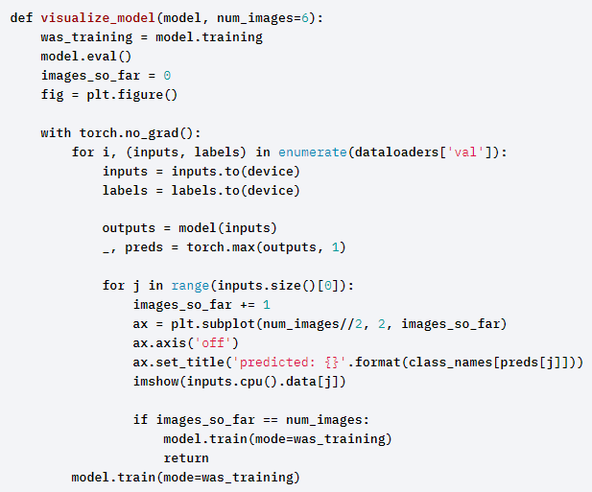
Visualizing the model prediction

Slide 19
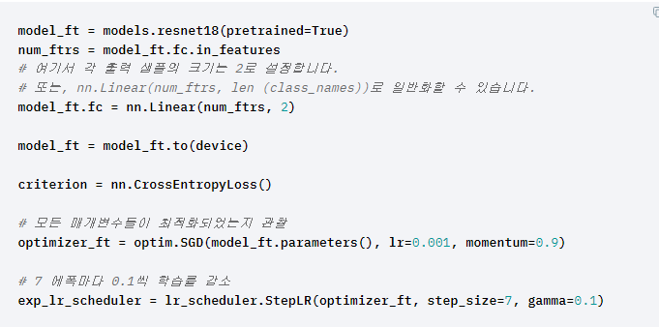
Convolution Network Finetuning

Slide 20

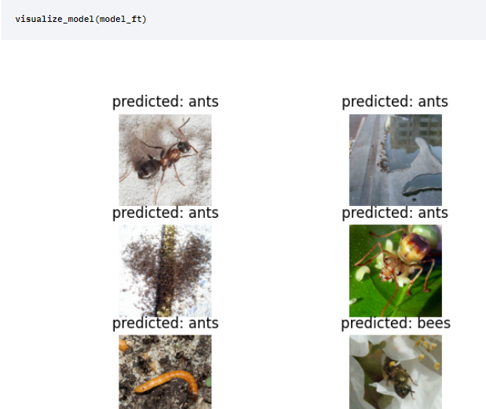
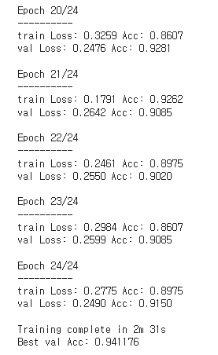
Train and Evaluate

Slide 21
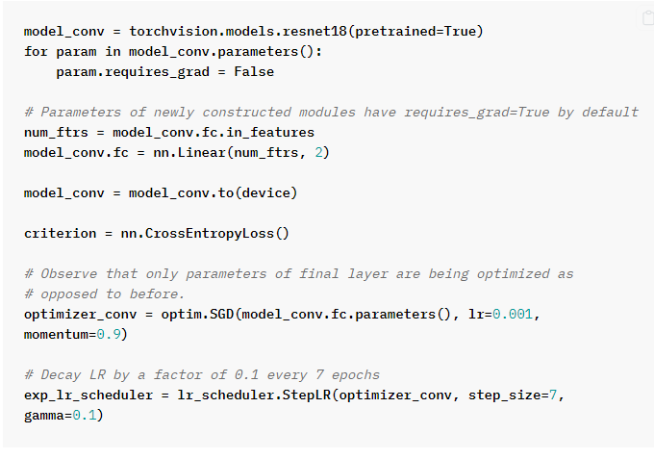
ConvNet as Fixed Feature Extractor

Slide 22
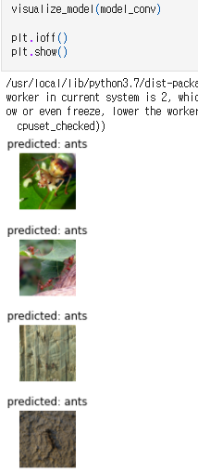

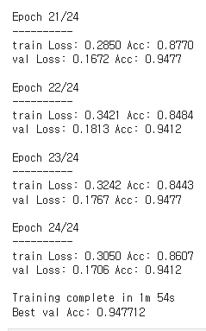
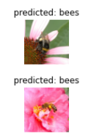
Train and Evaluate

