Slide 1


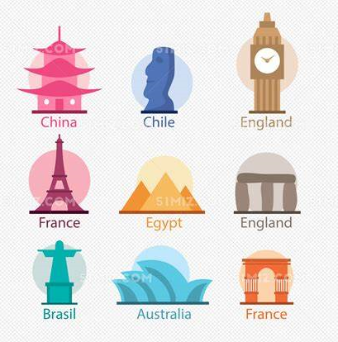


You only have four hours to get from the origin point to the destination and get as many points as possible!
Destination
1 point
4 points
4 points
1 point
1 point
3 points
3 points
1 point
2 points
3 points
1 point
2 points
2 points
5 points
3 points
1 point
Origin

Slide 2

Specific rules:
(1)After every two encounters with the same colour of graffiti, the score of that colour of graffiti will increase by 0.5.
First
Second
Third
Fourth
Fifth
0.5 point
0.5 point
1 point
1 point
1.5 point
0.5 point
0.5 point
1 point
1 point
1.5 point
0.5 point
0.5 point
1 point
1 point
1.5 point
Graffiti in other colours…

Slide 3

(2) Pair-spot task.
5 points
2 points
Ask you to go another
place that’s very close.
5+2=7 points

