Slide 1


Exploring the impact of spatial morphology of terraces on soil erosion from high spatial resolution digital elevation models
Yuzhou Chen
yuzhou.chen@stud.plus.ac.at

Slide 2
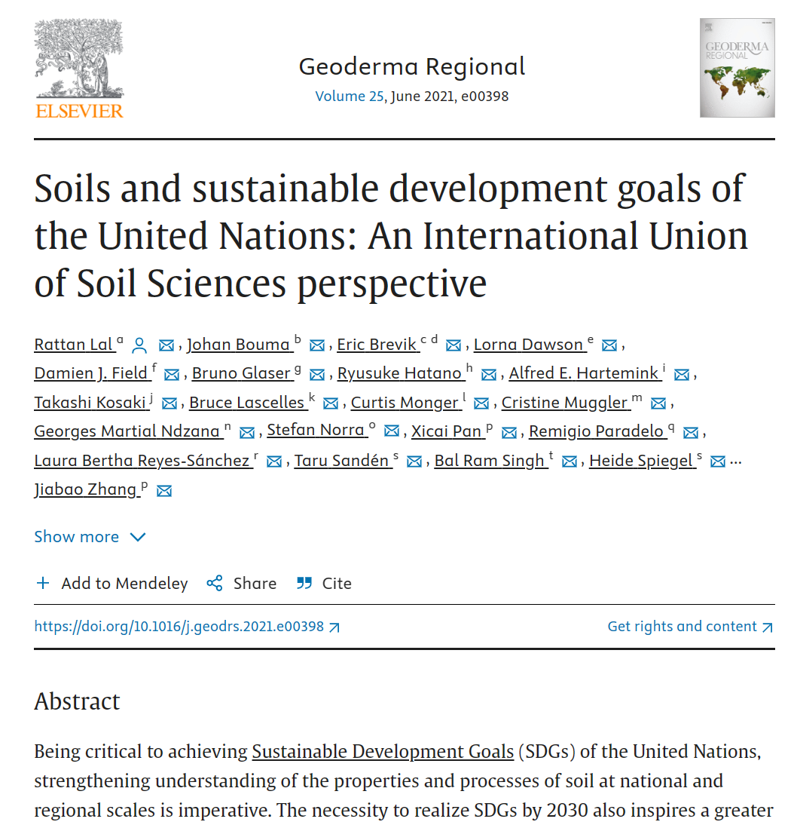
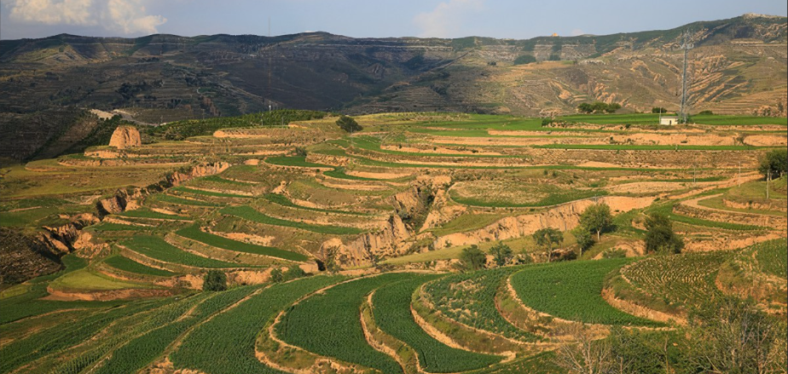

1. Background Introduction
1. Soil erosion
A Big problem!
2. Why Terrace?
reshape topography
larger farming area on gentle slope
soil and (water) conservation
$$A=f·R·K·\text{★}LS·C·P$$
3. So, How to evaluate the soil conservation ability of a terrace?
Soil Erosion Model (empirical model)
★ RUSLE
a revised version of USLE
suitable for croplands or gently sloping topography
proved to be useful in some area of our country
A is the annual soil erosion per unit area [t/(hm²·a)]
f denotes the modification constant
R is the rainfall erosivity factor [MJ.mm/(hm²·h·a)]
K is the soil erodibility factor [t·hm²·h/(hm²·MJ·mm)]
LS denotes the slope and slope length factor
C is the vegetation cover factor
P is the factor of soil and water conservation measures within a value range of [0,1]
Notes:
（1）soil erosion
Soil is a natural resource that may look endless, but actually It is eroding more quickly than it is being formed, this may cause the land to become unsuitable for agriculture
（2）To reduce soil erosion on slopes, terrace, a kind of artificial landform, can really help to facilitate the soil and (water) conservation.
that’s why we need terrace!

Slide 3

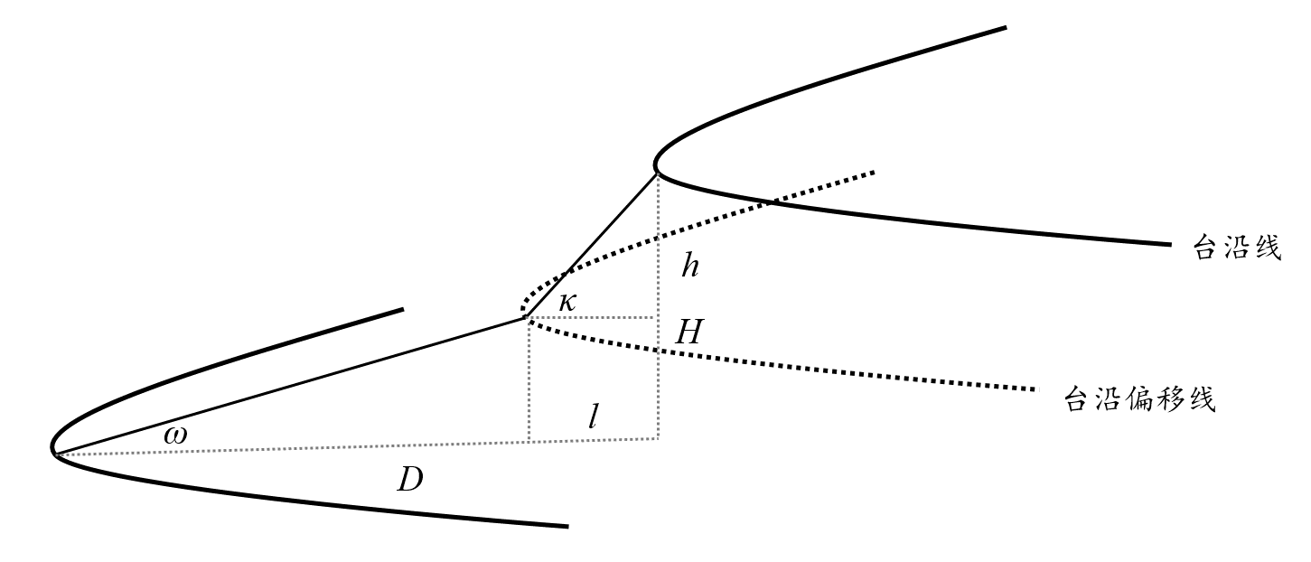
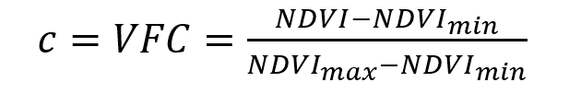
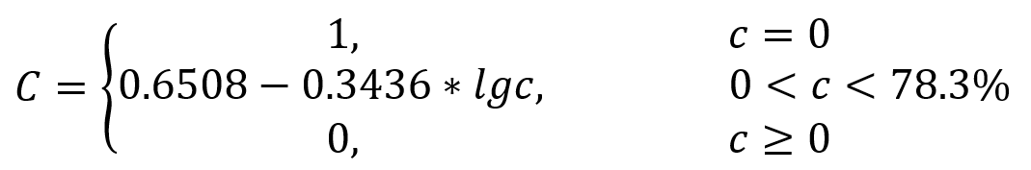
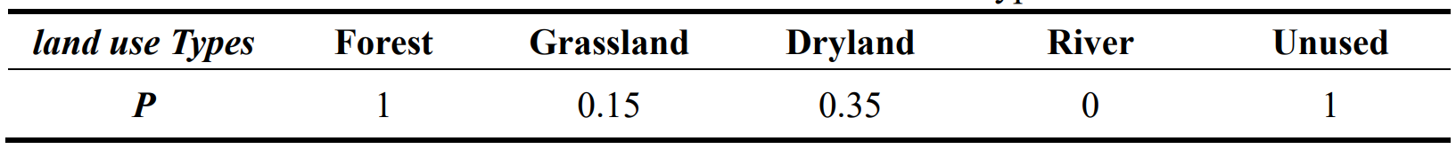
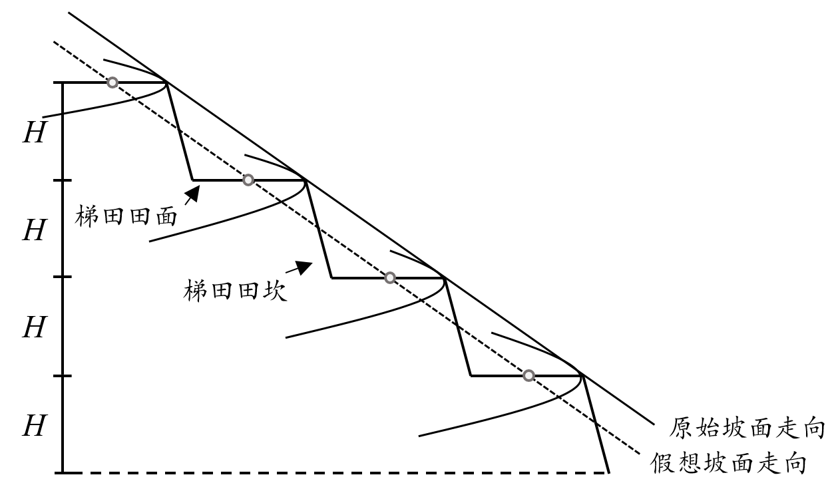
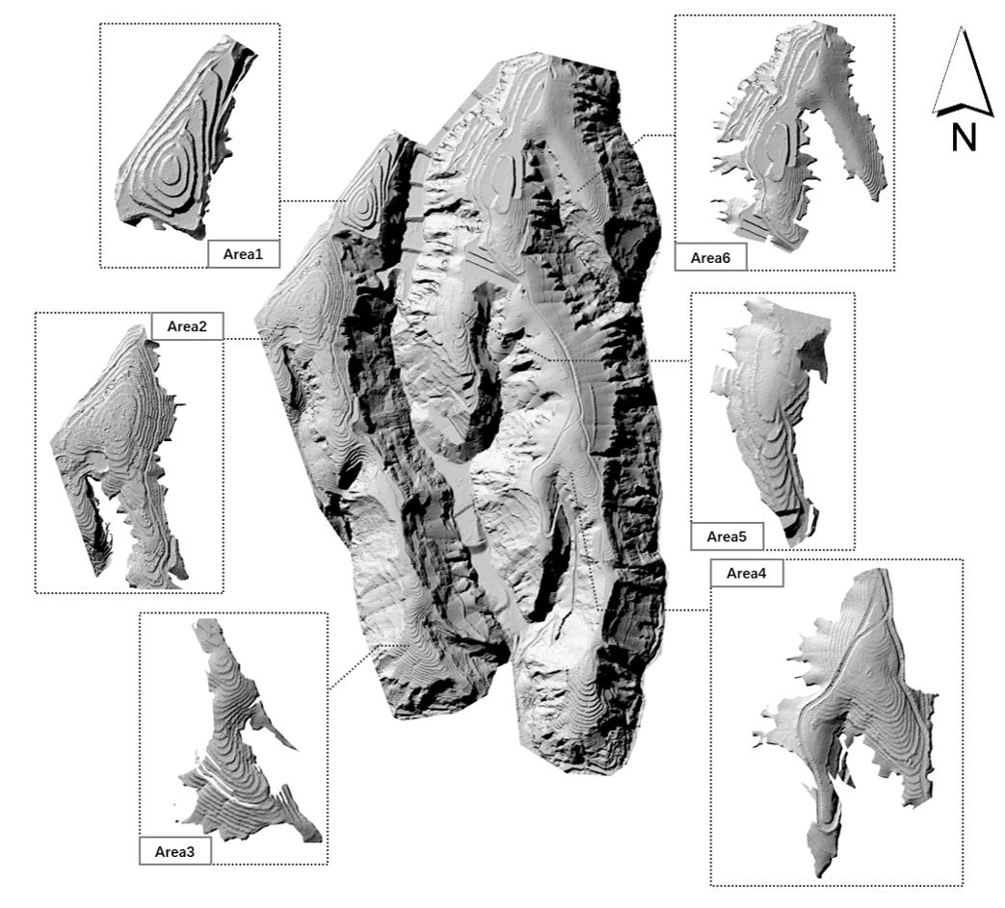
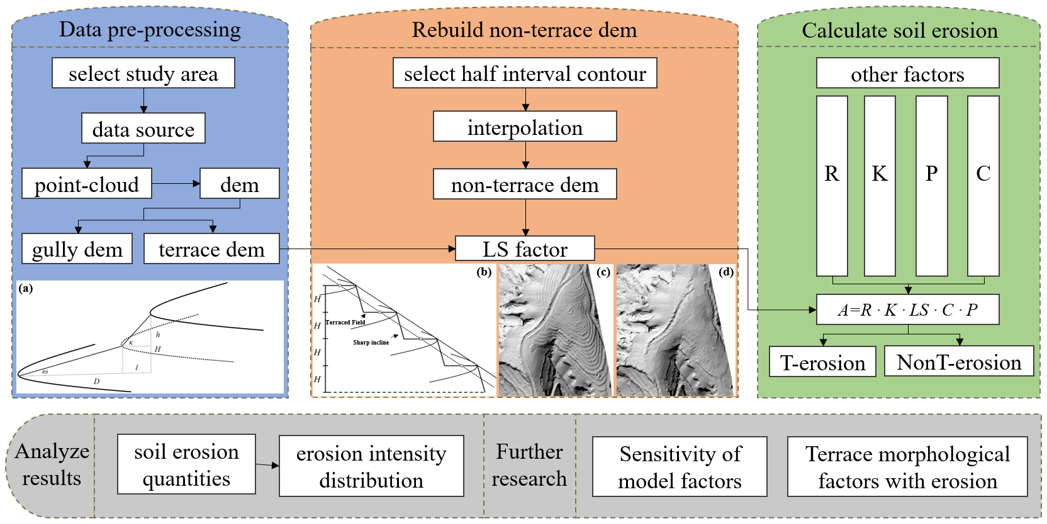
2. Data & Methods
1. The study area: Yaojiawan watershed
Environment: semi-arid climate, concentrated summer rainfall, easily to be infiltrated by water.
base DEM: 0.1 m resolution DEM from point cloud
Why use the high-resolution DEM?
To better depict the spatial morphology of the terraces
Morphology factor (LS) matters
2. Methods
1) Destruction of terraced fields
Why? Because the study aims to evaluate the soil erosion before and after terrace construction.
How? In terraces, choose contour lines running parallel to the edge line and the edge offset line from each terraced field surface. Then, these contour lines will be interpolated to generate a new DEM representing non-terrace fields.
2) RUSLE: for calculating soil erosion modulus
Terraced Field
Sharp incline
Notes:
（1）Let’s talk about the study area.
The study area is a watershed named Yaojiawan on the Loess Plateau of China, and covers 1.803 km^{2.}It contains many valleys and slopes, Terraces are constructed here.
This area is a transition zone from an arid climate to a warm-temperate humid monsoon climate, with an overall semi-arid climate, and the concentrated summer rainfall is the main driver of soil erosion in the watershed.
（2）So why we use such a high-resolution data?
As is mentioned before, the LS factor is a vital factor in evaluating soil erosion.
And In the study area, the construction of terraces can greatly change the topography.
（4）As is shown in the picture on the top-right, there are the important formulas we need to use, to calculate all the factors in RULSE model.
（5）And the whole workflow of this study is at the bottom right.

Slide 4
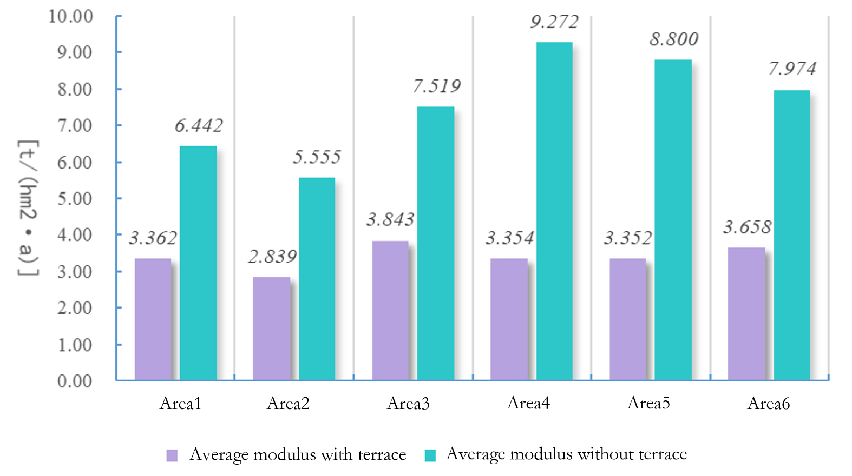
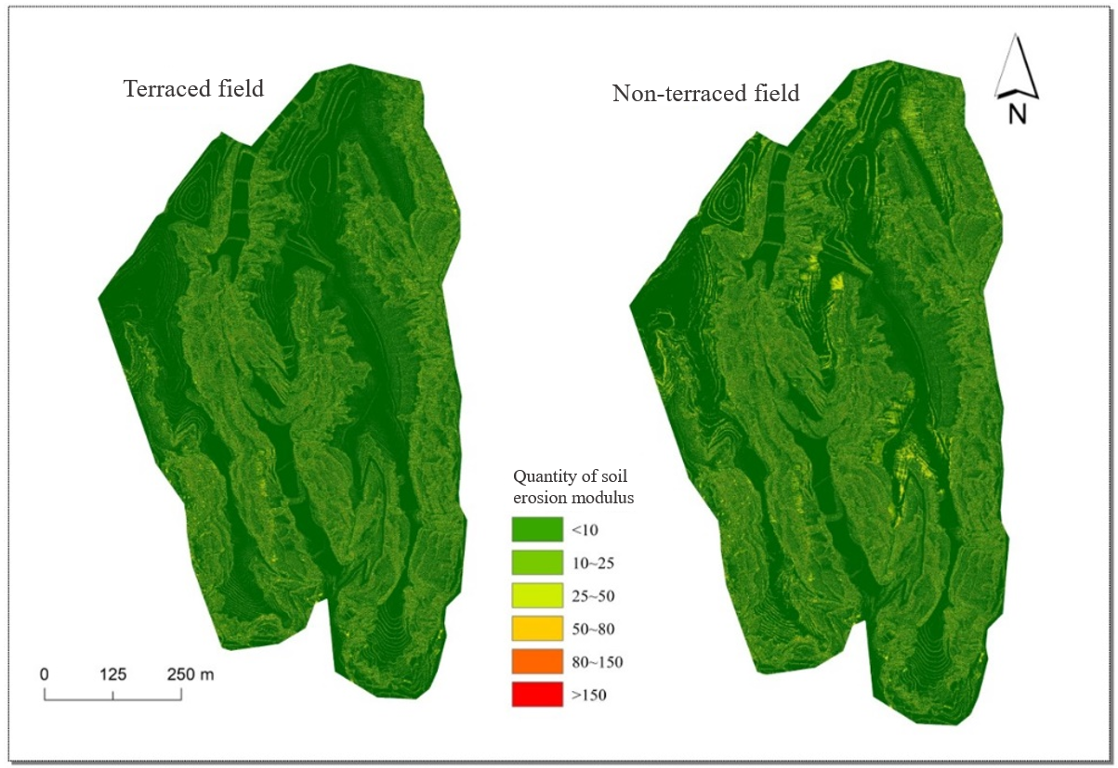
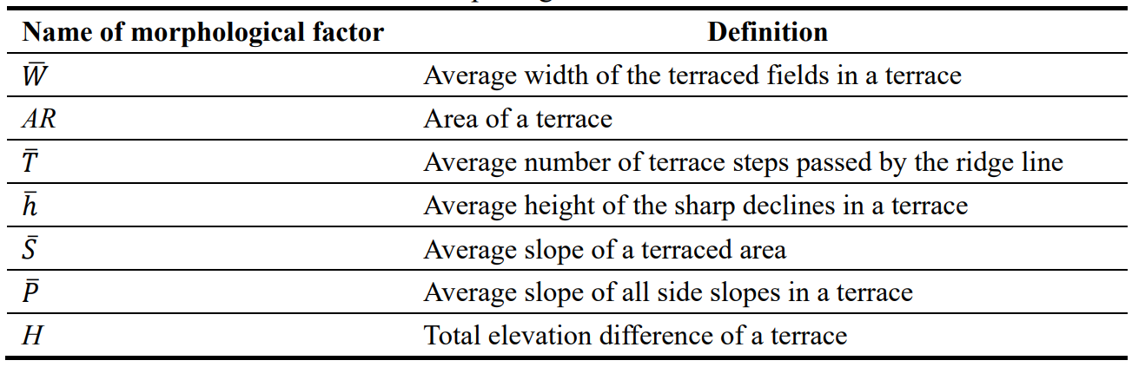
3. Results
Soil erosion before and after terrace construction
Soil erosion changes in sample areas
Scenario | Average soil erosion modulus | Total eroded area | Total amount of soil erosion
terraced | 8.30 t/(hm²·a) | 32.86 hm² | 272.74 t/a
non terraced | 9.92 t/(hm²·a) | 36.96 hm² | 343.36 t/a
Disussion: further study on terrace’s morphology
Notes:
（1）The result shows that, the construction of terraces will greatly impact LS factor,
and then change the total amount of soil erosion in the study area
As we can see in the table, the ….., the …. have a sharp decrease when the terraces are built.
And as a result, the total ……. may drop sharply for about 70 ton per year.
（2）The benefits of terracing for soil protection would be more noticeable if we evaluate
the soil erosion quantity at the scale of the selected terracing areas.
As is shown in the bar chart, the average soil erosion modulus inside terracing area would be reduced by about 50% to 60%
（3）In the final discussion, I should say further study on terrace’s morphology is needed.
Beyond slope and slope length, terrace morphology may also contains some character like ……..
That’s all with my presentation, thanks for listening.

Slide 5
Thanks for listening!!

