Slide 1
Fake News Detection Using LLMs and Retrieval-Augmented Generation (RAG)
Presented by: Tushar Raj
Date:16-05-2025

Slide 2
Project Overview
Developing a robust fake news detection system
Leverages Large Language Models (LLMs) like RoBERTa
Uses Parameter-Efficient Fine-Tuning (PEFT) with LoRA for domain adaptation
Integrates Retrieval-Augmented Generation (RAG) for real-time fact verification
Goal:
To improve fake news detection by fine-tuning RoBERTa with parameter-efficient methods (PEFT) for efficient domain adaptation, and to compare its performance with a retrieval-augmented generation (RAG) approach that uses dynamic external knowledge for accurate fact verification.

Slide 3
Why This Project?
Fake news impacts society & requires timely detection
Large pretrained LLMs are powerful but expensive to fine-tune fully
LoRA allows efficient adaptation with fewer parameters and less compute
Real-time fact verification improves trustworthiness by checking claims dynamically
RAG enhances models by incorporating external knowledge retrieval during inference

Slide 4
RoBERTa-based Fake News Detection
RoBERTa model fine-tuned on domain-specific news datasets
PEFT LoRA used to efficiently fine-tune only low-rank weight updates
Benefits:
Drastically reduced trainable parameters and memory use
Faster training and lower cost
Maintains high classification accuracy

Slide 5
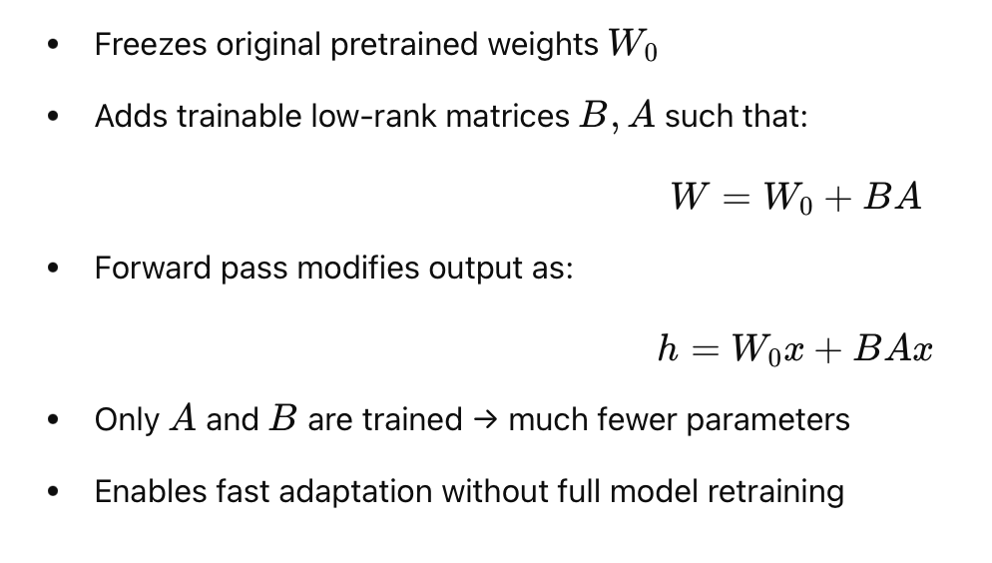
LoRA Recap – Low-Rank Adaptation

Slide 6
Model Backbone: RoBERTaForSequenceClassification
Input: Raw news article text
Tokenizer: RoBERTa tokenizer (WordPiece)
Embedding size: 768
Transformer layers: 12
Hidden size: 768
Classifier head:
dense(768 → 768) → Dropout(0.1) → Linear(768 → 1)

Slide 7
Base Model: RoBERTaForSequenceClassification
A pre-trained RoBERTa model fine-tuned for binary text classification (real vs fake):
Embedding Layer
word_embeddings: Embedding(50265, 768)
position_embeddings: Embedding(514, 768)
token_type_embeddings: dummy embedding (unused)
LayerNorm + Dropout

Slide 8
Encoder (12 Transformer Layers)
Each Transformer block consists of:
Self-Attention Module:
query, key, value: Linear(768 → 768)
LoRA injected into query and value:
W = W₀ + BA, B ∈ ℝ^{768×r}, A ∈ ℝ^{r×768}
r = 8
LoRA wraps Linear layers with dropout
Feed-Forward Network:
Dense: 768 → 3072 → 768
Activation: GELU
LayerNorm and Dropout after attention/output

Slide 9
Classification Head
Takes the [CLS] token output (first token):
dense: Linear(768 → 768)
dropout
out_proj: Linear(768 → 1) → logits for binary classification

Slide 10
Parameter-Efficient Fine-Tuning (PEFT) with LoRA
LoRA Applied To:
query and value projections in attention layers of all 12 Transformer blocks
Low-Rank Injection:
ΔW = BA, B ∈ R^768×8, A ∈ R^8×768
Base weights frozen: W_0 is not updated
Trainable modules: Only LoRA's A,B and classification head

Slide 11
Training Benefits with LoRA
RoBERTa weights frozen: only small LoRA adapters are trained
Efficient for low GPU memory (trained with 2GB CUDA GPU)
Reduces trainable parameters by orders of magnitude
No additional latency during inference (LoRA weights can be merged)

Slide 12
Real-Time Fact Verification
Integrated Wikipedia API for external knowledge access
System queries Wikipedia to verify factual claims dynamically
Provides context and validation for news articles beyond static datasets
Enhances fake news classification with up-to-date and reliable facts

Slide 13
Retrieval-Augmented Generation (RAG)
Combines retrieval with generation models
Retrieves relevant documents based on input queries
Augments model knowledge beyond pretrained data
Enables better reasoning and fact-checking in fake news detection
Comparison shows improved accuracy with RAG integration

Slide 14
Project Roadmap
Data Collection & Preprocessing
Gather labeled real/fake news articles
Clean, normalize, tokenize, and split datasets
Model Selection & Fine-Tuning
Fine-tune RoBERTa with PEFT LoRA
Evaluate on validation/test sets
Real-Time Fact Verification Integration
Integrate Wikipedia API
Implement fact verification workflow
RAG Implementation & Evaluation
Incorporate RAG for external knowledge retrieval
Compare performance with/without RAG
Evaluation & Deployment
Measure accuracy, precision, recall, F1-score
Deploy real-time detection system

Slide 15
Expected Outcomes
Improved accuracy in detecting fake news using LoRA-fine-tuned RoBERTa
Dynamic fact verification with real-time external knowledge access
Demonstrated performance gains from Retrieval-Augmented Generation
Efficient, scalable fake news detection pipeline suitable for real-world deployment

Slide 16
Conclusion
LoRA enables efficient adaptation of large language models for fake news detection
Real-time fact verification boosts trustworthiness and accuracy
RAG integration further improves system performance by leveraging external knowledge
The project combines state-of-the-art techniques for a practical and powerful fake news detection system

Slide 17
Thank you!

