Slide 1
Hybrid high-performance computing FORTRAN, OpenMP and MPI
By example
Because nobody likes dry theory

Slide 2


Slide 3
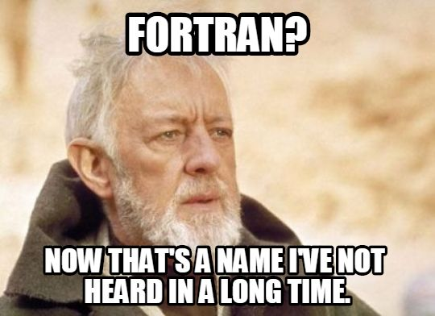
Part 1
The Who, What, How and Why

Slide 4
Who
Christoph Honal
Bachelor Informatics Student at Technische Universität München
Works on large-scale tsunami simulations
C. Honal: Efficient I/O Strategies for Checkpointing and Visualization in sam(oa)² (https://mediatum.ub.tum.de/1483697)

Slide 5

Why
Fortran widely used in scientific computing
Battle-tested OpenMP and MPI support
As fast as C, but easier to optimize
No void pointers
Intrinsic matrix and vector operations
Array slicing

Slide 6
How
FORTRAN, the FORmula TRANslation language
(SIMD, and other vectorization CPU extensions)
OpenMP, Open Multi-processing
MPI, the Message passing interface

Slide 7
What
Demonstration of hybrid parallelization techniques
By (simple) example: Conway‘s Game of Life
Comparable to techniques used in the industry and academia
https://github.com/StarGate01/HPCGOL

Slide 8
Part 2: Conway‘s Game of Life
Simple rule-based cellular automaton
Next state of a cell depends on its direct neighbors
Very high grade parallelization is possible

Slide 9
Conway‘s Game of Life
0-1 Neighbors: Cell dies of loneliness
2-3 Neighbors: Cell is happy
4-8 Neighbors: Cell dies of overpopulation
3 Neighbors: Cell is born if dead

Slide 10
Conway‘s Game of Life

Slide 11
Conway‘s Game of Life

Slide 12
Part 3: Implementation
Iteration 1: Naive
Sum neighbors and compare to rules

Slide 13

Implementation
Iteration 2: Optimized naive
Use lookup table for state computation
Eliminates comparisons

Slide 14
A Note on SIMD
Iteration 3: Vectorized loops using SIMD
Precompute row sums
Actually slower?
Memory read/write penalty
Small loops are unrolled nevertheless

Slide 15
Multithreading
Iteration 4: Multithreading
Parallelize main loop using OpenMP
Compute slice of work for each thread

Slide 16
Implementation
Iteration 5: MPI support
Distribute work across multiple CPUs
Again, compute work slices
Exchange boundaries
Keep internal state synchronized

Slide 17
Implementation
Iteration 6: Hybrid parallelization
Multithreading and Node-distribution

Slide 18
Part 4: Local Evaluation

Slide 19
Local Evaluation

Slide 20

Thank you
https://github.com/StarGate01/HPCGOL

