Slide 1
Hybrid high-performance computing FORTRAN, OpenMP and MPI
By example
Because nobody likes dry theory

Slide 2


Slide 3
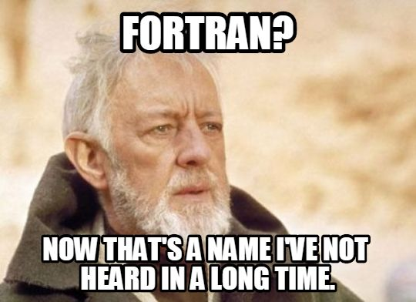
Part 1
The Who, What, How and Why

Slide 4
Who
Christoph Honal
Bachelor Informatics Student at Technische Universität München
Works on large-scale tsunami simulations
C. Honal: Efficient I/O Strategies for Checkpointing and Visualization in sam(oa)² (https://mediatum.ub.tum.de/1483697)

Slide 5

Why
Fortran widely used in scientific computing
Battle-tested OpenMP and MPI support
As fast as C, but easier to optimize
No void pointers
Intrinsic matrix and vector operations
Array slicing
Vectorizeable stdlib

Slide 6
How
FORTRAN, the FORmula TRANslation language
(SIMD, and other vectorization CPU extensions)
OpenMP, Open Multi-processing
MPI, the Message passing interface

Slide 7
What
Demonstration of hybrid parallelization techniques
By (simple) example: Conway‘s Game of Life
Comparable to techniques used in the industry and academia
https://github.com/StarGate01/HPCGOL

Slide 8
Part 2: Conway‘s Game of Life
Simple rule-based cellular automaton
Next state of a cell depends on its direct neighbors
Very high grade parallelization is possible

Slide 9
Conway‘s Game of Life
0-1 Neighbors: Cell dies of loneliness
2-3 Neighbors: Cell is happy
4-8 Neighbors: Cell dies of overpopulation
3 Neighbors: Cell is born if dead

Slide 10
Conway‘s Game of Life

Slide 11
Conway‘s Game of Life

Slide 12
Part 3: Implementation
Iteration 1: Naive
Sum neighbors and compare to rules
Use outflow border to avoid edge cases
Use two buffers and swap around pointers

Slide 13
Outflow borders
0 | 0 | 0 | 0 | 0 | 0 | 0
0 |  |  |  |  |  | 0
0 |  |  |  |  |  | 0
0 |  |  |  |  |  | 0
0 | 0 | 0 | 0 | 0 | 0 | 0

Slide 14

Implementation
Iteration 2: Optimized naive
Use lookup table for state computation
Eliminates comparisons

Slide 15
A Note on SIMD
Iteration 3: Vectorized loops using SIMD
Precompute row sums
Actually slower?
Memory read/write penalty
Small loops are unrolled nevertheless

Slide 16
Multithreading
Iteration 4: Multithreading
Parallelize main loop using OpenMP
Compute slice of work for each thread

Slide 17
Multithreading
Thread 1
Thread 2
Thread 3
0 | 0 | 0 | 0 | 0 | 0 | 0 | 0 | 0
0 |  |  |  |  |  |  |  | 0
0 |  |  |  |  |  |  |  | 0
0 |  |  |  |  |  |  |  | 0
0 | 0 | 0 | 0 | 0 | 0 | 0 | 0 | 0

Slide 18
Multithreading
Shared memory
Thread-private variables
Work slices
Loop indices

Slide 19
Implementation
Iteration 5: MPI support
Distribute work across multiple CPUs
Again, compute work slices
Exchange boundaries between CPUs
Keep simulation state consistent

Slide 20
MPI Implementation
Step 1:
Node 1
Node 2
Node 3
0 | 0 | 0 | 0
0 |  |  | T
0 |  |  | T
0 |  |  | T
0 | 0 | 0 | 0
0 | 0 | 0 | 0
T |  |  | T
T |  |  | T
T |  |  | T
0 | 0 | 0 | 0
0 | 0 | 0 | 0
T |  |  | 0
T |  |  | 0
T |  |  | 0
0 | 0 | 0 | 0
Step 2:

Slide 21
Implementation
MPI_Send
MPI_Recv
MPI_SendRecv
MPI_Reduce([…], MPI_SUM, […])

Slide 22
Implementation
Iteration 6: Hybrid parallelization
Multithreading and Node-distribution

Slide 23
Hybrid Implementation
Node 1
Node 2
Node 3
0 | 0 | 0 | 0
0
0
0
0 | 0 | 0 | 0
0 | 0 | 0 | 0
0 | 0 | 0 | 0
0 | 0 | 0 | 0
 |  |  | 0
 |  |  | 0
 |  |  | 0
0 | 0 | 0 | 0
Thread 1
Thread 2
Thread 1
Thread 2
Thread 1
Thread 2

Slide 24
Part 4: Local Evaluation

Slide 25
Local Evaluation

Slide 26
Local Evaluation

Slide 27
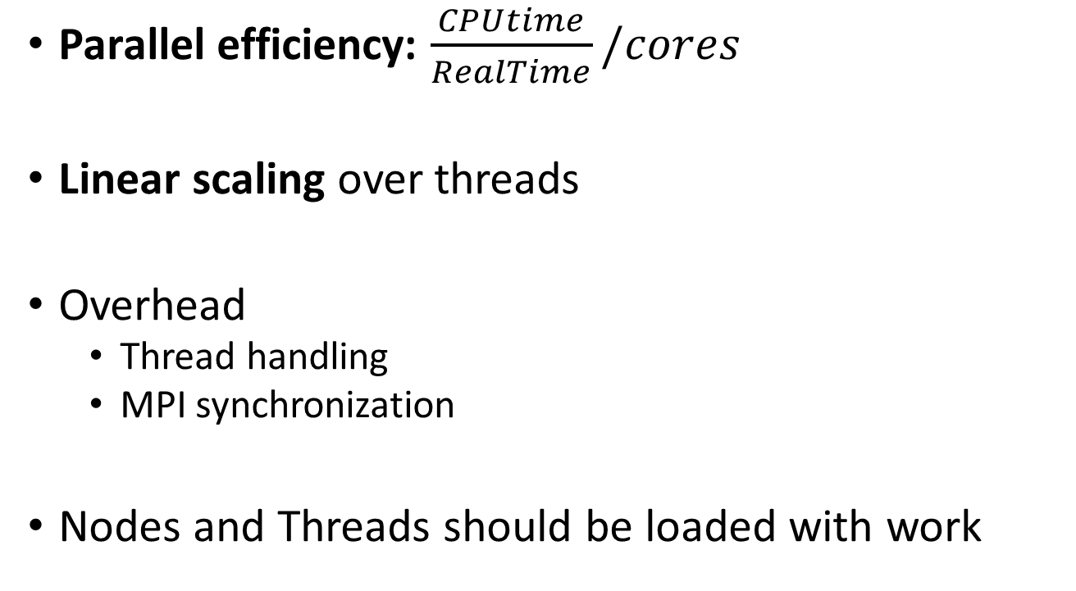
Local Evaluation
Parallel efficiency: $\frac{CPUtime}{RealTime}/cores$
Linear scaling over threads
Overhead
Thread handling
MPI synchronization
Nodes and Threads should be loaded with work

Slide 28
Part 5: HPC Evaluation

Slide 29
HPC Evaluation

Slide 30
HPC Evaluation

Slide 31
HPC Evaluation
Linear scaling on MPI
Performance penalty on large node counts
Use large sets per node
Try to saturate RAM

Slide 32

Thank you
https://github.com/StarGate01/HPCGOL

