Slide 1
JavaCard Primer
Hands-on crash course into JavaCard development
By Chris aka StarGate01

Slide 2
But Why?
Transparency disclosure: I work with DangerousThings and VivoKey
The VivoKey Apex and FlexSecure products are smartcards
Run your own code on your own meat (or how the FlexSecure came to be)
Open-Source for open sores: https://github.com/DangerousThings/flexsecure-applets

Slide 3
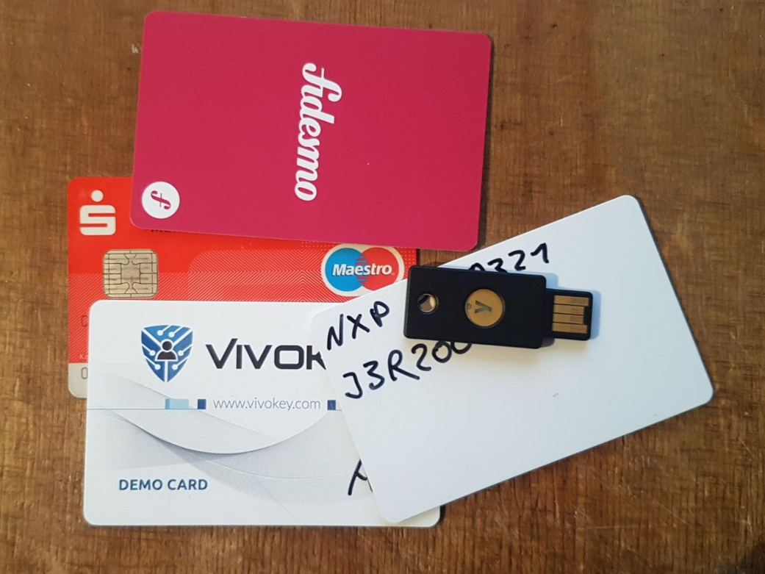
WTF is a Smartcard?

Slide 4
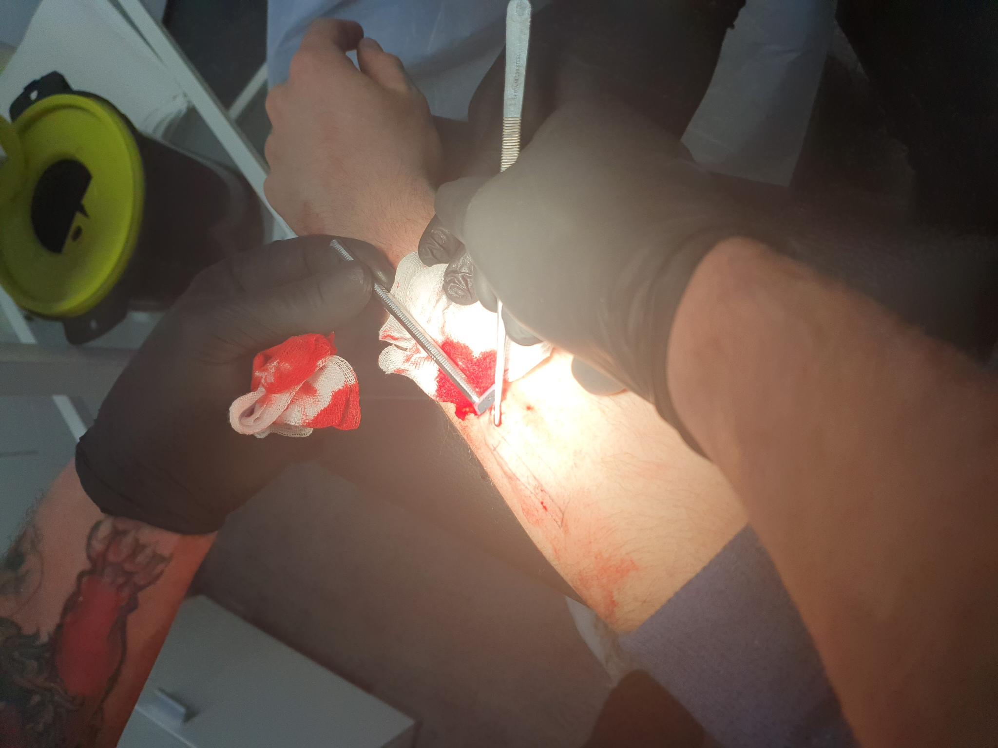
WTF is a Smartcard?

Slide 5
WTF is a Smartcard?
Small embedded and heavily protected processor
Interfaces: Contact (gold pads) and / or contactless (RFID / NFC) – obvious choice for implants
Subset: Smartcards which run embedded Java, called JavaCards
Embedded JVM for runtime safety
Stripped-down dialect of Java

Slide 6
Uses of Smartcards
Securely store secret key material
Perform operations using these keys
Impossible to retrieve keys
Authentication, Encryption, data storage, …
Extensibility after manufacturing
Keys can easily be rotated, your fingerprints or face not so much

Slide 7
Uses of Smartcards
Data storage (NDEF)
Single factor secure logins (FIDO2)
Login second factors (FIDO2, U2F, HMAC-SHA1, TOTP)
Car keys (Tesla)
Payments (MasterCard, VISA)
Encryption (PGP)
Signatures (Cryptocurrencies, Status.im, Satochip)
… and whatever you can cook up

Slide 8
VivoKey Apex
Apex is a managed platform
Administrative keys are held by Fidesmo (https://fidesmo.com/)
They provide a secure channel for easy and user-friendly remote card management via apps
Provide an “app-store” like experience for applets
They have built trust with third-parties and payment providers
Fidesmo Pay enables the Mastercard Applet (caveats with implants)
Third parties require Fidesmo to protect the keys

Slide 9
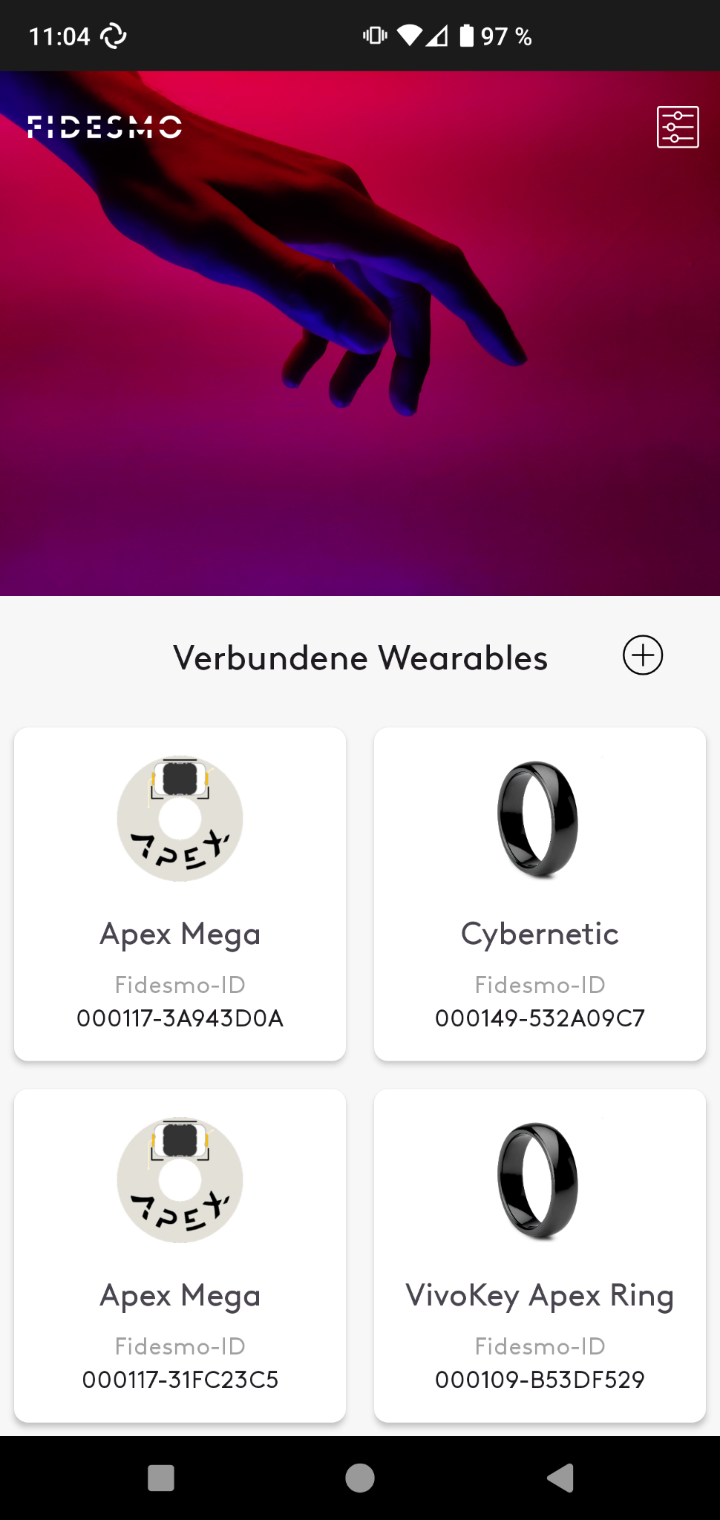
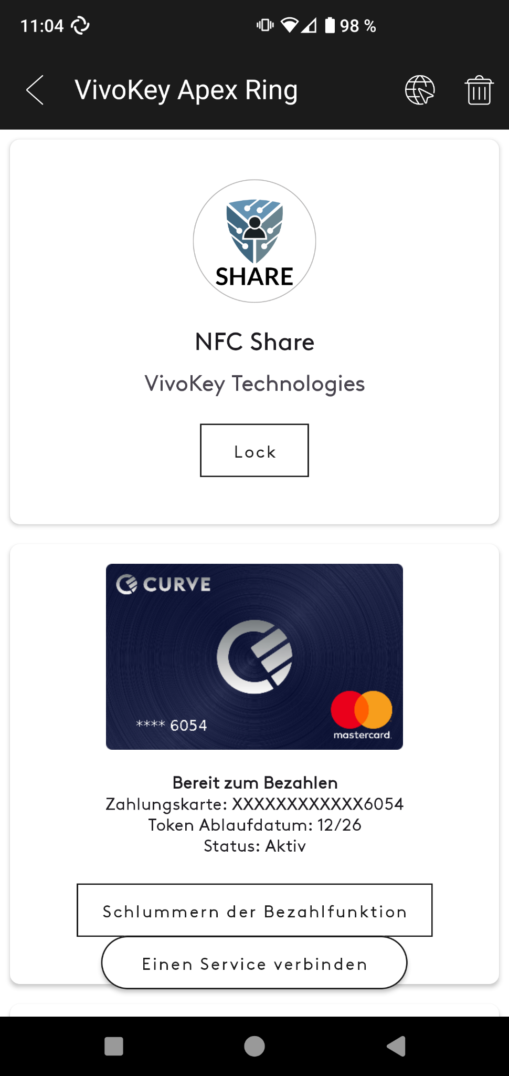
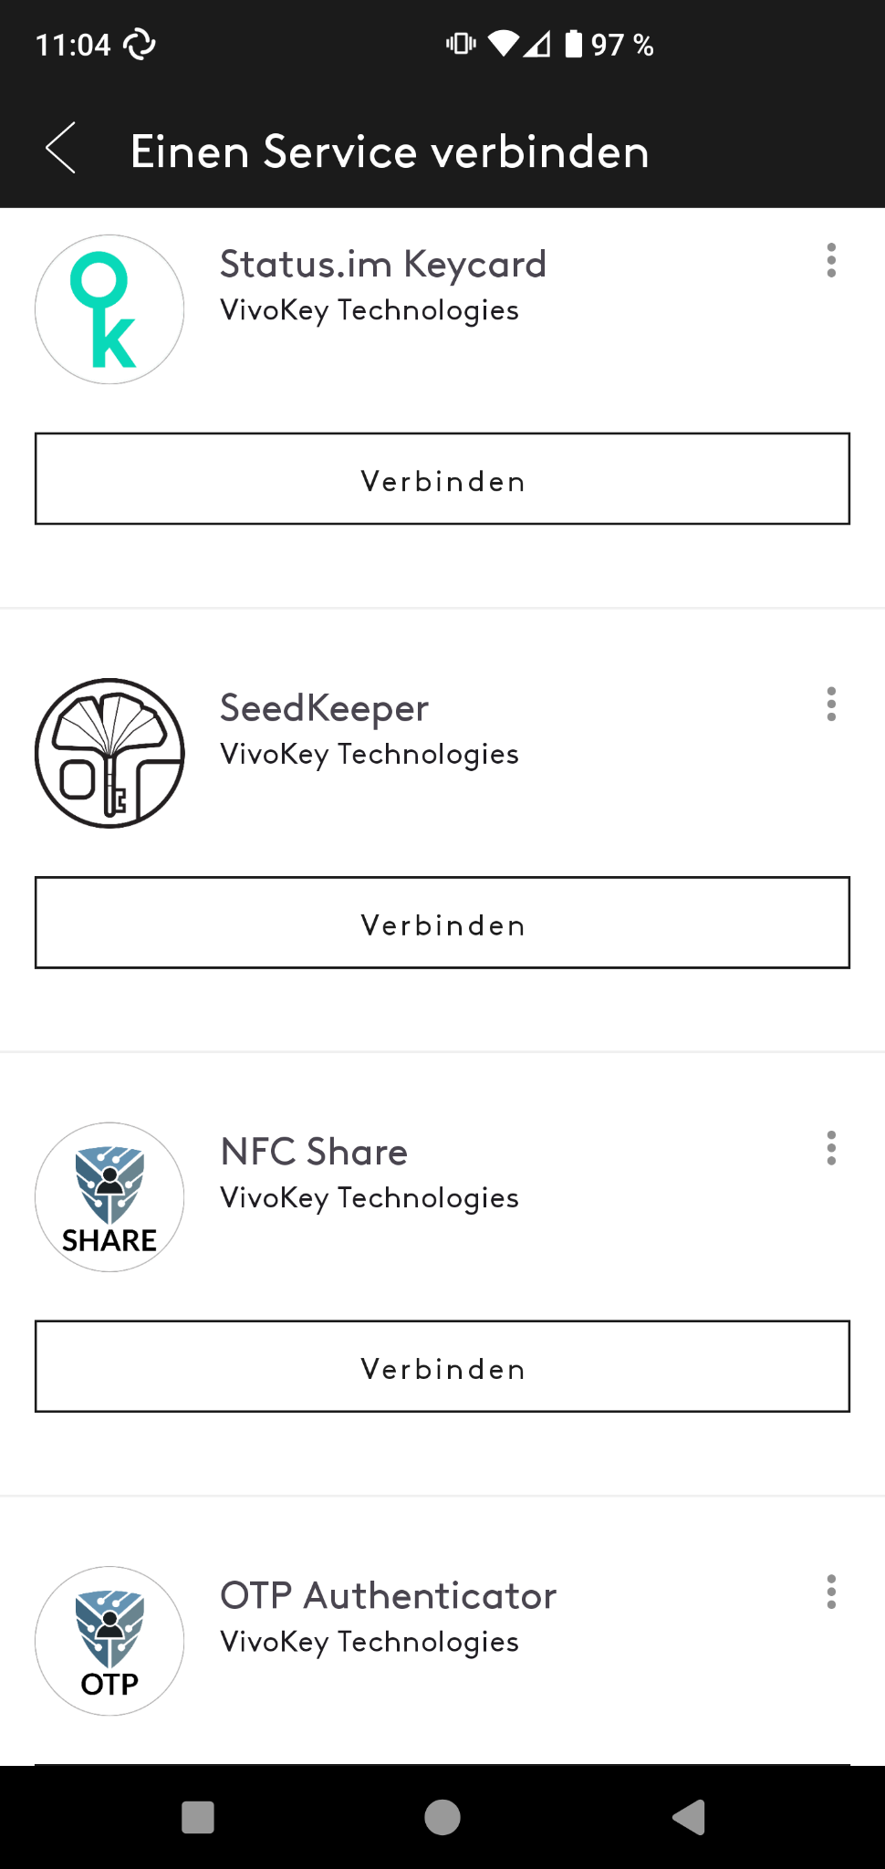
Fidesmo App

Slide 10
Apex Manager
Will eventually be used to configure all availabe applets
Also handles FlexSecures
Generate 2-Factor OTP codes, configure PGP keys, etc.

Slide 11
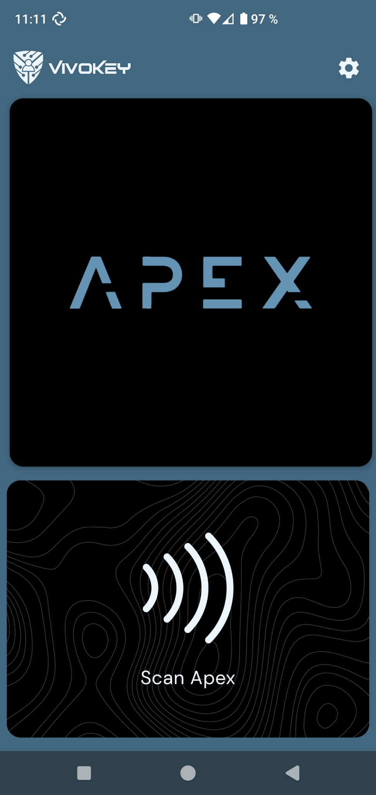
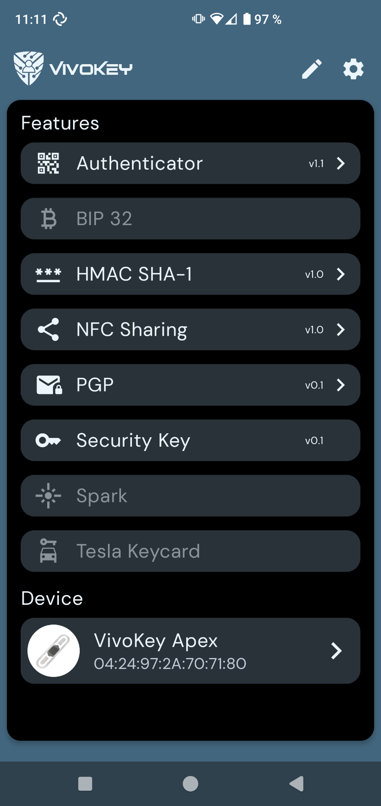
Apex Manager

Slide 12
DangerousThings FlexSecure
FlexSecure is an open platform, no connections to Fidesmo
Administrative keys are default and given to the users
Applet management has to be handled manually using CLI tools
No restrictions of what you can install, just compile code yourself if needed
Payments are not possible as the MasterCard applet is proprietary and well protected

Slide 13
FlexSecure
Effort by Miana and StarGate01
Sourced factory open P71 chips and had Amal stick them to Apex antennas
Now available as a DT product
No worries if Fidesmo ever goes under
Complete control
Use the same open-source applets as the Apex does

Slide 14
GlobalPlatform
Industry-Standard for the OS interface of a smartcard
Actual OS could be e.g. proprietary JCOP for NXP
Handles applet lifecycles and security configuration
Proprietary extensions are possible
FOSS tools for interfacing GP cards: GlobalPlatformPro, GPShell

Slide 15
Applets, Instances and Packages
Java source code is compiled to JVM machine code
A program on the card is called applet
Compiled code is loaded onto card in a package (.cap) via GP
A package can contain code for one or more applets
Packages are stored in the persistent memory of the card
A instance is the running “process” created from a package for an applet using GP. Only there RAM is allocated.
Packages, Applets, and Instances all have AIDs (Application Ids), by which they are addressed

Slide 16
GlobalPlatformPro
gp -install “applet.cap”
gp -f -delete D27600012401
etc…

Slide 17
Card Memory
Persistent (EEPROM, kept across power-cycles) and volatile memory (SRAM, lost on power loss or applet de-selection)
Typically only around max. 4KB of RAM and around 100KB-200KB of EEPROM per card
Memory is usually statically allocated at applet installation and never freed
Applets should run in constant memory
Code needs to be extremely efficient, especially when using multiple applets
Use JavaCard framework and OS APIs to do heavy lifting like cryptography

Slide 18
Communication
Data exchange between the card and reader happens in APDUs (Application Protocol Data Units)
More info in ISO/IEC 7816-4
Essentially byte-based commands and responses
Command code, parameters, payload
Response payload, error code
Supported on desktop via the PC/SC APIs
Windows: WinSCard, Linux: pcsc-lite, Python: pyscard

Slide 19
Learning by doing
Grad a card or implant
Grab a reader
Install drivers for said reader for your OS if needed
Install Python w/ pyscard, Java 8, GlobalPlatformPro
Or use Nix or Docker, I can help (but I recommend using Linux)
Run `gp --info` and `gp –list`
Deploy and play with some existing applets

Slide 20
A Simple Demo Applet
Demo applet which generates and stores an AES key
Takes in some data and encrypts or decrypts it
Should probably not be used in the real world
Two parts: Applet and Python client
Lets go together though the code

Slide 21
Simulator and Virtual Readers
The vsmartcard project provides a virtual PC/SC reader
Can use an Android Phone as a reader or an Emulator
Emulation of Javacards can be done using JCardSim
Setup is a bit tricky but provided in the example

